Slide 1


Department of Computer Science and Engineering
WEATHER FORECASTING USING MACHINE LEARNING
MOULI V – [211421104166]
NADESAN R -[211421104167]
POTHIMADHAVAN M -[211421104187]
Guide Name & Designation
DR.V. SATHYA ,M.E.,Ph.d.,
SUPERVISOR
Coordinator Name & Designation
Dr R. JOSEPHINLEELA M.E., Ph.D.,
PROFESSOR

Slide 2
Abstract
Advanced machine learning models for weather prediction, such as those aimed at forecasting conditions like clouds or thunderstorms, leverage complex algorithms to analyse vast datasets.
These models integrate various meteorological parameters such as temperature, humidity, wind speed, and atmospheric pressure, using techniques like neural networks, ensemble methods, and machine learning algorithms.
By processing historical weather data and real-time observations, these models can predict the likelihood and intensity of weather events with greater accuracy.
They play a crucial role in providing timely warnings and forecasts, aiding in disaster preparedness, agriculture, aviation, and daily planning for individuals and organizations alike.

Slide 3
Introduction
Advanced machine learning models play a crucial role in enhancing weather prediction capabilities, offering a sophisticated approach to analyzing vast datasets generated from various sources, including satellite imagery, sensor networks, and historical weather records.
These models leverage algorithms that can identify intricate patterns and correlations within the data, enabling more accurate forecasts that are essential for agriculture, disaster management, and urban planning.
By integrating climate science with cutting-edge computational techniques, researchers are developing innovative solutions that not only improve the accuracy of weather predictions but also contribute to a deeper understanding of climate dynamics and their implications for ecosystems and human societies

Slide 4
Objective of the Project
1. Develop Advanced Machine Learning Models: Create and optimize machine learning algorithms to enhance the accuracy and efficiency of weather predictions.
2. Integrate Climate Data: Utilize diverse climate datasets, including historical weather patterns, satellite imagery, and atmospheric conditions, to train and validate predictive models.
3. Implement Real-Time Analysis: Enable real-time processing of weather data to provide timely forecasts and alerts for extreme weather events.
4. Enhance Predictive Capabilities: Evaluate model performance to improve predictive capabilities and contribute to climate research and sustainable decision-making.

Slide 5
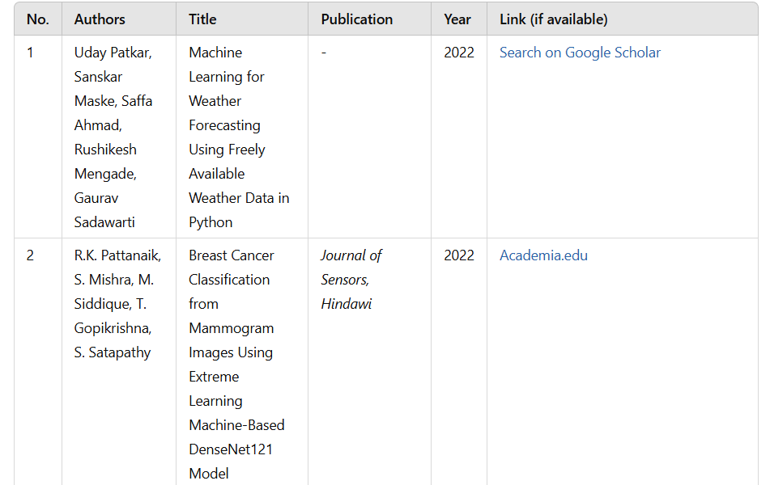
Literature Survey

Slide 6
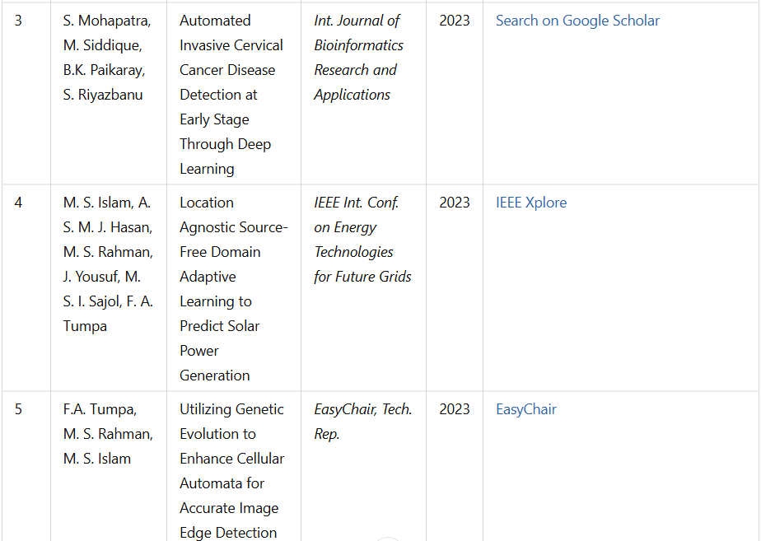
Literature Survey

Slide 7
Problem Statement
Weather forecasting is a critical task that affects various sectors, including agriculture, transportation, disaster management, and public safety. Traditional weather prediction methods rely on numerical models that often struggle with accuracy, computational efficiency, and real-time adaptability.
These conventional approaches require extensive data processing, making them slow and resource-intensive, leading to delayed or imprecise forecasts.
With climate change and increasing extreme weather events, there is an urgent need for a more accurate, data-driven, and efficient forecasting system.
Machine learning (ML) provides an opportunity to enhance prediction accuracy by analyzing large datasets, identifying complex weather patterns, and generating faster forecasts. However, challenges such as data quality, model selection, and computational requirements must be addressed for effective implementation.

Slide 8
Proposed System
For weather prediction using advanced machine learning models within the Django framework for local host server applications, the proposed system integrates sophisticated algorithms to predictions meteorological conditions with high accuracy.
Leveraging Django's robust capabilities in handling data processing and model deployment, the system will fetch real-time or historical weather data from external sources or a database.
Machine learning models such as deep learning neural networks, ensemble methods and statistical techniques will be employed to analyze and predict weather patterns.
The Django application will feature components for data preprocessing, model training, and inference. Users can interact through a user-friendly interface to input location-specific parameters or select predefined regions for weather forecasts.
The system will generate predictions based on the trained models, presenting results through visualizations or textual summaries that detail expected conditions like temperature, precipitation, wind speed, and humidity. Leveraging Django's scalability and flexibility in managing complex data workflows and model interactions.

Slide 9
Software / Hardware used
1. Software Requirements:
Operating System : Windows
Tool : Anaconda with Jupyter Notebook
2. Hardware requirements:
Processor : Intel core i5 or AMD Ryzen 5
Hard disk : minimum 300 GB
RAM : minimum 4 GB

Slide 10
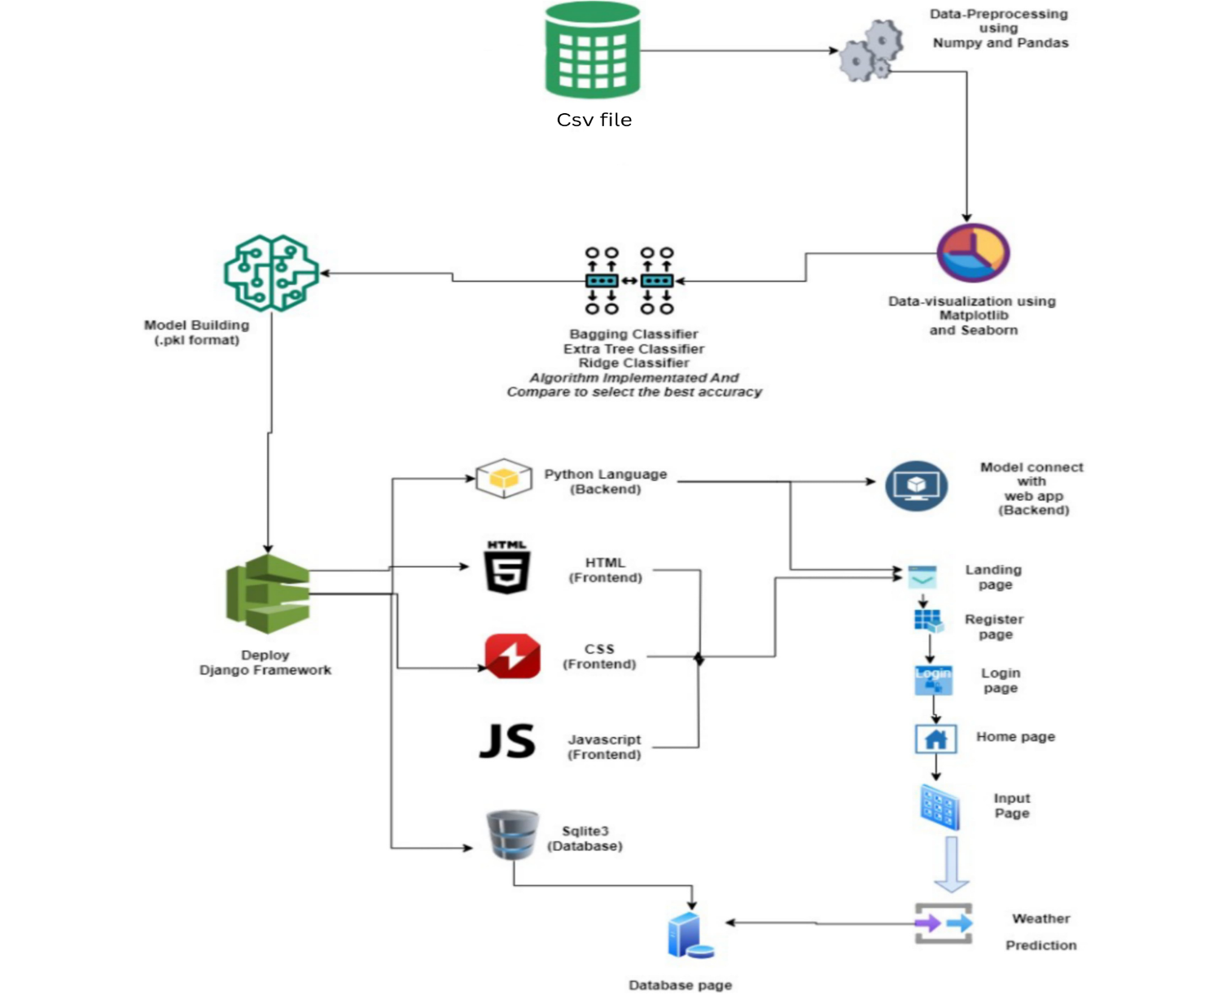
Architecture Diagram

Slide 11
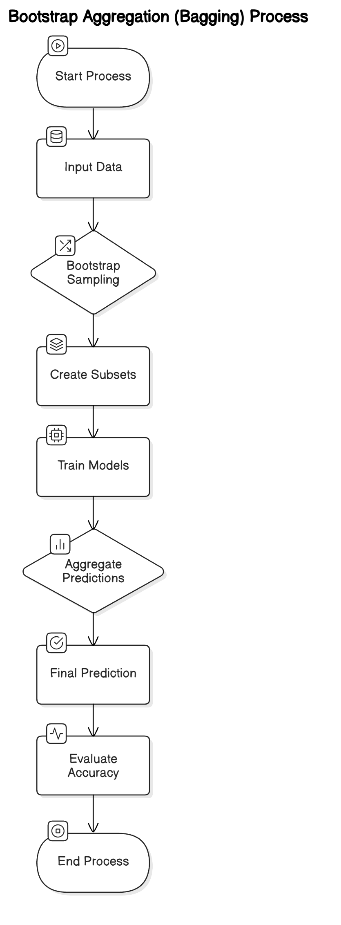
Bagging Classifier Diagram

Slide 12
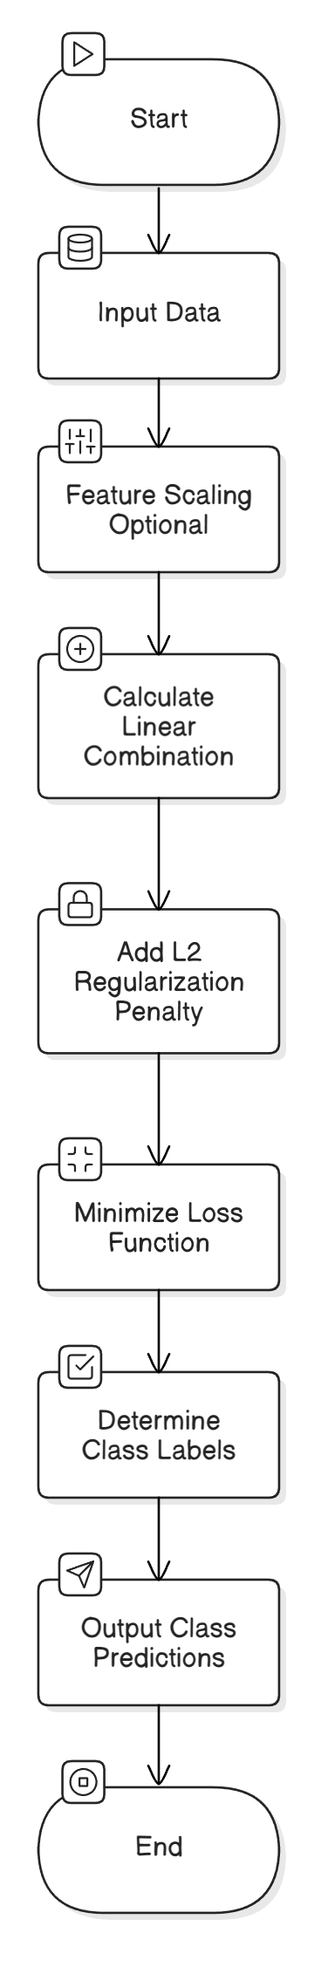
Ridge Classifier Diagram

Slide 13
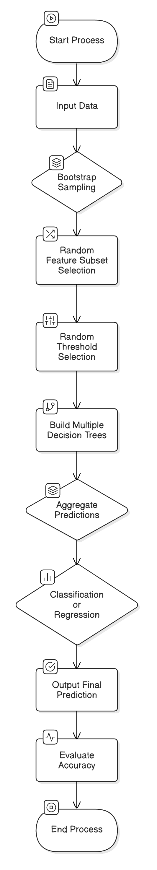
Extra Tree Classifier Diagram

Slide 14
Proposed Module
Data Pre-processing
Validation techniques in machine learning are used to get the error rate of the Machine Learning (ML) model, which can be considered as close to the true error rate of the dataset.
If the data volume is large enough to be representative of the population, you may not need the validation techniques. However, in real-world scenarios, to work with samples of data that may not be a true representative of the population of given dataset.
To finding the missing value, duplicate value and description of data type whether it is float variable or integer.
The sample of data used to provide an unbiased evaluation of a model fit on the training dataset while tuning model hyper parameters.

Slide 15
Proposed Module
2. Data Validation process
Importing the library packages with loading given dataset. To analyzing the variable identification by data shape, data type and evaluating the missing values, duplicate values.
A validation dataset is a sample of data held back from training your model that is used to give an estimate of model skill while tuning model's and procedures that you can use to make the best use of validation and test datasets when evaluating your models.
Data cleaning / preparing by rename the given dataset and drop the column etc

Slide 16
Algorithm And Techniques
1. Ridge Classifier
Ridge Classifier is a type of linear classifier that incorporates L2 regularization to prevent overfitting while improving generalization performance.
It is particularly useful in situations where the number of features exceeds the number of observations or when multicollinearity exists among features.
By adding a penalty term to the loss function, Ridge Classifier minimizes the coefficients of the linear equation, effectively shrinking them towards zero without completely eliminating any of them.
This process helps to retain all features in the model while controlling their influence, making it suitable for high-dimensional datasets.

Slide 17
Algorithm And Techniques
2. Bagging Classifier
Bagging, or Bootstrap Aggregating, is an ensemble machine learning technique designed to improve the stability and accuracy of algorithms used in classification and regression tasks.
The method operates by creating multiple versions of a predictor model, trained on different subsets of the training dataset. These subsets are generated through a process called bootstrap sampling, where random samples are drawn with replacement.
The final prediction is made by aggregating the predictions of all the individual models, typically through majority voting for classification tasks or averaging for regression tasks.
This approach helps to reduce variance and mitigate overfitting, making bagging particularly effective for high-variance algorithms such as decision trees.

Slide 18
Algorithm And Techniques
3.Extra tree classifier
The Extra Trees (Extremely Randomized Trees) Classifier is an ensemble learning method that builds upon the foundational principles of decision trees.
It is part of the family of ensemble methods that combine the predictions of multiple base estimators to improve overall performance and robustness. Unlike traditional decision trees that often suffer from overfitting, Extra Trees aims to enhance the model's accuracy and generalizability by introducing randomness in two key aspects: the selection of the features and the decision thresholds. This leads to the creation of diverse trees, each trained on a different subset of the data, thus reducing variance and increasing predictive power.
The algorithm operates by generating a large number of decision trees during the training phase, each using a random subset of the training data and features.
This extreme randomness in feature selection helps to create a robust model that is less sensitive to noise and outliers in the data. The final prediction is obtained through the aggregation of the predictions from all individual trees, typically using a majority vote for classification tasks or averaging for regression tasks.

Slide 19
Results
The weather forecasting system undergoes a comprehensive testing and performance evaluation process to ensure its accuracy, efficiency, and reliability.
Various testing methods, including functional testing, performance testing, security testing, and usability testing, are conducted to validate system operations.
Functional testing verifies that each component, such as data gathering, preprocessing, model training, and prediction, operates correctly.
Performance testing assesses the system’s speed, load-handling capability, and response time when processing large weather datasets. Security testing ensures that the system’s data sources and APIs are protected from unauthorized access, while usability testing checks for cross-platform compatibility and user experience.

Slide 20


Screen Shots
Landing Page
Register Page

Slide 21


Screen Shots
Login Page
Home Page

Slide 22
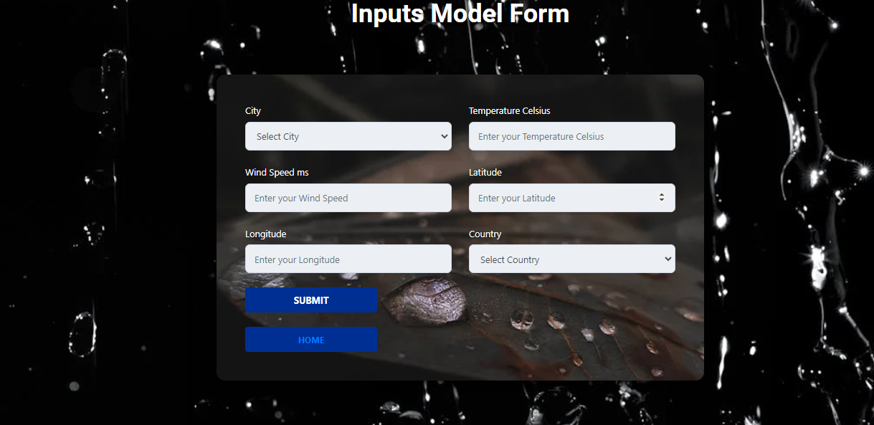

Screen Shots
Model Page
Output Page

Slide 23
Conclusion
In conclusion, the integration of advanced machine learning models in climate computing presents a transformative approach to weather prediction.
By leveraging vast datasets and sophisticated algorithms, these models significantly enhance the accuracy and reliability of forecasts, allowing for more informed decision-making in sectors such as agriculture, disaster management, and urban planning.
The ability to analyze complex climate patterns and predict extreme weather events is crucial in mitigating the impacts of climate change and improving resilience.
As technology continues to evolve, the collaboration between climate science and machine learning will pave the way for innovative solutions that address the challenges of an unpredictable climate, ultimately fostering a more sustainable future.

Slide 24
Feature Enhancement
The machine learning-based weather forecasting system has demonstrated significant accuracy and efficiency, but there are several areas for improvement to enhance its capabilities further.
Another potential enhancement is the implementation of cloud computing and edge computing to improve system performance and scalability, allowing faster processing of large datasets. Moreover, integrating the system with mobile applications and smart assistants can provide personalized weather alerts and early warnings for extreme conditions.

Slide 25
Reference Paper
Prof, Uday Patkar, Mr. Sanskar Maske and Mr. Saffa Ahmad, Mr. Rushikesh Mengade, Mr GauravSadawarti; “Machine Learning for Weather Forecasting Using Freely Available Weather Data in Python”; August 2022. [1]
Pattanaik, R.K., Mishra, S., Siddique, M., Gopikrishna, T., Satapathy, S.Breast Cancer Classification from Mammogram Images Using Extreme Learning Machine-Based DenseNet121 Model, Journal of Sensors, Hindawi Publication, ISSN No: 1687-725X, Volume 2022, Article ID 2731364, page:1-12, 2022. [2]
Mohapatra,S., Siddique,M., Paikaray, B.K, Riyazbanu, S., Automated Invasive Cervical Cancer Disease Detection at Early Stage Through Deep Learning, International Journal of Bioinformatics Research and Applications, 2023, 19(4), 306-326. [3]

