Slide 1

Capstone Project – I: Review – 2 on
Usage Based Insurance(UBI)
Presented by the Batch No. :G8
R . Srutha Keerthi BU21CSEN0101675(TL)
K. Vineesh BU21CSEN0100805
Y. V. Chandra Mouli BU21CSEN0100835
A. MD. Asif BU21CSEN0100856
Under the Guidance of
Thiruselvan S
Department of Computer Science and Engineering
GITAM School of Technology, GITAM (Deemed to be University),
Bengaluru, Karnataka, INDIA.

Slide 2
CONTENTS
Abstract
Introduction
Literature Survey
Problem Statement
Objectives
Identification of tools/technology/algorithms
Design Strategy(project workflow/system design/DFD/UML design)
Conclusion
References

Slide 3
Abstract
.What is Usage-Based Insurance (UBI)?
UBI calculates auto insurance premiums based on driving behavior and vehicle usage.
.How does the UBI system utilize AI and machine learning?
It analyzes driving data via telematics or apps, assessing factors like speed and braking to set premiums.
.What are the benefits of UBI?
UBI improves road safety, reduces environmental impact, and enhances customer satisfaction with dynamic pricing.
.What is the project's focus regarding UBI?
The project aims to develop a prototype integrating data collection, risk assessment, and premium models to showcase AI/ML's potential in modernizing auto insurance.
. How does UBI promote safer driving habits?
UBI uses real-time, personalized data to encourage safer driving, potentially lowering costs for low-risk drivers.

Slide 4
Introduction
Usage-Based Insurance (UBI) refers to a car insurance model where premiums are based on individual driving behavior and mileage.
Data is collected via telematics devices, mobile apps, or GPS, tracking factors like speed, braking, and distance.
UBI provides a more personalized insurance plan by assessing real-time driving patterns rather than general factors like age or location.
Types of UBI:
Pay-As-You-Drive (PAYD): Premiums are based solely on the total distance driven. Less driving leads to lower premiums.
Pay-How-You-Drive (PHYD): Premiums depend on driving behavior, including speed, braking, acceleration, and other safety metrics.
Manage-How-You-Drive (MHYD): Focuses on offering feedback to drivers, helping them improve driving habits over time, often with educational tools and suggestions.

Slide 5
Introduction..contd
Features of UBI:
Real-Time Data Collection: Continuous monitoring of driving behavior through telematics or mobile apps.
Customizable Premiums: Insurance premiums are adjusted based on individual driving behavior and mileage.
Driver Risk Profiling: AI/ML models analyze driving data to create a personalized risk profile for each driver.
Is UBI Implemented in India, and by Whom?:
Implemented by Insurers: Several insurance companies in India have begun offering UBI-based policies, including ICICI Lombard, HDFC ERGO, and Bajaj Allianz.
Regulatory Approval: The Insurance Regulatory and Development Authority of India (IRDAI) has allowed UBI models under sandbox programs, encouraging innovation in insurance.
Popular Models: The ‘Pay-As-You-Drive’ model is gaining traction in India, with insurers offering premium discounts based on driving patterns and mileage.

Slide 6
Literature Survey
Table 1: Literature Survey
S. No. | Paper Details | Summary | Techniques/Algorithms Used | Research Gap
1. | Automobile Usage-Based-Insurance: Improving Risk Management using Telematics Data | The study compares traditional statistical models (GLM) with a machine learning technique (Bagging-GLM) to predict the likelihood of car accidents based on factors like driving distance, driver behavior. | 1.GLM (Generalized Linear Model): A statistical method for modelling. 2. Bagging-GLM: A machine learning technique to improve prediction accuracy. | 1. Identifying the most valuable telematics data points for risk management. 2. Investigating the performance of alternative machine learning methods in insurance pricing.

Slide 7
Literature Survey…contd
Table 1: Literature Survey Contd…
S. No. | Paper Details | Summary | Techniques/Algorithms Used | Research Gap
2. | Driving risk prevention in usage-based insurance services based on interpretable machine learning and telematics data | This literature survey focus on driving risk prevention in UBI. The papers explore the use of interpretable machine learning and telematics data to assess driving risk, provide personalized feedback. | Interpretable Machine Learning (e.g., SHAP), Risk Assessment Models, Multi-Objective Counterfactual Model | Limited research on individual-level risk factor analysis and personalized suggestions in UBI

Slide 8
Literature Survey…contd
Table 1: Literature Survey Contd…
S. No. | Paper Details | Summary | Techniques/Algorithms Used | Research Gap
3. | Usage-based Car Insurance in India | The Acko insurance company offers Usage Based Insurance in India. Technology has made the insurance Ecosystem simple, convenient and easy. | Mobile App, Plug-in Device, GPS Devices, On-board Sensors, Mileage (Miles) Detection. | Yet to be proved as a widely accepted functional model

Slide 9
Problem Statement
Traditional auto insurance models rely on generalized risk factors such as age, gender, location, and vehicle type to determine premiums, leading to a one-size-fits-all approach that often results in unfair pricing. Safe drivers may end up subsidizing riskier ones, and there is limited incentive for individuals to adopt safer driving habits. Additionally, the static nature of traditional insurance models fails to account for changing driving patterns, contributing to inefficiencies and a lack of personalization.

Slide 10
Objectives
Personalized Pricing: Tailor insurance premiums to individual driving behavior
Risk Assessment: Continuously monitor and assess risk based on real-time driving data
Fraud Detection: Detect anomalies or potential fraud in driving patterns and incident reports
Claims Management: Streamline the claims process using AI to validate and process claims faster

Slide 11
Requirement Analysis
Functional Requirements:
  Data Collection: Capture driving behavior data using telematics devices, smartphone apps, or onboard vehicle sensors.
  Data Preprocessing: Clean the collected data, Normalize the data for consistent analysis across different drivers and conditions.
  Driver Scoring Model:
    Create a scoring system for drivers based on their driving behavior, which reflects risk levels.
    Implement an AI/ML model (e.g., decision trees, random forest, or neural networks) to classify drivers into risk categories.
  Premium Calculation: Use driver scores to determine insurance premiums.

Slide 12
Requirement Analysis
Non-Functional Requirements:
  Accuracy: The AI/ML model should have high accuracy in predicting risky behavior to set fair premiums.
  Scalability: The system should handle a large number of vehicles and data points from various telematics devices.
  Security: Ensure that all driving and personal data is securely transmitted, stored, and processed.
  Performance: The system should process data in near real-time to provide timely feedback to drivers and insurers.

Slide 13
Identification of Tools/Technology/Algorithms
Programming Languages:
  Python: For data processing, machine learning, and data analytics.
  NoSQL: NoSQL databases like MongoDB for storing large-scale telematics data.
Libraries:
  Pandas: Used for Data manipulation and analysis.
  NumPy: Numerical operations on arrays and matrices.
  Scikit-learn: Machine learning algorithms.
  Matplotlib: Data visualization.

Slide 14
Identification of Tools/Technology/Algorithms
Algorithms:
  Linear Regression: To predict the insurance premium based on driving features (e.g., speed, mileage, harsh braking).
  Logistic Regression: To classify drivers as “High Risk” or “Low Risk” based on driving patterns.
  Decision Trees: To model decision-making for premium calculation based on different driving behaviors (e.g., if harsh braking events > X, increase premium).
  Random Forest: To predict risk scores and insurance premiums with higher accuracy than a single decision tree.

Slide 15
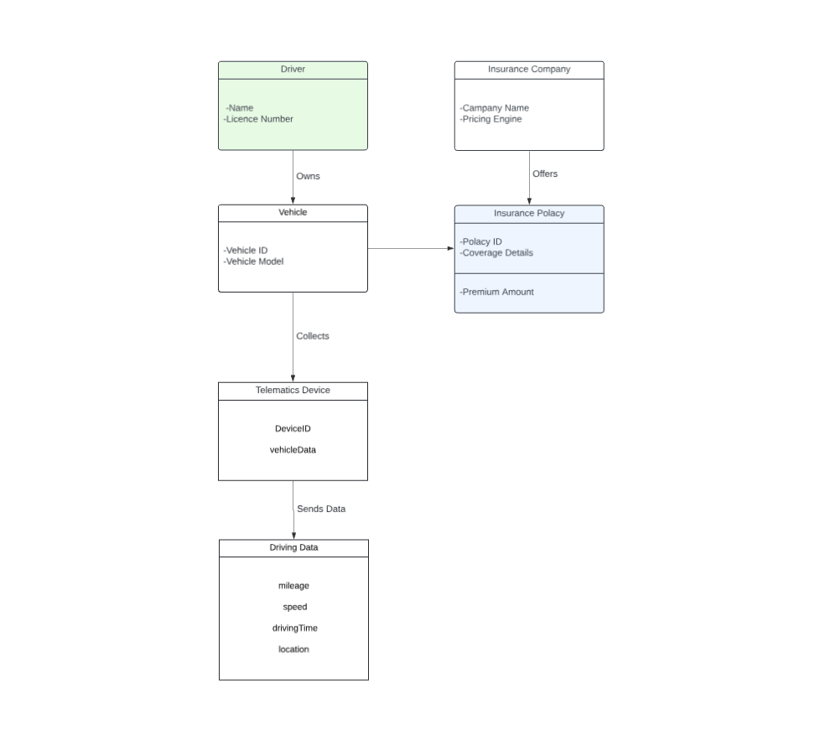
Design Strategy

Slide 16
Conclusion
The project illustrates how AI/ML can personalize insurance premiums based on individual driving behavior, leading to fairer pricing models.
Machine learning algorithms effectively assess risk levels by analyzing factors such as speed, mileage, and driving events.
Safe drivers are incentivized with lower premiums, promoting better driving habits and potentially reducing road accidents.
The use of data-driven insights enhances the optimization of insurance offerings and improves overall customer satisfaction.

Slide 17
References
Journals
[1] L. Cunha and J. M. Bravo, "Automobile Usage-Based-Insurance: : Improving Risk Management using Telematics Data”
https://ieeexplore.ieee.org/document/9820146?denied=
[2] Hong-Jie Li a, Xing-Gang Luo a, Zhong-Liang Zhang a b, Wei Jiang b, Shen-Wei Huang a “Driving risk prevention in usage-based insurance services based on interpretable machine learning and telematics data”
https://www.sciencedirect.com/science/article/abs/pii/S016792362300060X
[3] https://www.acko.com/car-insurance/telematics-or-usage-based-car-insurance/
[4] Litman, T. (2020). Autonomous vehicle implementation predictions: Implications for transport planning. Victoria Transport Policy Institute.
[5] https://www.linkedin.com/pulse/usage-based-insurance-detailed-analysis-aditya-basu?trk=prof-post

