Slide 1




Microblog Based Personalized News Recommendation Using Hybrid Approach
Guide By
Dr. S. Renugadevi
Department of Computer Science and Engineering,
Anna University CEG , Chennai 25
By
KARTHIKEYAN M - 2017103541
LOGESH J - 2017103550
MOULI R - 2017103555

Slide 2
Introduction
News item is different in nature when compared to other recommendations item like products, books and movies
Each news is more specific and different from other news
It has short life span and expires in small duration of time
Recency and Popularity plays a major role in changing user intertest on the news
We need to deal with large news corpus by addressing the scalability

Slide 3
Traditional recommendation methods are ineffective in addressing the drastic changing nature of news.
Also existing clustering algorithms are not considering the news nature while solving the scalability
The existing personalized news recommendation such as Google News, Yahoo News doesn’t filter the news specific to users
On the other hand, existing microblogging based / user read behavior based recommendations fails to use exact micro level properties of news and enriched user profile.

Slide 4
Overall Objectives
Aims to provide diverse set of news from the multiple press releases with improved accuracy by
Enriching user profile using user’s tweets, retweets.
Use exact properties and characteristic of news like recency and popularity to recommend news
Tune it specific to individual user’s read behavior using long term profile, short term profile, Reading rate and Hotness rate of user

Slide 5
Adopt the core advantage of recommendation concept from HYPNER, like
Ordered Clustering to cluster news and user based on nature of news and user’s reading behavior
User Profiling with long-term and short term user profile using user read behavior
Incorporate reading rate and hotness rate of user
Enrich news using recency and popularity parameter of it
News selection based on sub modularity
Address the limitation of mandatory user read behavior by selecting top user using FLANN Model

Slide 6

Proposed Model
PROPOSED COLLABORATIVE FILTERING
Tweets And News Data Scraper
Construction of Long Term User Profile from New Read Behaviour
User Ordered Clustering
Selection of higher Order Similar User from Top Users
Selection of News from Similar User
Weight News based on similarity in cluster and user specific weight
Data
Select top nearest users
Construction of user profile using given user tweets info of given users
(topic and entity)
Combine, Prioritise, and rate news
Given User twitter Id
Construct of FLANN model from all users short term profile
Limit Ranked News and Recommend
Construction of news metadata to entered news
Construction of short term user profile
Clustering News Metadata and short term user profile
Selection Similar higher Order cluster from Top 5 Users
Weight News based on Content Similarity and User specific weights
- Our Contribution
- Existing Algorithm with
modification
PROPOSED CONTENT BASED FILTERING
- Existing Algorithm without
modification

Slide 7
Overall Architecture
Web Application
(Shows News based on twitter id)
Scalable Tweets And News Data Scraper
(Task Queue Concept)
Collaborative Model using User Read Behaviour
(Ordered Clustering)
Personalised Recommandation
(Combine and Prioritise Algorithm)
Database
Additional Collaborative Model Using Short Term User Profile
(FLANN)
Content Based Model using News Content and Short Term User Profile
(Ordered Clustering)

Slide 8
Details of Modules
Tweets and News Data Scrapper
Collaborative Filter Module
Content Based Filter Module
Additional Collaborative Module and FLANN
Personalized News Recommendation

Slide 9
Tweets and News Data Scrapper
Extract the Tweets of Official News Handles from Twitter
Fetch the URL of the news from the tweet for scrapping the entire news content
Also fetch the Time the tweet was published
From the news tweet fetch the retweeter’s information like user id , time of the retweet and hashtags used in the retweet.
From the User account Extract the recent tweets and store it in the database
Perform the above step for the users followings also.
Using the News URLs obtained from news handles tweet form a task queue based web scrapper that scraps the news title ,content and other news related meta data from the specified URL.
All the data mined in this module are stored for further use in other modules.

Slide 10

Tweets And News Data Scraper
Extract news tweets from official twitter handle of news channels
Extract News links and its retweets
Extract news tweet time, retweet user ids, retweet time for each news links
News Read History
:news_id
:user_id
:read_time
Twitter Dev API
News
:news_id
:title
:meta_desp
:content,
:published_time
Using news links, scrap news title, meta description, and content
Extract given / subscribed user tweets and his following tweets
Extract user tweets, hashtag, @mentions of users
Tweets
:user_id
:tweet
:hash_tag
:mention_id,
:tweet_time
:following_ids
Extract recent tweets of following users

Slide 11
Collaborative Filter Module
Block Diagram
User News Read Data
Weighted based on User’s hotness rate and news’s hotness rate
News
Users
Higher Order similar users
User
Top weighted news of similar users
Extract News Read Binary Matrix between user and news
(Long Term Profile)
1. Select clusters having given user
2. Select the users with similarity above given user
User Read Behaviour Data
Perform Order clustering on users using Jaccard similarity score
Personalised News recommended by combining, prioritising, rating news using user’s reading rate , news weight and news category specified explicitly by the user

Slide 12
Collaborative Filter Module
Construct a News Read Binary Matrix from news read history of the user.
From the News Read Matrix calculate the similarity between the users using Jaccardian Similarity
Form a Similarity Matrix using the User-User Similarity score calculated in the above step
With the similarity Matrix as input perform ordered clustering on the users and group them into clusters
From the Clusters select the users similar to the users and only higher order similar users are selected in this step

Slide 13
Collaborative Filter Module
6. Collect the news items read by the similar users from the news read matrix obtained from step(1)
Calculate the weight of each news item based on the similarity score of the users
The news items are selected in order of higher weightage to the news.
9. The resulting news is the set of news items recommended from the collaborative filter module.

Slide 14
Content Based Filter Module
Summarized Topics and Named Entity of each users from news read history
1. Select clusters having given user short term profile
2.Select the news with similarity above given user short term profile
3. Select the other users short term profile above given user profile and repeat step 1 and 2 (submodularity model)
Extract Topics from Title
N + S
Extract Named Entity from Content
N + S
N+S
Higher order Similar news + Submodular news set
Extract Short term profile(S) of each user
Perform Order clustering on news using Semi-Cosine similarity score
Extract Metadata from all news
Topics and Named Entity of each news (N)
Similarity matrix between news including short term profile of user
Top weighted news
Personalised News recommended by combining, prioritising, rating news using user’s reading rate , news weight and news category specified explicitly by the user

Slide 15
Content Based Filter Module
Extract the Meta Data from news by Identifying the topics from the title of the news and named entities from the content of the news.
From the above meta data construct a news item N={T,E} which contains named entities and relevance tag from the title and content of the news
A Short Term Profile(S) for the user ,which contains the summarized Topics and Named Entity of each users from last two weeks news read history .
Similarity between the news items is calculated using Cosine similarity
Cosine Semi-Similarity is used to evaluate the degree of similarity between a users Short Term Profile(S) and News item(N)
Similarity Matrix is Constructed between the Short Term profiles and the news items using the precalculated similarity scores

Slide 16
Content Based Filter Module
Now User Short Term Profile and News Items are clustered using ordered clustering algorithms.
The news items that lies in the cluster in which the user belongs to are selected and extracted.
Also the other higher order User profile present in the cluster in which the user belongs are selected and are considered as similar to the user
Step (8) is again performed on the similar user profiles selected from the above step.
The news items are selected in order of higher weightage to the news.
12. The resulting news is the set of news items recommended from the content based filter module.

Slide 17
Additional Collaborative Module
Data
Similar Top Nearest user from the user read history
Fetch Tweets retweets, likes tag of given users
Construct user profile usinng extracted info of given users
(topic and entity)
Select top user
Construct news metadata to entered news
Construct short term user profile
Construct FLANN model from all users short term profile

Slide 18
Additional Collaborative Module
Fetch the Tweets of the User and other retweets and Hashtags from the Data-Base
Pre-Process the Tweets and perform Topic Modelling on the tweets to identify the important topics and entities.
Summarise the identified topics and entities of the user and form a User Profile
Extract the Meta Data from news by Identifying the topics from the title of the news and named entities from the content of the news.
Construct Short Term Profile for the users from the above extracted Rich Meta Data

Slide 19
Additional Collaborative Module
Construct a FLANN model from all users short term profile based on the topics and entities.
Now for the user profile in step(3) select the top 10 nearest neighbours in the FLANN model.
These Neighbours are considered as similar users based on their historical read behaviour.
These similar users are further used in Colaborative module and Content based module.

Slide 20



Personalized News Recommendation
USER
α
USER
TWEET
β
ORDERING
NEWS
EXPLICT USER
PROFILE
READING RATE
RECOMMENDATION

Slide 21
Personalized News Recommendation
The CFnews and CBnews are combined to produce final news set
News HYPNER = αNews CF + βNews CB
α and β are wights that signifies the trust corresponding to
CF –based and CB- based model
The final news set is prioritized based on the explicit rating specified by the user.
Finally the number of news articles recommended are limited by the reading rate coefficient of the user.
The resulting news articles are recommended to the user.

Slide 22
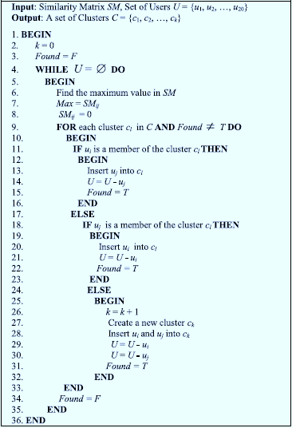
Ordered Clustering

Slide 23
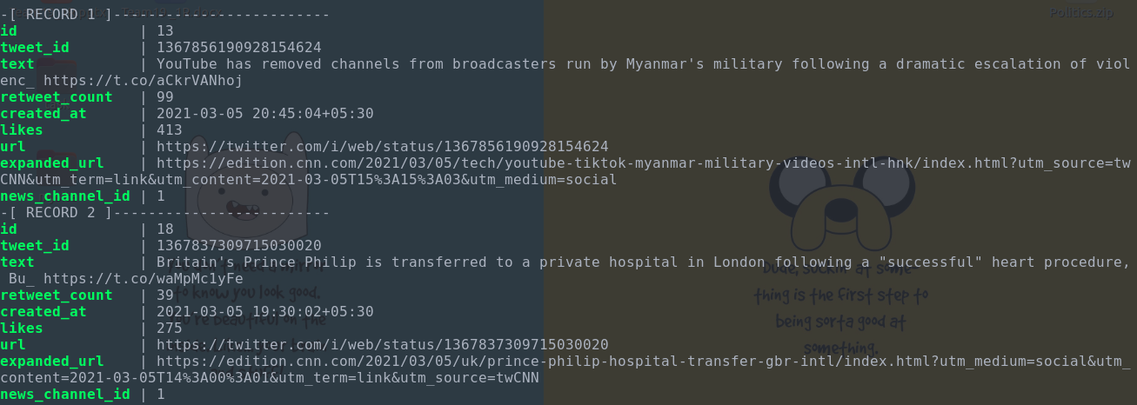
Implementation Details
News Channel Tweets Data

Slide 24
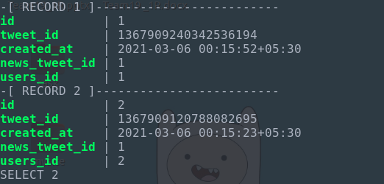
Implementation Details
Retweets Information

Slide 25
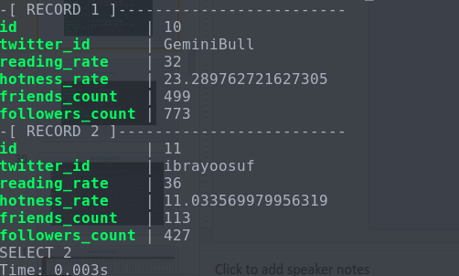
User’s Information

Slide 26
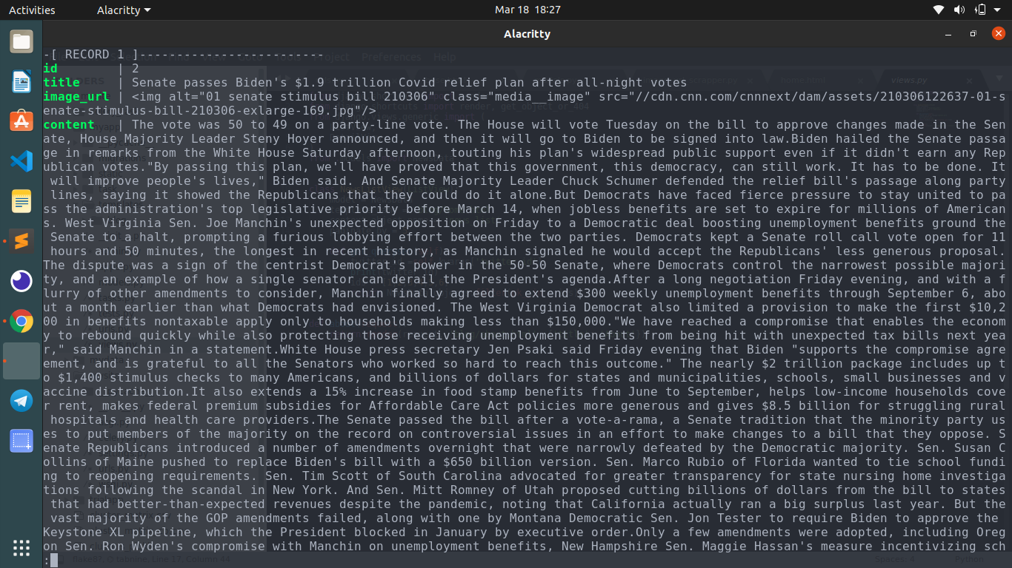
NEWS INFORMATION

Slide 27
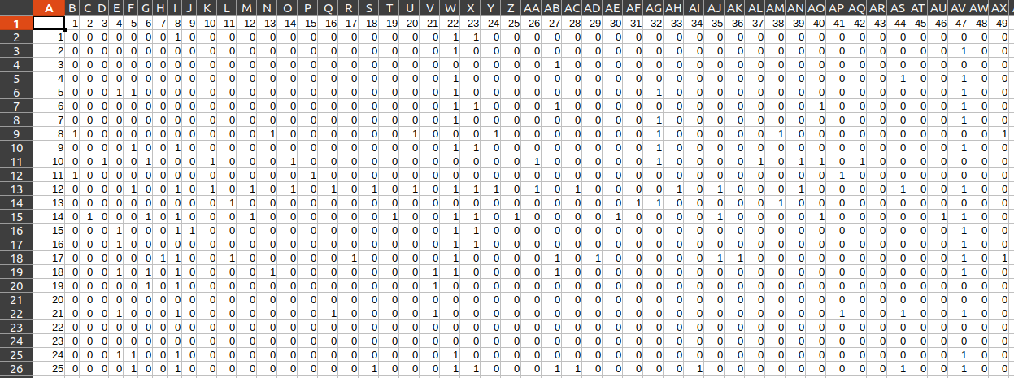
NEWS READ MATRIX

Slide 28
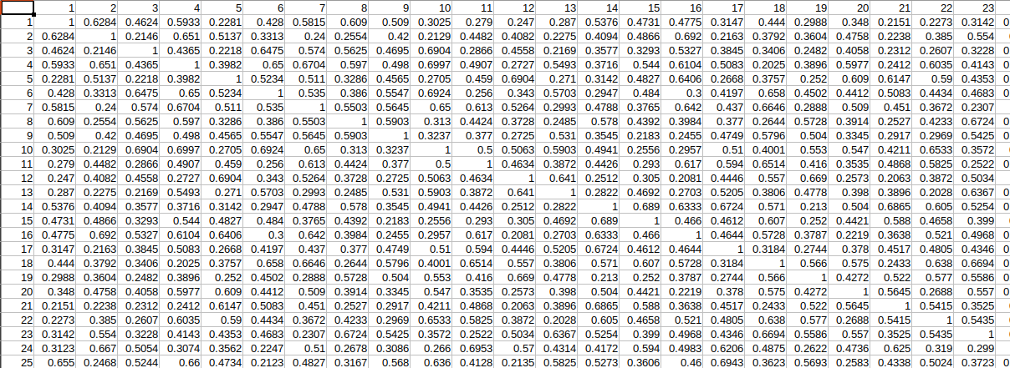
COLLABORATIVE SIMILARITY MATRIX

Slide 29
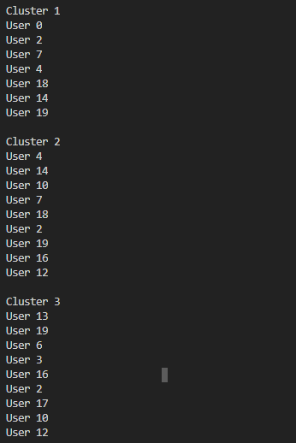
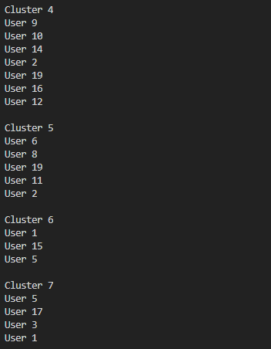
Clustering users based on the Similarity Matrix

Slide 30
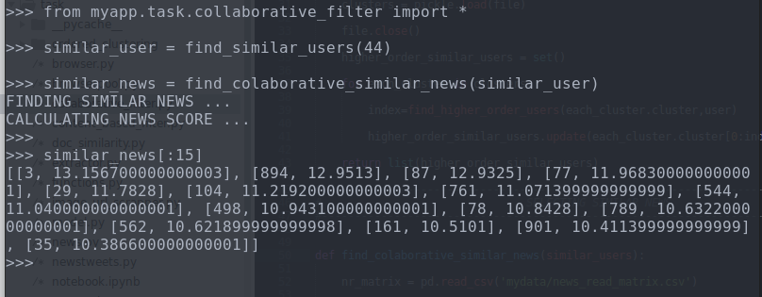
CALCULATING RECOMMENDATIONS OF COLLABORATIVE PART

Slide 31
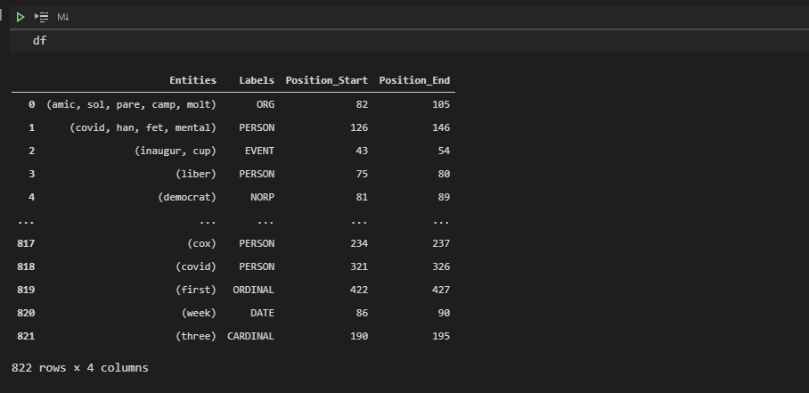
Named Entities Recognition

Slide 32
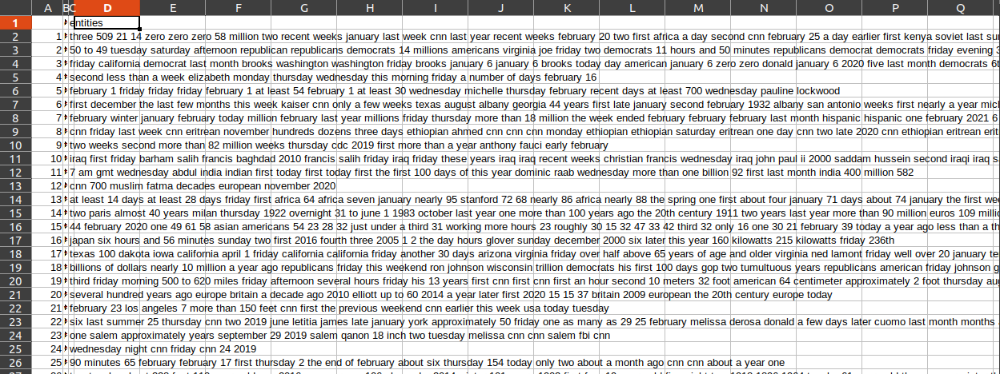
NEWS META DATA

Slide 33
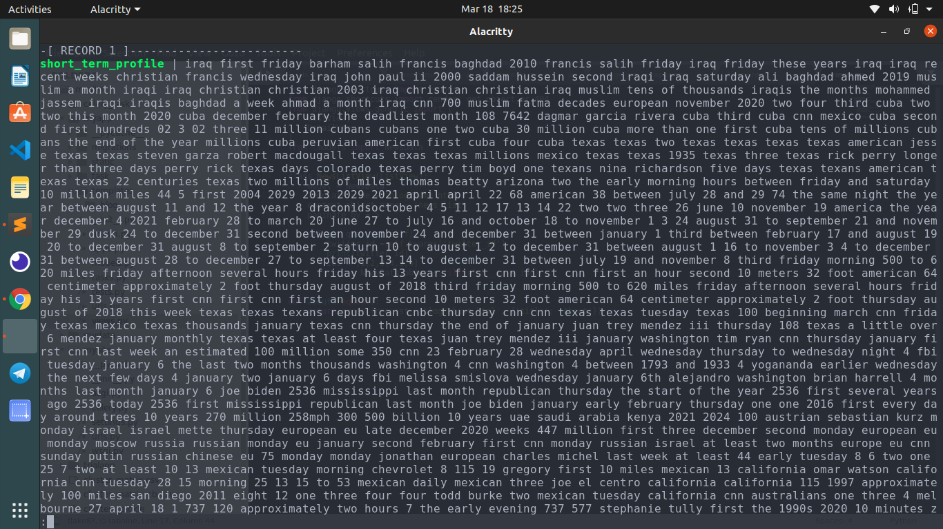
USER SHORT TERM PROFILE

Slide 34
Content Based Similarity Matrix

Slide 35
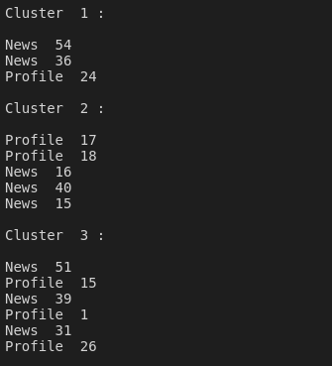
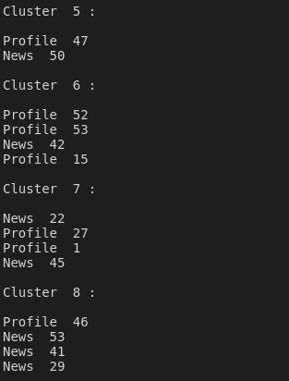
Clustering news and profiles based on the Similarity Matrix

Slide 36
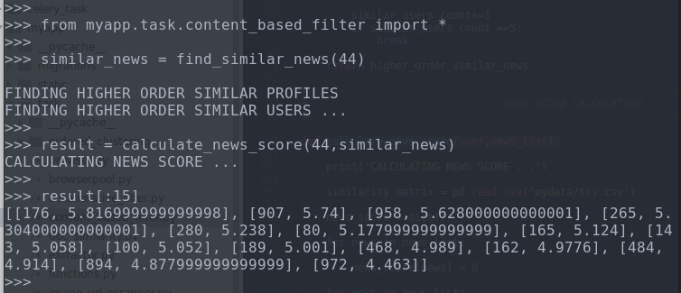
Recommendations from Content based Module

Slide 37
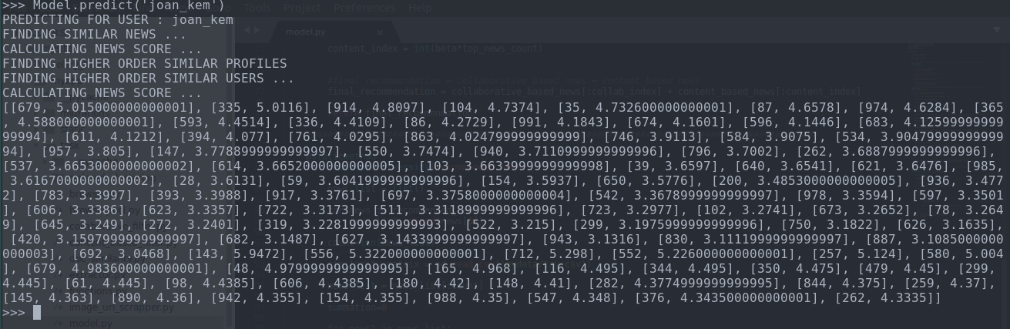
Combined & Prioritised Final Recommendations

Slide 38
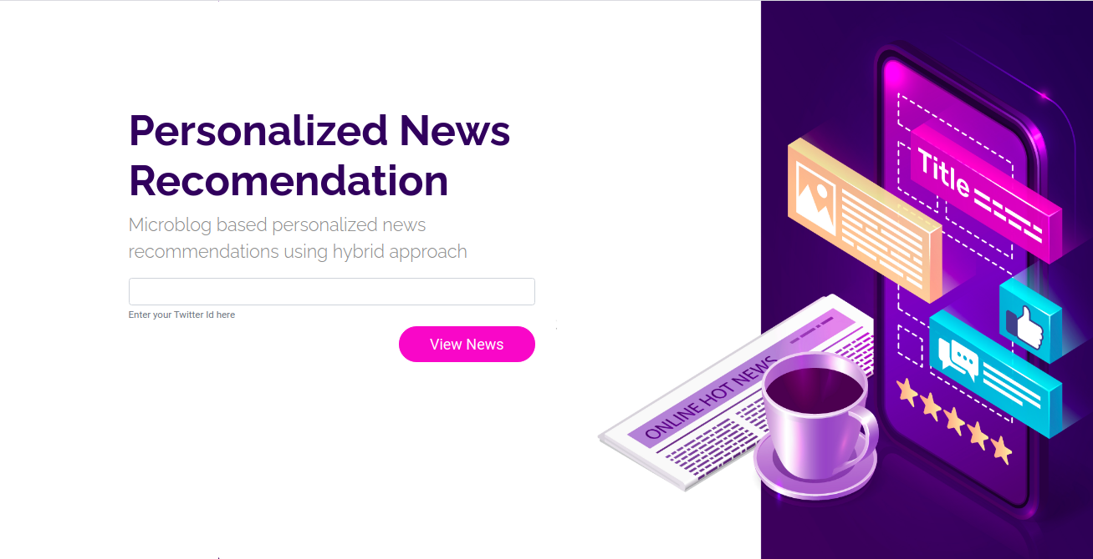
Final Results UI

Slide 39
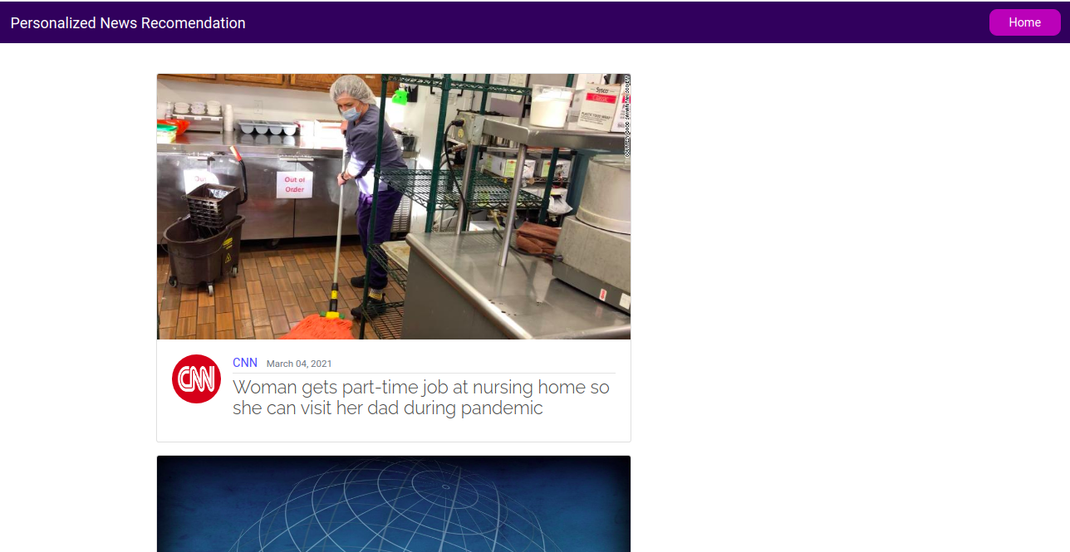
Final Results

Slide 40
Test Cases
Test Case 1 :
User is an existing user who is present in the system and recommendation is to be done to the existing user.
Test Case 2 :
User is a non existing user i.e. new to the system and recommendations is to be done to the user.
Test Case 3 :
User account of a user who does not tweet neither follows friends and news handles. i.e. the user is totally new to Twitter.

Slide 41
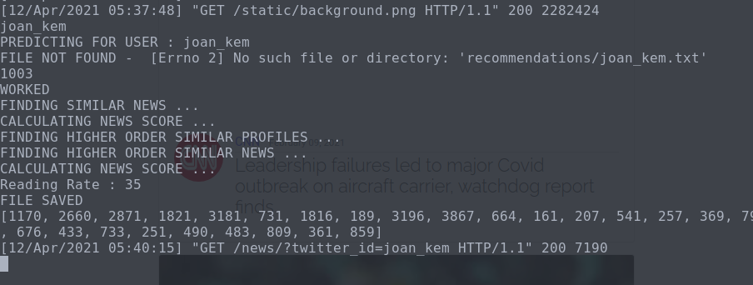
Test Case 1

Slide 42
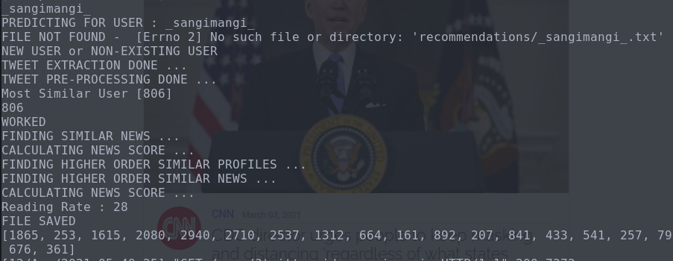
Test Case 2

Slide 43
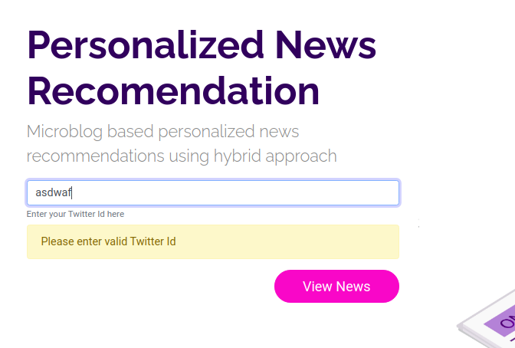
Test Case 3

Slide 44
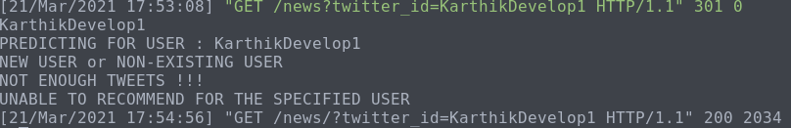
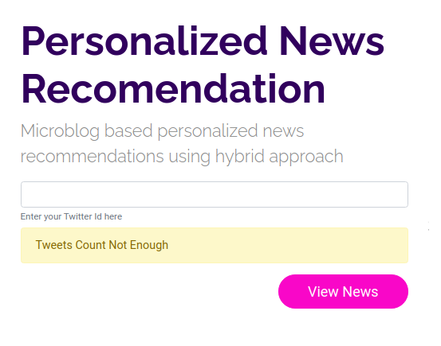
WHEN THE USER DOES NOT HAVE ENOUGH TWEETS

Slide 45
Performance Metrics
Diversity
Average dissimilarity between news items that are recommended to a given user.
2
Σni∈N Σnj∈N, ni!=nj
diversity(N) = -------------
( 1 -Sim(ni,nj) )
P(P-1)
The highest Diversity-Score obtained is 0.7312
Precision
The portion of recommended items that is in fact relevant to the user.
TP
precision = --------------------------
TP + FP
The highest Precision obtained is 0.6522

Slide 46
Performance Metrics
Recall
The portion of relevant items that is recommended to the active user
TP
Recall = ---------------------
TP + FN
The highest Recall Score obtained is 0.8795
F1-Score
The harmonic mean of precision and recall
precision x recall
F1-Score = ---------------------------------------------
precision + recall
The highest F1-Score obtained is 0.7489

Slide 47
ALL CASES
TRUE POSITIVE
News is relevant to the user and is recommended
TRUE NEGATIVE
News that is related to the user but not recommended
FALSE POSITIVE
News is recommended to the user but is not relevant
FALSE NEGATIVE
News that is not related to the user and is not recommended
 | RECOMMENDED | RELEVANT
TRUE POSITIVE | YES | YES
TRUE NEGATIVE | NO | YES
FALSE POSITIVE | YES | NO
FALSE NEGATIVE | NO | NO

Slide 48
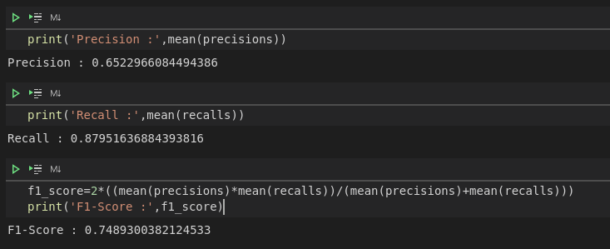
AVERAGE PRECISION, RECALL AND F-1 SCORE

Slide 49
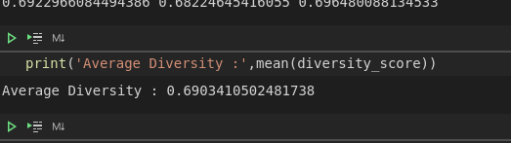
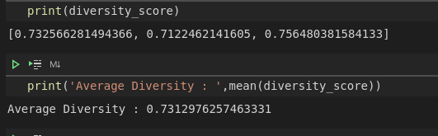
DIVERSITY SCORE BEFORE MODIFICATION
DIVERSITY SCORE AFTER MODIFICATION

Slide 50
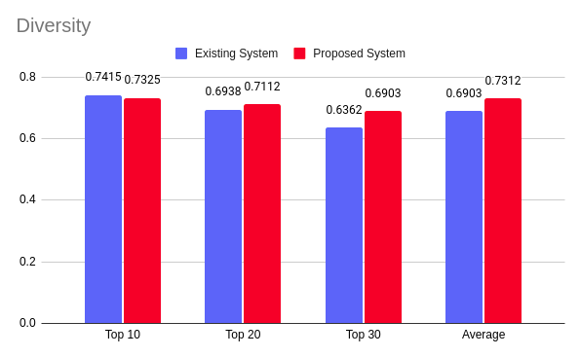
Analysis Graphs
DIVERSITY SCORE GRAPH

Slide 51
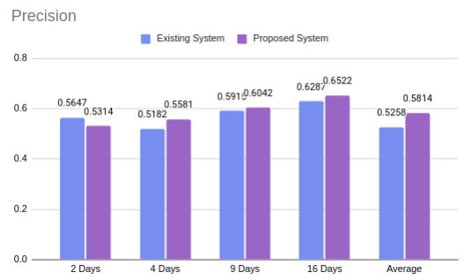
PRECISION GRAPH

Slide 52
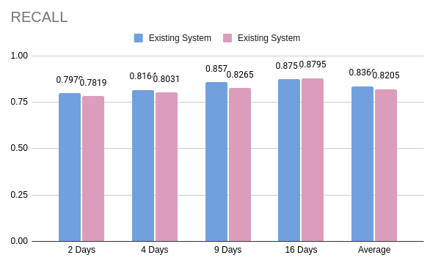
RECALL GRAPH

Slide 53
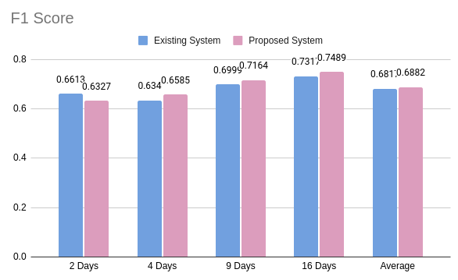
F1 SCORE GRAPH

Slide 54
Reference
[1] A. Darvishi, H. Ibrahim, F. Sidi and A. Mustapha, "HYPNER: A Hybrid Approach for Personalized News Recommendation," in IEEE Access, vol. 8, pp. 46877-46894, 2020,
​[2] C. Feng, M. Khan, A. U. Rahman and A. Ahmad, "News Recommendation Systems - Accomplishments, Challenges & Future Directions," in IEEE Access, vol. 8, pp. 16702-16725, 2020,
[3] D. Wu, M. Zhang, C. Shen, Z. Huang and M. Gu, "BTM and GloVe Similarity Linear Fusion-Based Short Text Clustering Algorithm for Microblog Hot Topic Discovery," in IEEE Access, vol. 8, pp. 32215-32225, 2020

Slide 55
[4] R. Nugroho, J. Yang, W. Zhao, C. Paris and S. Nepal, "What and With Whom? Identifying Topics in Twitter Through Both Interactions and Text," in IEEE Transactions on Services Computing, vol. 13, no. 3, pp. 584-596, 1 May-June 2020.
[5] G. De Souza Pereira Moreira, “CHAMELEON: A meta architecture for news recommender systems,” in Proc. 12th ACM Conf. Recommender Syst. (RecSys), 2018, pp. 578-583.
[6] D. Khattar, V. Kumar, M. Gupta, and V. Varma, ‘‘Personalized news recom-
mendation: A review and an experimental investigation,’’ in Proc. NewsIR Work-shop, 2018, pp. 45–50.

Slide 56
[7] L. Zheng, L. Li, W. Hong, and T. Li, ‘‘PENETRATE: Personalized news
recommendation using ensemble hierarchical clustering,’’ Expert Syst.
Appl., vol. 40, no. 6, pp. 2127–2136, May 2013.
[8] L. Li, D. Wang, T. Li, D. Knox, and B. Padmanabhan, ‘‘SCENE: A scalable
two-stage personalized news recommendation system,’’ in Proc. 34th. Int.
ACM SIGIR Conf. Res. Develop. Inf. Retr., 2011, pp. 125–134.
[9] A. S. Das, M. Datar, A. Garg, and S. Rajaram, ‘‘Google news personaliza-
tion: Scalable online collaborative filtering,’’ in Proc. 16th Int. Conf. World
Wide Web (WWW), 2017, pp. 271–280.

Slide 57
Thank You

