Slide 1
Tc-capstone project calculator using html,css and java script
Presented by
B.Jayanth
S.Sravani
M. Chaitanya
S.priyamvada

Slide 2
outline
Abstract
Problem statement
Introduction
Technologies
Method Adapted
Software Showcasing
Features
Conclusion

Slide 3
ABSTRACT
As we know, the Calculator is a portable device used in our daily life to perform various mathematical functions such as addition, subtraction, multiplication, division, root, etc. However, we have scientific or sophisticated calculators used to solve complex tasks such as trigonometry functions, degrees, exponential operators, log functions, hyperbolic functions, square root, and so on. In this topic, we will create a calculator program in JavaScript.

Slide 4
PROBLEM STATEMENT
You can make a simple calculator using just core web technologies: HTML, CSS, and JavaScript. This calculator can perform basic mathematical operations like addition, subtraction, multiplication, and division.

Slide 5
Introduction
Html calculator is used for performing basic mathematical operations like Addition ,substraction,multiplication and divison. To design the basic calculator we will use the HTML,CSS,JAVASCRIPT
Html is used to design the basic structure of the calculator
CSS style are used to apply the style on the calculator and
JAVASCRIPT is used to add the calculation functionality

Slide 6
TECHNOLOGY
The Technology is adopted to develop a single page calculator are:
Angularjs (Front End)
Java (Back End)
HTML
CSS(Bootstrap)

Slide 7
METHOD ADAPTED
The Calculations uses a 2-way method operation control to calculate the values of inputted information via the frontend

Slide 8
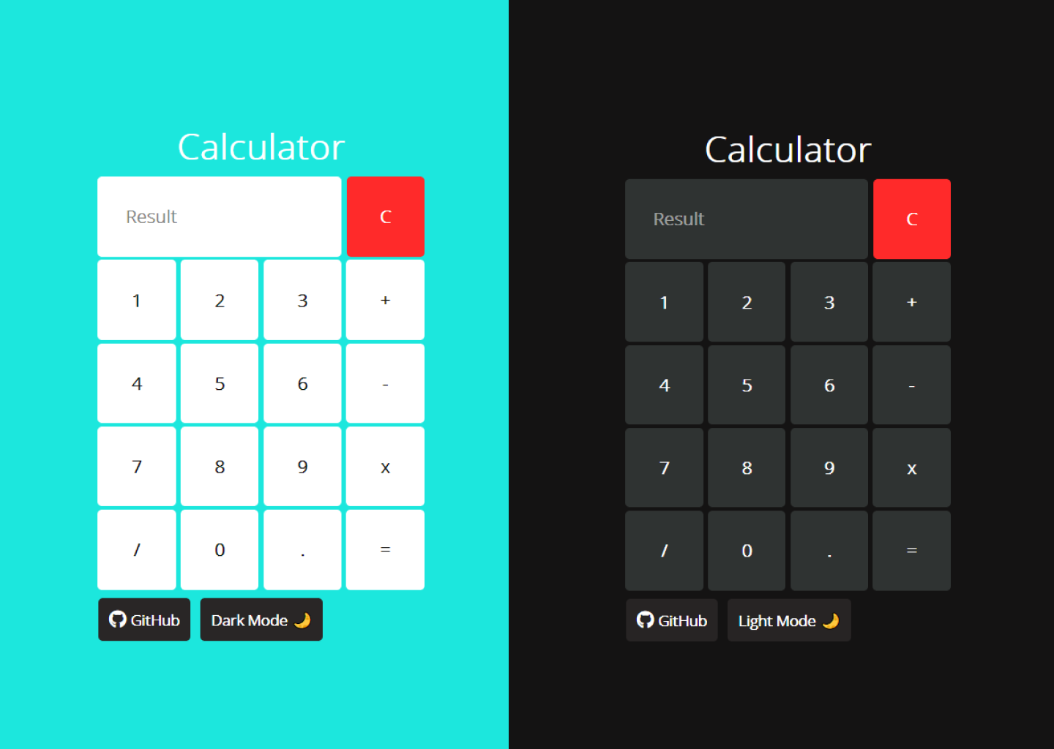
Software Showcasing

Slide 9
FEATURES
Features of the Calculator
In this project, you are going to develop a calculator that will have the following features:
It will perform basic arithmetic operations like addition, subtraction, division, and multiplication.
It will perform decimal operations.
The calculator will display Infinity if you try to divide any number by zero.
It will not display any result in case of invalid expression. For example, 5++9 will not display anything.
Clear screen feature to clear the display screen anytime you want.

Slide 10
conculsion
As we know, the Calculator is a portable device used in our daily life to perform various mathematical functions such as addition, subtraction, multiplication, division, root, etc. However, we have scientific or sophisticated calculators used to solve complex tasks such as trigonometry functions, degrees, exponential operators, log functions, hyperbolic functions, square root, and so on. In this topic, we will create a calculator program in JavaScript.

Slide 11


