Slide 1


CYBER FORENSICS T20 SERIES
TEAM NAME : CyberRivet
TEAM MEMBER : MOULIK SINGH ARORA – 20BIT0415
PREKSHA J DADHANIA – 20BIT0158
VINEET JAIN – 20BIT0342
TOPIC : INVESTIGATING WEBSITES/PROFILES RELATED TO ROMANCE SCAM

Slide 2
Hack-a-thon Problem Statement
Design and develop a technological solution/software tool that may read information on web pages, and identify possible instances of romance scams. The system may send notifications. Over a period of time, a dynamic infringing website list (IWL) may be developed and maintained. The system may send notifications to online social media like Facebook for blacklisting of such websites, thereby discouraging romance scams.

Slide 3
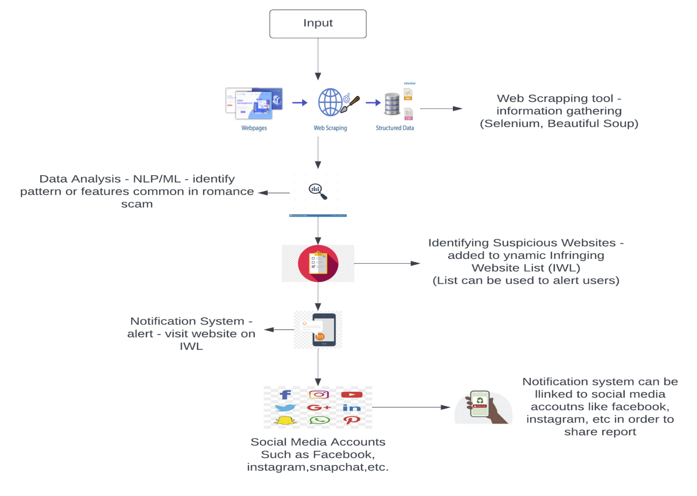
Design Architecture

Slide 4
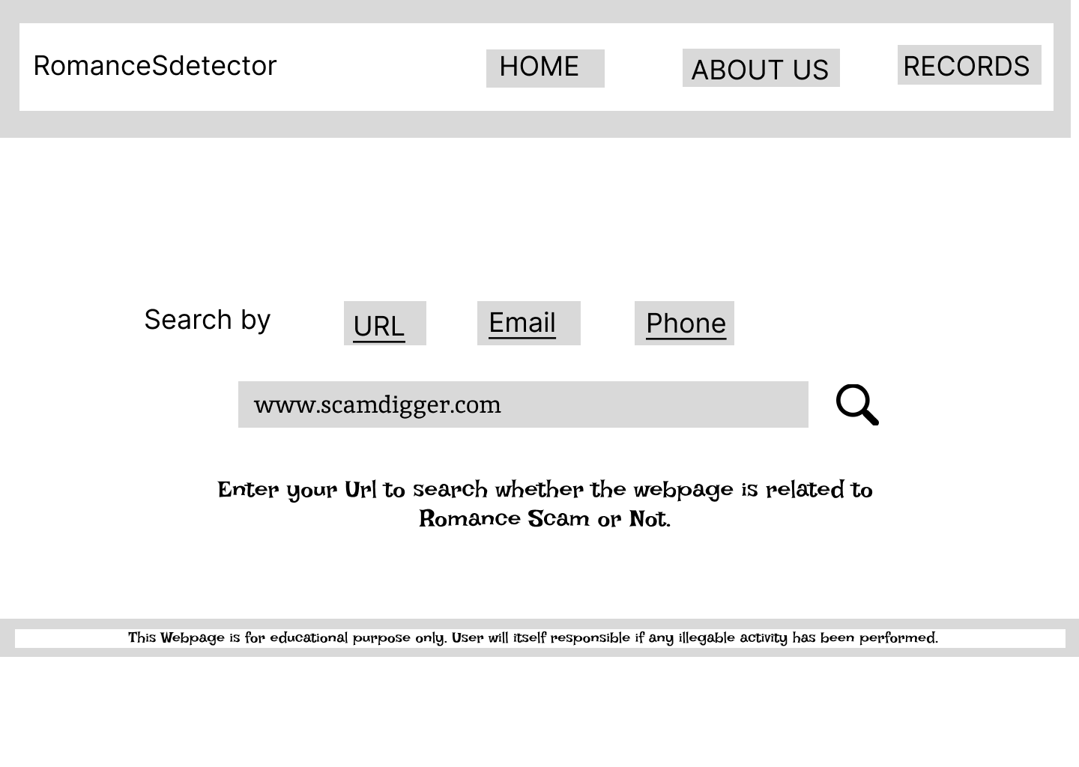
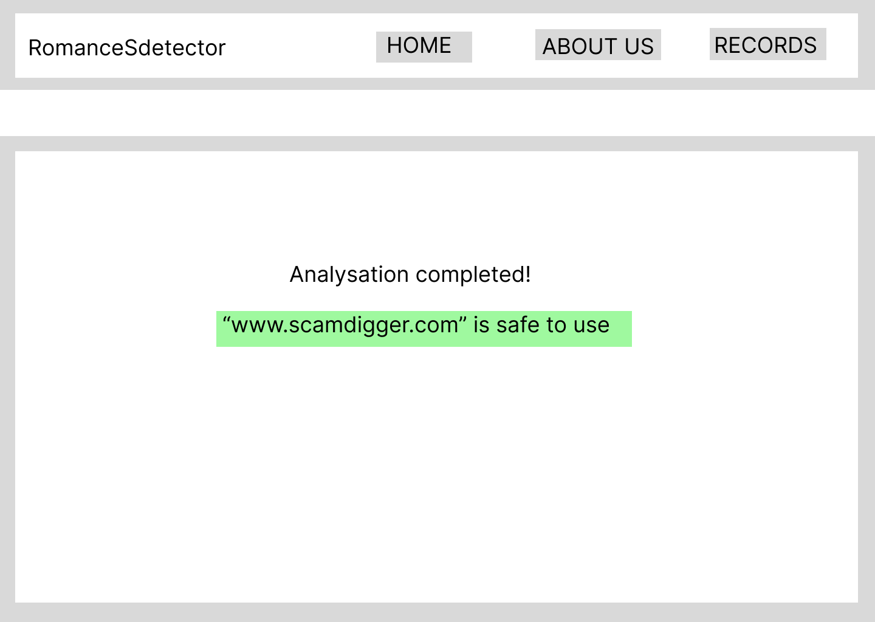
Design Prototype

Slide 5
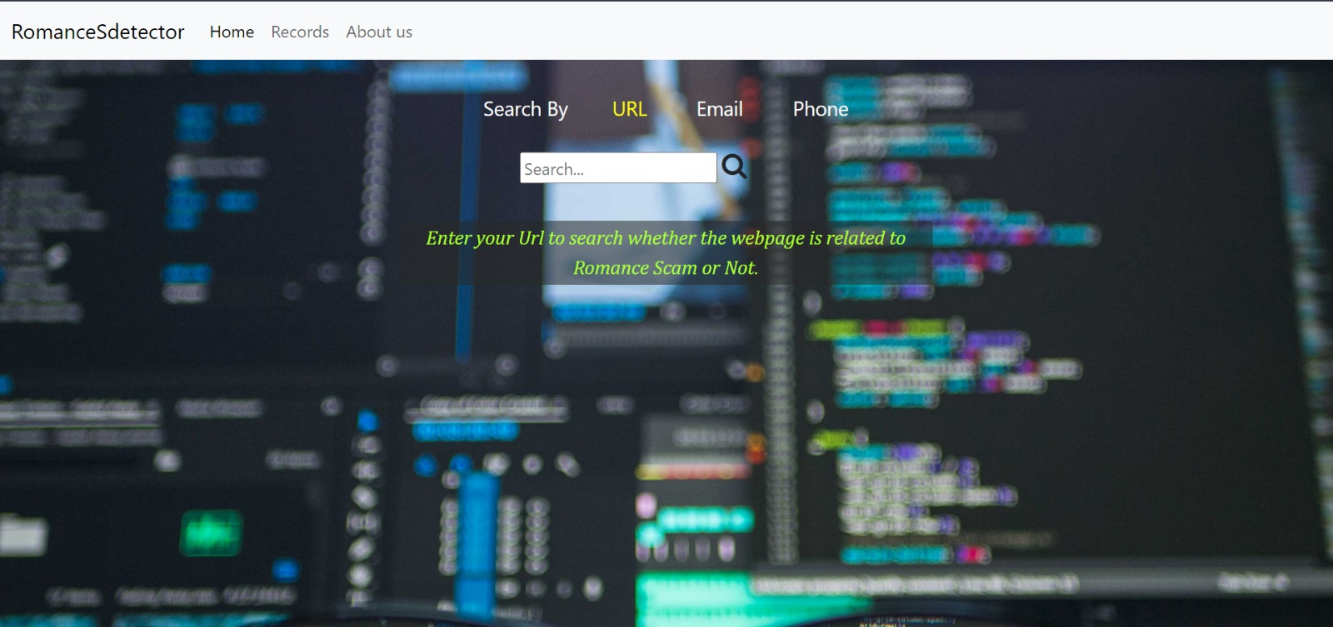
Actual Website

Slide 6
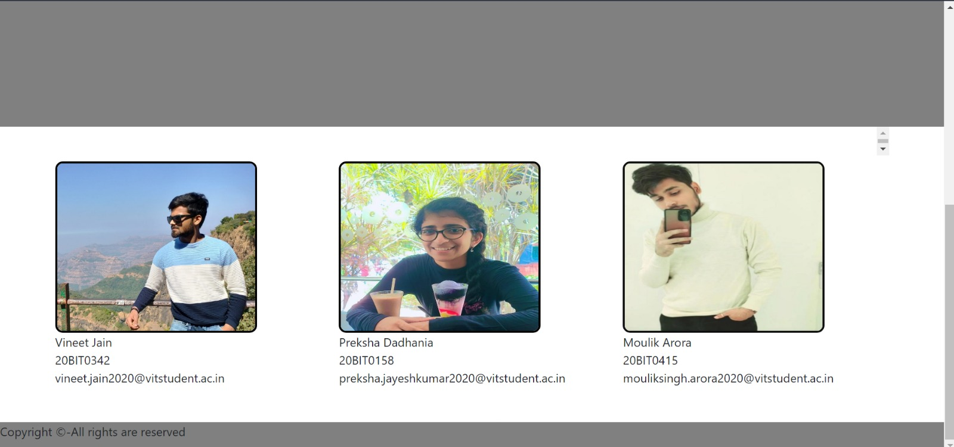
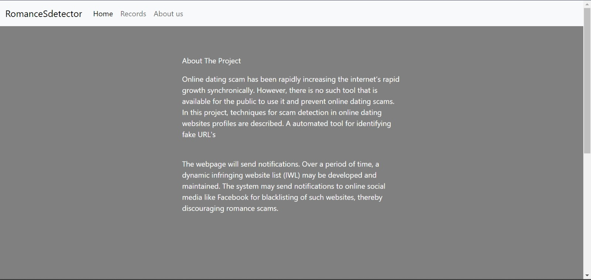
About Us

Slide 7
Working Explanation
The website takes URL from the user and analyses if it is related to romance scam or not by performing web scraping to extract email addresses and links from a given website, then uses a logistic regression model to assign a suspiciousness score to each email address based on its features. (Our code imports necessary libraries such as requests, BeautifulSoup, re, string, pandas, sklearn, smtplib, time, and os to scrape scamming websites and notify social media accounts if there is any suspicious email or link.)
The analysed result is stored in a csv file and shown to the user on the website. An email is also sent to the user as an alert message on email.
If the website is found being related to romance scam then it adds that URL to a “blacklist”. The blacklist can then be circulated on social media platforms (like Instagram, twitter, Facebook, etc), periodically, to send alert notification to users over a period of 24/7.
The blacklist can also be seen by the users on the website.

Slide 8
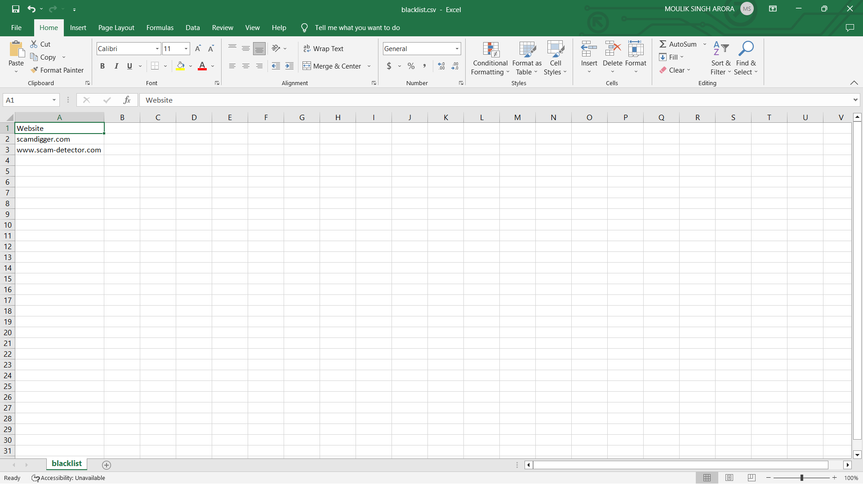
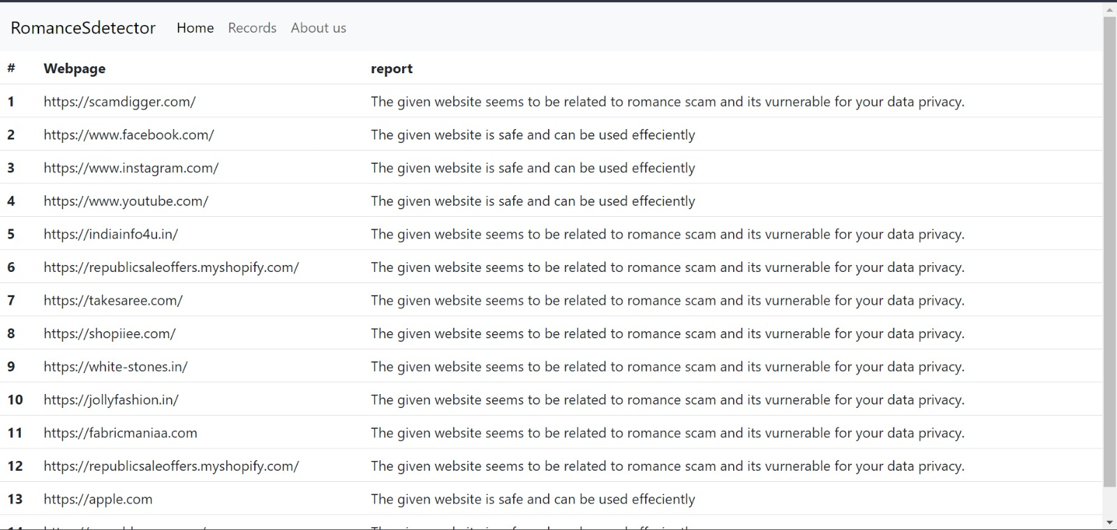
BlackList

Slide 9
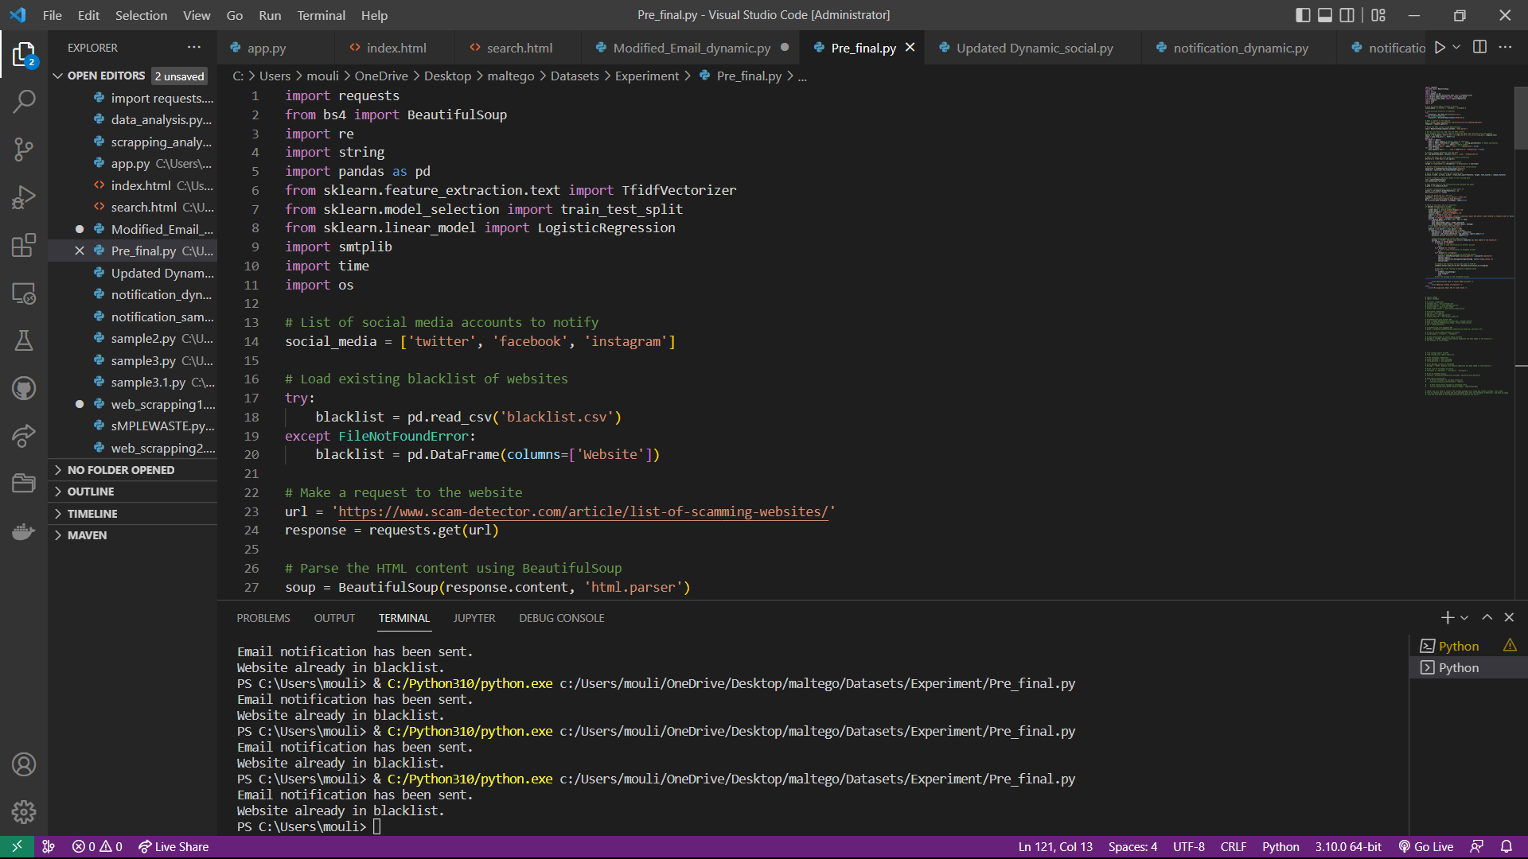
Code

Slide 10
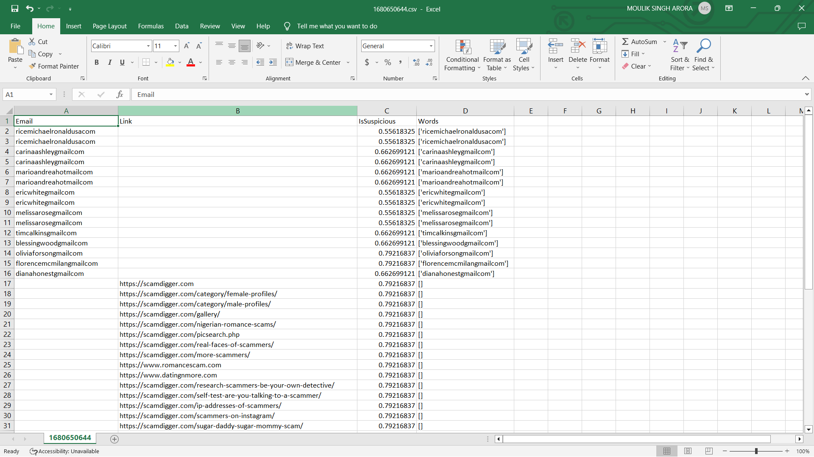
Database

Slide 11
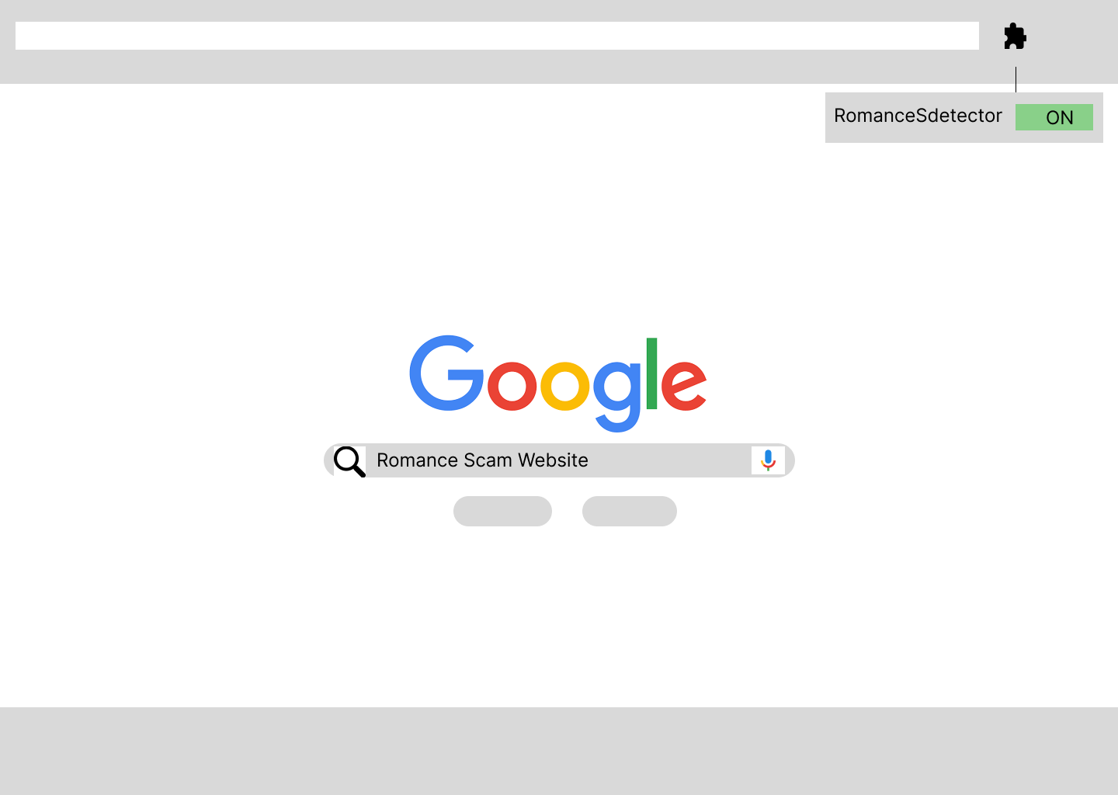
Future Work
We can create an extension of our website in order to detect whether the website that the user opens is associated with romance scam or not.

Slide 12
Github Repository Link:
https://github.com/Moulik07/RomanceSdetector.git

