Slide 1




ADAPTIVE DATA PROCESSING SYSTEMS

Slide 2



THEME
C.A.R.M.A

Slide 3


INTRODUCING:
A Banking Services Software that
.
C
A
.
.
.
R
M
A
.
ares
bout
eliable
oney
ccess

Slide 4
OUR TEAM
Aman Pathak 231ADB028
Moulik Arora 231ADB036
Cong Minh Tran 231ADB072
Rakesh Gudimetla 221ADB239
Anas Mehmood 221ABD134
Davyd Bogomolov 221ADB232
Akshat Dhingra 221ADB173
Hemant – 231ADB009

Slide 5
SYSTEM INFORMATION
SECURE ONLINE BANKING FOR PERSONAL USERS
01
02
CARD AND INVESTMENT MANAGEMENT
PASSWORD AUTHENTICATION WITH OTP VERIFICATION
05
03
04
AI-POWERED CUSTOMER SUPPORT CHATBOT
INTERNAL TRANSACTIONS & REAL-TIME BALANCE TRACKING

Slide 6






System Design in Detail - Workflow
3.•Main Menu (Account, Cards, Support)
1.User Login &
Registration
5•Card Management
7•Customer Support Chatbot
6.Report Generation
2.Authentication (OTP verification)
4•Account Management
8•Money Transfer & Add Recipient

Slide 7
MODULAR
DIAGRAM
CARMA Banking Services Software
LOGIN & SECURITY
CUSTOMER
INTERFACE
BANK
BALANCE
CARD
MANAGEMENT
INVESTMENT
INFORMATION
REPORTS
TRANSACTION
HISTORY
NOTIFICATIONS
STATEMENTS

Slide 8

Why We Chose This System
1
2
3
4
5
FinTech is booming
Scope of Finance
Practice of Security
Perfect Balance of Backend, Frontend & Database
Diverse Target Audience

Slide 9




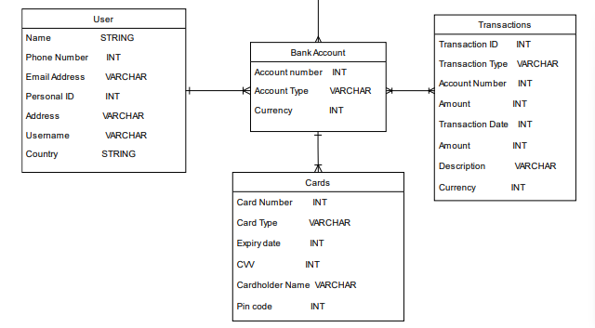







System Design in Detail - Database Design (ER Model)

Slide 10


REQUIREMENTS
FUNCTIONAL
NON-FUNCTIONAL
High security with encryption & Authentication
Fast performance (<2s response)
99.9% system reliability
Scalable for growth
User-friendly interface
Easy to maintain & update
Secure registration & authentication with OTP
Account & transaction management
Money transfers & report generation
AI customer support chatbot
Profile management

Slide 11
Features of the software
04
FINISH
02
03
01
Security
START

Slide 12
SECURITY
Spring Security with BCrypt password encryption
Custom authentication flow with request validation
Error Handling forwarding
Protection against brute-force login attempts
Multi-layer security architecture

Slide 13
Features of the software
04
FINISH
Reliability
02
03
01
Security
START

Slide 14
Reliability
Spring Boot + PostgreSQL for enterprise-grade stability
ACID compliance ensuring zero data loss
Designed for high availability and minimal downtime
Robust error handling for transaction failures

Slide 15
Features of the software
04
FINISH
Reliability
Efficiency
02
03
01
Security
START

Slide 16
Efficiency
Lightweight Spring Boot framework for fast processing
JPA/Hibernate for streamlined database operations
RESTful API design reducing communication overhead
Minimalist frontend for rapid page loads
Clean code structure improving execution speed

Slide 17
Features of the software
Maintainability
04
FINISH
Reliability
Efficiency
02
03
01
Security
START

Slide 18
Maintainability
Docker containerization for consistent deployment
GitHub Actions for continuous integration
Heroku for automated continuous deployment
Modular Spring Boot architecture for easy modifications
Comprehensive code
comments

Slide 19
Features of the software
Maintainability
04
FINISH
Reliability
Efficiency
02
03
01
Security
START

Slide 20

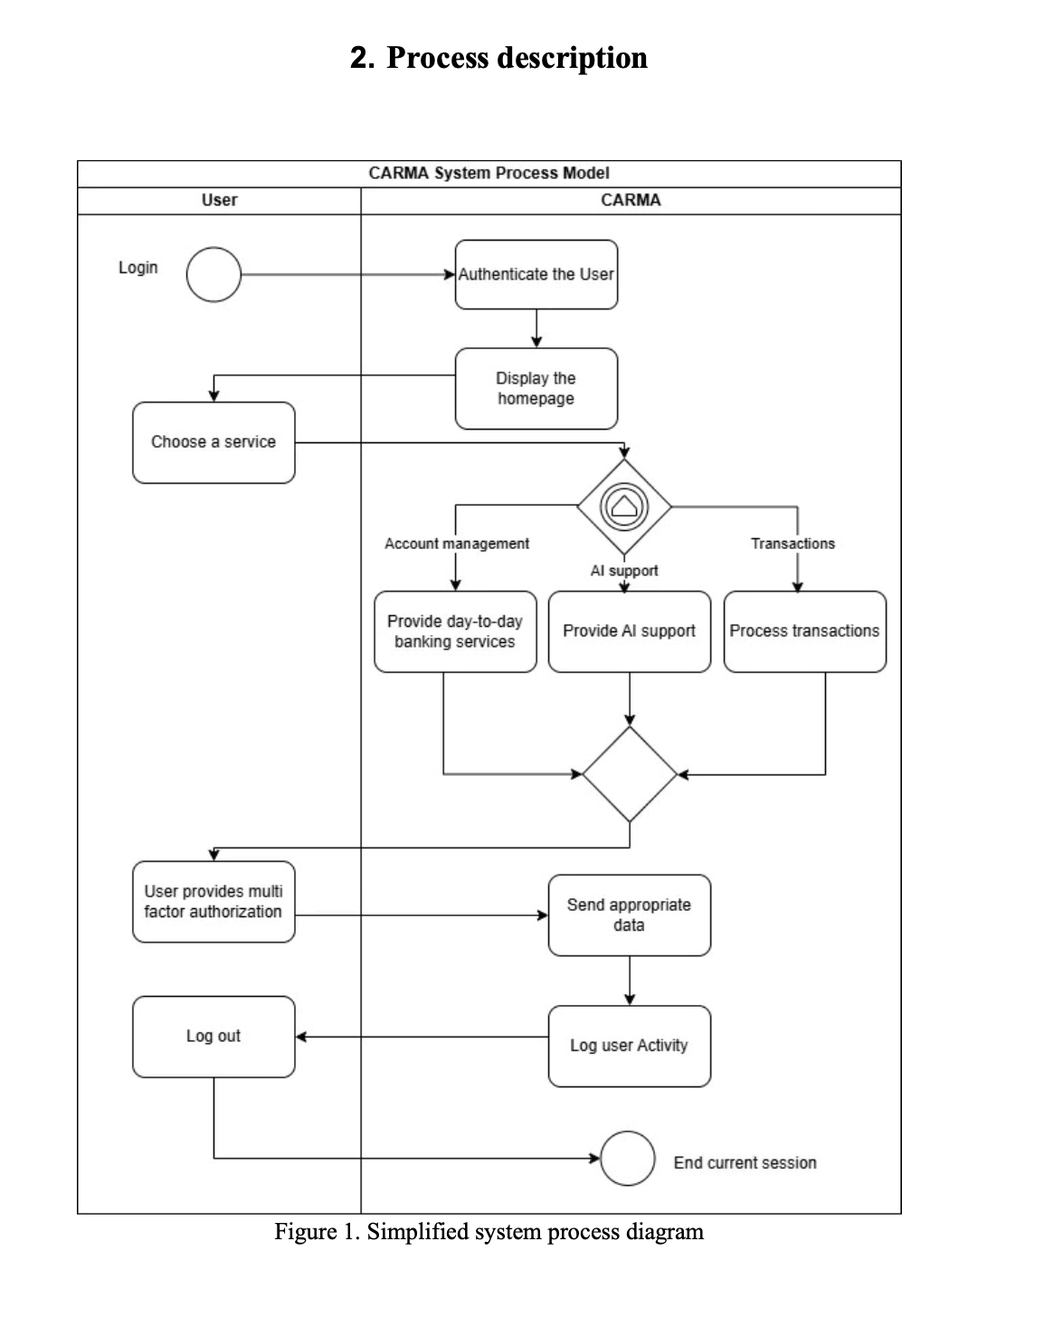






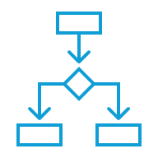

Process description

Slide 21


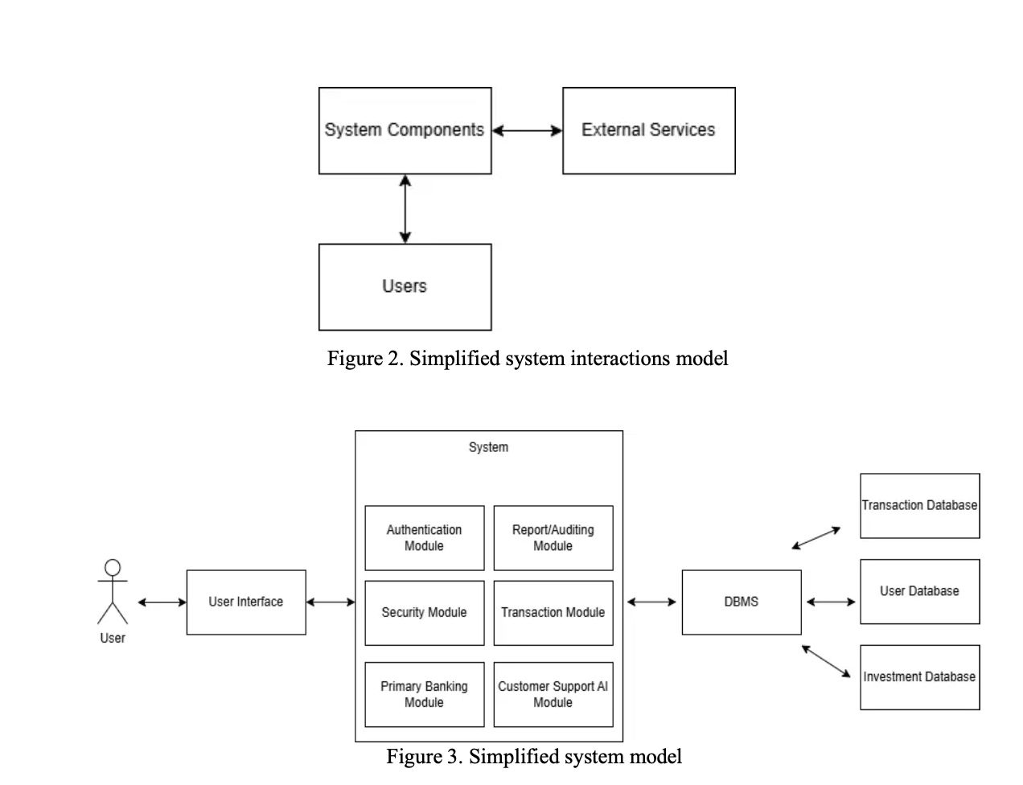








Process description

Slide 22

3. User authentication and security check, Transaction processing, AI-driven customer support
SIPOC
1. Clients of the CARMA Banking services
5. Clients of the CARMA Banking services
SUPPLIER
INPUTS
PROCESS
OUTPUTS
CUSTOMER
2. Financial, Biometric, Personal and Transaction Data
4. Statement, Account details, transaction history

Slide 23
SWOT ANALYSIS
1. Refined skills in programming
2. Time Coordination
3. Team Versatility
4. Dedication
1. Limited Practical Experience
2. Lack of Banking Knowledge
S
W
1. 24/7 Library access for meetings
2. Free or Discounted software licenses
3. FinTech companies’ mentorship
4. Professor's guidance
5. Easily accessible learning resources on Internet
O
T
1. Other websites/apps providing banking services
2. Deadline
SUSTAINABLE

Slide 24





TECHNOLOGIES & TOOLS
POSTGRESQL
Lightweight & Free
JAVA
SPRING BOOT
Microservices
GITHUB
Version
Management
HEROKU & GITHUB ACTIONS
Cloud and CI/CD
HTML / CSS
Most Popular for UI

Slide 25
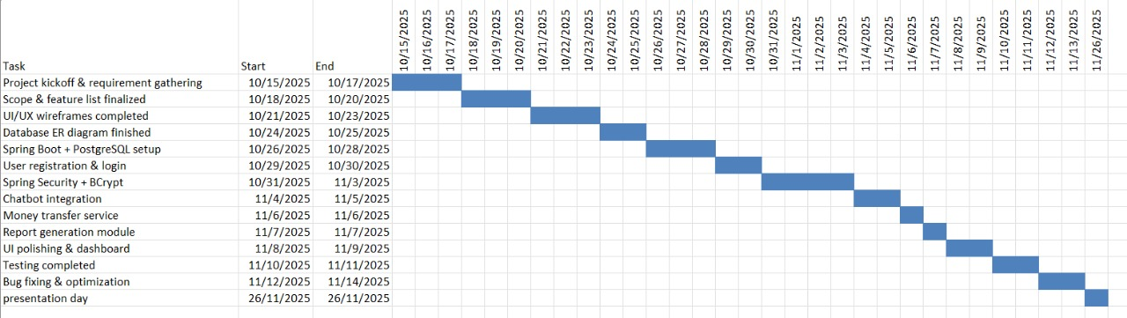
Gantt Chart

Slide 26
FUTURE IMPROVEMENTS
EASY INVESTMENTS
REAL PAYMENTS THROUGH STRIPE
ANOMALY DETECTION
JWT SECURITY

Slide 27




THANK YOU
For Your Attention & Appreciation

