Slide 1
Taxi Fare Prediction using Machine Learning
Course: Data Analysis and Knowledge Discovery
Instructor: Priyan Malarvizhi Kumar
Semester: Fall 2025
Team Members:
  Akhila Nandikonda
  Bushra Afrin Mohammed
  Soumya Padala
  Yashas Chandra Bathini
  Moulya Reddygari Bhupal

Slide 2
Introduction
Data Science extracts insights and predictions using statistical and computational methods.
Transportation industry generates vast data — trips, fares, passenger counts, and locations.
Predicting fares improves transparency, efficiency, and urban planning.
Machine Learning applied to predict fares using distance and time.

Slide 3
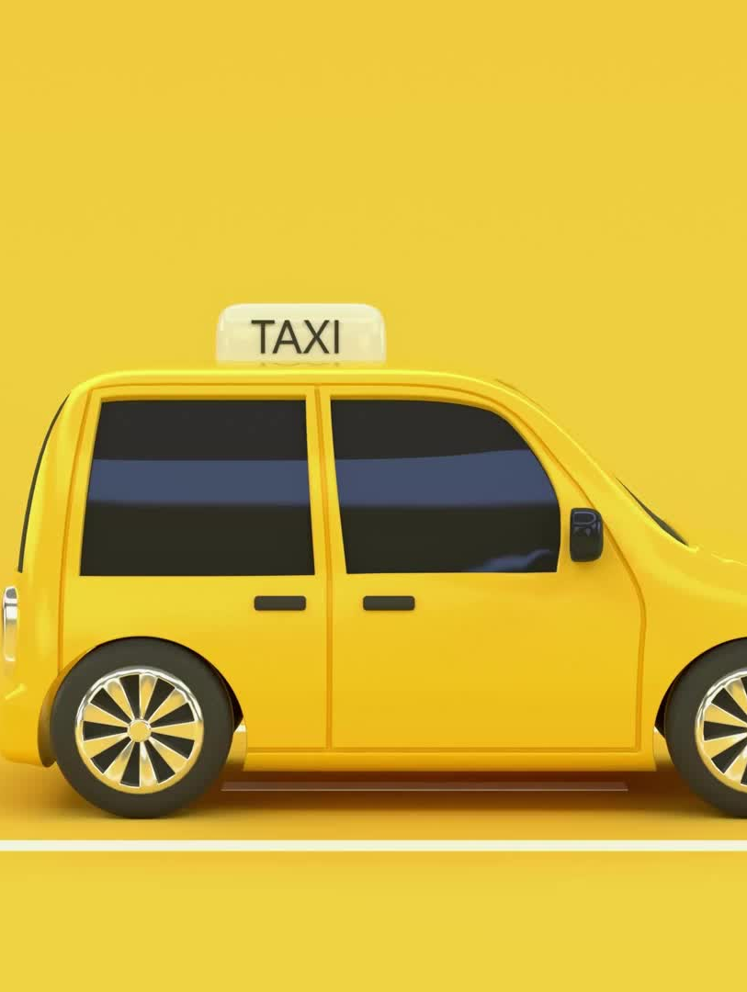
Problem Statement
Taxi fares vary due to distance, time, passengers, and traffic.
Passengers face unpredictable costs.
Operators face inconsistent earnings and reputation issues.
Goal: Build a data-driven model to predict fares before trips.

Slide 4

Objective
  • Build a model to estimate taxi fare using trip details.
  • Use ML algorithms to find relationships between features and fares.
  • Evaluate with RMSE and MAE.
  • Visualize for better understanding.

Slide 5

Dataset Overview
• Data Source: NYC Taxi & Limousine Commission (TLC)
• Features: Pickup & Drop-off Coordinates, Passenger Count, Trip Distance (Haversine formula), Pickup Date/Time
• Target Variable: Fare Amount
• Cleaned data: removed missing or unrealistic entries.

Slide 6
Data Preprocessing
• Removed duplicates & missing data.
• Filtered out unrealistic fares.
• Computed distances using Haversine formula.
• Extracted time-based features.
• Split: 80% Train, 20% Test.
• Tools: Pandas, NumPy, Matplotlib, Scikit-learn.

Slide 7
Model Implementation
• Used Supervised Learning (Regression).
• Trained model on trip features → predicted fare amount.
• Evaluated using RMSE & MAE.
• Visualized Actual vs Predicted and Residual errors.

Slide 8
Results & Analysis
• RMSE ≈ 2.75, MAE ≈ 1.80
• Distance & pickup time most impactful.
• Accurate for short–medium trips.
• Outliers affect precision (e.g., airport rides).

Slide 9
Visualization
• Scatter Plot: Actual vs Predicted Fares
• Bar Graph: Feature Importance
• Histogram: Prediction Errors
• Created using Matplotlib & Seaborn.

Slide 10
Conclusion
• ML predicts fares effectively with key trip features.
• Preprocessing & feature selection vital for accuracy.
• Future improvement: add weather, traffic, surge data.
• Demonstrates Data Science role in smart mobility.

Slide 11
Future Work
• Integrate live GPS for real-time prediction.
• Develop a public web or mobile app.
• Test advanced ML models (e.g., Gradient Boosting, Deep Learning).

Slide 12
References
Bui, T., Tran, D., & Nguyen, H. (2021). Taxi fare prediction using ML techniques: A comparative study.
Kumar, R., & Singh, P. (2022). Fare estimation and trip analysis using ensemble learning.
NYC Taxi and Limousine Commission (TLC) Dataset (2024).

