Slide 1
How We Use R in Production
Andy Pryke Chief Data Scientist (Sales & Marketing Solutions) Sidetrade

Slide 2
What Sidetrade Sales & Marketing Do
Take data from businesses who sell to businesses (B2B)
Do useful "Data Science" stuff with it
Churn Prediction - Will this customer leave or stay in next year?
Lead Prioritisation - Which leads are most likely to become customers?
Product Recommendations - Based on what they buy already, what might they buy in the future
Value - How much will a customer/lead spend?
Topic Modelling – What topic do customers websites cover Segmentation - Customers by behaviour & background?

Slide 3
What is the Data?
Transactions - Who bought what, when, for how much
Customer - Date of 1st purchase, how acquired, any background
Leads - Any background data
Products - names, price, profit, product hierarchy
External Data – We add business sector, turnover, segmentation based on customer website etc... if available.
Data Volumes - from 100s to 100,000s of customers, sometimes very unbalanced data

Slide 4
Overall Architecture
Client Interaction Data Engineering Data Science
Data dropped via FTP
Transformed to "Analytical Data Set"
CSV Data Files
Modelling & Analysis
Client views web interface
Results loaded into database
Result pushed to client’s CRM
CSV Results Audit Files Warnings/Errors

Slide 5

Overall Architecture
Client Interaction Data Engineering Data Science
Data dropped via FTP
Transformed to "Analytical Data Set"
CSV Data Files
Modelling & Analysis
Client views web interface
Results loaded into database
Result pushed to client’s CRM
CSV Results Audit Files Warnings/Errors
Notes:
Data dropped via FTP
Transformed to standard tables
Customer, Transactions...
Transformed to "Analytical Data Set", typically:
1 row per customer
300 derived attributes like "Number of purchases of product type 3 in last 30 days"
Normally a "train" and "score" set. Score data is current status, train is 1 year ago
Predictive modelling runs
Tightly defined interface
CSV files in & out
Parameters in YML (pulled from config database)
Error & warning log
Results loaded (if no error)
Clients see results in Web App & can download
Some results pushed to client Customer Relationship Management (CRM) systems e.g. Add a score for each lead to Linkedin
Warning logs visible in internal tool
Warning flagged up in slack - now moved to MS-Teams :-(

Slide 6
How We call R
Shell calls to a R file which loads a text file (YML file) specifying what “function” to run and what parameters to use
Rscript.exe runDataScience.R "parameterFile=testBinaryModelAndScore.YML“
This calls multiple R Markdown Files with parameters via shell:
Rscript.exe -e "renderWithReportOnKnitrError('10.2_-_Preprocess_data.Rmd', output_file='Preprocess_HealthInsurance.html', output_dir=‘x:/Test', quiet = TRUE)"
"baseYearFile=HealthInsurance_Train.txt"
"validationYearFile=HealthInsurance_Validation.txt"
"outputDataFilename=HealthInsurance.Rdata"
"randomSeed=0"
"numericDataChangeThreshold=0.4"
:

Slide 7
R Markdown is Key
Each “function” in our data science API is a RMD file. For example
“Create new binary prediction model”
“Score new data against binary prediction model”
“Compare model performance with prior performance”
Reports are generated as we process data & build model. If something goes wrong we can look at a partial report
Warnings like “Dataset is very small” are logged to file. Warnings include machine readable recommendations like “set option to retrain on all data”, which can be automated. Lots of reporting & charts

Slide 8
Challenges
2 Data scientists(!)
100s of models in production.
Making sure they are "good"
Justifying decisions
Understanding what models are doing
Detecting changes in data and model performance
Detecting data errors

Slide 9
Challenges (continued)
Large & small data volumes: from < 1k rows to 500k rows
Balanced & very unbalanced (1:10,000) data (ratio of positive to negative examples)
Making configuration easy
Automating defaults

Slide 10
Detecting Dodgy Data
Check for too many missing values & warn
Data with no or low variance caret::nearZeroVar
Detect ID like fields (too many different discrete values)
Data distributions are different in train & score stats::ks.test & Cramer’s V test
Are some fields too predictive? Use caret::filterVarImp() to check

Slide 11
Preventing Perilous Predictions
Are model predictions different on test & score data (KS & Cramer’s V)
How does our complex model compare with a simple one? Compare with a decision tree model.
Track various metrics over time (e.g. lift in top 10%, false positive rate etc…)
Warn if metrics change “too much” between runs
Lots of diagnostics: Variable importance, show decision trees for most influential variables, what values of variables have the highest impact, examples of high & low scoring customers (rows)

Slide 12
Example Reports

Slide 13
Coding Principles
Pragmatic programmer book – old but lots of good tips
Write for your future self
Clear code rather than conciseness or comments
Intermediate variables, rather than excessively chained code ("%>%")
Few abbreviations in names - so you don't have to remember what /when you abbreviated
Keeping things generic - no hard coding!
Literate (like) Programming / Processing – Using R Markdown

Slide 14
Key packages

Slide 15
Key packages - Reporting
rmarkdown, knitr - All code runs as R Markdown reports
ggplot - plots in reports (use base R plots & other too)
DT - Print tables nicely in markdown

Slide 16
Key packages - Data manipulation
data.table - Fast manipulation of larger datasets
dplyr – data transformation (but not used much as can be slower than data.table on larger datasets)
fasttime – Quickly turn text into a date object

Slide 17
Key packages - Modelling
caret - Standardised interface to many many classification & regression methods
randomForest - Prediction
party, rpart, arules, discretization, infotheo - Explaining relationship of data & model
arules, recommenderlab - Recommendations
cluster - K-medians segmentation (more robust than k-means)
topicmodels - modelling topics of texts

Slide 18
Key Packages - Misc
RPostgres, DBI – Database access
RColorBrewer – Nice, principled, colours
xml2, yaml – Read XML & YML files
tm – Text Mining
lubridate – text to date, timespans
testthat – Test functions to check they do what they should

Slide 19
Thanks!
Any Questions
Contact Details
Andy Pryke on LinkedIn https://www.linkedin.com/in/andypryke/ (include a message please)
Andy@AndyPryke.com

Slide 20
Example Diagnostic Charts

Slide 21
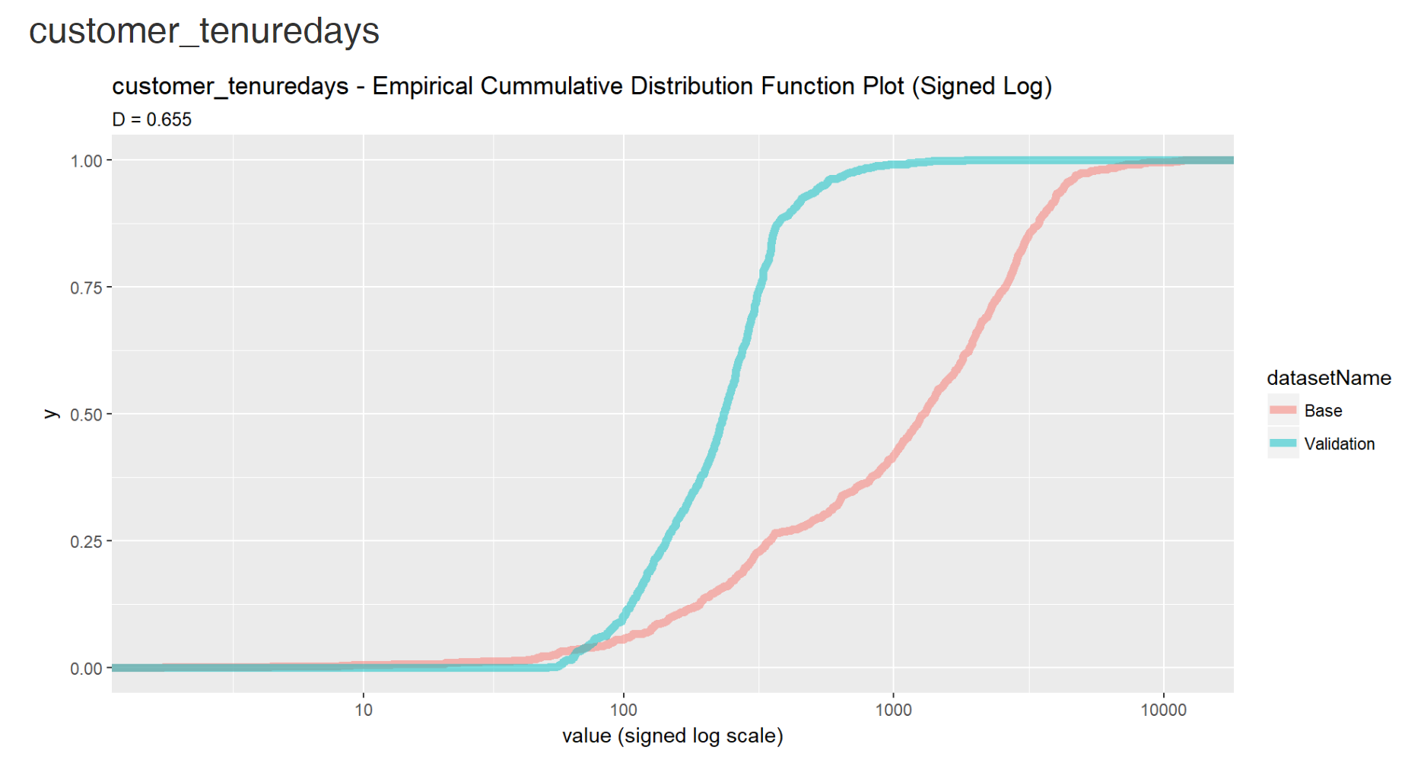
Detecting Differences between Train & Score Data
Kolmagorov-Smirnov test is one measure used to detect differences

Slide 22
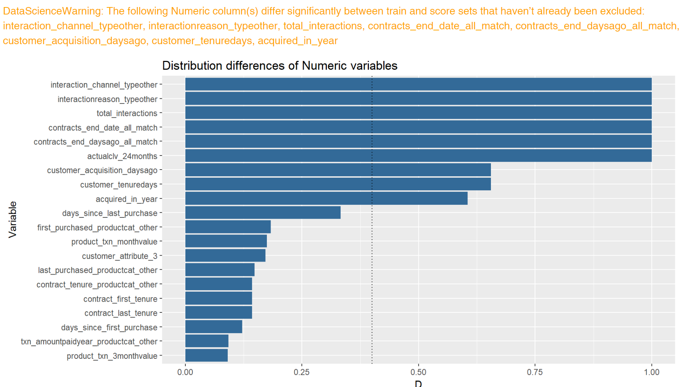
Overview of Numeric Columns which Differ (using KS-Test)

Slide 23
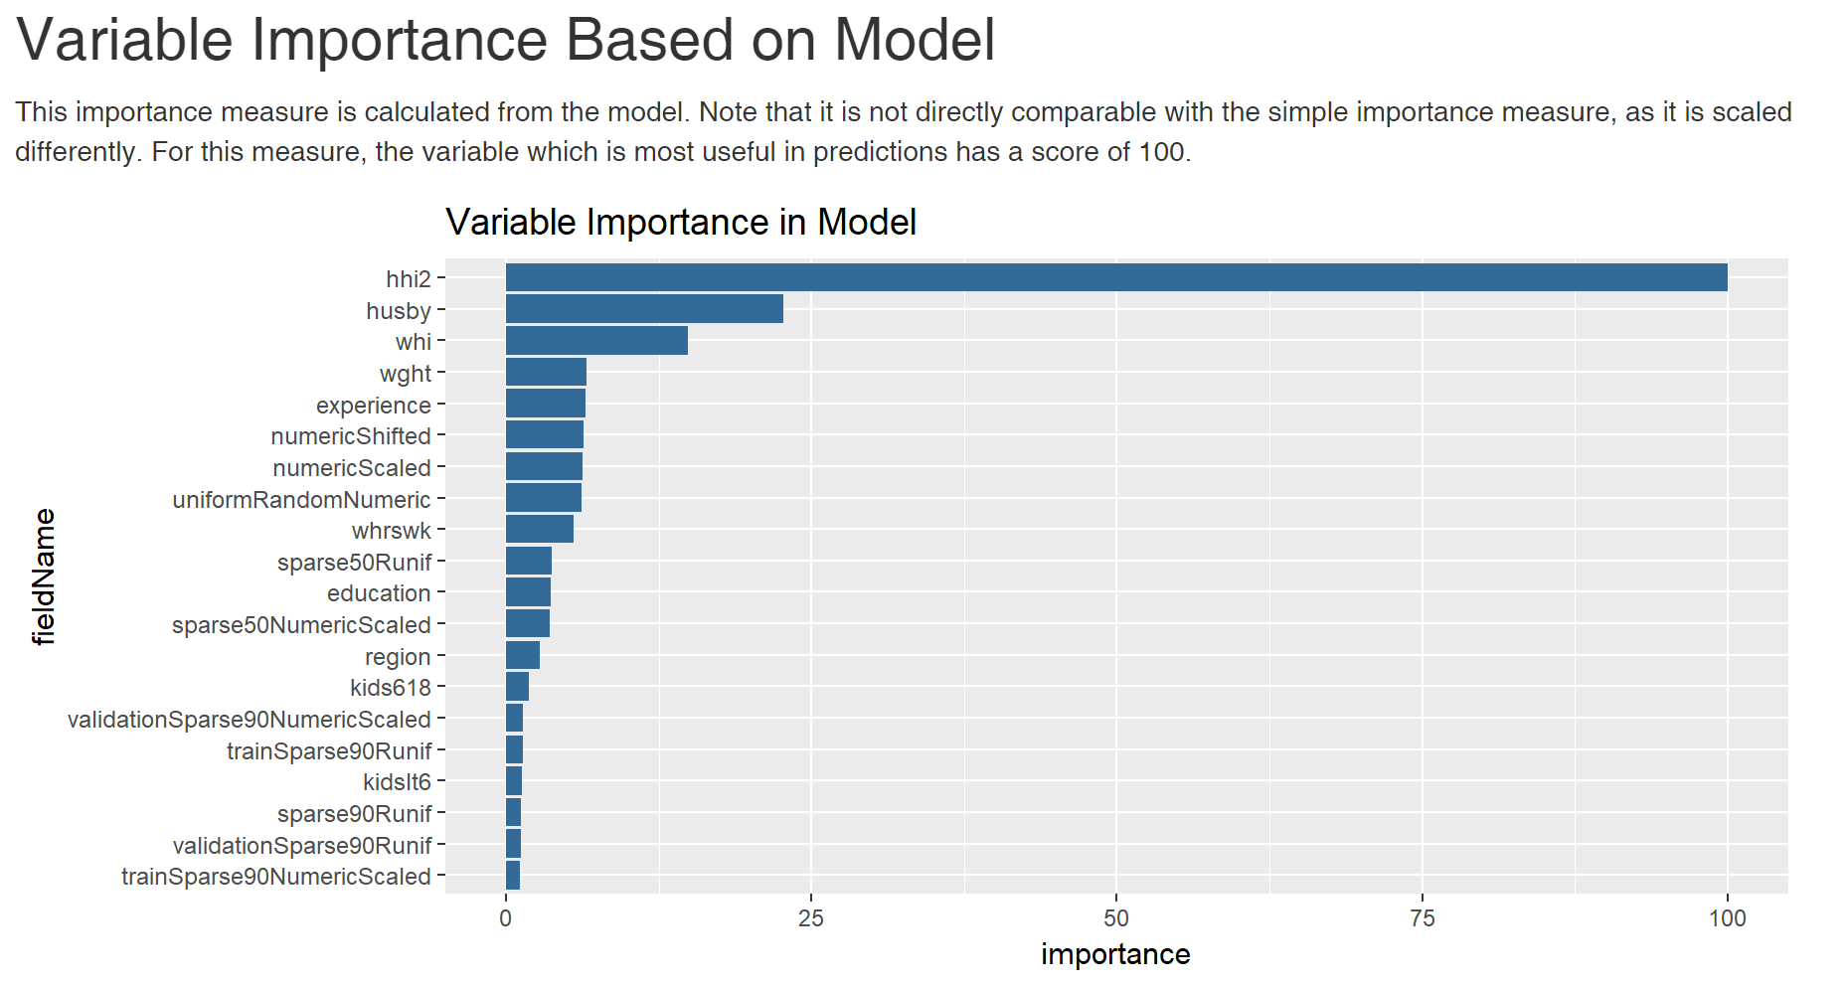
What Variables Influence Model?

Slide 24
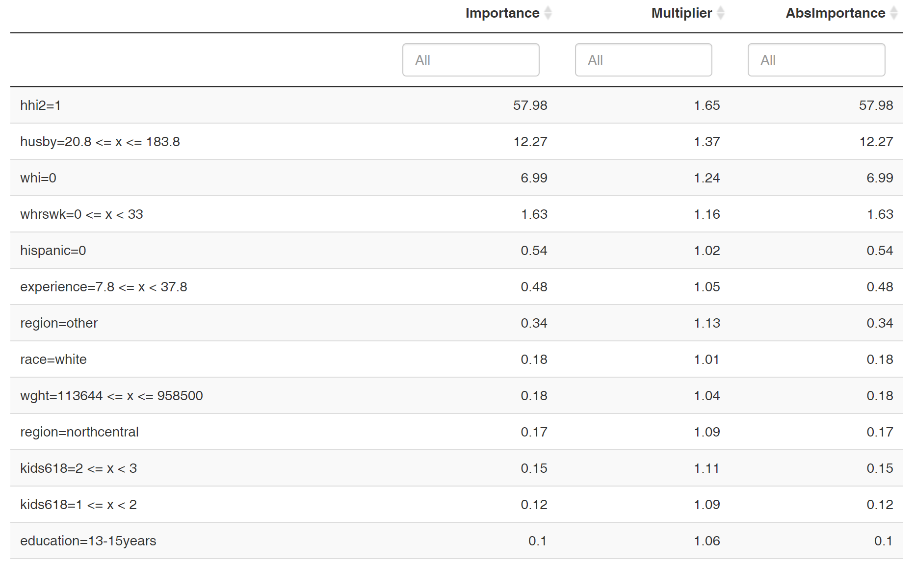
What Values of Variable Matter?

Slide 25
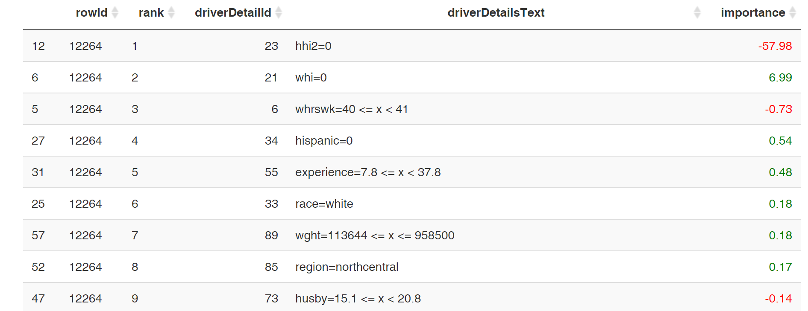
What Influences an Individual Prediction?

Slide 26
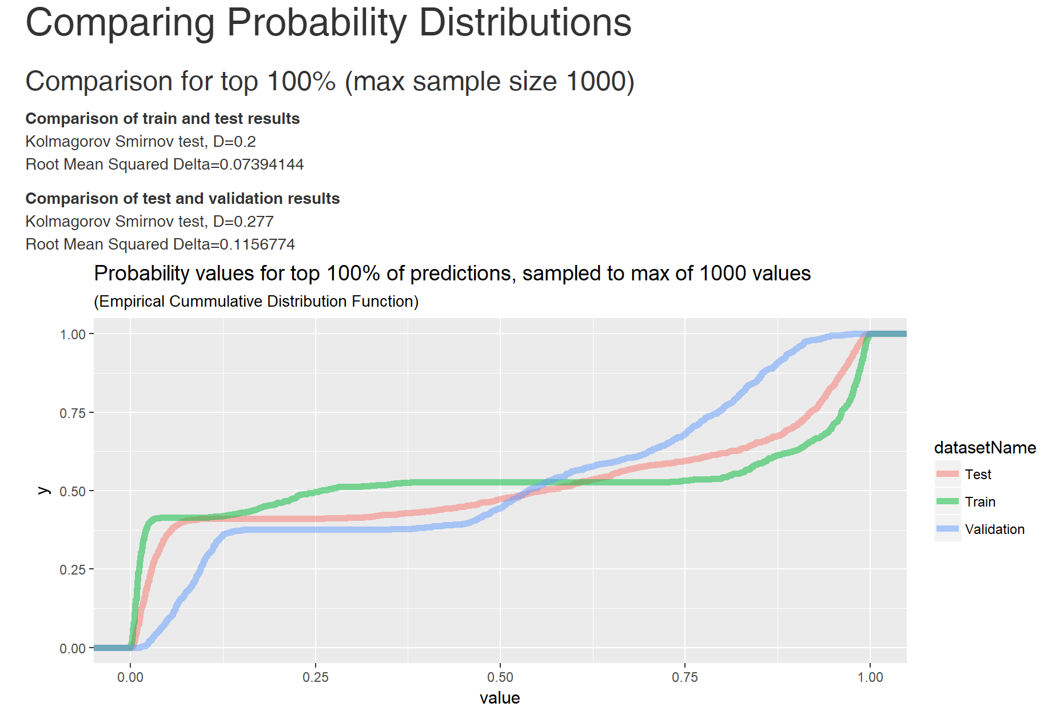
Comparing Distributions of Predictions

