Slide 1
Critical Thinking:
What is It?
Why is it Important?
How Does it Improve Teaching and Learning?

Slide 2
Active Engagement In Lecture
Person A states his/her understanding of what has been said, then elaborates.
Person B agrees or disagrees with the interpretation, or adds to the interpretation, then gives an example of it, relating the idea to something in life.

Slide 3
Active Engagement In Lecture (cont.)
Person B states his/her understanding of what has been said, then elaborates.
Person A agrees or disagrees with the interpretation, or adds to the interpretation, then gives an example of it, relating the idea to something in life.

Slide 4
Why Concern
Ourselves With
Thinking?

Slide 5
Because whenever we are dealing with human life, we are almost always dealing with thinking.

Slide 6
Thinking is the way that the mind makes sense of the world.

Slide 7
There is no way to understand anything except through thinking.

Slide 8
Thinking tells us:
what there is
what is happening
what our problems are
what our options are
what threatens us
what is important
what is unimportant
who our friends are
who our enemies are
what our “history” is
who we are
who loves us

Slide 9
Thinking determines:
what we learn
how we learn
what we think is important to learn
what effort we should expend
what we think is true
what we think is false
how things should be viewed
whether our learning is of high or low quality
whether our learning is deep or superficial

Slide 10
Everything we know, believe, want, fear and hope for, our thinking tells us.

Slide 11
Think of some problem behavior your students engage in.
See if you can identify the thinking that leads to the behavior.

Slide 12
Thinking
is
the core
of the curriculum

Slide 13
Critical Thinking
Is a Self-Directed Process
By Which We Take Deliberate Steps
To Think at the Highest Level of Quality.

Slide 14
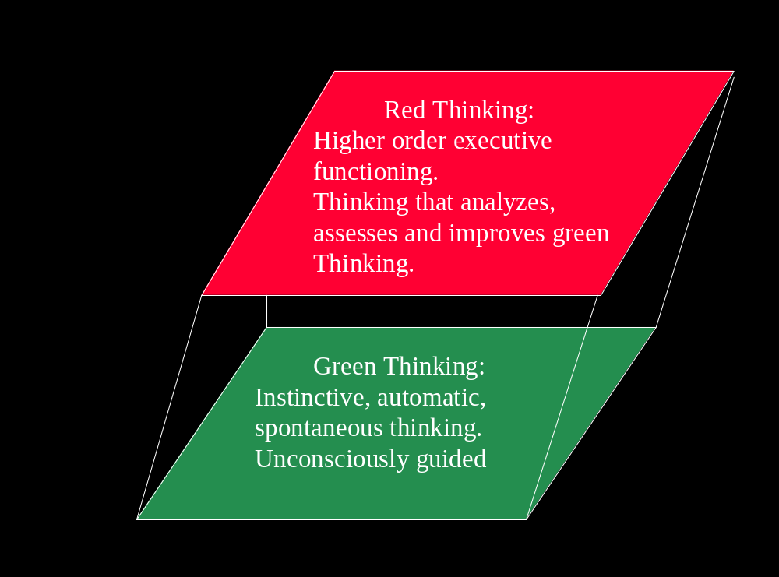

Slide 15
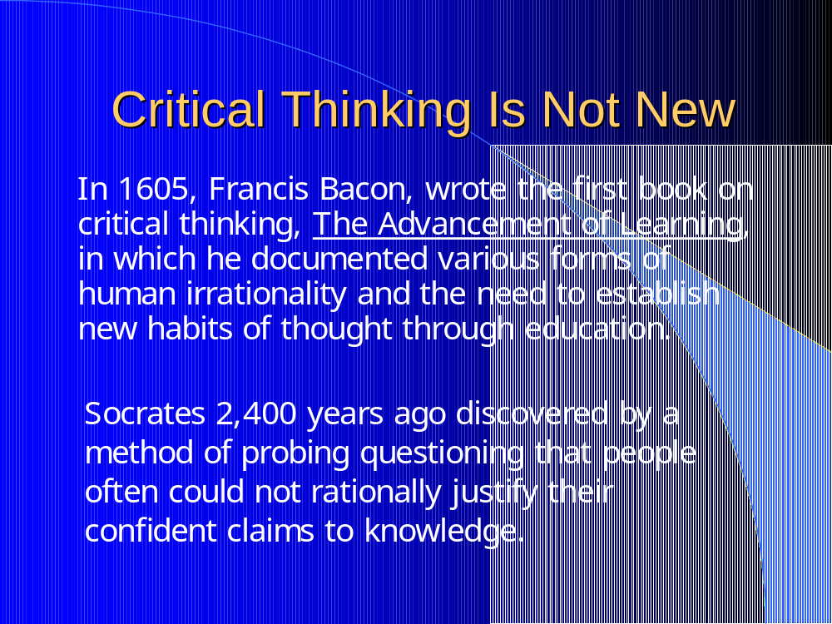

Slide 16
Green Thinking
Unconscious Mixture Of High Quality
And Low Quality Thinking
Spontaneous Subconscious Uncontrolled
Impulsive Self protecting Unanalyzed
Reflexive Self validating
Includes ideas that are valid, as well as nonsense, confusion, stereotypes, prejudices. The key is that we cannot distinguish the difference between high and low quality thought in green thinking mode.
Green thinking goes without assessing itself.

Slide 17
Red Thinking
Red Thinking stops and assesses itself before going forward.
Disciplined Seeks the truth Self assessing
Critical Thinking Self correcting Probing
In red thinking mode, we actively work to eliminate prejudices, biases, dysfunctional thinking from our thinking. We actively work on our thinking.
We rigorously apply intellectual standards to our thinking.

Slide 18
The Critical Thinking Mind
=
The Educated Mind

Slide 19
Read
It
Write
It
Substantive
Learning
Hear
It
Apply
It
Say
It

Slide 20
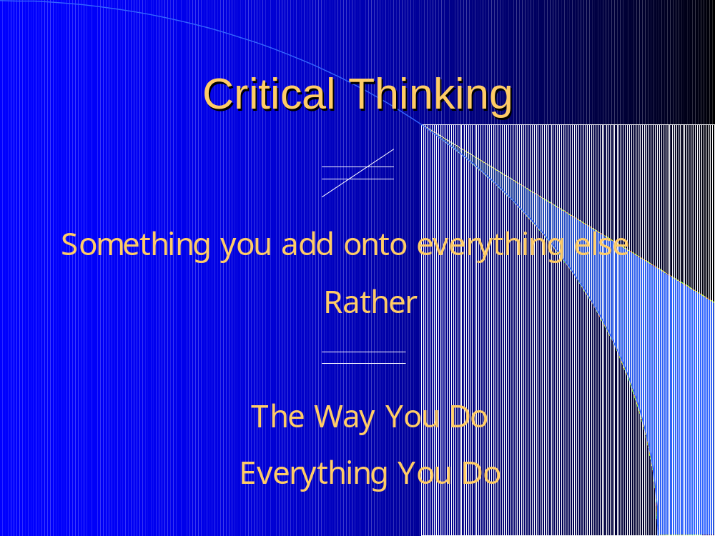

Slide 21
Activity: What is Critical Thinking?
To be clear in writing:
1) state
2) elaborate (In other words…)
3) exemplify and/or illustrate
Write out the most important thing you know about critical thinking, in this form:
1) Critical thinking is …..
2) In other words…
3) For example of…

Slide 22
Think for Yourself: 1-1
Beginning to
Think About Your Thinking
To begin to think about your thinking, make a list of any problems you believe currently exist with your thinking. Try to be as explicit as possible. The more problems you identify the better. For each problem you identify, complete the following statements:
1. One problem with my thinking is…
2. This is a problem because…
3. If I adequately addressed this problem, the quality of my life would improve in the following ways…

Slide 23
Think for Yourself: 1-2
Critique Your Thinking
Consider your thinking in these domains of your life: at work, in personal relationships, in teaching, in intimate relationships, as a reader, as a writer, in planning your life, in dealing with your emotions, in figuring out complex situations. Complete these statements:
Right now, I believe my thinking across all domains of my life is of ______________ quality. I based this judgment on _________________.
1. In the following areas, I think very well…
2. In the following areas, my thinking is OK, not great, but not terrible either…
3. In the following areas, my thinking is probably of low quality…
List at least three areas for each of the above.

