Slide 1
JDBC
M K
Codinghub.org.in

Slide 2
PRINT RESULT SET IN BOTH DIRECTIONS
Result set interface constant is TYPE_SCROLL_SENSITIVE
TO RETRIEVE THE DATA IN FORWARD DIRECTION WE WILL USE rs.next() method and TO RETRIEVE THE DATA IN BACKWARD DIRECTION WE WILL USE rs.previous();

Slide 3
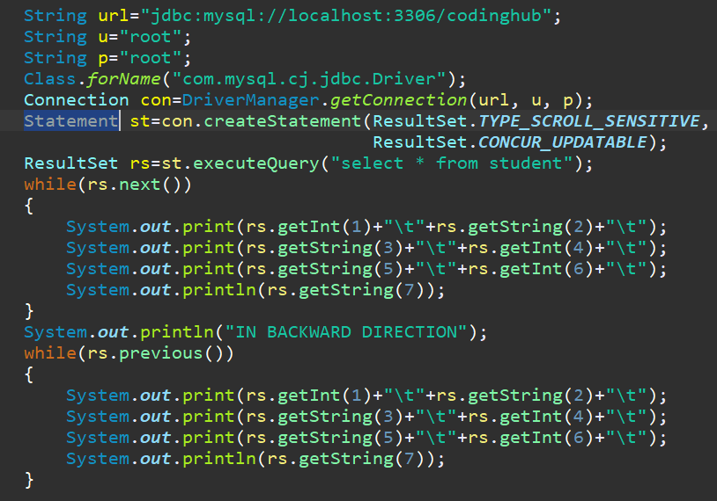

Slide 4
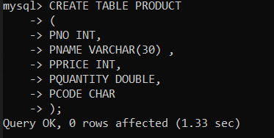

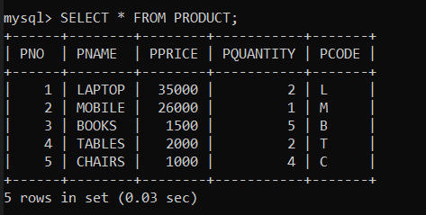

Slide 5
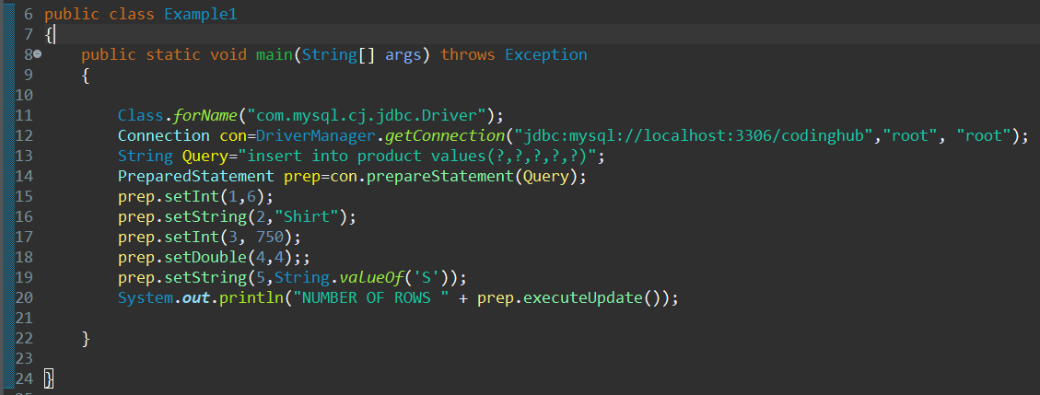

Slide 6
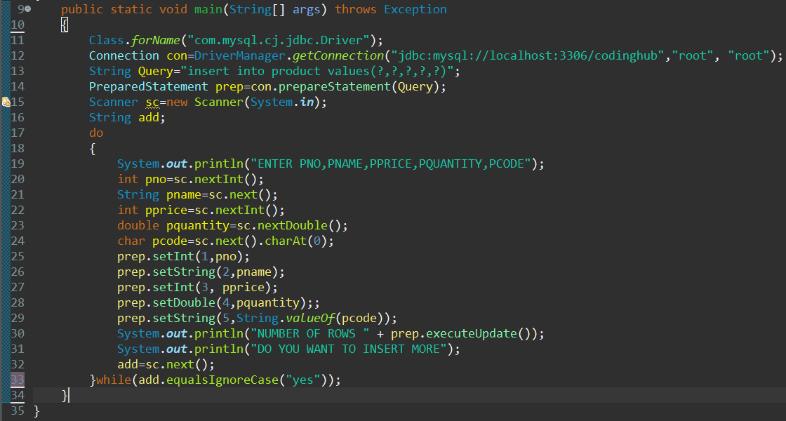

Slide 7
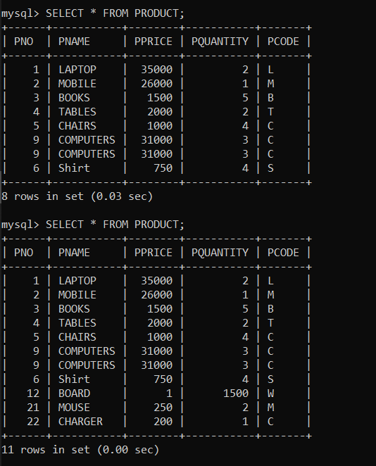

Slide 8
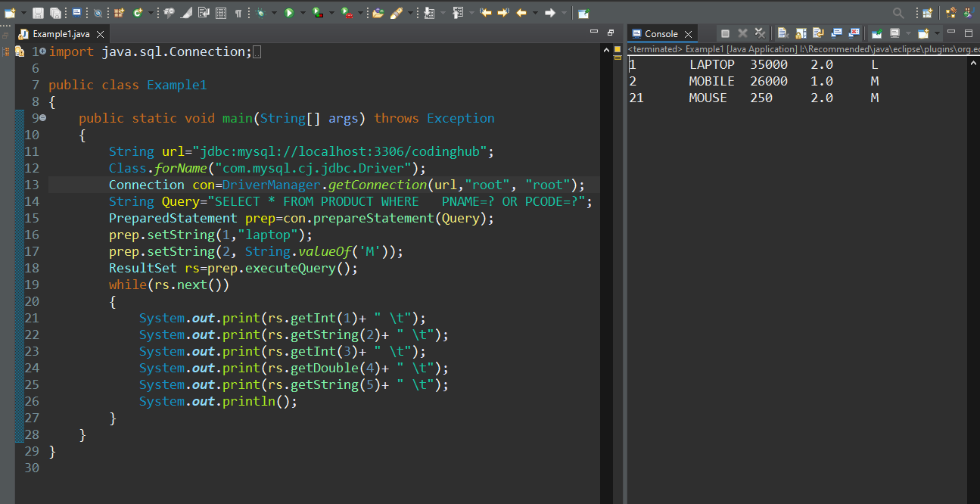

Slide 9
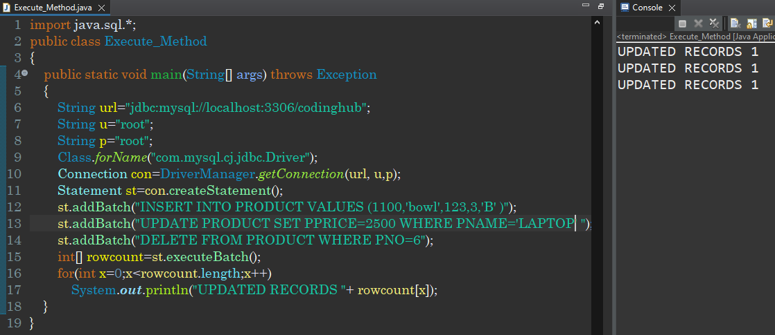

Slide 10
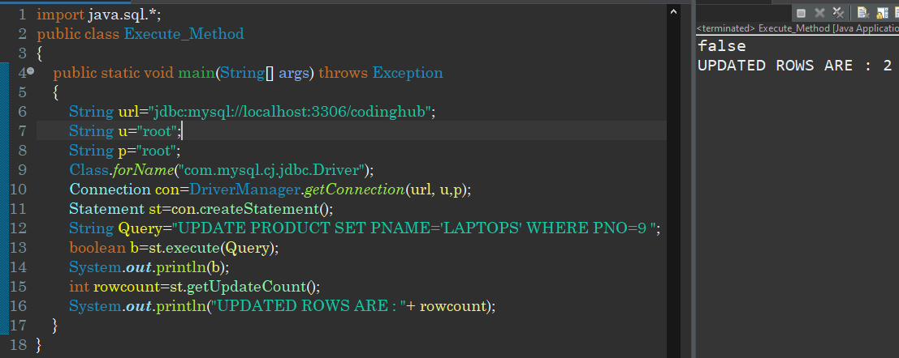

Slide 11
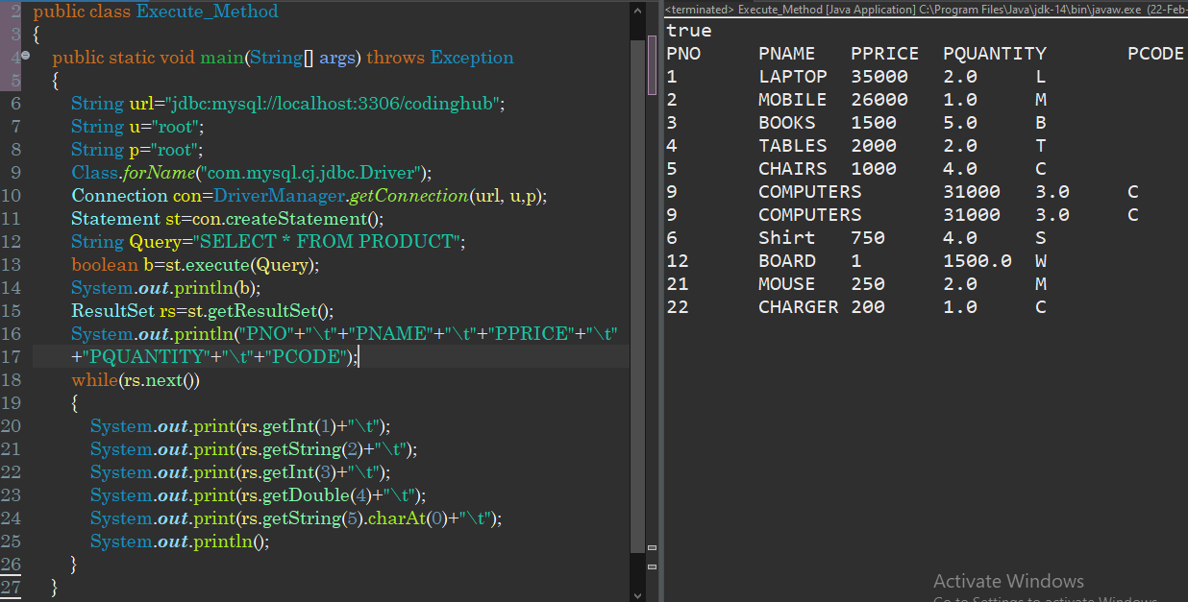

Slide 12
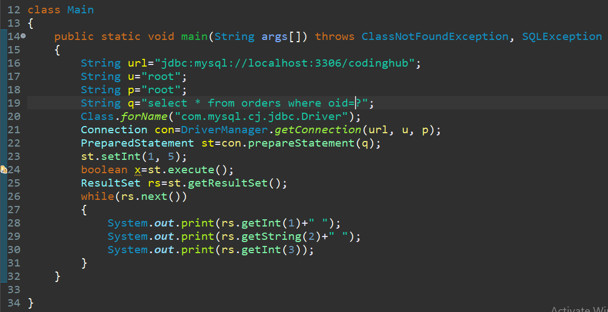

Slide 13
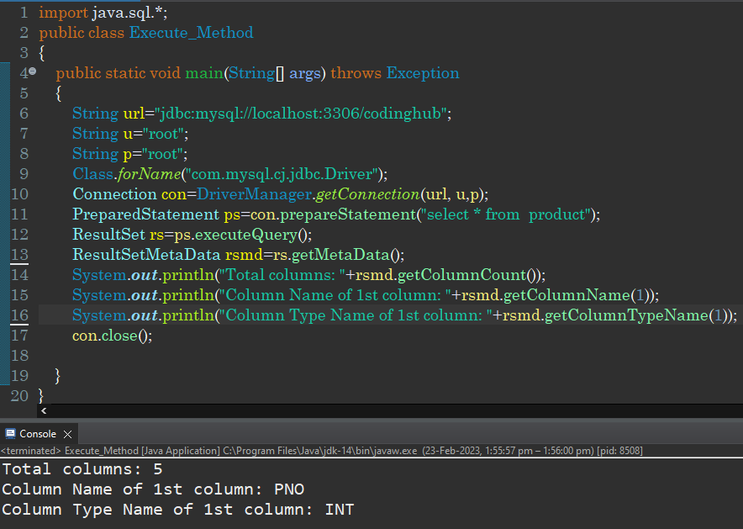
Result Set Meta Data

Slide 14
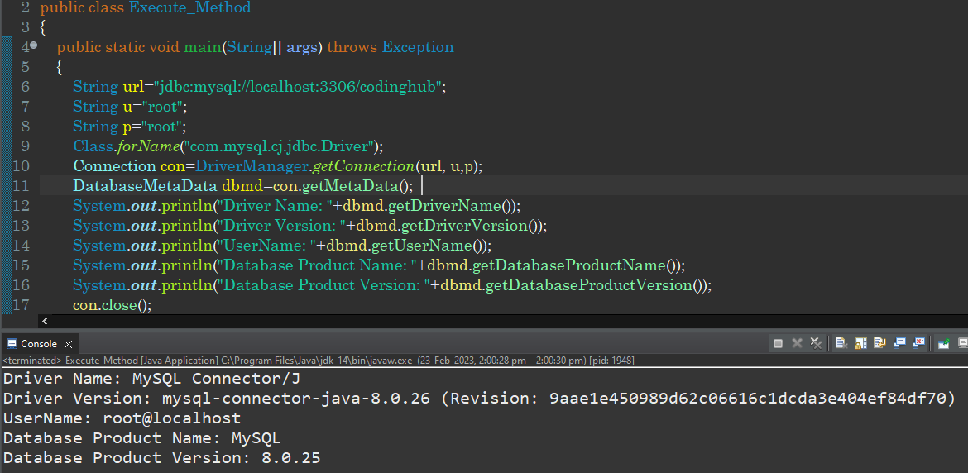

Slide 15
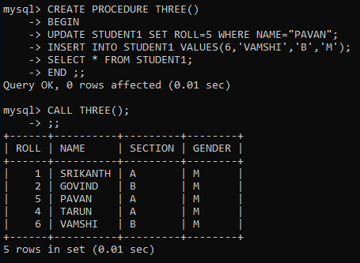
CALLABLE STATEMENT

Slide 16
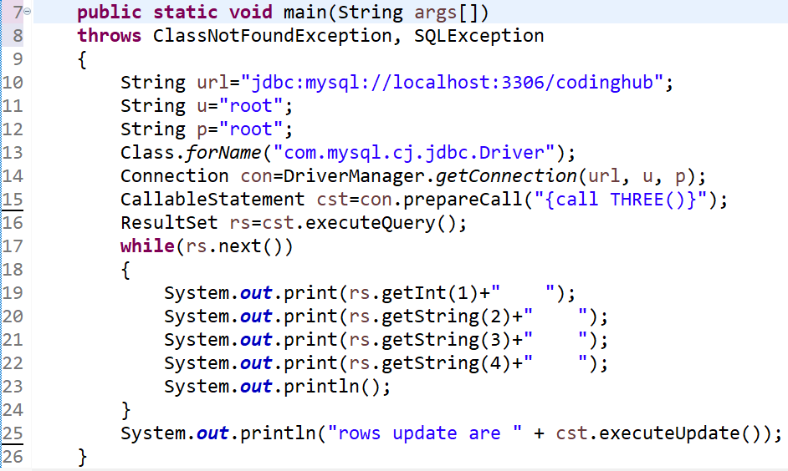

Slide 17

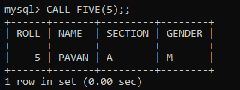
WITH PARAMETERS

Slide 18
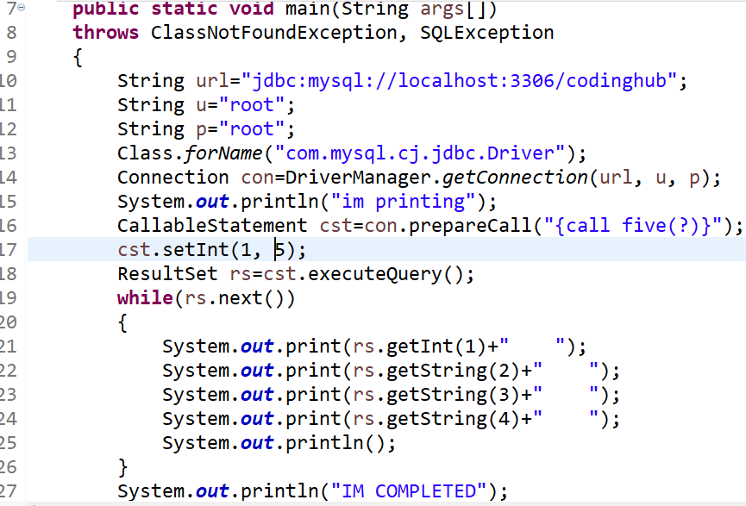

Slide 19
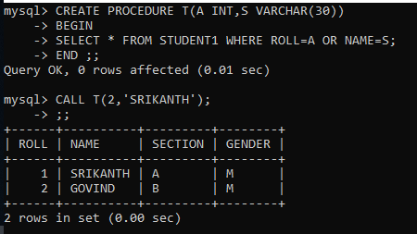

Slide 20
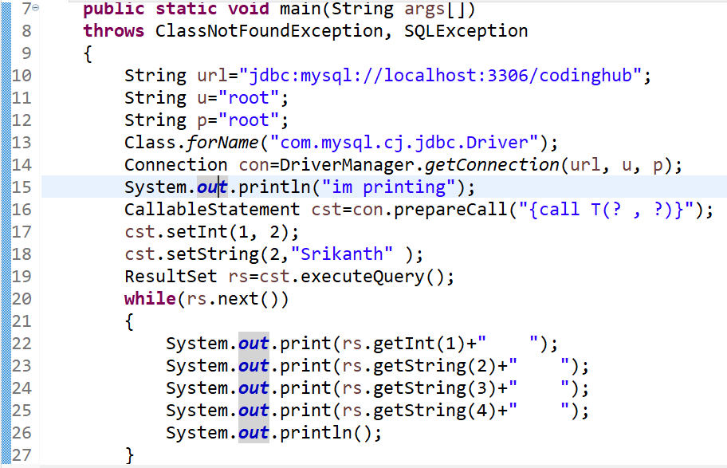

Slide 21
USING DTO

Slide 22
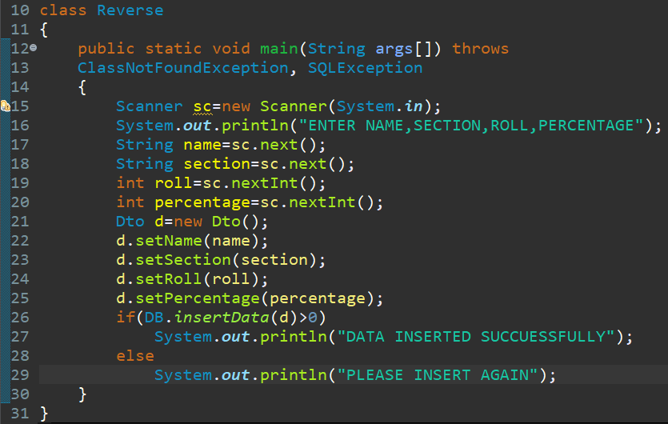

Slide 23
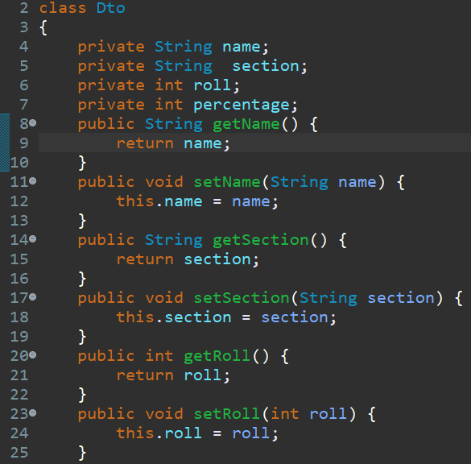

Slide 24
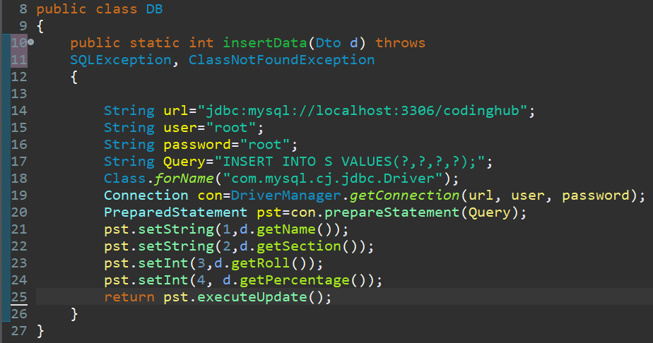

Slide 25
Standard

Slide 26
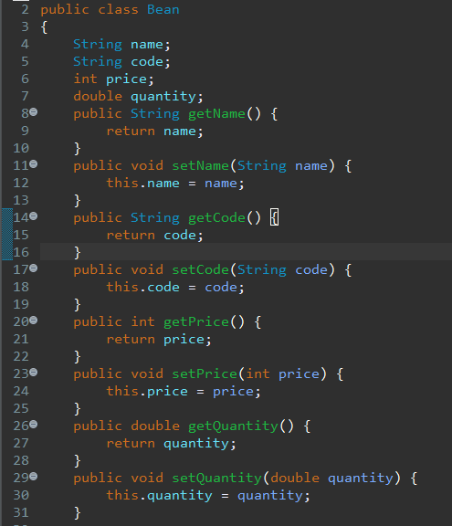

Slide 27
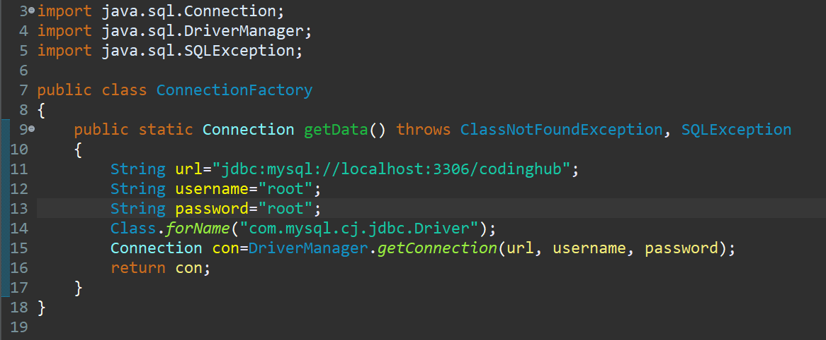

Slide 28


Slide 29
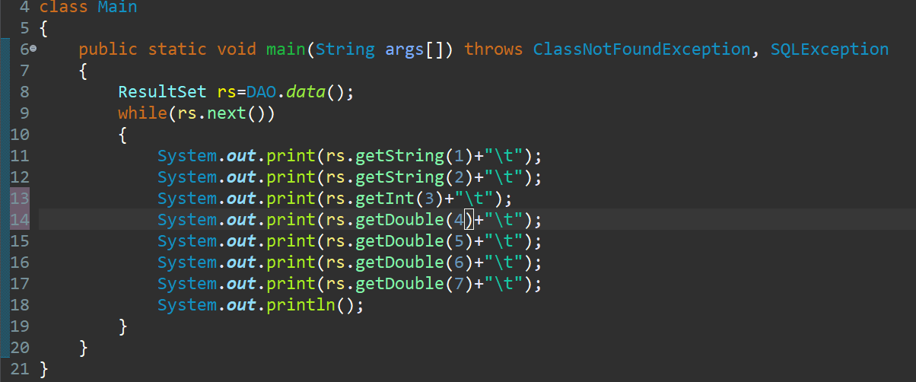

Slide 30
NON SELECT

Slide 31
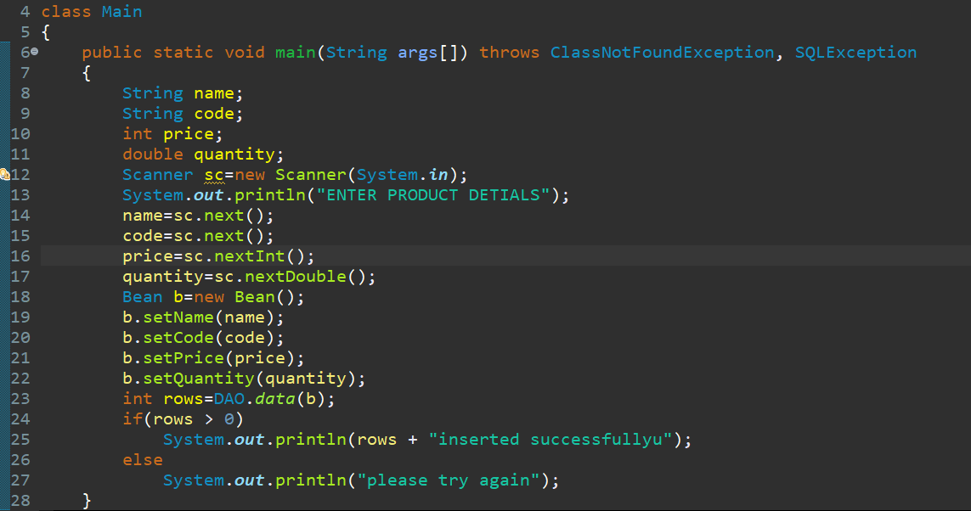

Slide 32
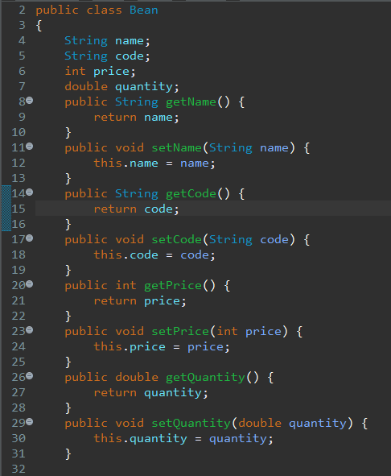

Slide 33


Slide 34
