Slide 1


Student Details
Name: - Mouni Sri Nallapaneni
Roll no: - AP22110010129
Email id:- nallapanenimounisri@gmail.com
Branch:- CSE
College Name:- SRM UNIVERSITY AP
Organization: EDUNET(DGT)

Slide 2
EMPLOYEE BURNOUT PREDICTION -USING LINEAR REGRESSION
Problem Statement
Employee burnout is a severe problem that has a big influence on both productivity within the company and personal well-being. The goal of this project is to develop a regression-based predictive model that can forecast employee burnout based on multiple factors. Analyzing data such as workload, performance indicators, and behavioral patterns to predict when an employee may burn out. This method assists in spotting signs of exhaustion or lower productivity, enabling employers to intervene and provide assistance and adjustments to minimize burnout and assure their employees' continuous health and efficiency

Slide 3
AGENDA
References
Project Overview
Analyzing the data
Outcome
Applications
Links

Slide 4
PROJECT OVERVIEW
Employee Burnout is a condition of extreme physical, mental, and emotional tiredness caused by prolonged stress. . This may have a negative impact on employee's health and productivity inside the company.
Here are a few symptoms:
Tiredness/Exhaustion: A constant feeling of exhaustion.
Ineffectiveness: Decreased focus and performance.
Negative feelings: Include annoyance and disappointment.
Health Problems: Chronic stress-related increases in sickness
Early detection, encouraging a work-life balance, providing support, and cultivating a positive work environment are all important components of preventing burnout.

Slide 5
END USERS of this project
.
The end users of this project are those who seek advantages from the early identification and management of employee burnout.
Human Resource Professionals:- Implement focused interventions in an efficient manner and create long-term, beneficial plans for employee well-being.
Managers: to precisely identify and proactively assist team members who are in danger of burnout.
Employees: To raise awareness of burnout, make helpful resources widely accessible, and strongly encourage self-care routines.
Executives and Senior Management: They may utilize aggregated data to make strategic choices about corporate health plans, workplace enhancements, and policies.

Slide 6
YOUR SOLUTION AND ITS VALUE PROPOSITION
.
Solution Overview
Data Integration: Optimizes operations by seamlessly integrating with project management and HR systems
Predictive Modeling: Utilizes advanced AI technology to forecast trends and detect risks proactively
Real-time Insights: Gives constant updates and analysis for useful information.
Personalized Interventions: Design customized strategies to proactively prevent and address employee burnout
Value Proposition
Cost Efficiency: Lowers turnover and healthcare expenses, improving overall organizational efficiency.
Compliance and Reporting: Guarantees regulatory compliance with detailed analytics for well-informed decision-making.
Employee Engagement: Increases satisfaction and cultivates a culture of strong engagement and positivity.

Slide 7
How did you customize the project and make it your own
Data Collection
Model Selection
Machine learning models are selected based on their suitability for student data.
Model Training
The model was trained on the collected data to predict student burnout.
Survey data on various burnout-related factors was gathered from students.
Model Evaluation
The model's performance was assessed using appropriate metrics.

Slide 8
MODELLING
Data Collection: Employee surveys covering various burnout factors were gathered and analyzed
Data Preprocessing: Data was cleaned, transformed, and readied for training the model.
Model Selection: A machine learning algorithm was chosen that best fit the data and project objectives
Model Training: The selected model was trained using the well-prepared employee data set.
Model Evaluation: The model’s accuracy and reliability were tested using relevant performance metrics

Slide 9
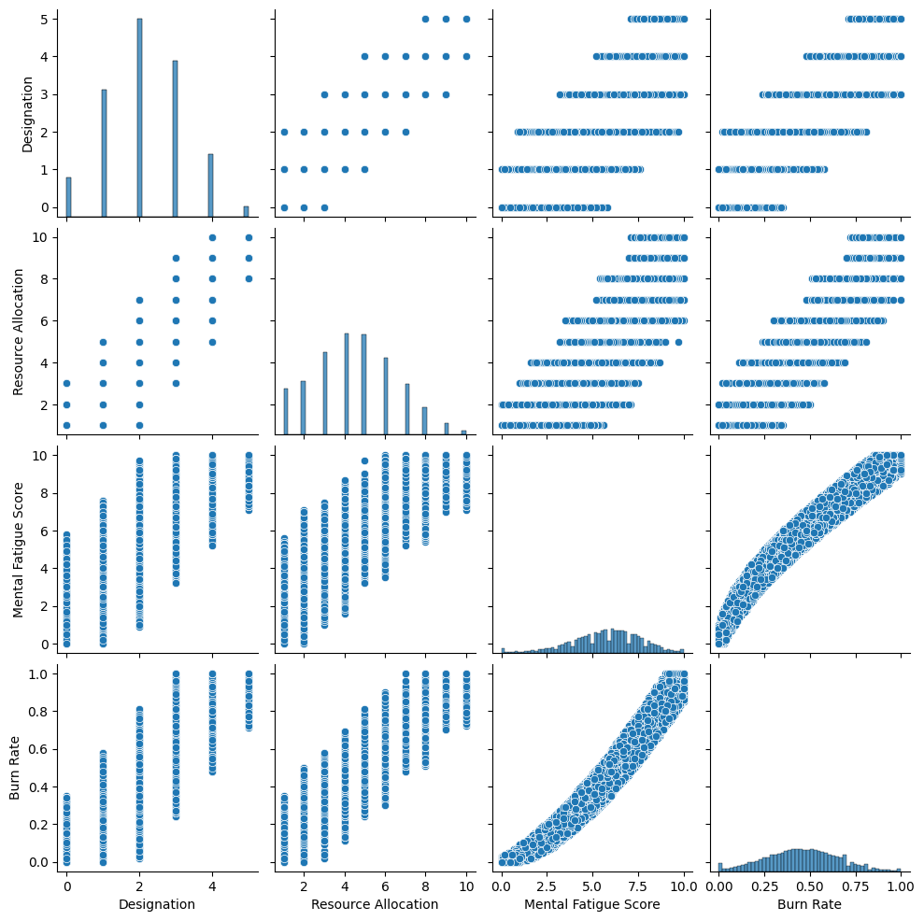
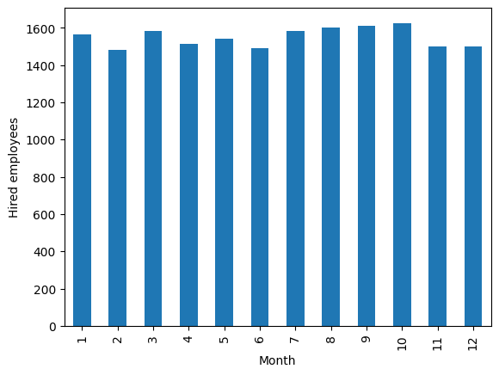
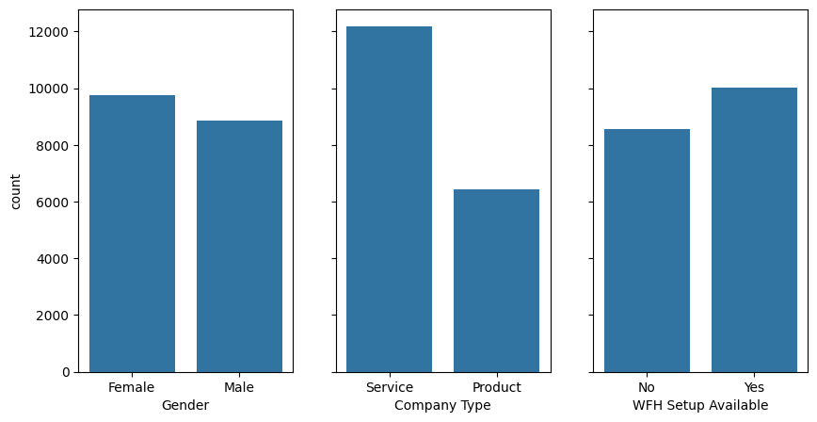
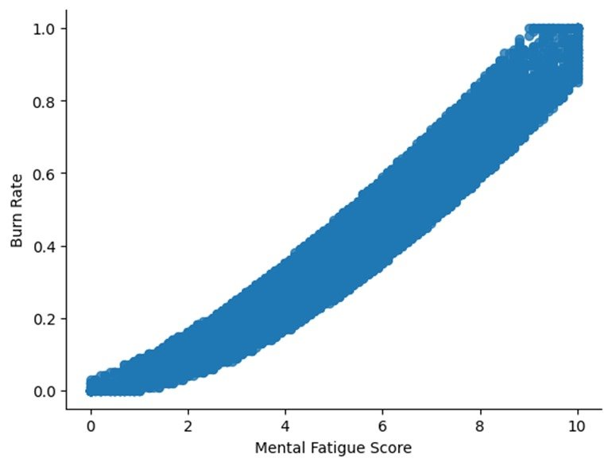
Results
The model was very precise in forecasting employee burnout and identifying significant factors to burnout. These insights offer valuable guidance for crafting targeted intervention strategies to enhance employee well-being

Slide 10
links
Google collab link- https://colab.research.google.com/drive/1IhzBqykxslwRYTGiAginkSsbJlVVKHBi?usp=sharing
GitHub link- https://github.com/MouniSri039/Employee_burnout_prediction-project/tree/main
-Thankyou

