Slide 1
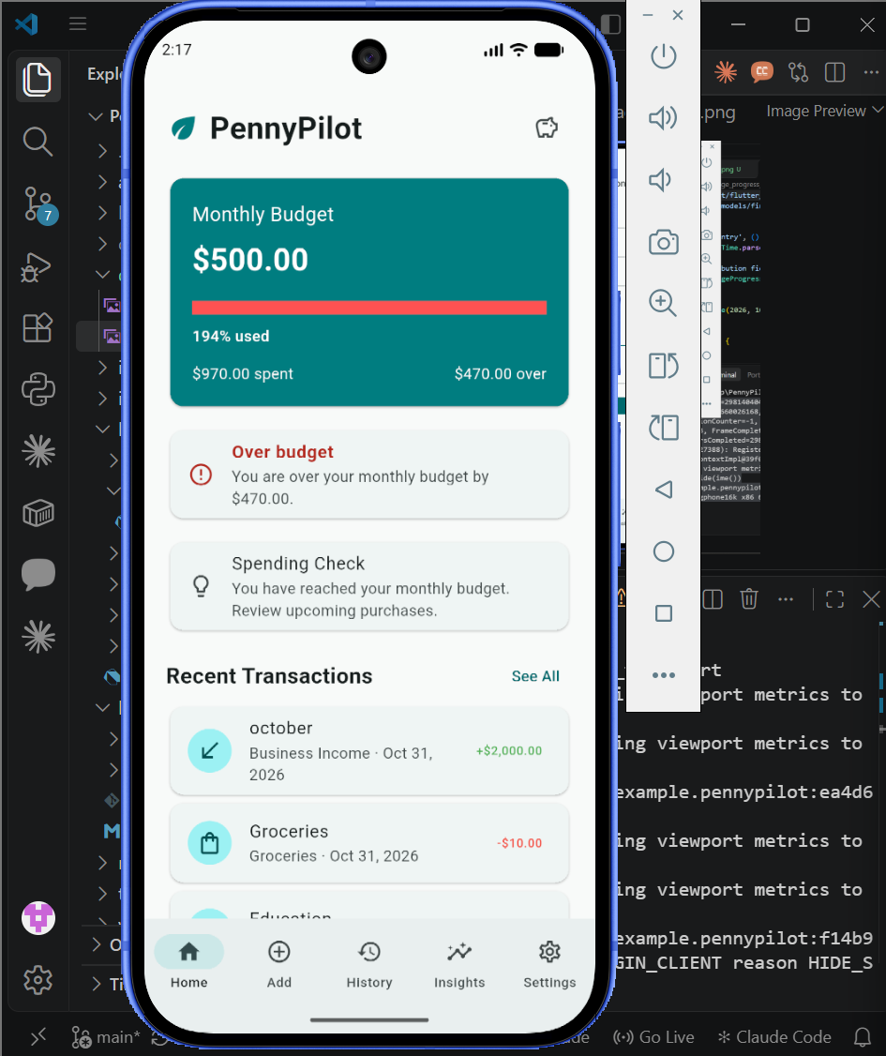
FINAL PROJECT • FLUTTER • FALL 2026
PennyPilot
Student Finance Management App
Track money. Plan budgets. Build better saving habits.
Akshitha Sainath Sanagarapu • Mouni Sri Nallapaneni
PennyPilot | Akshitha & Mouni
01

Slide 2
PROJECT OVERVIEW
The problem we wanted to solve
Small expenses add up, but are easy to forget.
Our approach
One offline Flutter app for daily transactions, budgets, savings challenges and spending insights.
Tracking income, budgets and savings separately takes effort.
We wanted a simple app that still works without internet.
PennyPilot | Akshitha & Mouni
02

Slide 3
MAIN FEATURES
What we built
Transactions
Budgets
Savings
Add, edit, delete and search income or expenses.
Set limits and check spending against them.
Create challenges and update progress.
Insights
Spending helper
Offline use
See category totals and charts.
Get a local, rule-based suggestion.
Keep records on the device.
PennyPilot | Akshitha & Mouni
03

Slide 4
APP WALKTHROUGH • I1
Dashboard: where everything starts
See a quick overview of income and expenses.
Move between the main app sections.
Updated records are reflected in the summary.
PennyPilot | Akshitha & Mouni
04

Slide 5
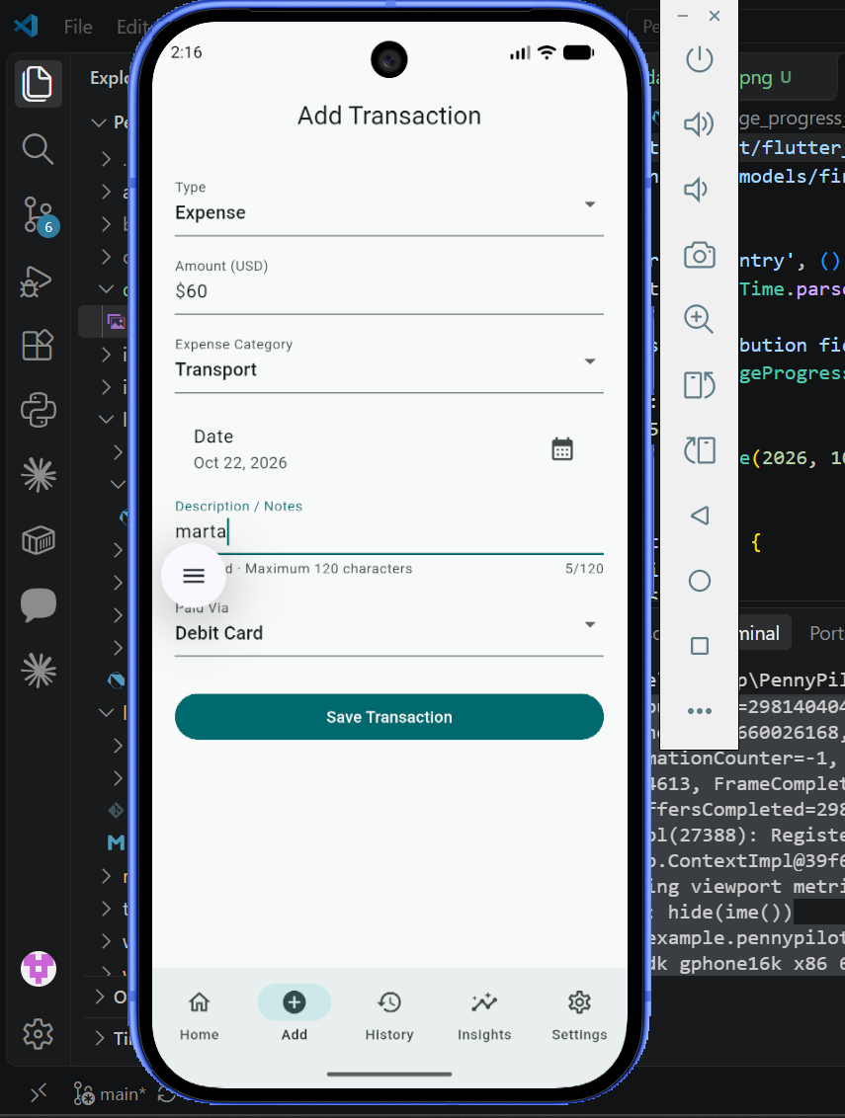
APP WALKTHROUGH • I2 / D1
Adding a transaction
Demo steps
1. Enter an amount and category.
2. Save the transaction.
3. Check the updated history.
PennyPilot | Akshitha & Mouni
05

Slide 6
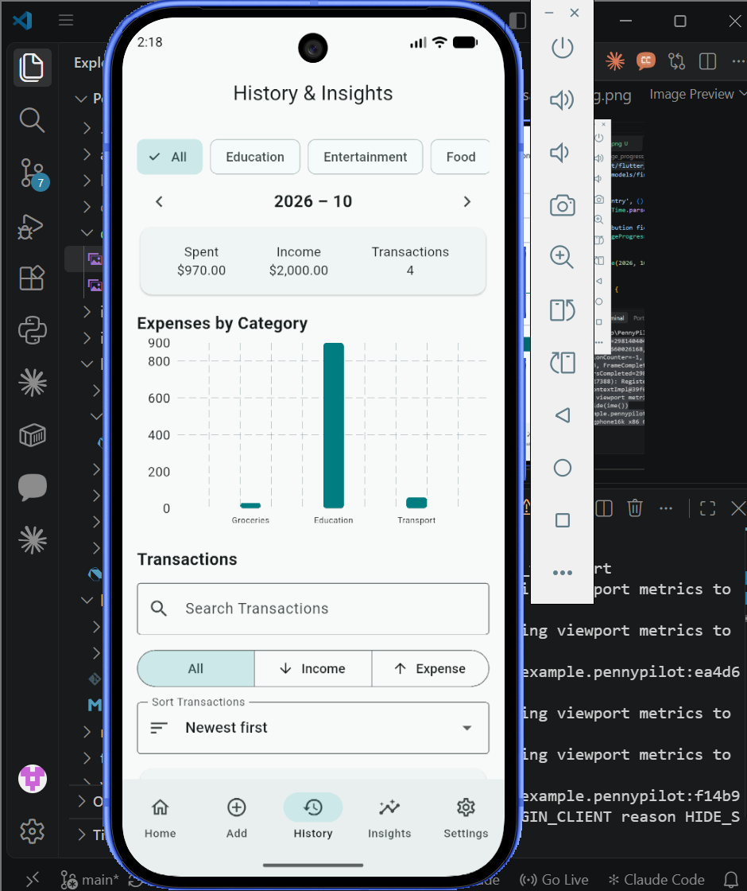
APP WALKTHROUGH • D1
Managing past transactions
Search and filter past records.
Edit a record and check the updated amount.
Delete a record and confirm it disappears.
PennyPilot | Akshitha & Mouni
06

Slide 7
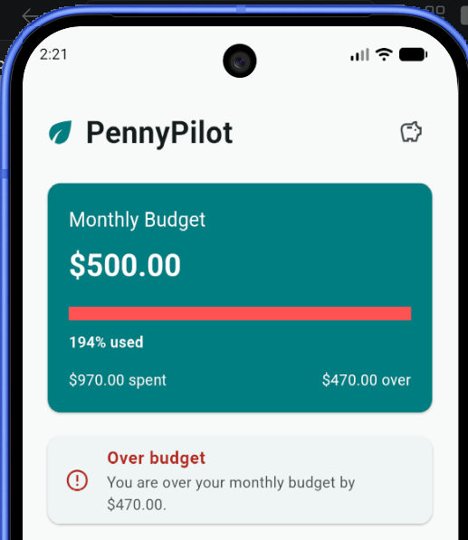
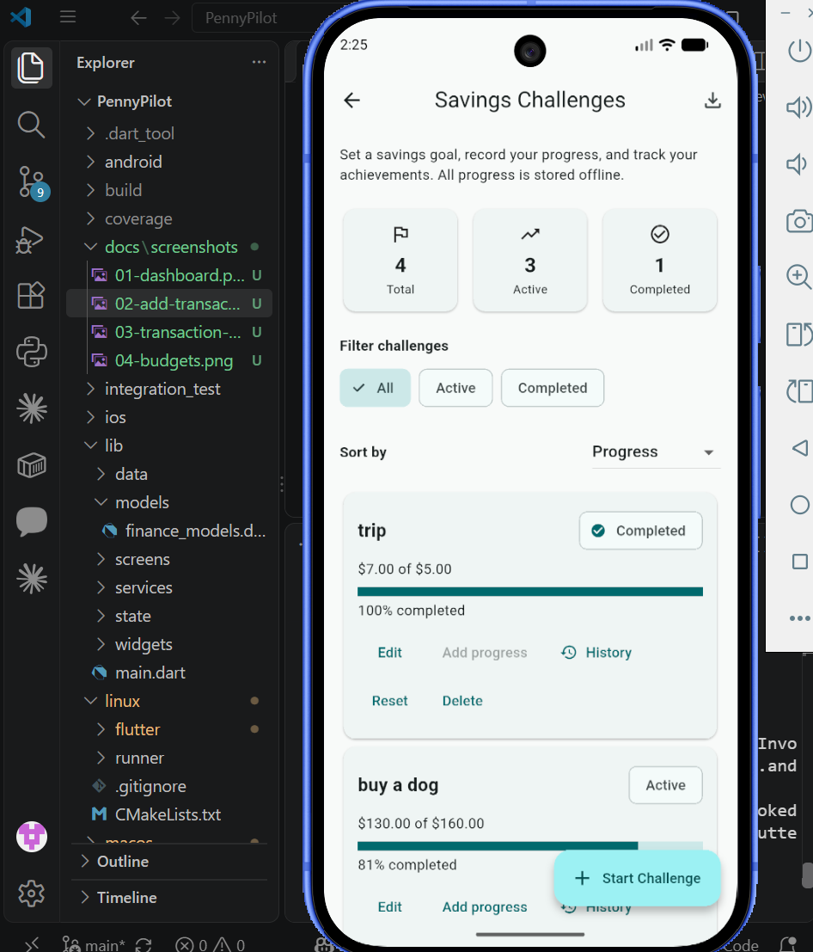
APP WALKTHROUGH
Budgets and savings challenges
Demo: show a budget limit, then open a savings challenge and its progress.
PennyPilot | Akshitha & Mouni
07

Slide 8
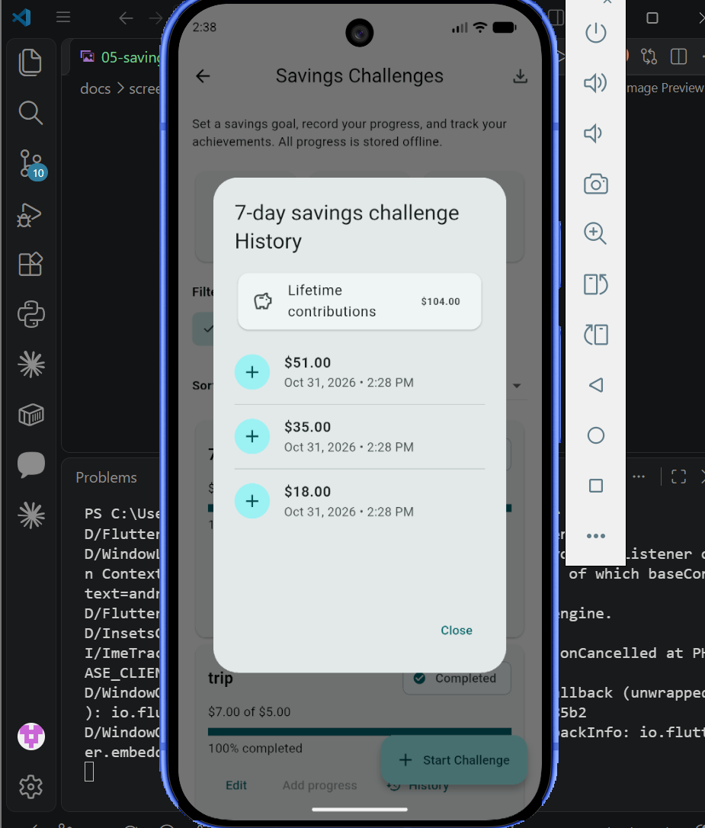
APP WALKTHROUGH
Following savings progress
Why this matters
Instead of only recording expenses, we also wanted a way to follow a saving target over time.
PennyPilot | Akshitha & Mouni
08

Slide 9
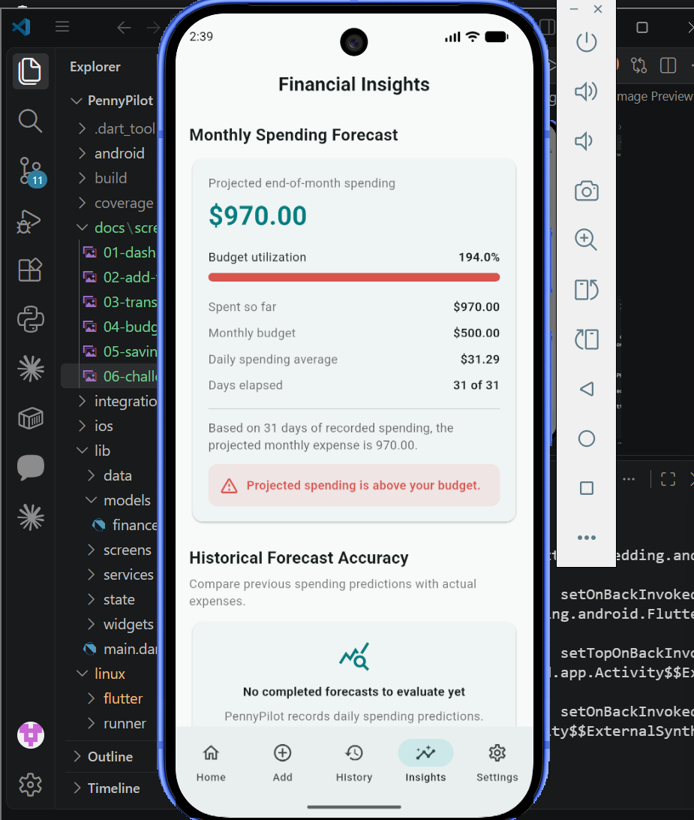
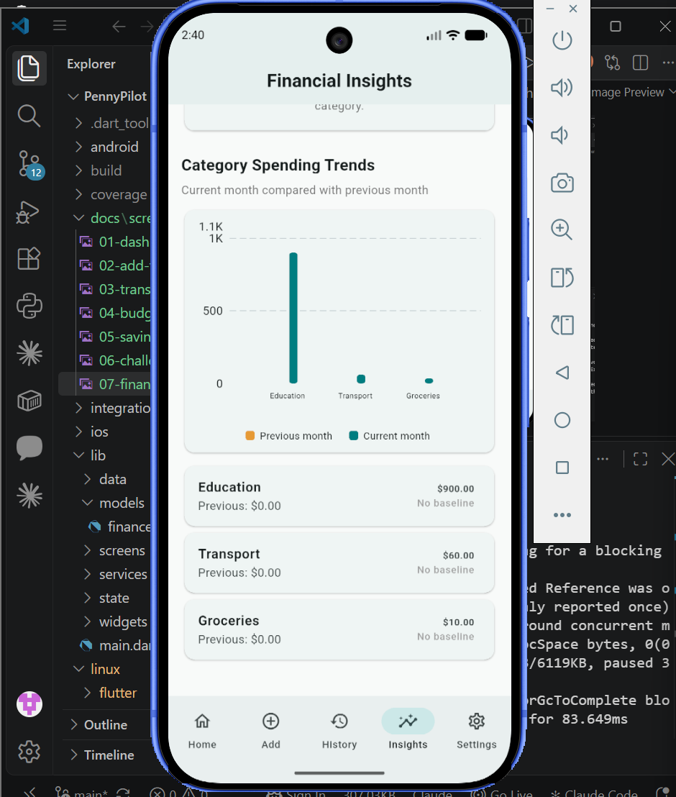
APP WALKTHROUGH
Understanding where money goes
Charts and category summaries make spending patterns easier to notice.
PennyPilot | Akshitha & Mouni
09

Slide 10
ARCHITECTURE • A1 / A3
How the app is organized
Flutter screens
Provider + models
Local storage
Forms, buttons, charts and navigation
→
Shared state and updated values
→
SQLite records + saved preferences
The UI shows the data; state and storage handle changes behind the scenes.
PennyPilot | Akshitha & Mouni
10

Slide 11
LOCAL STORAGE • D2 / D3
How we keep data offline
SQLite
SharedPreferences
Stores transaction records so they remain available after closing the app.
Keeps lightweight settings such as display preferences.
Turn off internet access.
Add a transaction and change a setting.
Close and reopen the app to check both are saved.
PennyPilot | Akshitha & Mouni
11

Slide 12
SMART FEATURE • R4
Our local spending helper
Input
Suggestion
Explanation
Uses the spending information available in the app.
Returns a simple recommendation based on rules.
We can explain why the suggestion was given.
It is a rule-based helper, not a trained machine-learning model.
During the demo: show the helper, a no-data case and the baseline comparison.
PennyPilot | Akshitha & Mouni
12

Slide 13
TESTING • T1 / T3
Testing and release checks
153
80.28%
0
automated tests passed
code coverage
static analysis issues
Android release APK built successfully
PennyPilot | Akshitha & Mouni
13

Slide 14
TEAMWORK • R1 / R2
Working as a team
GitHub
ClickUp
We used branches, commits and code review to manage changes.
We tracked tasks and project progress on our board.
Each of us will explain our own implementation work during the demo.
PennyPilot | Akshitha & Mouni
14

Slide 15
WRAP-UP
Demo plan and questions
Start with the dashboard and add a transaction.
Show budgets, savings and spending insights.
Explain Provider, local storage and the spending helper.
Finish with testing evidence and our selected Q&A.
github.com/MouniSri039/PennyPilot
PennyPilot | Akshitha & Mouni
15

