Slide 1
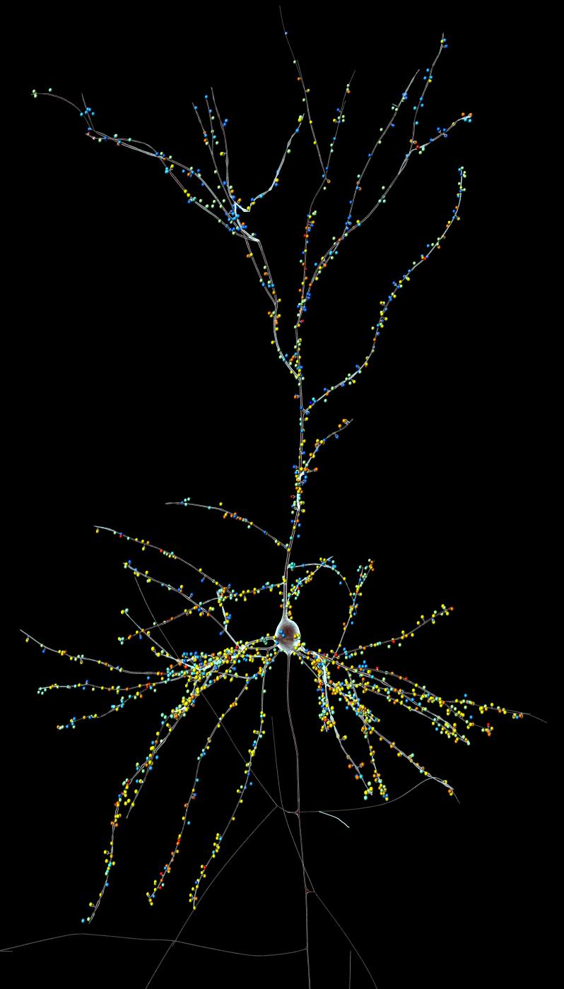
Dendrites Impact the Encoding Capabilities of the Axon
Guy Eyal and Idan Segev Hebrew University H. Mansvelder and C. De Kock (Amsterdam)
Journal of Neuroscience 2014

Slide 2
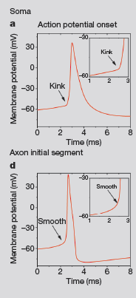
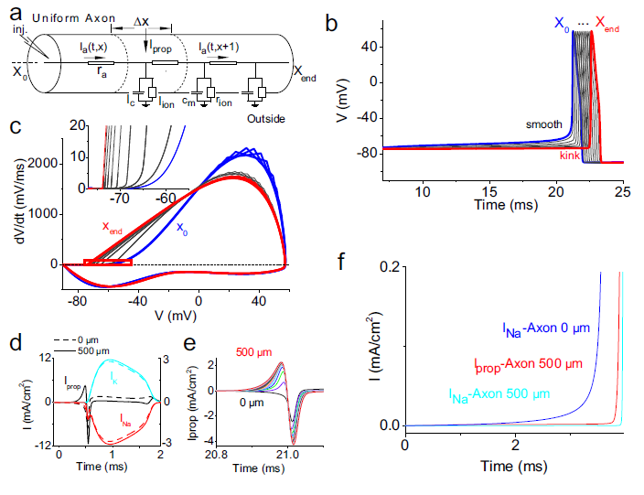
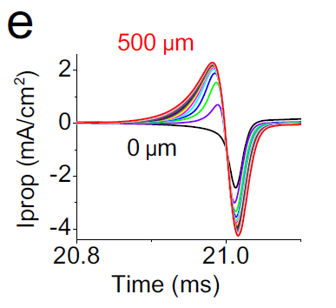
Motivation
F. Wolf vs. D. McCormick debate on origin of soma AP kinkiness
McCormick, Shu Yu, 2007
Yu, Shu McCormick, 2008
Notes:
Go over McCormick paper

Slide 3
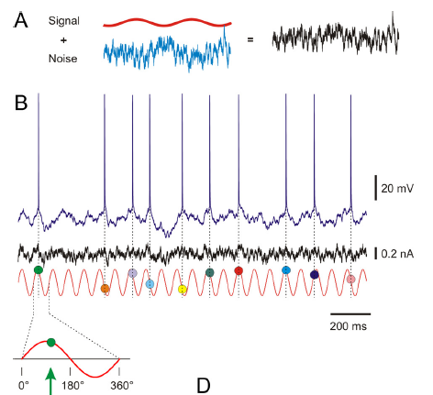
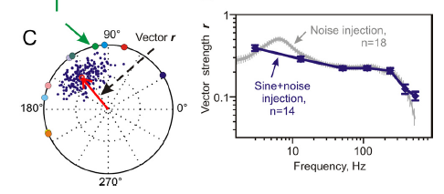
Motivation
2. Brunel and colleagues proving that AP onset rapidness markedly affects the tracking capability of input modulations by axonal spikes (and further experimental work by Michele Giugliano, Fred Wolf and others
Ilin, Malyshev, Wolf and Volgushev, 2013

Slide 4
Spike Initiation Point And Onset Rapidness In The Axon
partial electrical decoupling
from the large
impedance load (“current loss”)

Slide 5
Spike Initiation Point And Onset Rapidness In The Axon
partial electrical decoupling
from the large
impedance load (“current loss”)
“Kinkier” spikes
at the soma

Slide 6
Spike Initiation Point And Onset Rapidness In The Axon
Rapidness at the SIP is critical for tracking input modulations

Slide 7
Dependence Of AP Onset Rapidness In The Axon
On The Dendritic Load
Same active properties

Slide 8
Tracking Capability Of Modulated Input Via Spike Output Depends On Dendritic Load

Slide 9

Impact Of Dendritic Load On Effective System Time Constants (And Cutoff Freq. (In Passive Case))
1D Passive Cable Equation
Rall’s General Solution(1969):
IN THE TIME DOMAIN
Notes:
\

Slide 10
Impact Of Dendritic Load On Effective System Time Constants (And Cutoff Freq. (In Passive Case))
1D Passive Cable Equation
Rall’s General Solution(1969):
IN THE TIME DOMAIN
IN THE FREQ DOMAIN

Slide 11
Why Dendritic Load Decrease The Effective
System Time Constant?

Slide 12
Dissecting The Two Effects Of Dendritic Load On Spike Tracking Capability
(Passive Filtering And Change In Ap Onset Rapidness)

Slide 13
Tracking Capability Of Human Vs. Mouse L2/3 Pyramidal Cells

Slide 14
Tracking Capability Of Human Vs. Mouse L2/3 Pyramidal Cells

Slide 15




Ongoing research in the lab
Eyal Gal
Network patterns in cortical microcircuits connectivity
Yoav Tal
orientation selectivity
in mouse v1
Oren Amsalem
The effect of gap junction on brain microcircuits
Ohad Dan
Computation of visual information in the dendritic trees of the fly.

Slide 16
THANKS

