Slide 1
Uber vs Lyft Ride Analysis
-Mounica Peddada

Slide 2
Introduction
What is this project about?
This project analyzes Uber & Lyft ride data.
The goal is to identify price trends, surge pricing effects, ride demand, and route popularity.
Key Questions:
Which service is more affordable?
How does surge pricing impact costs?
What are the most popular routes?
When are rides most expensive?
How does demand fluctuate across different times?

Slide 3
Dataset Information
Data Source
Dataset: Rideshare data from Kaggle (https://www.kaggle.com/datasets/brllrb/uber-and-lyft-dataset-boston-ma)
Columns Used:
Cab Type (Uber or Lyft)
Datetime (Day, Month, Hour)
Source & Destination (Ride locations)
Price (Ride cost in USD)
Distance (Miles traveled)
Surge Multiplier (Effect of high-demand pricing)
Data Cleaning Steps
Removed unnecessary weather columns.
Eliminated missing values.
Standardized datetime formats.
Extracted key insights using Tableau.

Slide 4
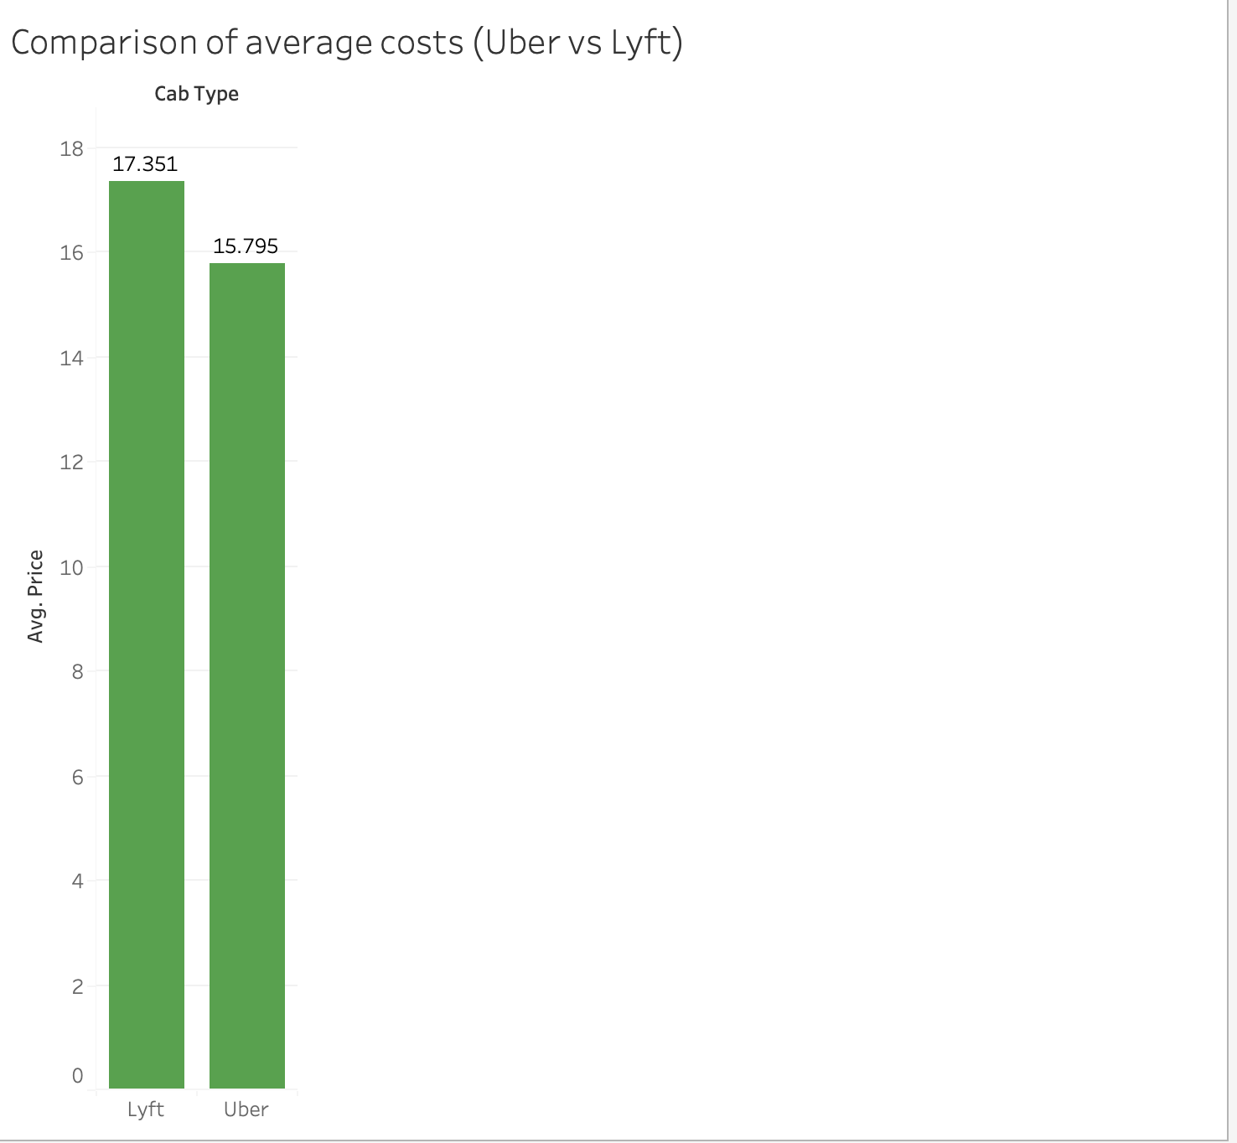
Price Comparison Between Uber & Lyft
Visualization: Bar Chart
Lyft's average price: $17.35
Uber's average price: $15.79
Insight: Uber is slightly cheaper on average.

Slide 5
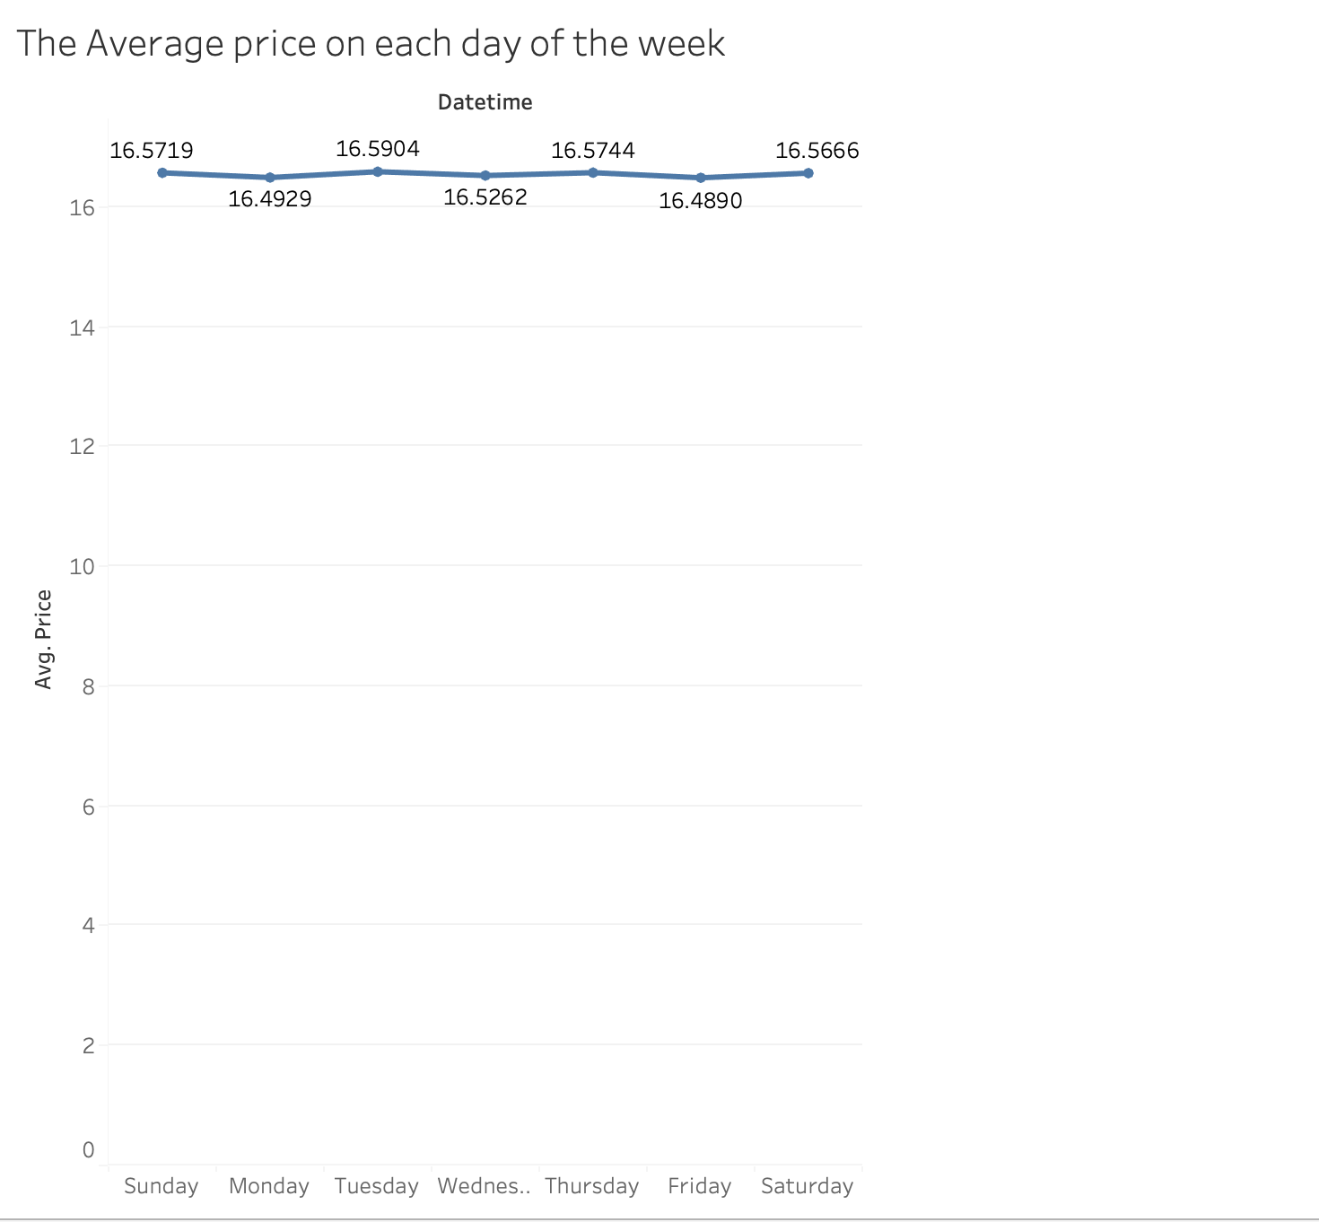
Variance of price based on the day of the ride
Visualization: Line Chart
Ride prices remain consistent across all days of the week, with minor fluctuations.
The highest average price is on Monday ($16.59), while the lowest is on Thursday ($16.49).
No significant weekday price variations, suggesting pricing is demand-driven rather than day-specific.

Slide 6
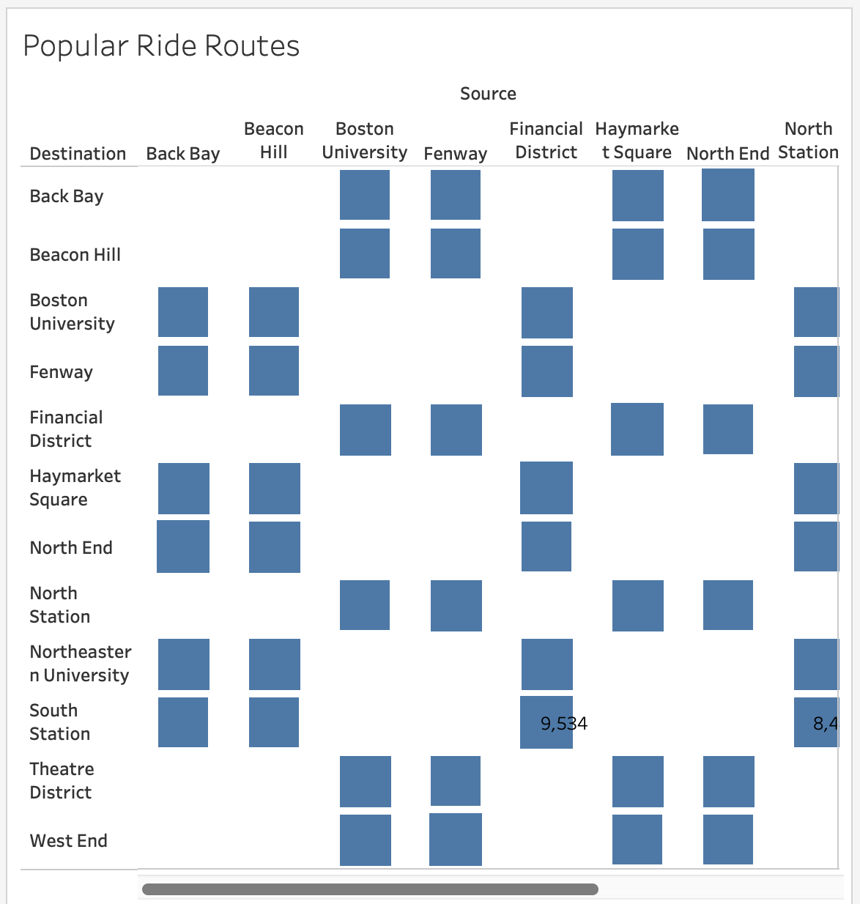
Popular Ride Routes
Visualization: Heatmap
Top locations:
Popular pickup/drop-off spots include Boston University, North Station, and the Financial District.
Insight: People frequently use rideshare services in high-traffic urban areas.

Slide 7
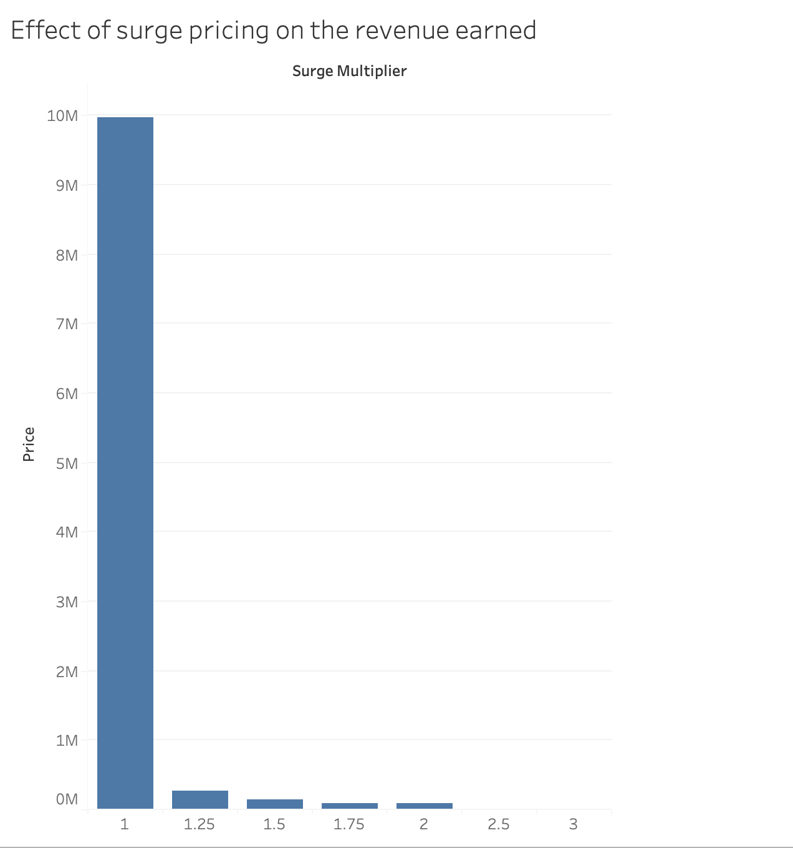
Role of price surge on the revenue earned
Visualization: Bar Chart
Key Insights
Majority of rides occur without surge pricing (Surge Multiplier = 1).
Revenue contribution from higher surge multipliers is significantly lower.
While surge pricing increases ride costs, it is applied to only a small fraction of rides.

Slide 8
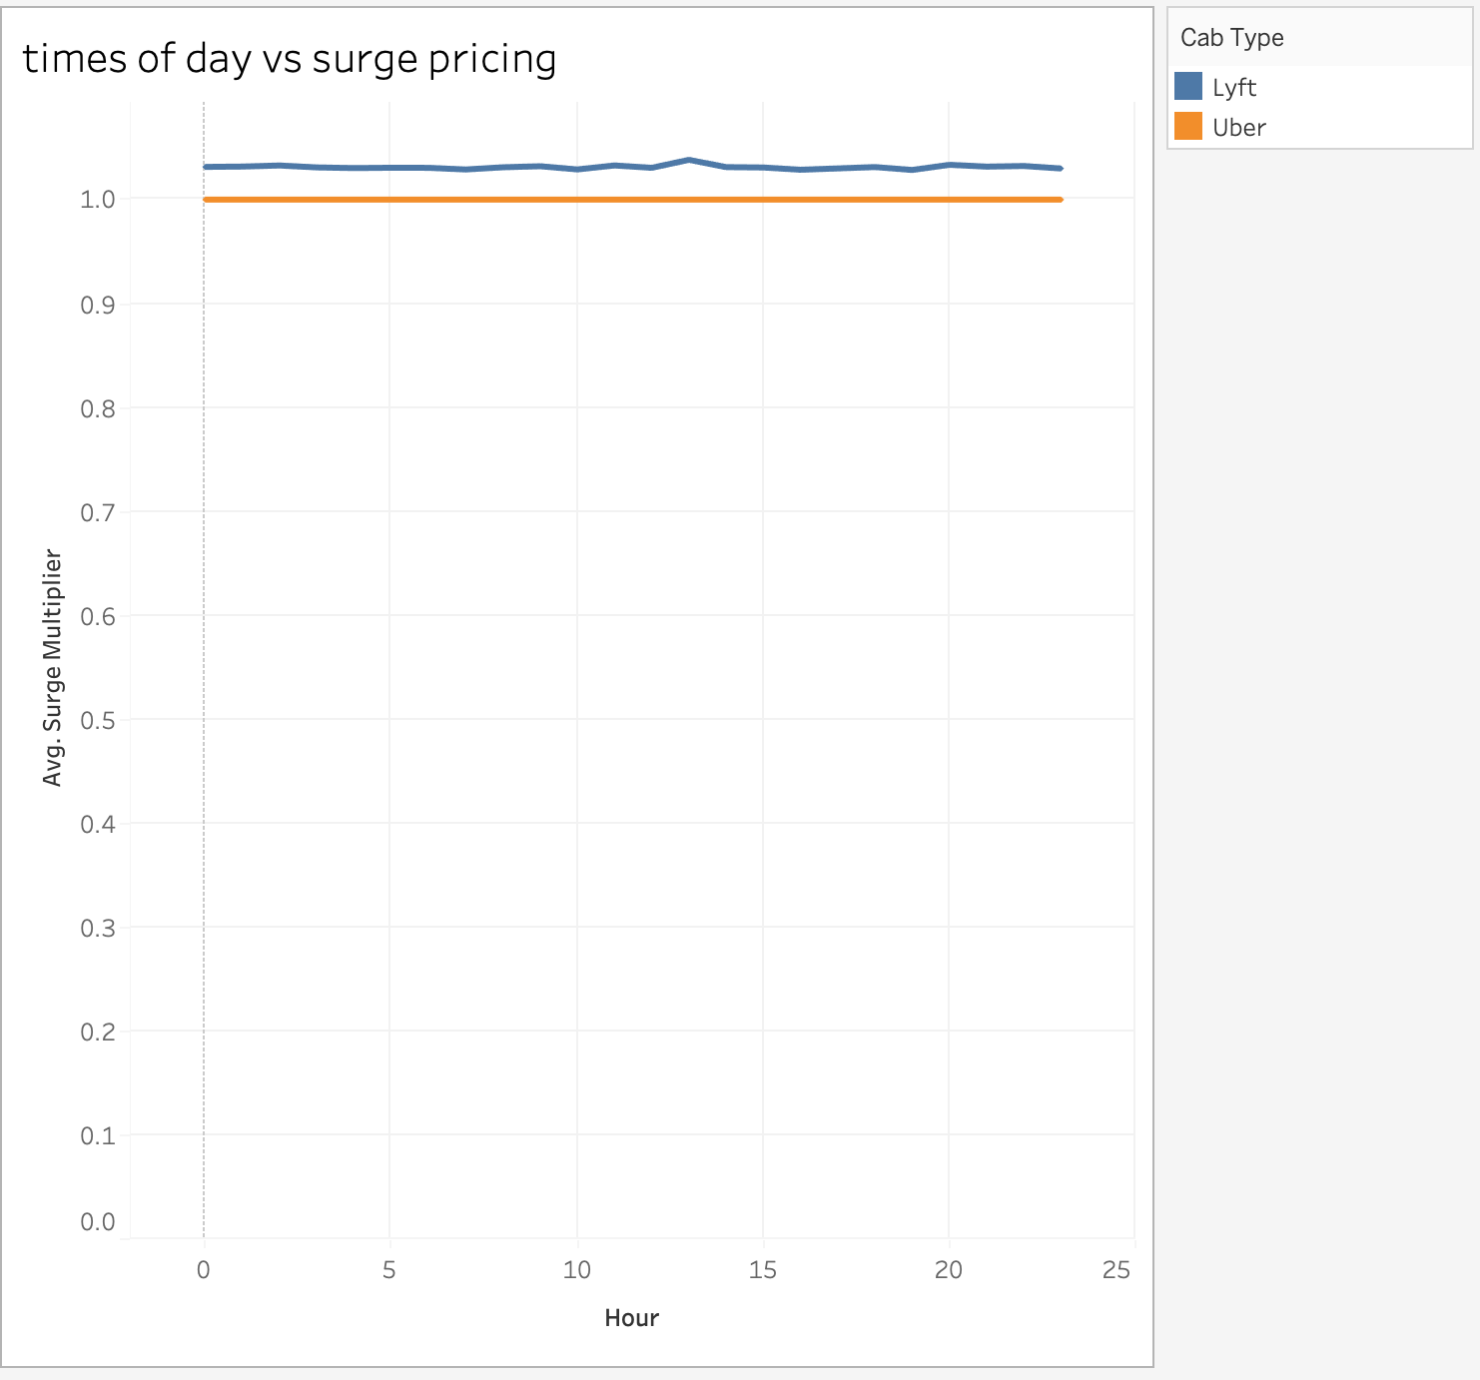
Time of the day vs Surge
Visualization: Line Chart
Key Insights
Surge multipliers remain relatively stable throughout the day. Lyft shows slightly higher surge multipliers compared to Uber. There are minor fluctuations in surge pricing, but no major spikes at specific times.

Slide 9
Conclusion
Summary of Findings
✔ Uber is slightly cheaper than Lyft. ✔ Surge pricing significantly increases ride costs. ✔ Rides are most common in city hotspots. ✔ Peak ride times match rush hours.
Real-World Implications
🔹 Passengers can save money by avoiding peak times. 🔹 Drivers can maximize earnings by working during surge pricing. 🔹 Uber & Lyft can adjust pricing strategies based on demand trends.

