Slide 1
NASA GUVI Project: Near‑Earth Object (NEO) Tracker
Presented by Mounica Srinivasan

Slide 2
1. Introduction
• Near‑Earth Objects (NEOs) are asteroids or comets that approach Earth.
• This project tracks and analyzes NEOs using NASA's NeoWs API.
• Provides real-time insights into asteroid proximity, size, and hazard level.

Slide 3
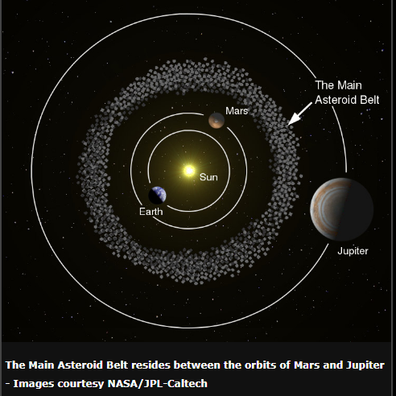
WHAT ARE ASTEROIDS?
Do Some Asteroids Come Toward Earth?
Yes — some leave the asteroid belt due to:
Gravitational nudges from planets (especially Jupiter)
Collisions between asteroids
Yarkovsky effect (solar heat alters their spin/orbit over time)
These become Near-Earth Objects (NEOs):
NEAs (Near-Earth Asteroids) are a type of NEO that cross Earth’s orbit
If large and close enough, they're called Potentially Hazardous Asteroids (PHAs)

Slide 4
2. Asteroids – Threats, Resources & NASA Missions
🔭 What Are Asteroids: rocky remnants from the early solar system (Mars–Jupiter belt)
☄️ Potential Threats: large NEOs can cause catastrophic events like Chelyabinsk (2013)
🪨 Valuable Resources: water ice; metals (platinum, nickel, cobalt)
🚀 NASA Missions:
• OSIRIS‑REx – Sample return from Bennu (2023)
• Psyche Mission – Exploring metallic asteroid (launched 2023)
• DART – Successful deflection demonstration (2021)

Slide 5
3. Purpose & Motivation
Understand and alert about potentially hazardous asteroids.
Mineral exploration
Strengthen space data analytics using real datasets.
Build public awareness and educational , and R&D purposes.

Slide 6
4. Architecture & Tools
• Python – Data collection and automation
• Streamlit – Interactive visual dashboard
• MySQL – Backend storage of asteroid data
• Pandas – For data processing and analysis
• NASA NeoWs API – Source for daily asteroid feeds

Slide 7
5. Data Pipeline
1. API Fetch – Pulls asteroid data from NASA NeoWs.
2.Data Cleaning/Preprocessing
3. Database Storage – Stores it in MySQL.
4. Query Layer – Filters and aggregates via SQL & Pandas.
5. Visualization – Dashboards display risk, size, speed, and trends.

