Slide 1
🚗 TripFare : Predicting Urban Taxi Fare with Machine Learning
By:
Mounica Srinivasan
Batch : DS-S-WD-T-B61

Slide 2
About & Problem Statement
About:
Urban Transportation Analytics & Predictive Modeling project.
Involves EDA, preprocessing, feature engineering, model building, and deployment with Streamlit.
Problem Statement:
Build a predictive model to estimate taxi fare based on trip features, enhancing pricing transparency.

Slide 3
Tools Used
Python, Pandas, NumPy
Matplotlib, Seaborn
Scikit-learn
Streamlit
Haversine Formula
Jupyter Notebook

Slide 4
Data Pipeline
1️⃣ Data Collection: Load dataset using Pandas
2️⃣ Data Understanding: Inspect shape, datatypes, missing values
3️⃣ Feature Engineering
4️⃣ EDA: Univariate & bivariate analysis, outlier detection
5️⃣ Data Transformation: Handle skewness, encode categorical vars
6️⃣ Feature Selection: Correlation, feature importance
7️⃣ Model Building: Train multiple regression models
8️⃣ Hyperparameter Tuning: GridSearchCV/RandomizedSearchCV
9️⃣ Deployment: Build Streamlit UI for predictions

Slide 5
Inferences
No of days : 3
Geography of collected data : In and around Newyork
No of vendors : 2 (VendorID1,2) where vendorID 2 has max trips
Passenger count : 1 to 6 where single passengers are taking higher number of trips
RatecodeID : 1 to 6,99 where RatecodeID 1 has highest no. of trips
Payment type: 1 to 4 where payment type 1 was highest
Am/Pm : no. of trips in ‘am’ was highest
Is_late_night : Late night trips was highest
Hour : early morning 2-6 am had highest rides
Single passengers in the ‘am’ has highest trips
We see that in the am (early morning) and in the late night we highest no of passengers
There are more single passengers in the late night

Slide 6
Inferences
RatecodeID 1 and the paymentype 1 has the most no of passengers
The late night has low fare compared in the other time of the day
We infer 19% on an average other charges is being charged on the whole
The total fare in the pm is high than in the am
RatecodeID 3 has the highest mean total fare and RatecodeID 6,99 has the lowest total fare
The passenger count 2 has the highest mean total fare amount
Long trip distances are covered in am than pm
There are more mid length trips between 1 and 4 kms
More midlength trips(1-4km) in the am(mornings)
Peak time has the highest trips and Revenue generated
There are 229 areas in total in the dataset
Annadale-Huguenot-Prince's Bay-Woodrow area has the highest drop-off total amount mean.
South Ozone Park area has the highest pickup area total amount mean.
The highest pickup trips is made at Midtown-Times Square area
The highest dropoff trips is made at Midtown-Times Square area
We see that the Midtown-Times Square area one of the famous hotspots in that region

Slide 7
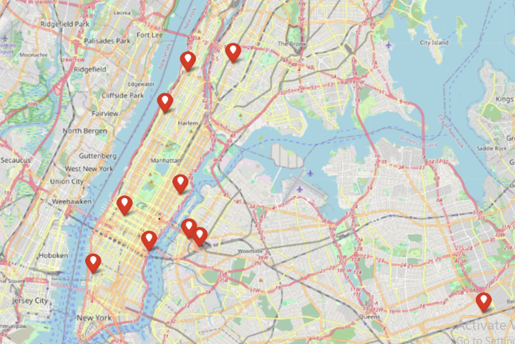
Top 10 Hotspots (Folium)

Slide 8
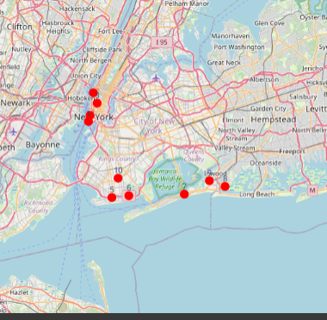
Top 10 Late Night Long Trip Hotspots by single Passenger -Security Pov

Slide 9
ML Algorithms used
Linear Regression
Random Forest
XGBoost
SVR
LightGradientBoosting
Model Selection : Xgboost showed better metrics hence pickled it to be used in Streamlit

Slide 10
Thanks!!! Hope you enjoyed !!

