Slide 1
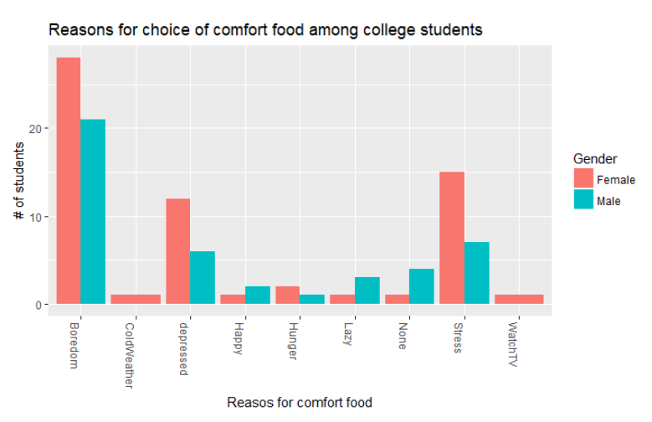
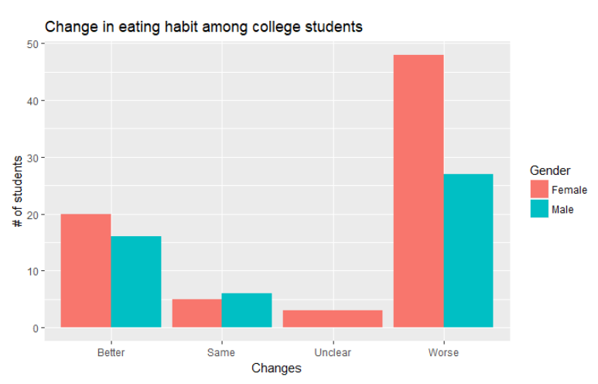
FOOD CHOICES AND PREFERENCES OF COLLEGE STUDENTS
This is a raw and uncleaned dataset that includes information on food choices, nutrition, preferences, childhood favorites, and other information from Mercyhurst University students. There are 126 responses from students discussing briefly on how important is nutrition information for today's college kids.
Figure : Reasons for comfort food
College kids have various food choices and few are preferred as comfort food by them depending on their mood swings.
This graph shows the reasons for comfort food and analyses which gender is suffering or experiencing the extreme mood swings and also, who is more depressed or sad.
As per the graph, Female students are having extreme mood swings comparatively, except for few like laziness or void with no such odd feelings and They are the ones who are feeling more depressed and sad.
Figure : Change in eating habit
It is also recorded in the dataset that the eating habit of college kids changes rapidly.
This graph shows the various levels of changes and discusses about which gender is likely to be having the worst changes.
As per the graph, female students are highly having worst food habits comparatively.
Source : https://www.kaggle.com/borapajo/food-choices/version/1/data

