Slide 1
Sentiment Analysis on Drug Reviews
Mounica Subramani
Sai Divya Sangeetha Bhavagatula
Sushma Suresh Kalkunte

Slide 2
Introduction
What is Sentiment Analysis?
Contextual mining of text data
Measures inclination of people’s opinion
Uses text analysis and natural language processing
Why Sentiment Analysis for Drug Reviews
Examine the patient’s experience with medication
Help doctors and pharma companies quickly analyze drug performance

Slide 3
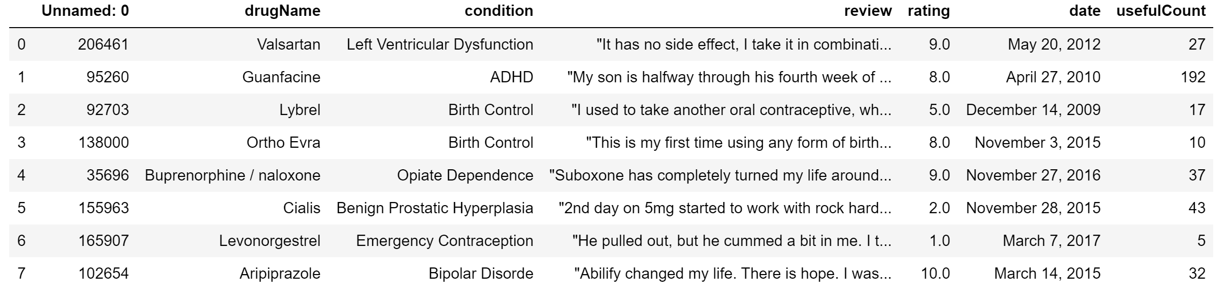
About the Dataset
Training dataset-
7 features
161298 data points
Testing dataset-
7 features
53757 data points

Slide 4

Project Objective
Predict sentiment of patient reviews as “Positive” or “Negative” based on vectorized words from comments.

Slide 5
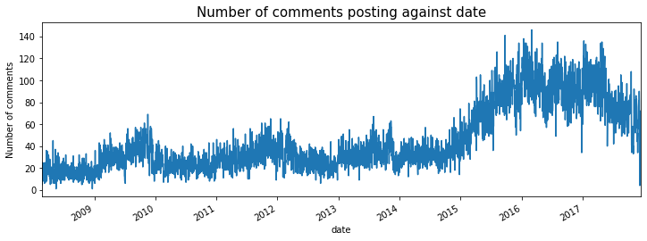
Exploratory Data Analysis
Almost stable pattern between 2008 to 2015
Number of reviews increased suddenly from 2015
Gradual decrease observed after 2017

Slide 6
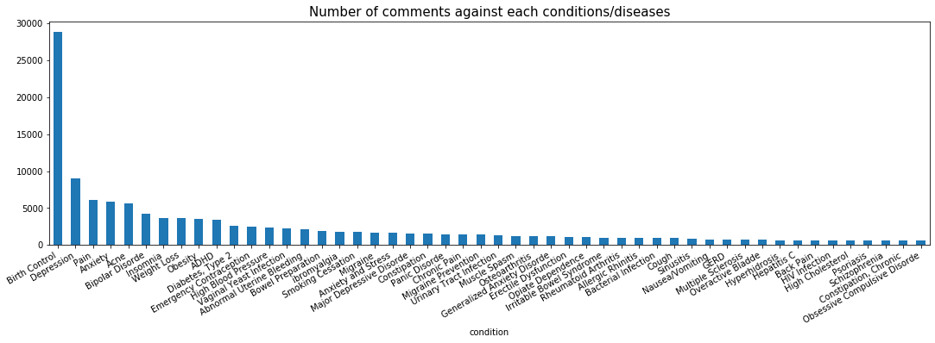
Exploratory Data Analysis
Birth control saw the greatest number of reviews
Followed by Depression, Pain and Anxiety
Obsessive Compulsive Disorder saw the least reviews

Slide 7
Data Preprocessing
Convert the ratings into a binary format
Remove html content
Remove non-alphabetical characters
Convert all text into lower case
Tokenize the sentences
Lemmatize each word
Remove negator words from stop words
Remove stop words from reviews

Slide 8
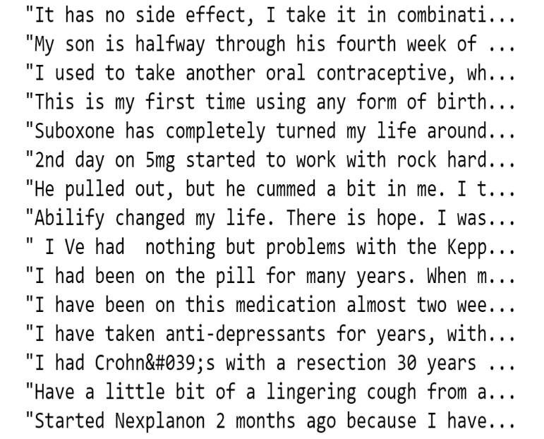
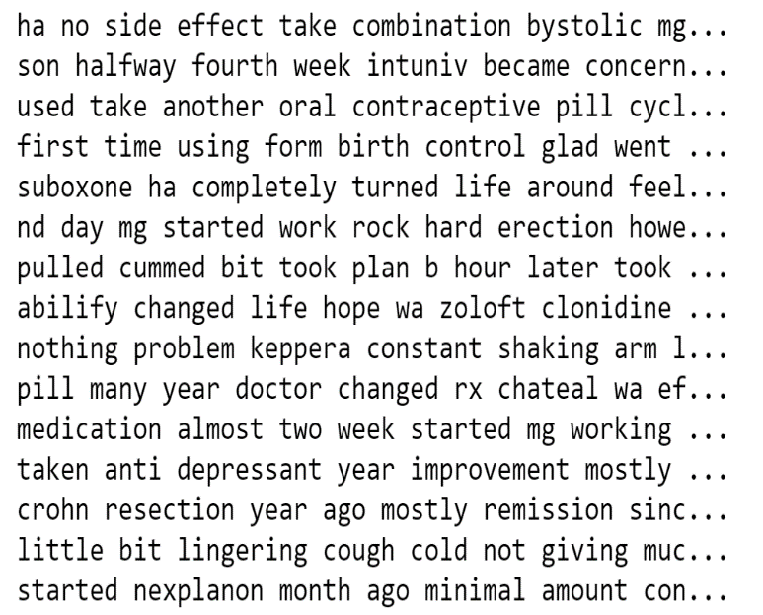
Reviews before cleaning
Reviews after cleaning

Slide 9
Modelling Techniques
Naïve Bayes Classifier
Support Vector Machines
K-Nearest Neighbors
Light Gradient Boosting
LSTM neural network
Logistic Regression

Slide 10
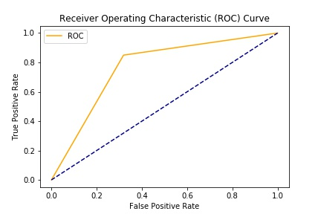
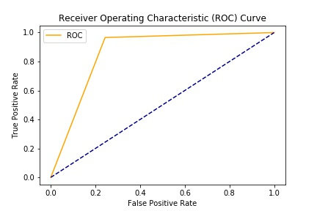
Naïve Bayes Classifier
Unigrams
Bigrams
 | Accuracy | Error | Precision | Recall | F1
Train | 82% | 18% | 87% | 85% | 86%
Test | 80% | 20% | 86% | 90% | 85%
 | Accuracy | Error | Precision | Recall | F1
Train | 98% | 2% | 98% | 99% | 98%
Test | 90% | 10% | 90.5% | 96.5% | 93%

Slide 11
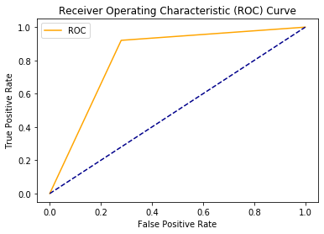
Support Vector Machines
 | Accuracy | Error | Precision | Recall | F1
Train | 96% | 4% | 98% | 99% | 99%
Test | 94% | 6% | 94% | 96.5% | 95.7%

Slide 12
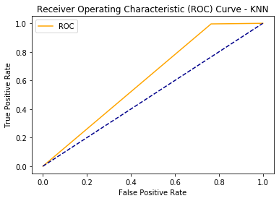
K Nearest Neighbors
 | Accuracy | Error | Precision | Recall | F1
Train | 78% | 22% | 75% | 98% | 85.8%
Test | 77% | 23% | 70.8% | 96% | 82.5%

Slide 13
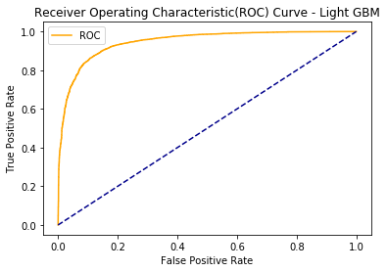
Light Gradient Boosting
 | Accuracy | Error
Train | 90% | 10%
Test | 88.05% | 11.95%

Slide 14
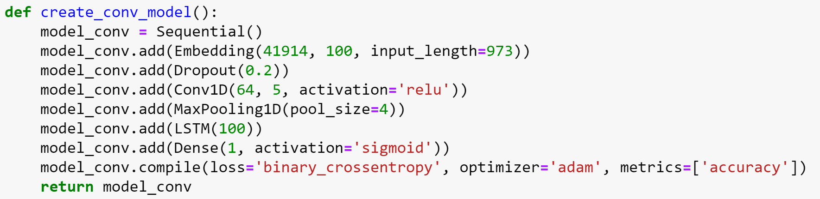
Long Short-Term Memory
Implementation
Architecture
Compute the total number of words in training and testing
Compute the vocabulary length
Compute the length of the longest sentence
Tokenize reviews and convert to sequences
Pad shorter reviews to maximum length of sentence
Build the network architecture

Slide 15
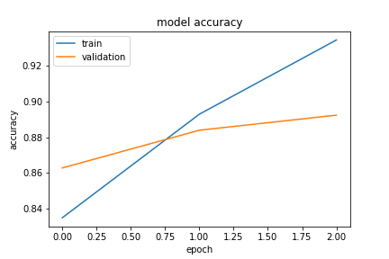
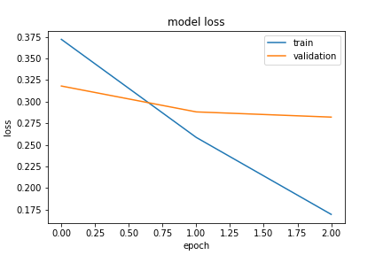
Long Short-Term Memory
Train Accuracy- 0.9345
Test Accuracy- 0.8924
Train Loss- 0.1693
Test Loss- 0.2821

Slide 16
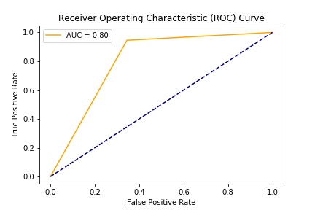
Logistic Regression
 | Accuracy | Error | Precision | Recall | F1
Train | 91.95% | 8.05% | 93.13% | 94.80% | 92.98%
Test | 86.15% | 13.84% | 88.41% | 93.80% | 91.03%

Slide 17
Comparative Analysis
 | NBC | SVM | KNN | LGBM | LSTM | Logistic
Accuracy | 0.90 | 0.94 | 0.77 | 0.8805 | 0.8924 | 0.8732
Error | 0.10 | 0.06 | 0.23 | 0.1195 | 0.1076 | 0.1268
Precision | 0.90521 | 0.9443 | 0.708 | - | - | 0.8841
Recall | 0.96511 | 0.96512 | 0.9634 | - | - | 0.9380
F1 | 0.9331 | 0.95732 | 0.825 | - | - | 0.9103

Slide 18
Conclusion
SVM performs the best in our scenario of sentiment analysis
LSTM also performs well but with high training and testing time
LGBM performs moderately well
Naïve Bayes model has a low accuracy
KNN has the highest error as compared to call as it isn’t learning anything new but just classifying the given data

Slide 19
Future Steps
Split the ratings into multiple classes and implement mentioned models to compare their performance
Build a recommendation engine to recommend a medicine to a patient based on previous reviews of the drug
Try CNN+LSTM with multiple layers instead of 1 and observe if any changes to the performance
Implement Logistic Regression with Bigrams instead of Unigrams

Slide 20
Data Reference
Data – UCI ML Drug Review Dataset
Link to test data set- https://www.kaggle.com/jessicali9530/kuc-hackathon-winter-2018#drugsComTest_raw.csv
Link to the train data set -https://www.kaggle.com/jessicali9530/kuc-hackathon-winter-2018#drugsComTrain_raw.csv

Slide 21



Thank you!

