Slide 1
SENDGRID

Slide 2
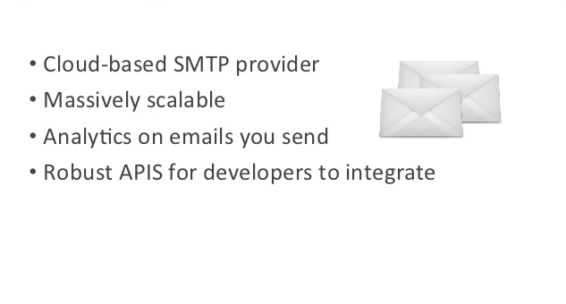
What is Sendgrid ?

Slide 3
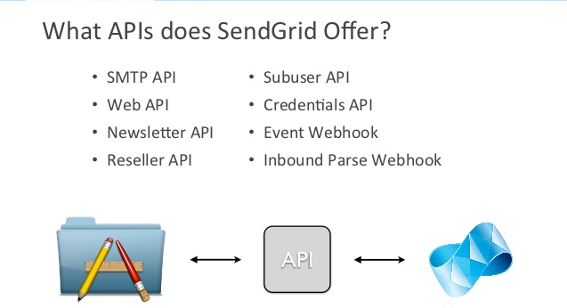
APIs Overview

Slide 4
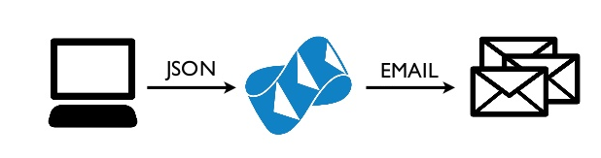
The indboud parse data

Slide 5
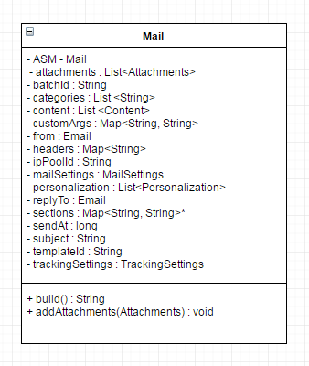
Mail

Slide 6

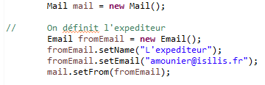
From
How your name/email adress appears in the recipient’s inbox

Slide 7
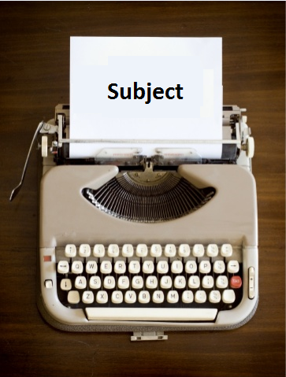

Subject
The mail subject

Slide 8
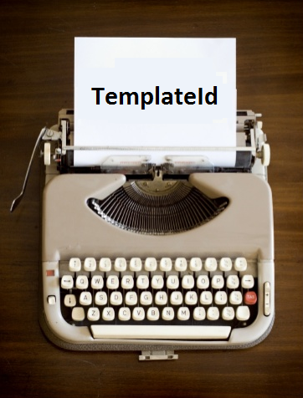

TemplateId
The template that you want to use

Slide 9


Content
The « main course » of your email

Slide 10
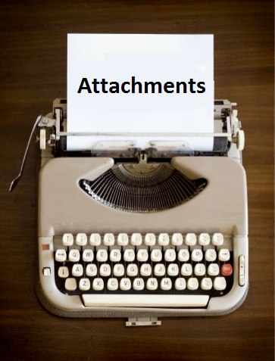
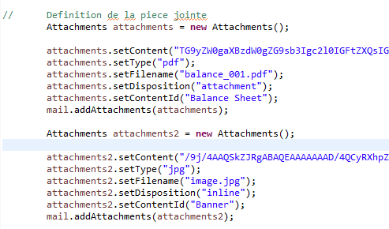
Attachments

Slide 11
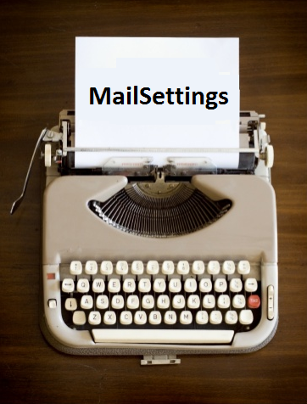
MailSettings
Instantiate some settings like footer, spamTracking, bounceTracking etc.

Slide 12
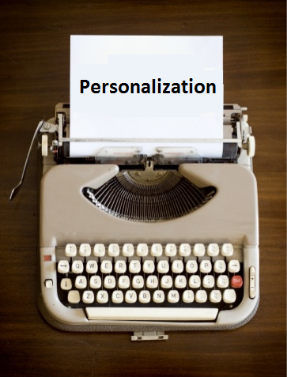
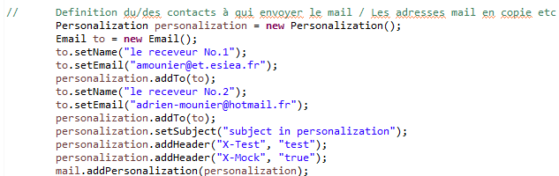
Personalization

Slide 13
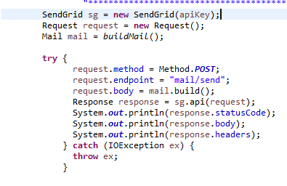

Slide 14
It doesn’t pay to hit ‘send’ and hope for the best
Manager Email Prgrams

Slide 15
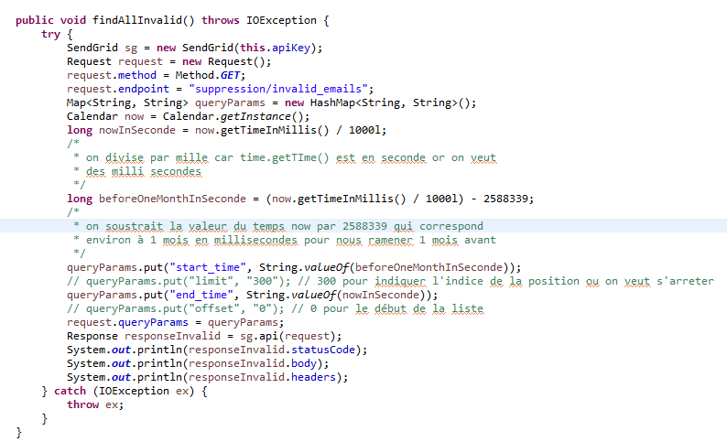
suppression/invalid_emails

Slide 16
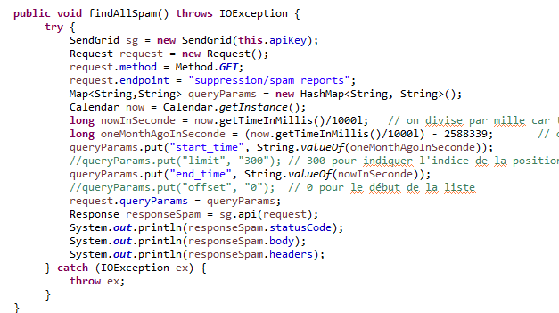
suppression/spam_reports

Slide 17
TrackingSettings endpoints
Tracking_settings/click
Tracking_settings/open
Tracking_settings/subscription
Tracking_settings/google_analytics

Slide 18
Thank you

