Slide 1


Teach2Learn: An AI-Driven Personalized Tutor Recommendation System Using Machine Learning, Deep Learning
R.V.R. & J.C. COLLEGE OF ENGINEERING
Project-1 (CD363)
Team: Mounika Mogalapalli (Y23CD122)
Bhavya Sri Kasireddy (Y23CD090)

Slide 2
1.1 Introduction of the Project
Teach2Learn is a web‑based platform that connects students with suitable tutors using AI‑based recommendation techniques.
The system analyzes student profiles, learning goals, and feedback to recommend the most relevant tutors and peer mentors.
It aims to make teaching and learning more personalized, efficient, and data‑driven.

Slide 3
1.2 Existing System
1.3 Proposed System
Traditional tutor search is mostly manual through word‑of‑mouth, social media groups, or coaching centers with no personalization.
Existing online platforms often recommend tutors based only on basic filters like subject and location, ignoring learner preferences and learning style.
Very few systems continuously learn from student feedback to improve future recommendations.
The proposed system uses ML/DL models to match students with tutors based on academic needs, skill level, tutor expertise, ratings, and historical feedback.
Students can create profiles, specify subjects, difficulty level, preferred mode (online/offline), and time slots.
The recommendation engine predicts and ranks the best tutors, and updates its model using new interactions and feedback.

Slide 4

1.4 Potential Users, Features & Market Demand
Students
Learners seeking personalized tutoring and skill development opportunities.
K-12 and higher education students
Skill development seekers
Exam preparation needs
Teachers
Professional educators and subject matter experts offering specialized knowledge.
Certified teachers
Subject specialists
Experienced tutors
Student-Teachers
Peer educators who teach while learning, creating collaborative learning environments.
Advanced students
Peer mentoring
Earn while learning

Slide 5
1.5 Demand For The Product
1.6 Protection Of Idea
Growing demand for personalized online education and skill‑based learning platforms.
Students face difficulty in identifying trustworthy and compatible tutors among many options.
Institutions and freelance tutors need a smart platform to reach the right students efficiently.
Post‑pandemic shift towards hybrid learning increases the relevance of AI‑based educational platforms.
User authentication and role‑based access control to protect data and platform misuse.
Secure storage of user profiles and session data using database access control and basic encryption of sensitive data.
Scope to extend with IP protection for the recommendation logic and model configurations.

Slide 6
2.1 Literature Review
Existing platforms recommend tutors or courses using simple filters and basic recommendation techniques.
Most systems focus on course recommendation rather than personalized tutor matching.
2.1.1 Review Findings
Current systems do not deeply consider student preferences, learning style, and feedback in one model.
There is limited support for peer‑to‑peer learning along with professional tutoring.
2.1.2 Objectives of the System
To build an AI‑driven platform that recommends suitable tutors based on student profile, tutor expertise, and feedback.
To support continuous improvement of recommendations using ratings and session outcomes.

Slide 7
2.2 Requirements Analysis
2.2.1 Functional Requirements
Student registration and profile creation
Tutor registration and expertise listing
AI-based tutor recommendation
Peer-to-peer interaction
Admin management panel
2.2.2 User Requirements
Easy tutor search and recommendation
Secure login system
Simple and responsive interface
2.2.3 Non-Functional Requirements
Scalability
Data security
High availability
Fast response time
2.2.4 System Requirements
Internet connection
Browser support
Server with Python environment

Slide 8
2.3 Feasibility Study
2.3.1 Technical Feasibility
The system uses Python, Flask, MySQL/SQLite, and AI libraries like Scikit-Learn and TensorFlow, which are well-supported and feasible.
2.3.2 Operational Feasibility
Users can easily operate the system with minimal training due to a simple UI.
2.3.3 Behavioral Feasibility
The system encourages collaboration and personalized learning, making it acceptable to users.

Slide 9
2.4 Modules Description
2.5 Process Model Used
User Authentication Module
Student Module
Tutor Module
Recommendation Engine Module
Admin Module
Incremental Model is used, allowing the system to be developed in phases such as authentication, recommendation engine, and peer learning.

Slide 10
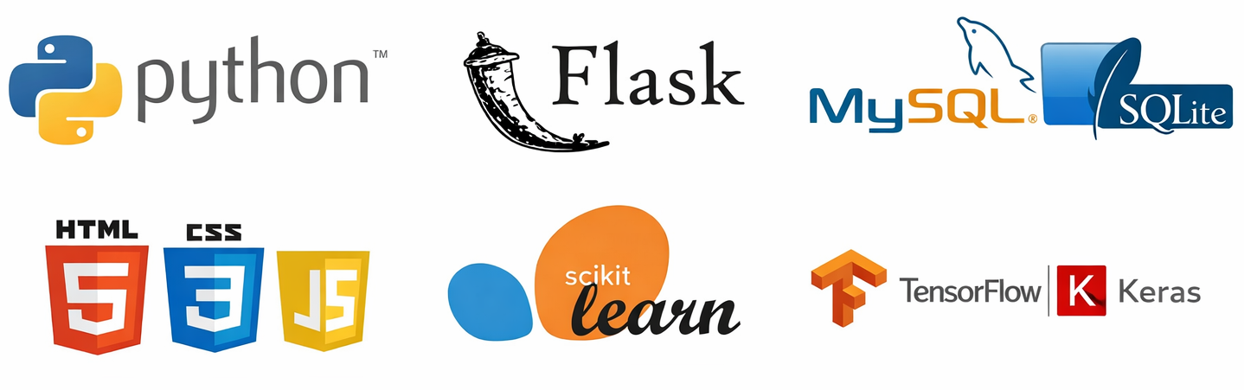
2.6 Hardware and Software Requirements
Hardware:
Minimum 4GB RAM
Standard PC/Laptop
Software:
Python
Flask
MySQL / SQLite
HTML, CSS, JavaScript
Scikit-Learn, TensorFlow/Keras

Slide 11
2.7 SRS Specification
The SRS defines system functionality, constraints, interfaces, and performance requirements to ensure reliable development and deployment.
The Software Requirements Specification (SRS) defines the functional and non-functional requirements of the Teach2Learn system. It describes system behavior, user interactions, constraints, and performance expectations. The SRS serves as a blueprint to ensure accurate implementation of the AI-based tutor recommendation platform.

Slide 12
3.1 Design Phase / System Design
3.1.1 Conceptual Design
3.1.2 Logical Design
Use case diagram:
Actors: Student, Tutor, Admin.
Use cases: Register, Login, Manage Profile, Get Recommendations, Manage Tutor List, Give Feedback, Generate Reports.
Flowcharts and data flow diagrams showing:
User login
Data processing
Tutor recommendation logic

Slide 13
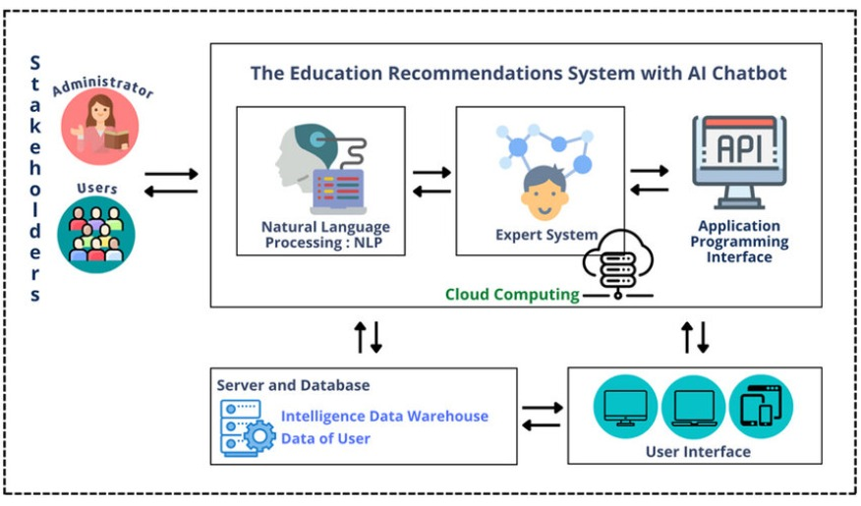
3.3 Design Diagram of the System

Slide 14
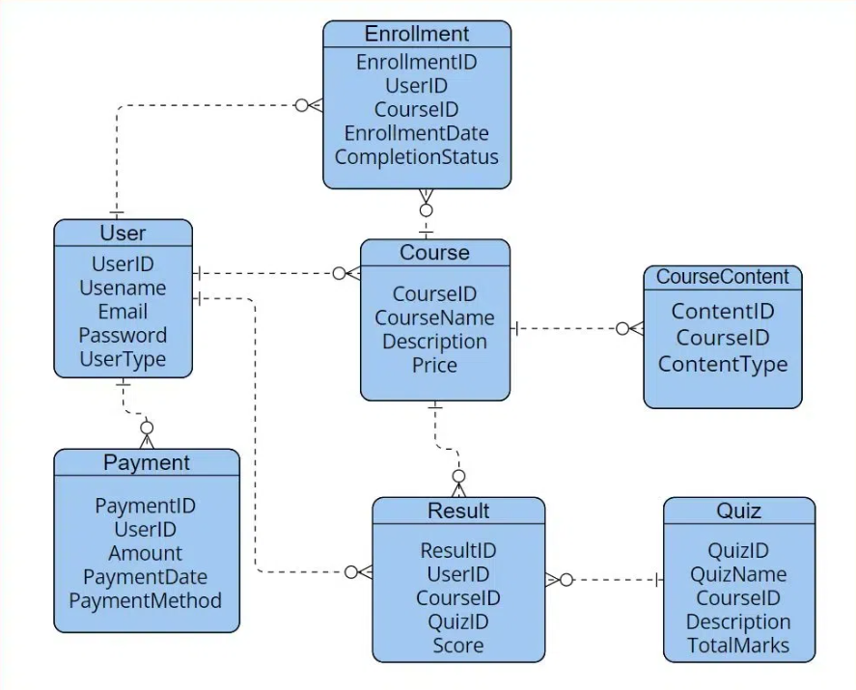
3.4 Database Design

Slide 15
Thank You!
Any questions?

