Slide 1
Loss of Bee Colonies
By Mounika Ganta and Celia Watson

Slide 2
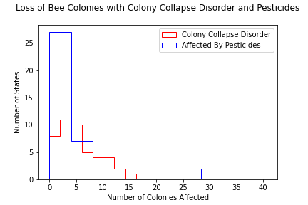
More colonies appear to be affected by pesticides than lost to colony collapse disorder.

Slide 3
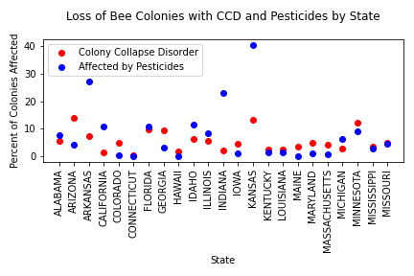
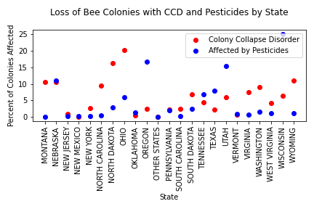
Loss of Bee Colonies with CCD and Pesticides by State

Slide 4
Hypothesis
Based on our findings with the histogram graph the percentages of colonies affected by pesticides are higher than those lost by colony collapse disorder.
There appear to be many factors that contribute to the loss of colonies to collapse, including pesticides, parasites, weather conditions, etc. Also, not all colonies affected by pesticides do go on to collapse.
For example, in the survey results for Jan-March in Arizona there was no colonies affected by pesticides, but there were 13.44% of total colonies lost to colony collapse.
The correlation coefficient calculated on the state level showed a -0.08112837 correlation indicating not much correlation at that level.

