Slide 1
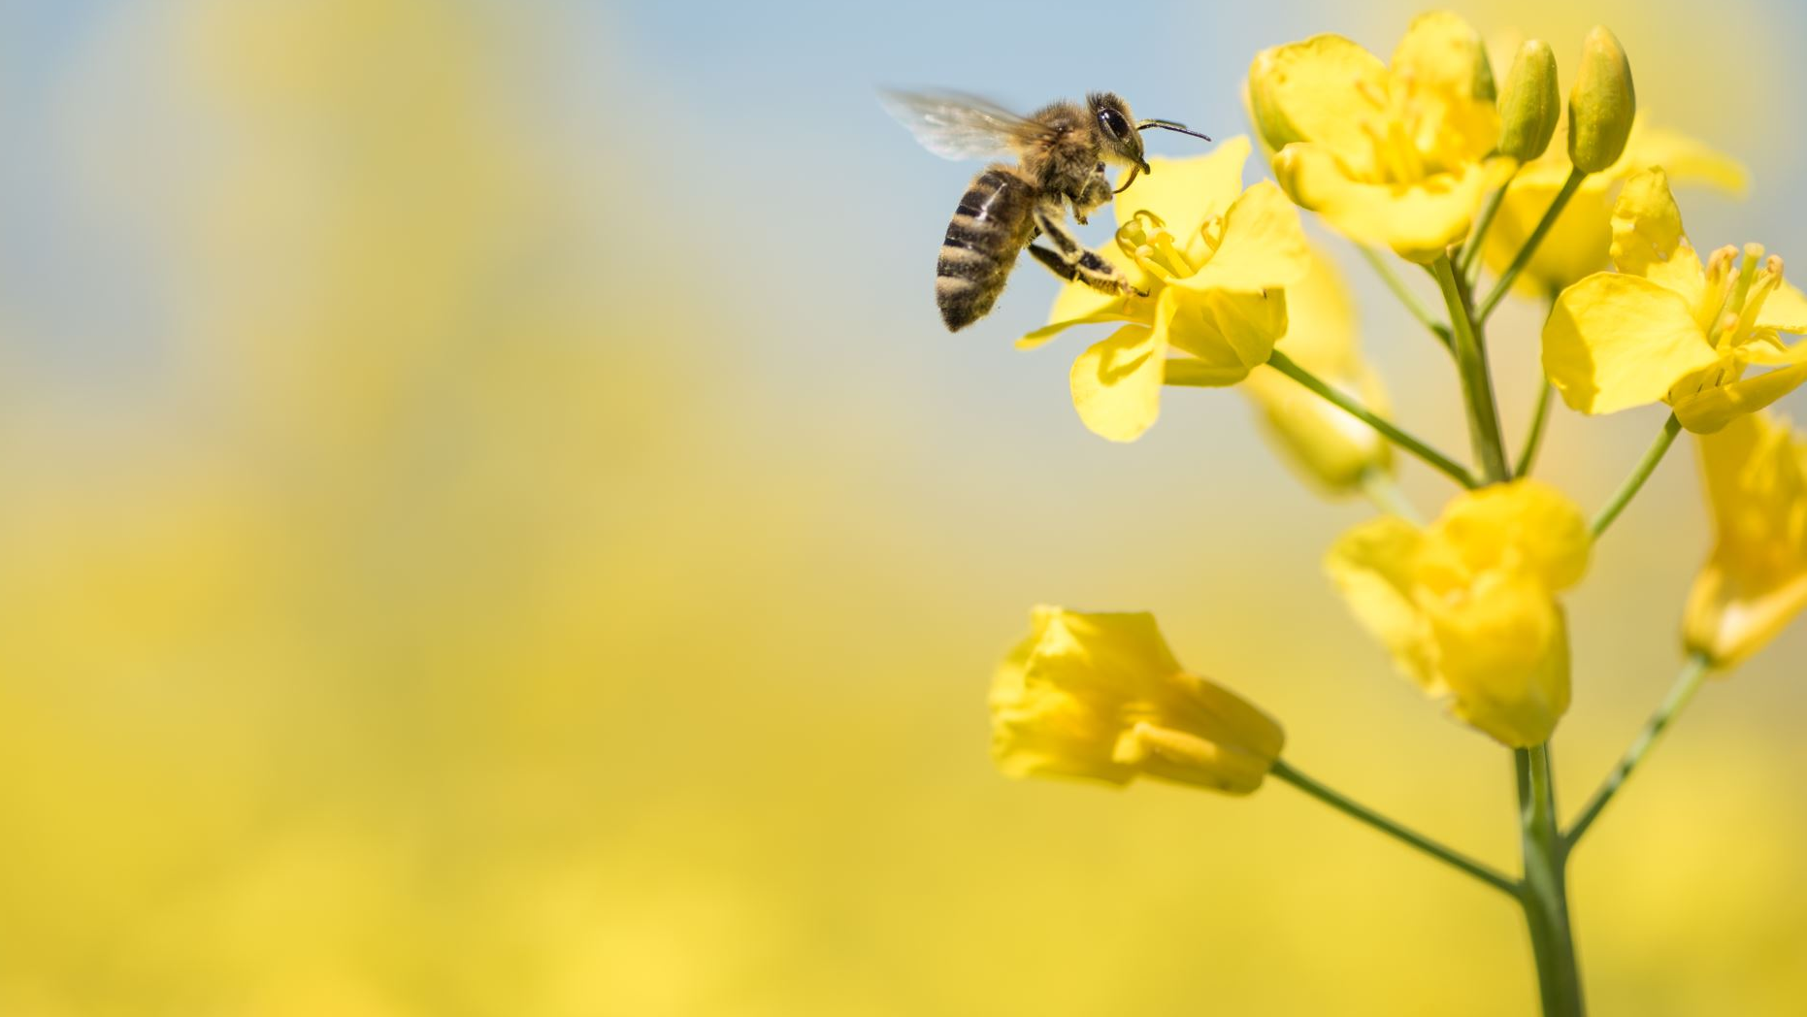
Loss of Bee Colonies
By Mounika Ganta and Celia Watson

Slide 2
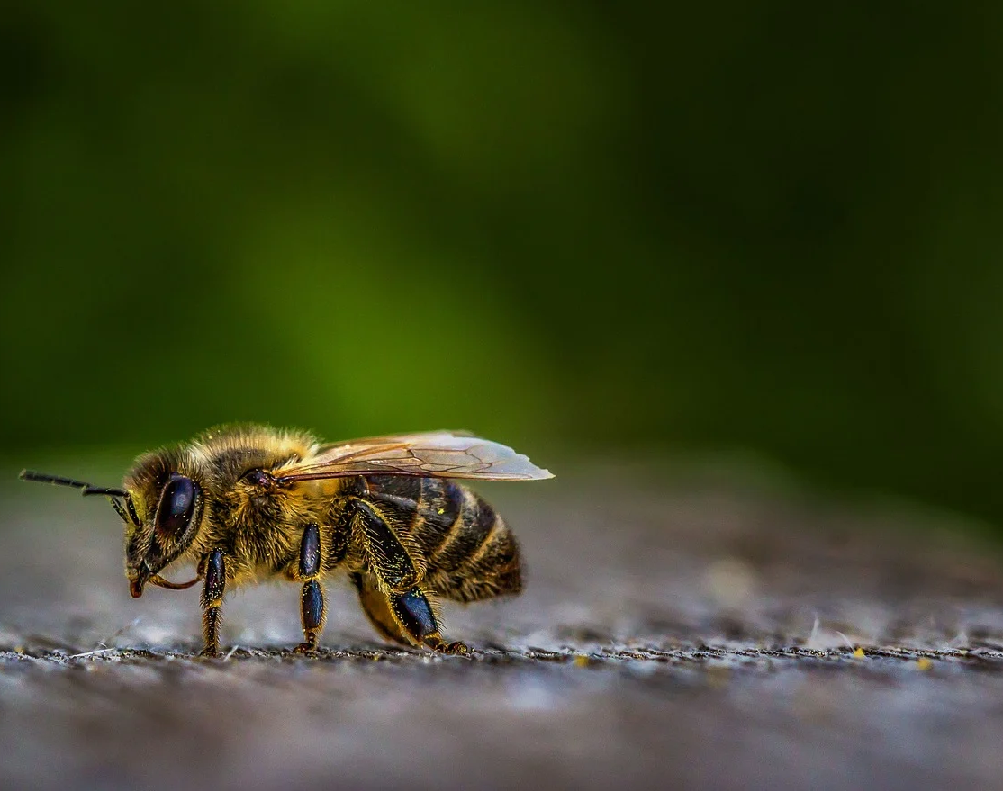
Hypothesis
- Our initial hypothesis was that there would be a compelling connection between the use of pesticides and colony collapse disorder.
- Our analysis grew to include the other categories of problems facing honey bees, as the various US states surveyed have unique and varied problems.

Slide 3
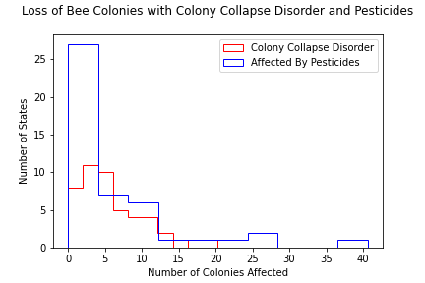
More colonies appear to be affected by pesticides than lost to colony collapse disorder.

Slide 4
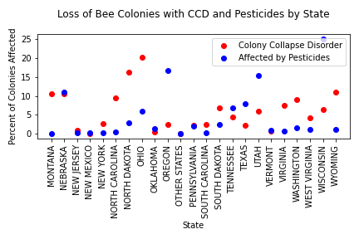
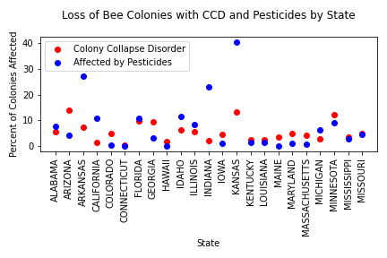
Loss of Bee Colonies with CCD and Pesticides by State

Slide 5
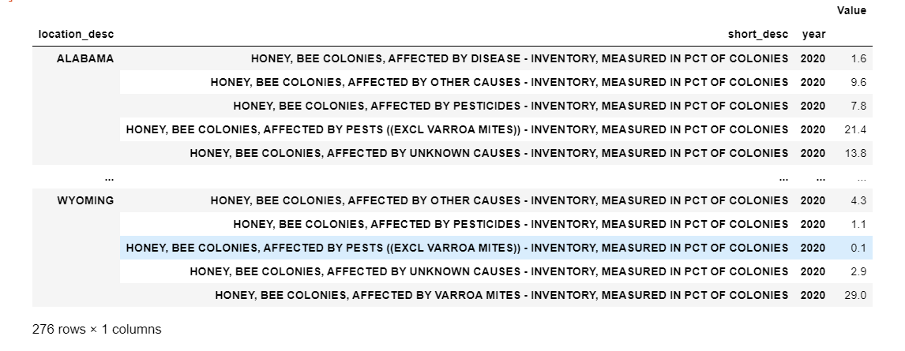
Accumulated Adverse Effects by State

Slide 6
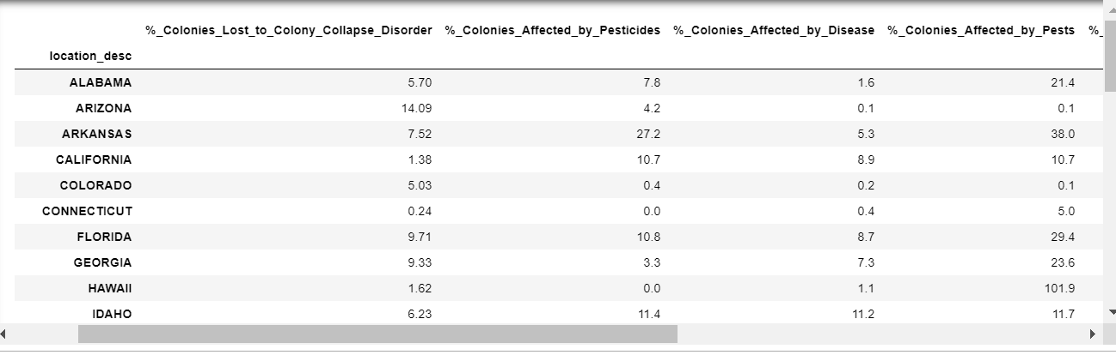
DataFrame With Adverse Effects

Slide 7
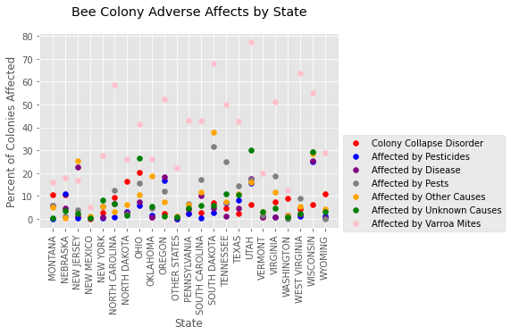
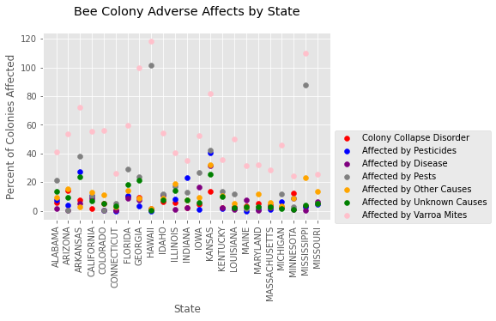
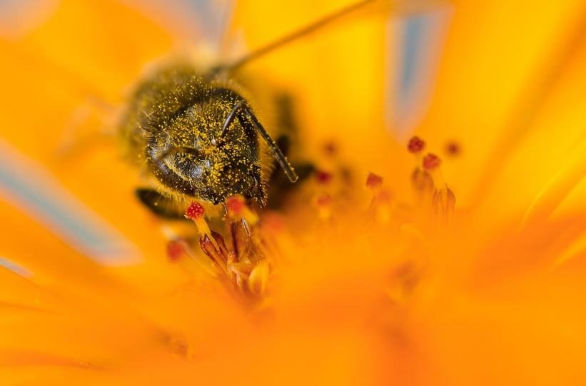
Bee Colony Adverse Effects by State

Slide 8
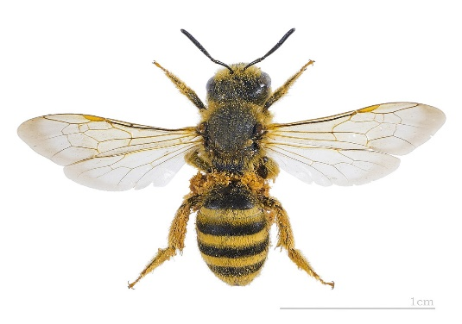
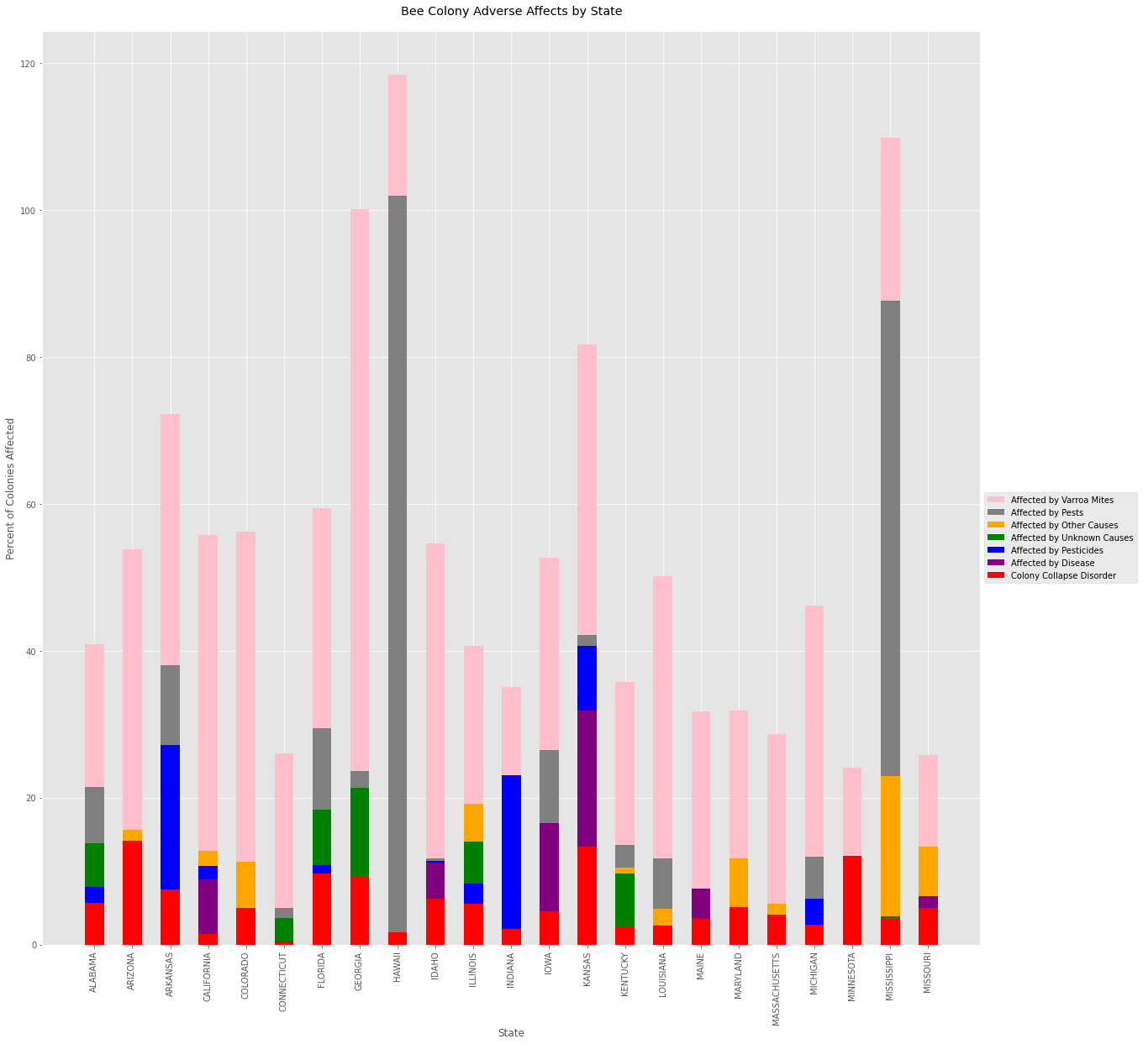
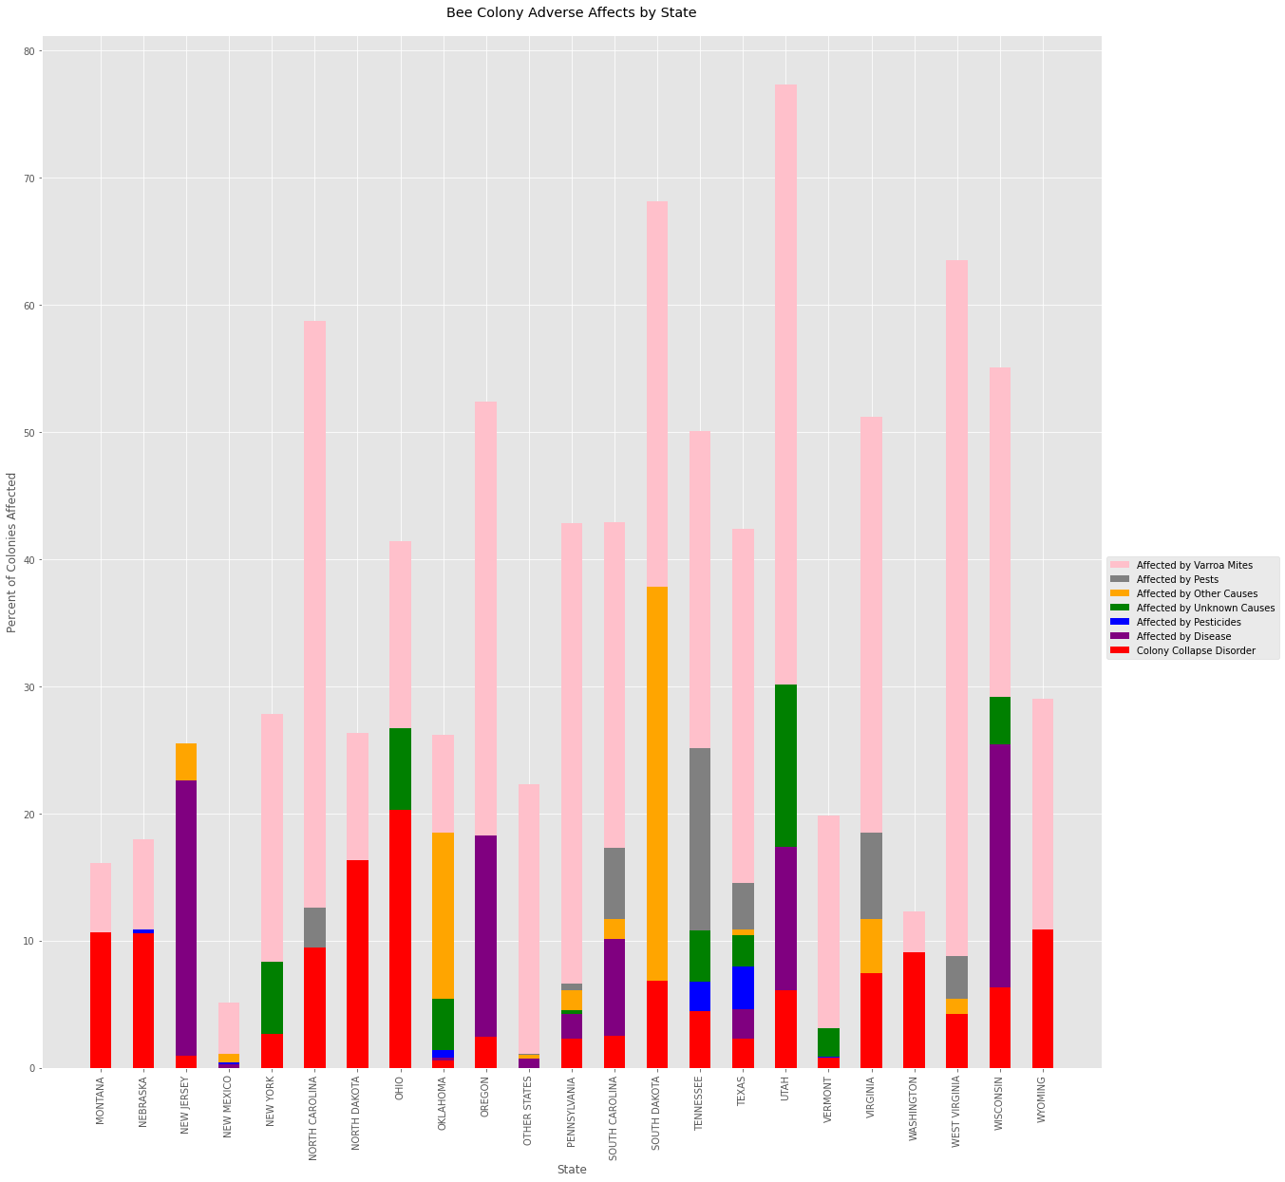
Bee Colonies Adverse Effects by State
This Photo by Unknown Author is licensed under CC BY-SA

Slide 9
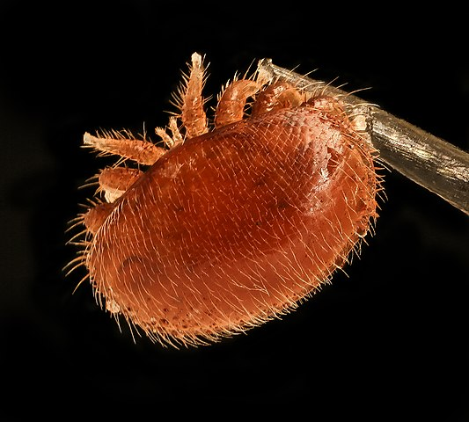
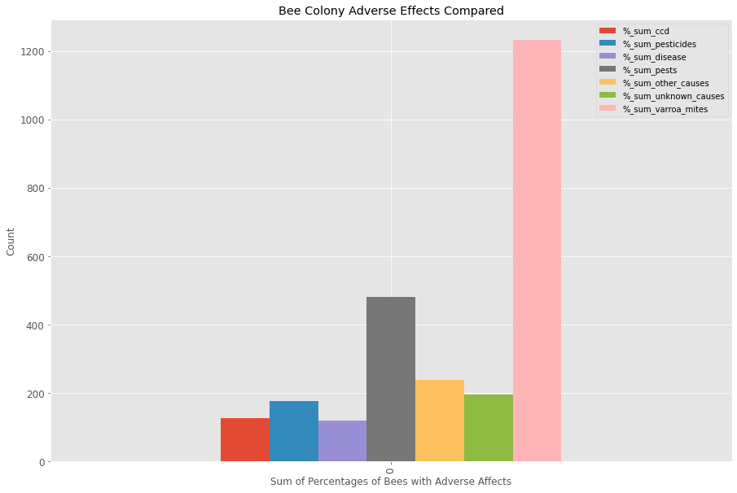
Comparison of Adverse Effects on a National Level

Slide 10
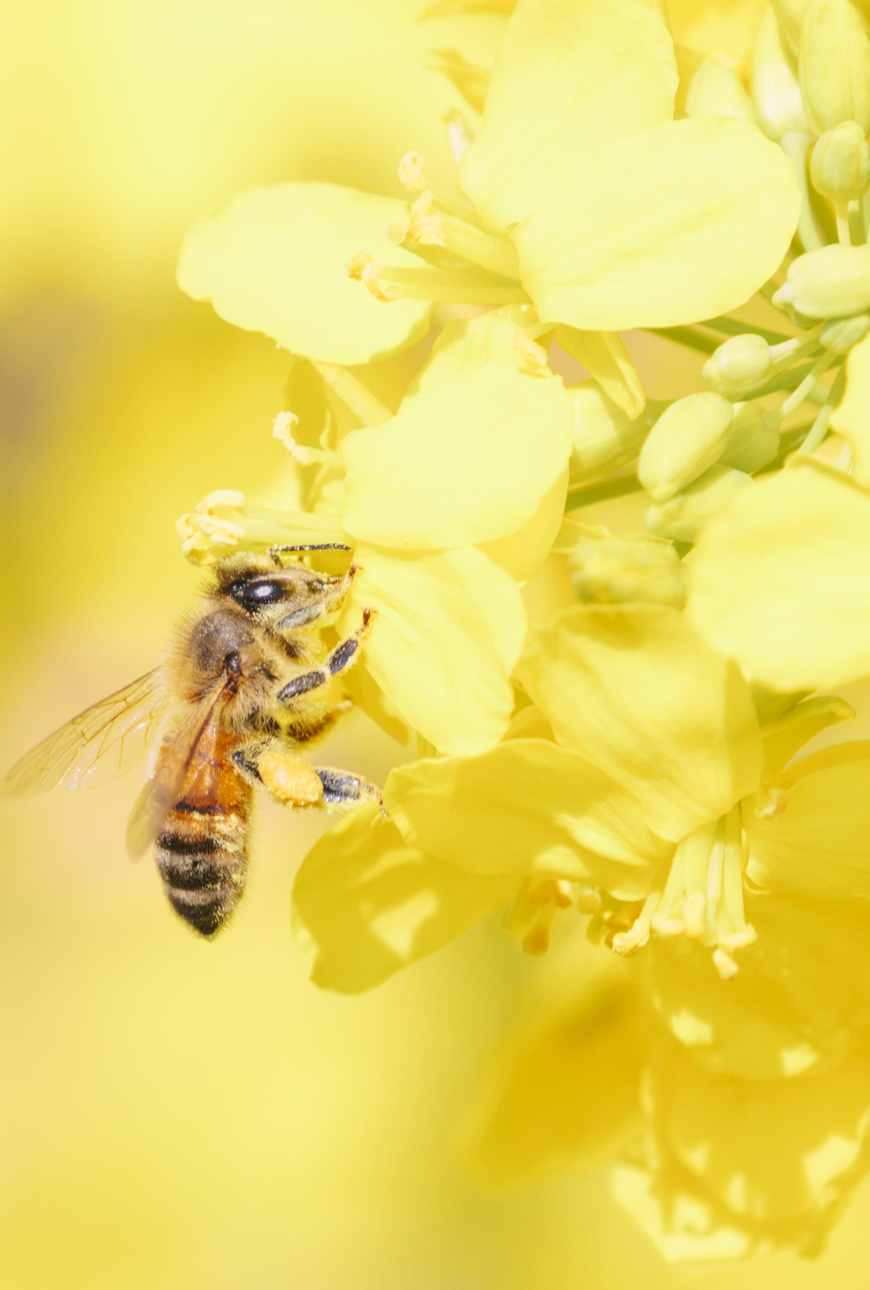
Conclusion
Based on our findings with the histogram graph the percentages of colonies affected by pesticides are higher than those lost by colony collapse disorder.
There appear to be many factors that contribute to the loss of colonies to collapse, including pesticides, parasites, varroa mites, disease etc. The worst problem facing bee colonies presently is varroa mites.
Regional and climate related conditions likely affect the types of problems faced by bees. Due to the varied nature of climates and regions in the US, this may be an area for further exploration.
Due to the high degree of dependence of the world’s food sources on the health of honey bees, it is extremely important for people around the world to collaborate to find the best ways to meet these challenges.

