Slide 1
Week 10

Slide 2
Warm-up (10 minutes)
Take the following list [0,1,2,3,4,5,6,7,8,9] and reverse it. Try to come up with the simplest way of doing this you can.
Write a list comprehension to take the reversed list and divide each value by two.

Slide 3
Today's Activities
Warmup (15 mins)
Remaining Presentations (45 mins)
Break (10 mins)
Linear Algebra in Python (45 mins)
Break (5 mins)
Group Exercise (60 mins)

Slide 4
Class Memo
You must have completed 11 of the 12 assignments by May 26th to continue is this course!
We will tend to have more complex homework questions but fewer questions in each assignment. Expect 6-10.

Slide 5
Presentations (45 mins)

Slide 6
Break (10 Minutes)
Attendance word: OutstandingOpsEngineer

Slide 7
Linear Algebra
Vector math
What is a vector?
Has magnitude and direction
Matrix Math
Practically we use this for PCA and One-Hot encoding

Slide 8
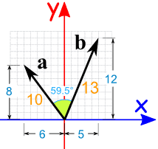
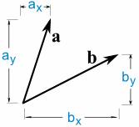
Dot product
BUT, if all we have is the vector itself:

Slide 9
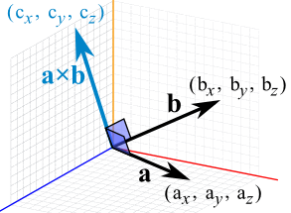
Cross product

Slide 10
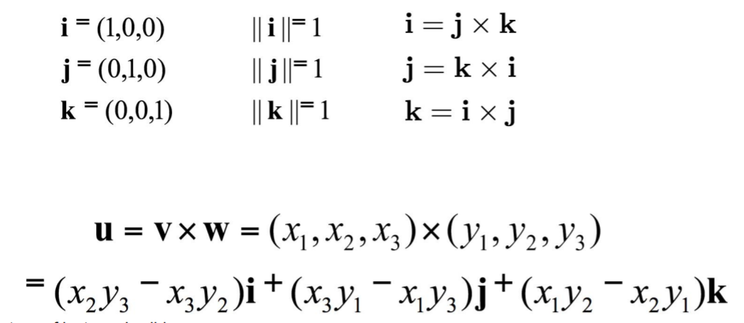
Cross Product

Slide 11
One Hot Encoding
A vector representation of a categorical value
This is a type of preprocessing used in machine learning
We will talk more about this in a few weeks!
So, you are converting categories to numbers so they can be processed better and more efficiently!
You are creating dummy variables… BUT This can lead to the Dummy Variable Trap
Notes:
https://www.educative.io/edpresso/one-hot-encoding-in-python

Slide 12
Dummy Variable Trap
Independent variables are multicollinear
Simply: variables are highly correlated, and one can be predicted from one or more others
Example: creating a dummy variable for male and a dummy variable for female is redundant

Slide 13
Break (5 Minutes)
Attendance word: OutstandingOpsEngineer

Slide 14
Week 9 Group Exercise
Once you finish and have submitted your exercise in Canvas via a github link, use the remaining time to work on your homework.

