Slide 1

SAMASTHA
-Information in its purest form
N190263
B.M.S.Lakshmi Durga

Slide 2
ABSTRACT
This project is a role-based web application aimed at supporting students in their academic and career planning. It features tailored dashboards for Super Admin, Admin, and Student roles. Key services include SOP Generator, Career Accelerator, and University Shortlist, which provide personalized outputs based on student data. My main contribution is frontend development and integration of backend APIs for these services

Slide 3
INTRODUCTION
Students often face challenges in planning their academic and career paths due to a lack of structured guidance and tools. Educational institutions also need efficient systems to manage students and provide relevant services. This project was initiated to address these needs by creating a platform that bridges this gap through digital solutions and personalized experiences

Slide 4
PROPOSED METHODOLOGY
User Authentication
Role-Based Dashboards
Services for Students

Slide 5
EXPERIMENTAL SETUP
Technologies Used:
Frontend: React, TypeScript, Tailwind CSS
Backend: Node.js
Database: MySQL
Routing: TanStack Router
State Management: Zustand
Libraries:
Axios, ShadCN UI

Slide 6
EXPERIMENTAL SETUP
System Hardware:
Processor: AMD Ryzen with 3 3250U with Radeon Graphics
RAM: 8 GB
OS: Windows
Testing Environment:
Manual and functional testing performed on different browsers like Microsoft Edge, Chrome

Slide 7
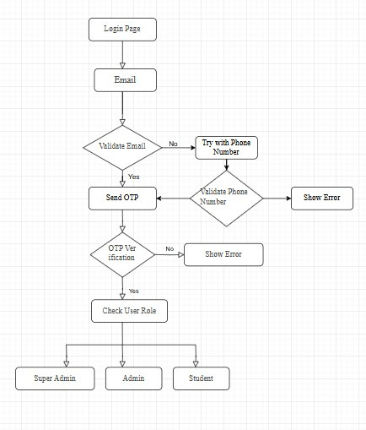
FLOWCHART
Authentication Flow:
Login Page Initiation
Email Input
Email Validation
Phone Number Validation
OTP Verification
User Role Check
Redirect Based on Role

Slide 8
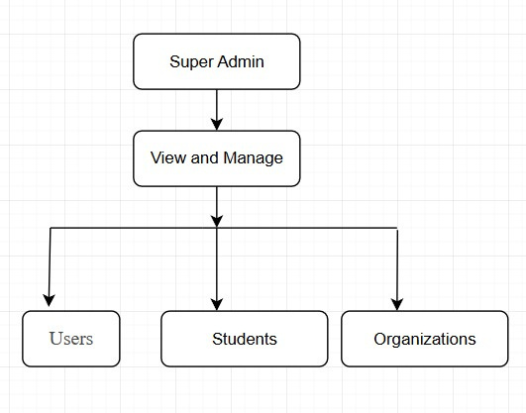
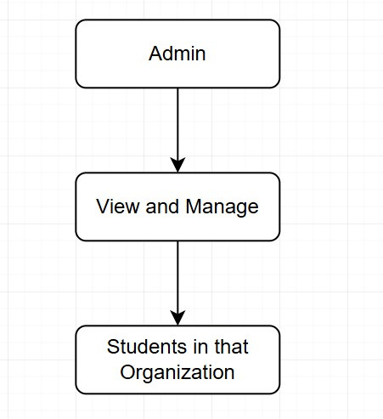
SUPER ADMIN AND ADMIN FLOW
Super admin can view and manage the users, students and organizations
Admin can view and manage the students in their organization

Slide 9
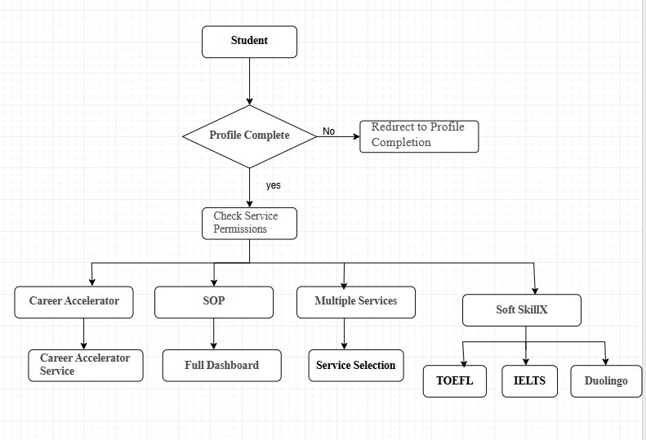
STUDENT WORKFLOW
Profile Check
Check Service Permissions
Available Services
Career Accelerator
SOP
SoftSkillX

Slide 10
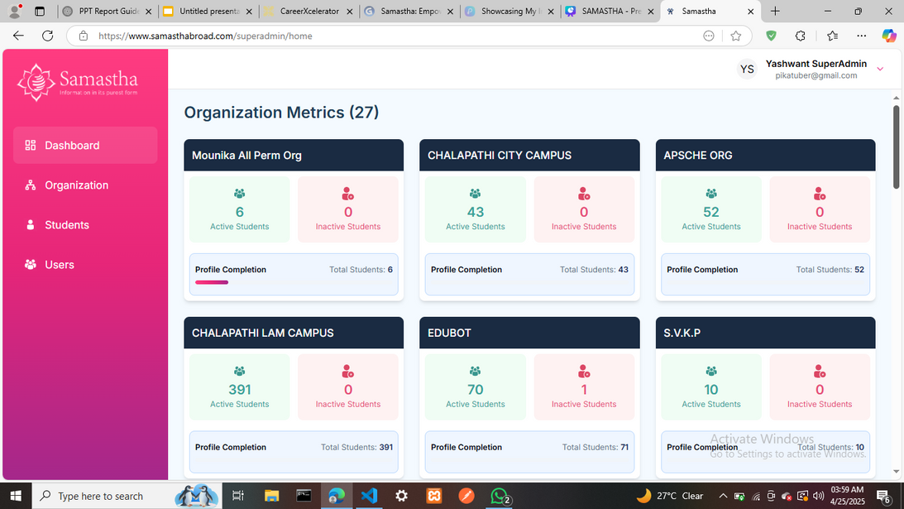
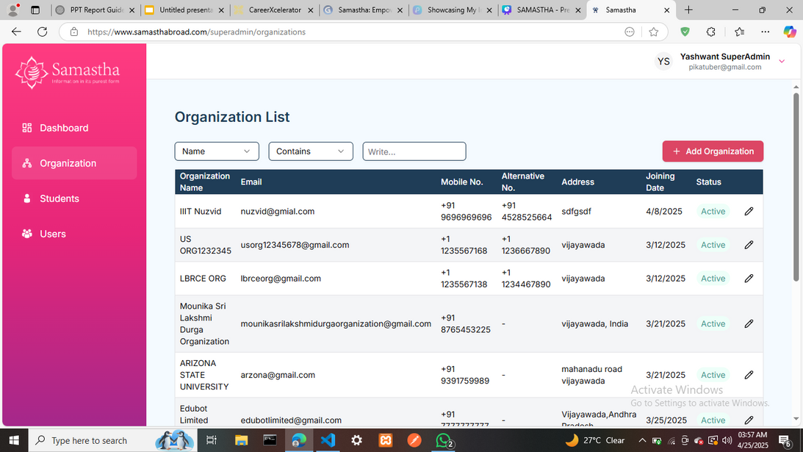
RESULTS
Super Admin Dashboard:
Samastha Link:
www.samasthabroad.com

Slide 11
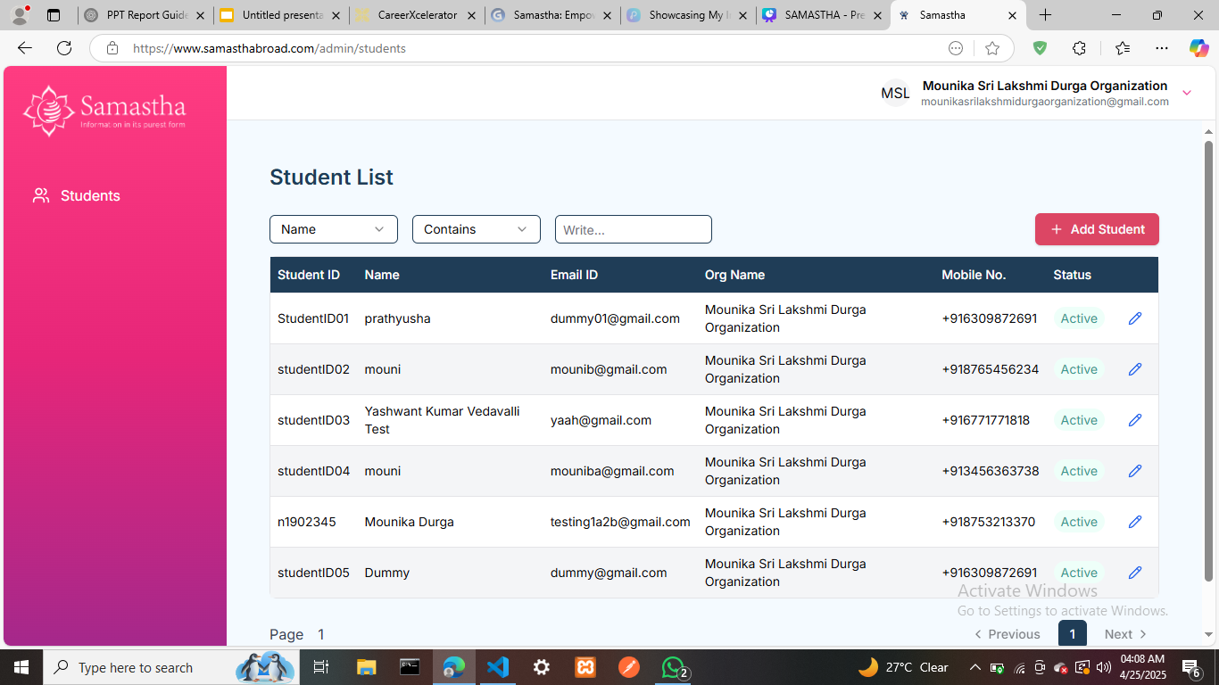
ADMIN DASHBOARD

Slide 12
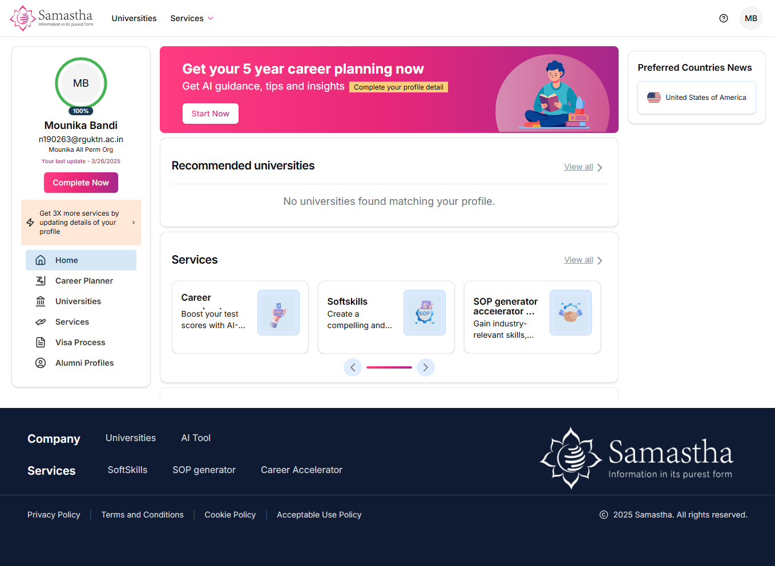
STUDENT DASHBOARD

Slide 13
CONCLUSION
The project provides a structured, role-based platform for managing students and delivering personalized academic services. My main role was in UI development and API integration to ensure a smooth and interactive user experience.

Slide 14
THANK YOU

