Slide 1

Maximizing Brand Impact with Influencers

Slide 2

Mounika, Aithagoni
Data Analyst
Manogna Vennela, Ramireddy,
Data Scientist
(Team Lead)
Jagadeesh chandra bose, Mende,
Data Visualization Modeling
Chandramohan,
Chandanakumar
Data Engineering

Slide 3

BUSINESS CHALLENGE
How can you find highly visible influencers that fit your reach and budget and have active followings that complement your brand?

Slide 4
PROPOSED SOLUTION
The objective of this project is to identify highly visible influencer who fit for different brand's reach and budget criteria and have active followings that complement the brand. By strategically partnering with these influencers, we aim to maximize brand visibility, engagement, and ultimately, drive business growth.

Slide 5




DATA SOURCES
Social Media Platforms
Influencer Marketing Platforms
APIs
Social Listening Tools
Publicly Available Datasets

Slide 6





TOOLS USED
REPOSITORIES :
GitHub
ANALYTICS :
Google analytics
Adobe Analytics
CLOUD STORAGE:
Amazon Web Services (AWS)
Microsoft Azure
PROGRAMMING LANGUAGE :
Node.js
Python
PROGRAMMING:
Jupyter notebook
DATABASE :
SQL database (MySQL)
NoSQL database (MongoDB)

Slide 7
METHODOLOGY
Project Planning and Definition
Define project objectives, scope, and deliverables.
Market Research and Analysis
Conduct market research to understand the landscape of influencer marketing platforms, competitor apps, and user needs.
User Persona Development
Personas representing target users such as marketers, brand managers, or social media managers
Business Understanding
CRISP DM
Deployment
Deploy the app to relevant platforms such as app stores (e.g., Apple App Store, Google Play Store) or web platforms.
Integration of Data Sources
Integrate APIs provided by social media platforms, influencer marketing platforms, and third-party data providers to gather influencer data.
Development
Implement features and functionalities of the app according to the defined requirements and technical specifications.

Slide 8
OVERCOMING CHALLENGES FOR STRATEGIC SUCCESS
Effectively assessing influencer performance and brand alignment involves navigating a nuanced web of metrics
1
The pervasive issue of fake followers and influencer fraud can distort data, making the identification of genuine influencers a complex task.
2
Fostering lasting and mutually beneficial relationships with influencers is a cornerstone of sustained success in influencer marketing.
3
The dynamic nature of social media algorithms poses an ongoing challenge, impacting how content is displayed and reaches audiences.
4
Addressing the challenges through well-thought-out strategies, the likelihood of successfully implementing influencer marketing projects and achieving desired outcomes is significantly increased, promoting cost-effective and impactful campaigns.
5

Slide 9
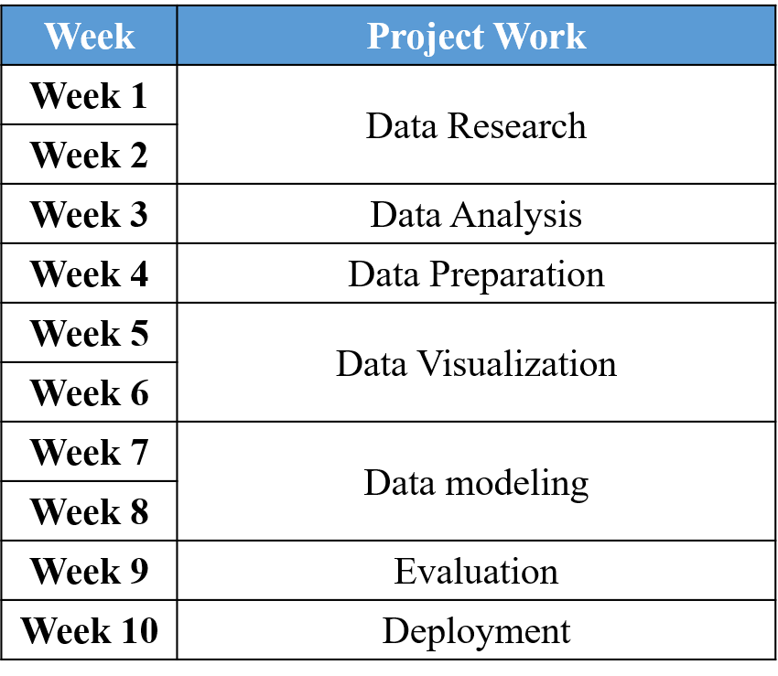
PROJECT TIME LINE
WEEK
WEEK | PROJECT WORK

Slide 10
https://github.com/Mounika-401/Distributed-Scalable_Data_Engineering

Slide 11

THANK YOU

