Slide 1


Maximizing Brand Impact with Influencers

Slide 2

Mounika, Aithagoni
Data Analyst
Manogna Vennela, Ramireddy,
Data Scientist
(Team Lead)
Jagadeesh chandra bose, Mende,
Data Visualization Modeling
Chandramohan,
Chandanakumar
Data Engineering

Slide 3


BUSINESS CHALLENGE
Today, it's really important for brands to team up with social media influencers. These influencers have followers who trust them, so when they talk about a product, it feels real. Plus, they can reach a lot of people and get them excited about stuff in a way regular ads can't. But to make sure these partnerships work well. brands need to use data to make smart choices. Data helps brands understand who follows the influencers and what they like. This helps them pick the right influencers and make content that hits the spot. By using data with influencer marketing, brands can make their campaigns even better and get great results for their business.

Slide 4
PROPOSED SOLUTION
The proposed solution focuses on leveraging data driven insights to optimize the marketing strategy for the product launch. Firstly, careful selection of influencers based on engagement rates, relevant content, and audience alignment is crucial. This ensures that the chosen influencers resonate with the target demographic and have established trust with their followers. Secondly, thorough audience analysis provides valuable insights into preferences and behaviors, enabling tailored messaging and content creation that appeals to the target audience. Collaboration with influencers to develop authentic and engaging content further enhances the campaign's effectiveness. Continuous monitoring and optimization based on real-time metrics allow for agile adjustments to maximize campaign performance. A/B testing helps identify the most effective strategies, guiding future decision making. Building long-term relationships with successful influencers fosters trust and loyalty among their audience. Finally, post-campaign analysis provides valuable learnings for refining future marketing strategies. Overall, integrating data driven insights into influencer marketing efforts ensures a strategic approach that drives successful outcomes for the product launch.

Slide 5



DATA SOURCES
Social Media Platforms
Influencer Marketing Platforms
APIs
Social Listening YouTube Tool
Publicly Available Datasets

Slide 6





TOOLS USED
PROGRAMMING LANGUAGE :
Python
MATLAB
REPOSITORIES :
GitHub
PROGRAMMING:
Jupyter notebook
DATABASE :
AWS

Slide 7
METHODOLOGY
Project Planning and Definition
Define project objectives, scope, and deliverables.
Market Research and Analysis
Conduct market research to understand the landscape of influencer marketing platforms, Most category wise and user needs.
User Personal Development
Persons representing target users such as marketers, Most liked category in YouTube
Business Understanding
CRISP DM
Deployment
Deploy to relevant platforms such as YouTube
Integration of Data Sources
Integrate APIs provided by social media platforms, influencer marketing platforms, and third-party data providers to gather influencer data.
Development
Implement features and Most liked content (music, food and education) according to the defined requirements and specifications.

Slide 8
OVERCOMING CHALLENGES FOR STRATEGIC SUCCESS
Effectively assessing influencer performance and brand alignment involves navigating a nuanced web of metrics
1
The pervasive issue of fake followers and influencer fraud can distort data, making the identification of genuine influencers a complex task.
2
Fostering lasting and mutually beneficial relationships with influencers is a cornerstone of sustained success in influencer marketing.
3
The dynamic nature of social media algorithms poses an ongoing challenge, impacting how content is displayed and reaches audiences.
4
Addressing the challenges through well-thought-out strategies, the likelihood of successfully implementing influencer marketing projects and achieving desired outcomes is significantly increased, promoting cost-effective and impactful campaigns.
5

Slide 9
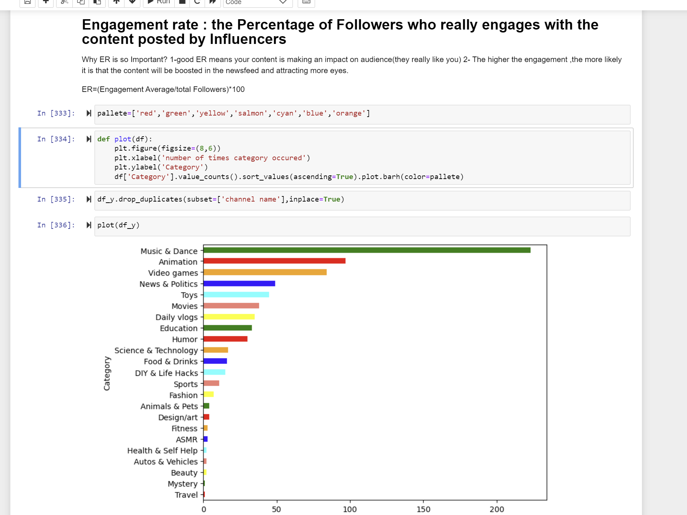
Engagement rate : the Percentage of Followers who really engages with the content posted by Influencers
The engagement rate measures the proportion of an influencer's followers who actively interact with their content, indicating the level of audience involvement and interest. It is calculated by dividing the total number of music dance, animation, video games, News & politics, toys, Movies, Daily Vlogs, Education and Food & Drinks etc.., A higher engagement rate signifies a more engaged audience and indicates that the content resonates well with followers. Brands often use engagement rate as a key metric to assess the effectiveness of influencer partnerships and gauge the impact of content on audience interaction and brand awareness.

Slide 10
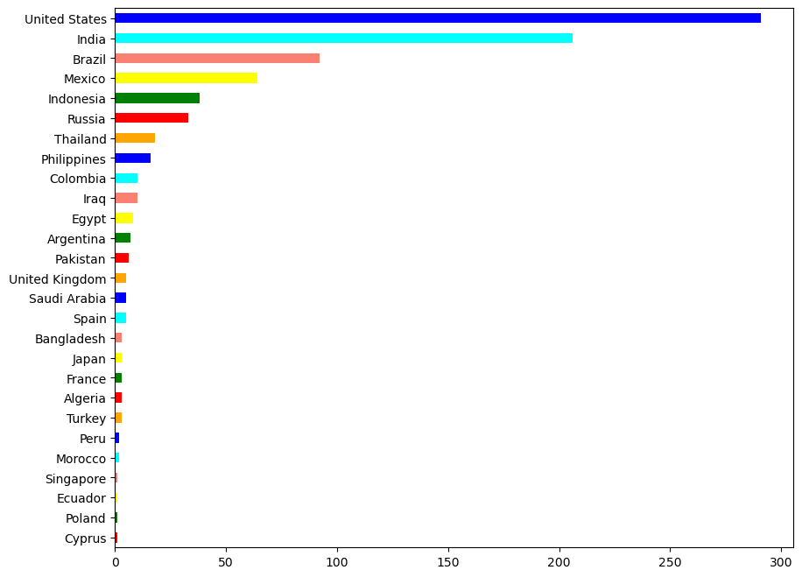
TOP consumer countries of the influencers content on YOUTUBE
Which countries consume the most content from influencers on YouTube helps businesses understand where their audience is located. This information helps them tailor their marketing strategies to reach these audiences better. By focusing on these top consumer countries, businesses can create content that resonates with people in those places, leading to stronger connections and better engagement.

Slide 11
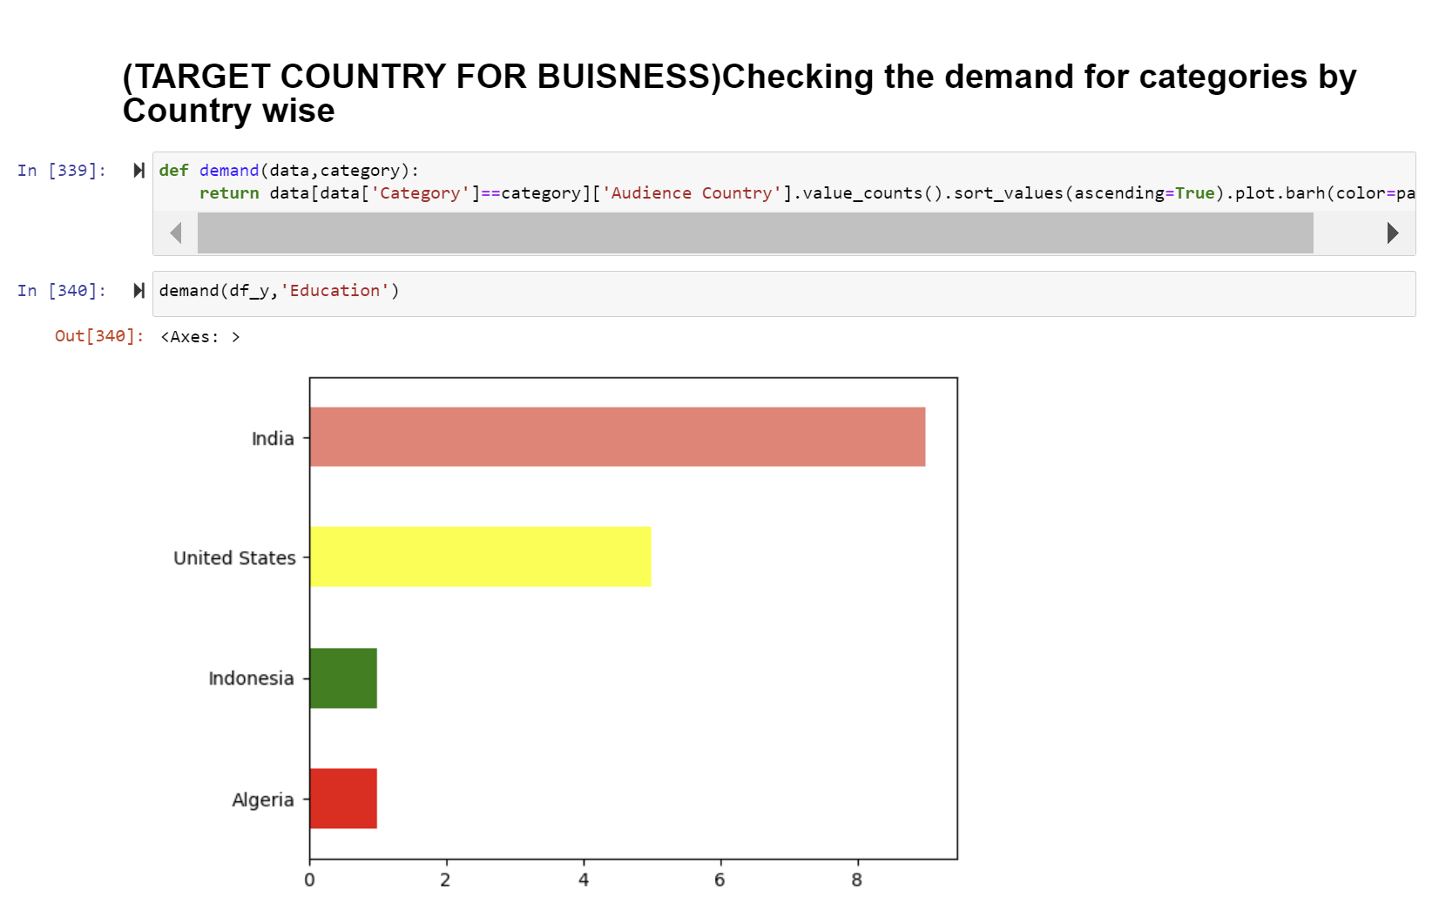
Checking the demand for categories by Country wise (TARGET COUNTRY FOR BUISNESS)
Checking the demand for different categories in specific countries (India, USA, Indonesia, and Algeria) is crucial for businesses to identify potential target markets. Analyzing which categories are popular in particular countries, businesses can tailor their products, services, and marketing strategies to meet the preferences and needs of those markets. This data driven approach helps businesses allocate resources effectively and maximize their chances of success in each target country.

Slide 12
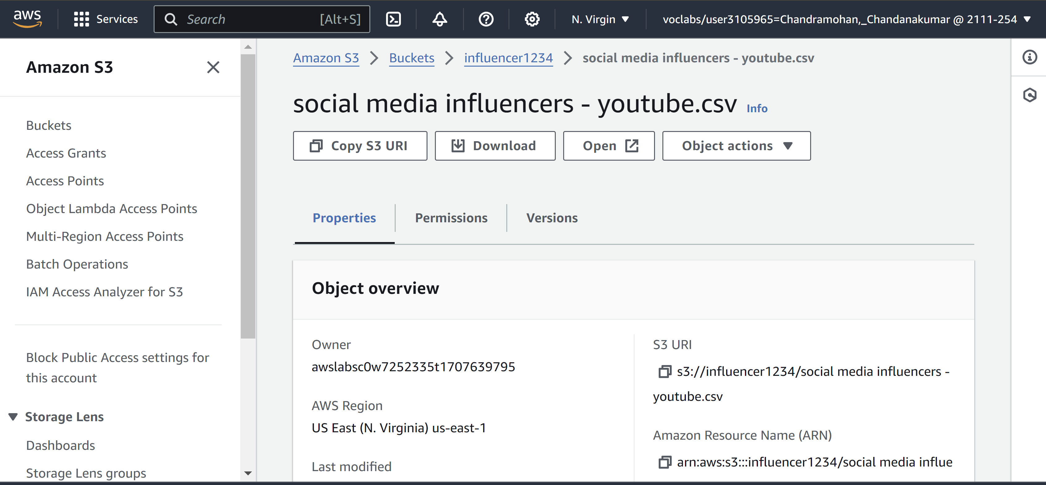
AWS S3-Bucket

Slide 13
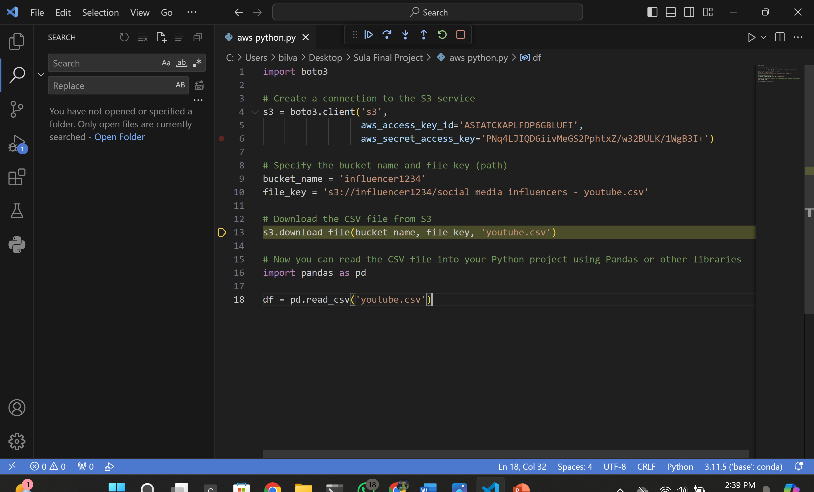
AWS – Python code

Slide 14
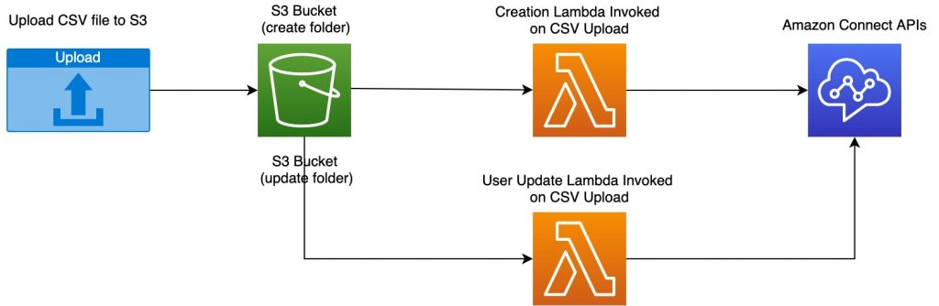
AWS tool tool used for data source

Slide 15
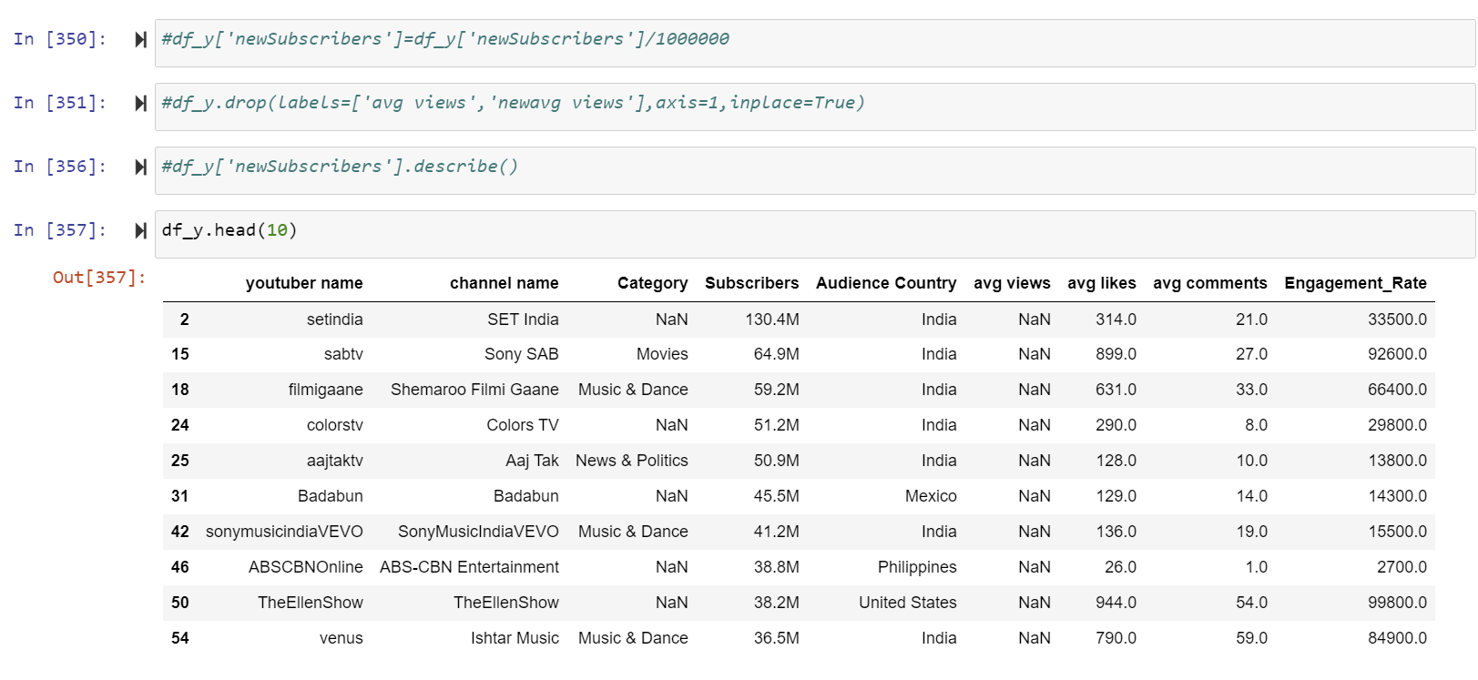
Listed in order Subscribers Hight-Low for YouTube influencers
Sorting Higher to lower YouTube influencers by their subscriber count is essential in influencer marketing.

Slide 16
Conclusion
Content Impact and Engagement:
A high engagement rate suggests that the content is impactful and resonates with the audience.
Emphasizing content quality and relevance can further enhance engagement and audience satisfaction.
Marketing Opportunities and Strategy Formulation:
Insights from the analysis can guide marketing strategies, helping to target specific content categories or geographic locations effectively.
Tailoring marketing campaigns based on audience preferences and content trends can lead to better engagement and higher ROI.

Slide 17
https://github.com/Mounika-401/Distributed-Scalable_Data_Engineering

Slide 18

THANK YOU

