Slide 1
Fitness Buddy
IBM AICTE PROJECT
Presented By:Pasupuleti Mounika
College Name & Department : Prasad V Potluri Siddhartha Institute of Technology&CSE(AI&ML)

Slide 2
OUTLINE
Problem Statement
Technology used
Wow factor
End users
Result
Conclusion
Git-hub Link
Future scope
IBM Certifications

Slide 3
PROBLEM STATEMENT
In today’s fast-paced world, individuals often struggle to maintain a healthy lifestyle due to a lack of personalized guidance, time constraints, and inconsistent motivation. Existing fitness solutions are often expensive, rigid, or not tailored to individual routines and preferences.
There is a growing need for an accessible, intelligent, and friendly virtual assistant that can offer personalized support in fitness, healthy habits, and nutrition—anytime, anywhere.
Fitness Buddy aims to bridge this gap by providing an AI-powered conversational coach that:
Recommends home workouts based on user input
Delivers motivational tips and daily inspiration
Suggests simple, nutritious meal ideas
This ensures a flexible, user-friendly, and affordable solution for achieving personal health goals.
Proposed Solution:- Fitness Buddy is an AI-powered virtual health and fitness assistant designed to help individuals maintain a healthy lifestyle in a simple, personalized, and accessible way.It addresses key challenges like time constraints, lack of guidance, and low motivation by offering:

Slide 4
TECHNOLOGY USED
IBM cloud lite services
Natural Language Processing (NLP)
IBM Granite model

Slide 5
IBM CLOUD SERVICES USED
IBM Cloud Watsonx AI Studio
IBM Cloud Watsonx AI runtime
IBM Cloud Agent Lab
IBM Granite foundation model

Slide 6
WOW FACTORS
This assistant makes fitness simple, accessible, and personal — helping users build a healthy lifestyle without expensive trainers, strict schedules, or overwhelming routines.Smart Course Recommendations
Unique Features:
Personalized workout suggestions
Recommends beginner to advanced home workouts based on user input and fitness level.
Daily motivational messages & habit reminders
Keeps users consistent with fitness through short, encouraging messages and simple daily habits.
Healthy meal recommendations
Provides nutritious, easy-to-make food options for breakfast, lunch, and dinner — tailored to goals like energy, weight loss, or muscle gain.
Flexible scheduling support
Helps users set workout times, rest periods, and track weekly goals with no pressure
Friendly, conversational interface
Feels like chatting with a real fitness coach — 24/7 and free of cost.
Instant access, no downloads needed
Works from anywhere through chat, no gym, app, or equipment required.

Slide 7
END USERS
Fitness Beginners
Busy Professionals & Students
Budget-Conscious Individuals
Tech-Savvy Users
Remote or Rural Area Users

Slide 8
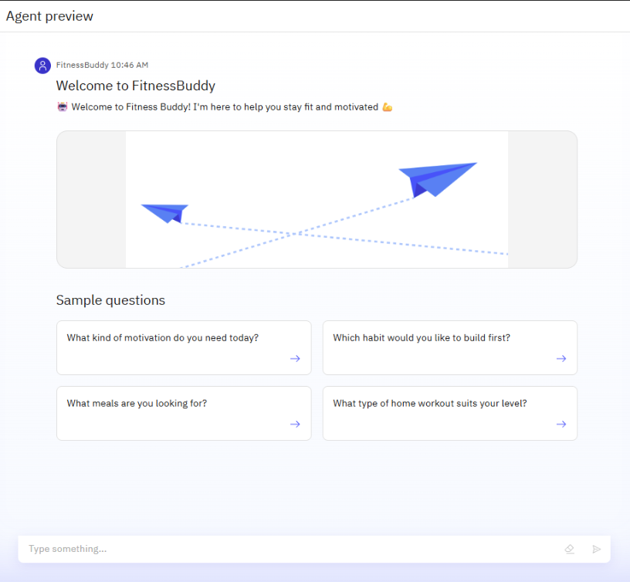
RESULTS

Slide 9
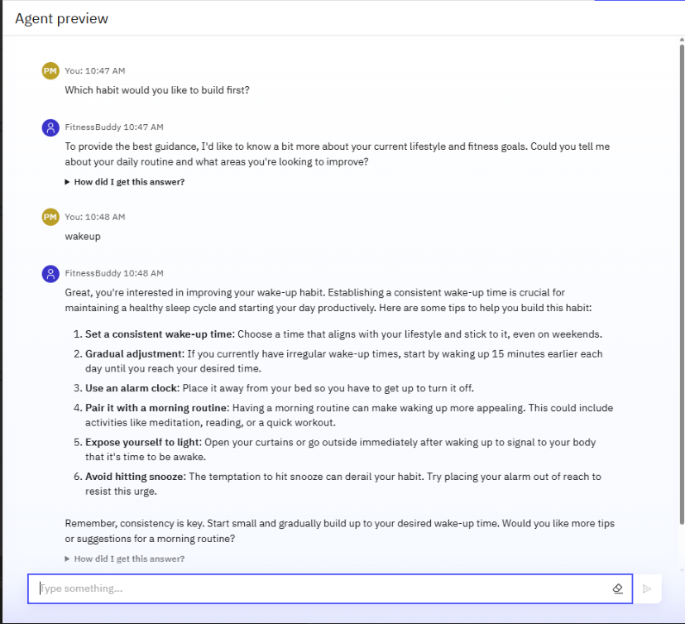
RESULTS

Slide 10
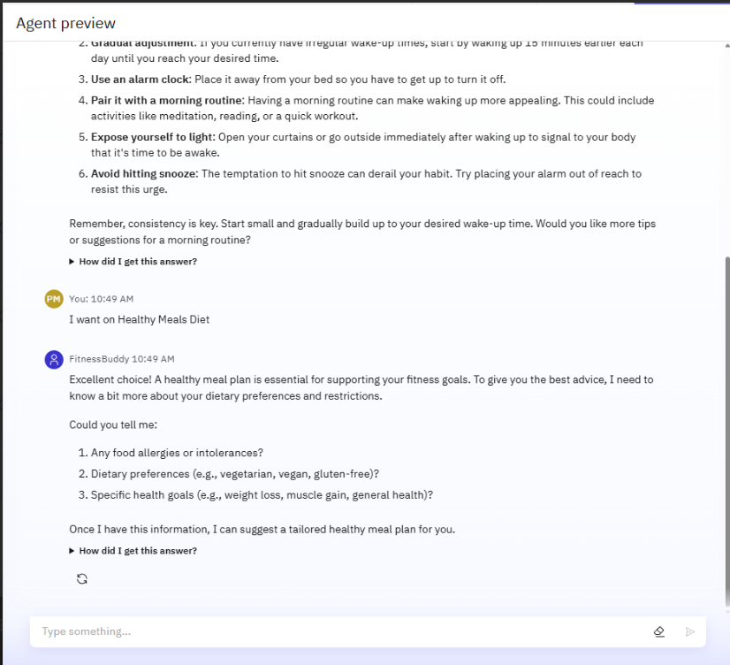
RESULTS

Slide 11
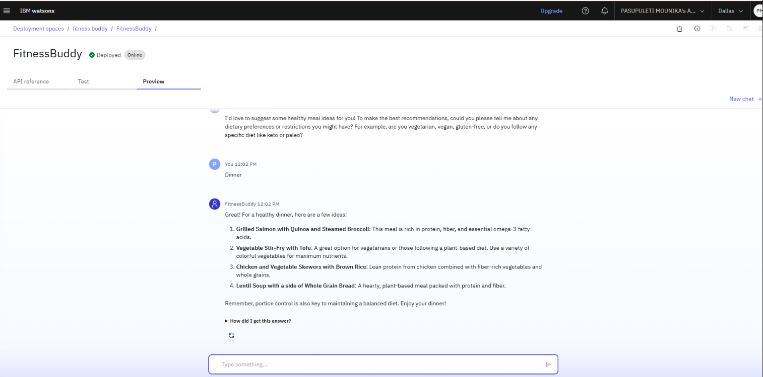
RESULTS
Deployed AI Agent

Slide 12
CONCLUSION
Easy & Accessible– Fitness guidance available anytime, anywhere.
Personalized Support– Workouts, meals, and motivation tailored to the user.
Healthy Lifestyle Made Simple– Helps users build lasting habits with ease.

Slide 13
GITHUB LINK
GitHubLink :
https://github.com/Mounika-Pasupuleti/FitnessBuddyProject/upload

Slide 14
FUTURE SCOPE
AI-Based Personalization
Use AI to generate smarter workout and meal plans based on user data.
Integration with Wearables
Sync with smartwatches/fitness bands to track steps, heart rate, and sleep.
Voice Assistant Support
Enable voice commands for hands-free fitness tracking and coaching.

Slide 15
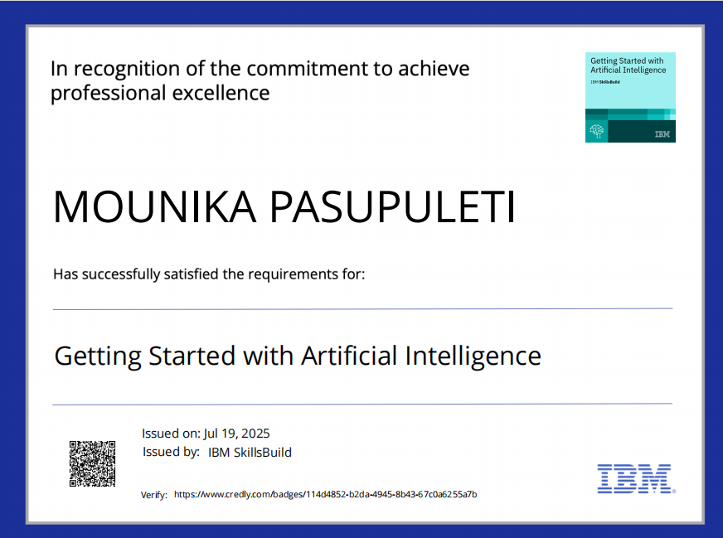
IBM CERTIFICATIONS

Slide 16
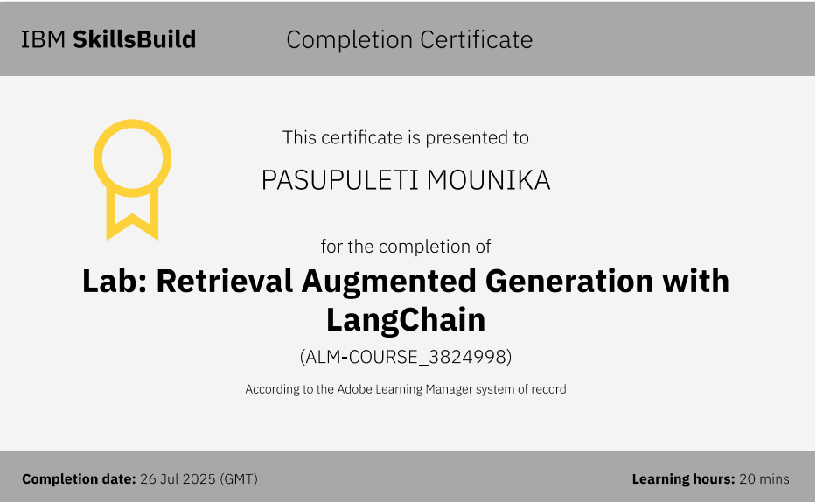

Slide 17
THANK YOU

