Slide 1

A HYBRID APPROACH FOR CROP YIELD PREDICTION USING A GRADIENT-ENHANCED MULTIPLE LINEAR-POLYNOMIAL MODEL
Batch Members
T. Mounika (21NN1A0561)
M. Sravya (21NN1A0543)
G. Malleswari (21NN1A0519)
D. Prasanna (22NN5A0501)
Under the Esteemed Guidance of Dr. A. Naresh Professor
28-03-2025

Slide 2
INDEX
Abstract
Introduction
Literature Survey
Research Gaps Identified
Proposed Work
System Architecture
Algorithm
Dataset Used
Results and Discussion
Conclusion
References
28-03-2025

Slide 3
ABSTRACT
Accurate crop yield prediction is essential for optimal agricultural resource management and food security. Traditional models, limited by few environmental parameters, often yield suboptimal results. This study proposes a Hybrid Gradient-Enhanced Multiple Linear-Polynomial (GEMLP) model, combining Multiple Linear Regression (MLR), Polynomial Regression (PR), and Gradient Boosting Regressor (GBR) for improved accuracy. The model incorporates ensemble learning, polynomial feature expansion, and hyperparameter tuning, leveraging key variables such as temperature, rainfall, and pesticide use. Experimental results show a substantial reduction in Mean Squared Error (MSE) and a significant increase in R² score (97%), outperforming conventional methods. GEMLP offers a scalable, robust, and data-driven framework for precision agriculture, enabling informed decision-making, resource optimization, and promoting sustainable farming practices.
28-03-2025

Slide 4
INTRODUCTION
Conventional farming relies heavily on intuition, causing inaccurate yield forecasts, inefficient resource usage, and reduced profits due to excessive water, pesticide, and fertilizer use.
GELPM analyzes soil, temperature, rainfall, and pesticide usage to accurately forecast yields—enabling smart crop selection and efficient resource planning.
By reducing chemical and water dependency, GELPM promotes soil health and supports sustainable, eco-friendly agriculture.
The hybrid model uses both historical and real-time data to provide adaptable strategies for unpredictable weather and effective crop planning.
Data-driven insights from GELPM lower input costs, increase yields, and align farming with market demand—ensuring both sustainability and profitability.
28-03-2025

Slide 5
LITERATURE SURVEY
S.NO | Authors & Year | Technology Used | Advantages | Limitations
[1] | Kuradusenge et al. (2023) | Random Forest (RF), Polynomial Regression (PR), Support Vector Regressor (SVR) | RF achieved high accuracy; identified optimal weather for potatoes and maize | Limited to Musanze district; only used rainfall and temperature
[2] | Musanase et al. (2023) | Machine Learning, IoT, Data-driven Analysis | Enabled real-time insights; improved precision farming and productivity | Requires robust IoT infrastructure; high data processing needs
28-03-2025

Slide 6
[3] | Ali et al. (2022) | Remote Sensing (RS), Hyperspectral & Multispectral Imaging, Radar, Lidar, Spectroscopy | Effective for large-scale monitoring and early disease detection | High-resolution imagery is expensive; demands significant computational resources
[4] | Abbas et al. (2020) | Linear Regression (LR), Elastic Net, k-NN, SVR | SVR performed well; use of proximal sensing improved accuracy | Ineffective k-NN; required large datasets for reliable results
[5] | Tian et al. (2020) | Hybrid MLR-ANN, SVR, Random Forest | Increased accuracy with reduced computation time | Focused only on paddy; validated on limited datasets

Slide 7
RESEARCH GAPS IDENTIFIED
Limited Feature Scope: Many models use only basic parameters like rainfall and temperature,
ignoring critical factors such as pesticides, soil type, and real-time weather variations.
Regional Limitations:
Most studies are constrained to specific regions, reducing their generalizability to diverse agro-
climatic zones.
Lack of Hybrid Approaches: Few works combine linear, non-linear, and ensemble learning
methods in a unified framework for yield prediction.
Scalability Issues: Existing models often struggle to scale with larger datasets or adapt to multi-
crop prediction scenarios.
28-03-2025

Slide 8
PROPOSED WORK
Objective: Develop an accurate, scalable crop yield prediction model using a hybrid GEMLP
approach
Model Components:
MLR for linear trends
PR for non-linear relationships
GBR for boosting prediction accuracy
Inputs Used: Rainfall, temperature, pesticide use, and historical yield data
Techniques Applied:
Feature engineering (encoding, standardization, polynomial expansion)
Ensemble learning with performance tuning
Evaluation using MSE, RMSE, MAE, R²
Outcome: Achieves high accuracy (R² ≈ 97%), supports precision agriculture, and enables resource-efficient planning
28-03-2025

Slide 9
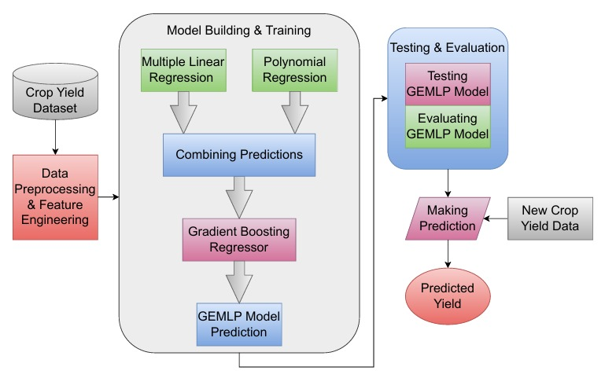
SYSTEM ARCHITECTURE
Fig: Gradient-Enhanced Multiple Linear-Polynomial Model (GEMLP)
28-03-2025

Slide 10
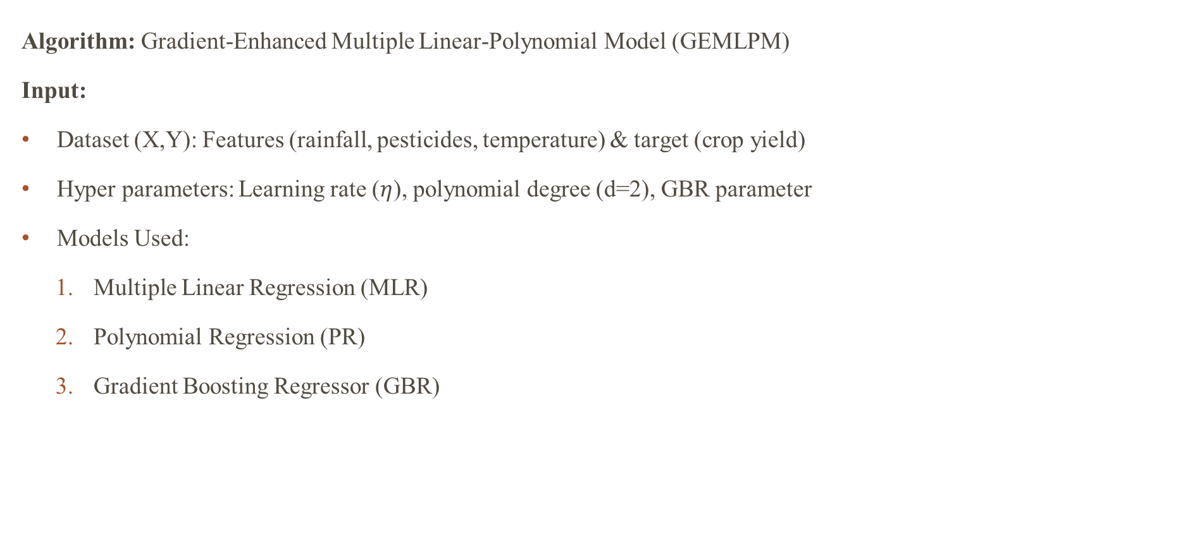
ALGORITHM
Algorithm: Gradient-Enhanced Multiple Linear-Polynomial Model (GEMLPM)
Input:
Dataset (X,Y): Features (rainfall, pesticides, temperature) & target (crop yield)
Hyper parameters: Learning rate ($η$), polynomial degree (d=2), GBR parameter
Models Used:
Multiple Linear Regression (MLR)
Polynomial Regression (PR)
Gradient Boosting Regressor (GBR)
28-03-2025

Slide 11
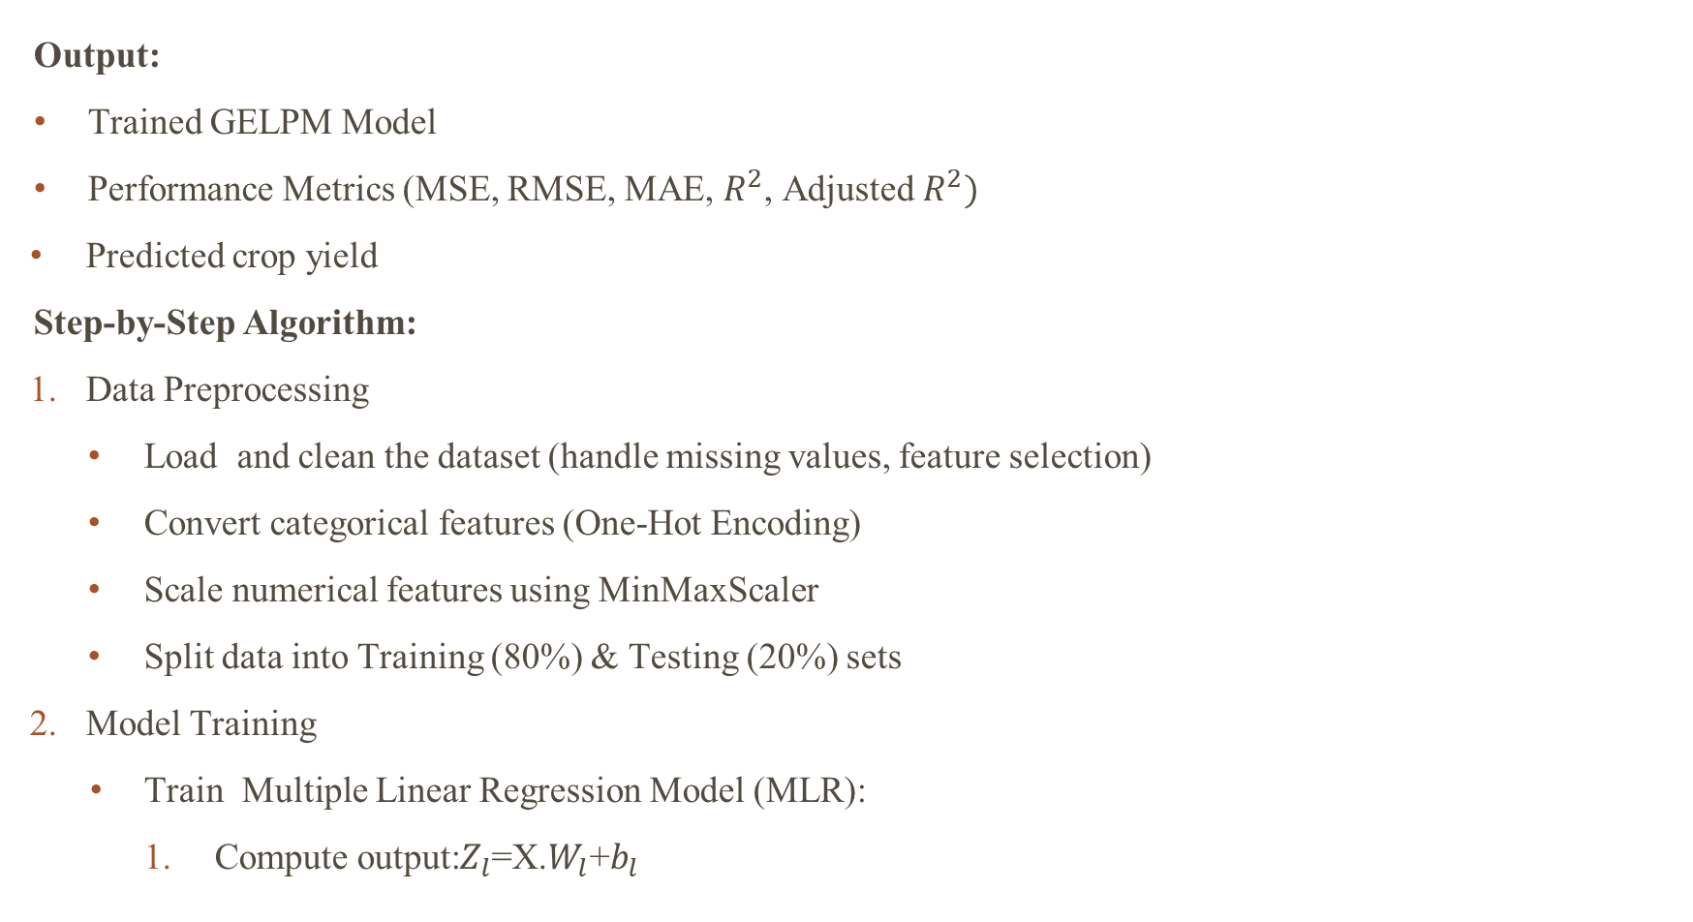
Output:
Trained GELPM Model
Performance Metrics (MSE, RMSE, MAE, $R^{2}$, Adjusted $R^{2})$
Predicted crop yield
Step-by-Step Algorithm:
Data Preprocessing
Load and clean the dataset (handle missing values, feature selection)
Convert categorical features (One-Hot Encoding)
Scale numerical features using MinMaxScaler
Split data into Training (80%) & Testing (20%) sets
Model Training
Train Multiple Linear Regression Model (MLR):
Compute output:$Z_{l}$=X.$W_{l}$+$b_{l}$
28-03-2025

Slide 12
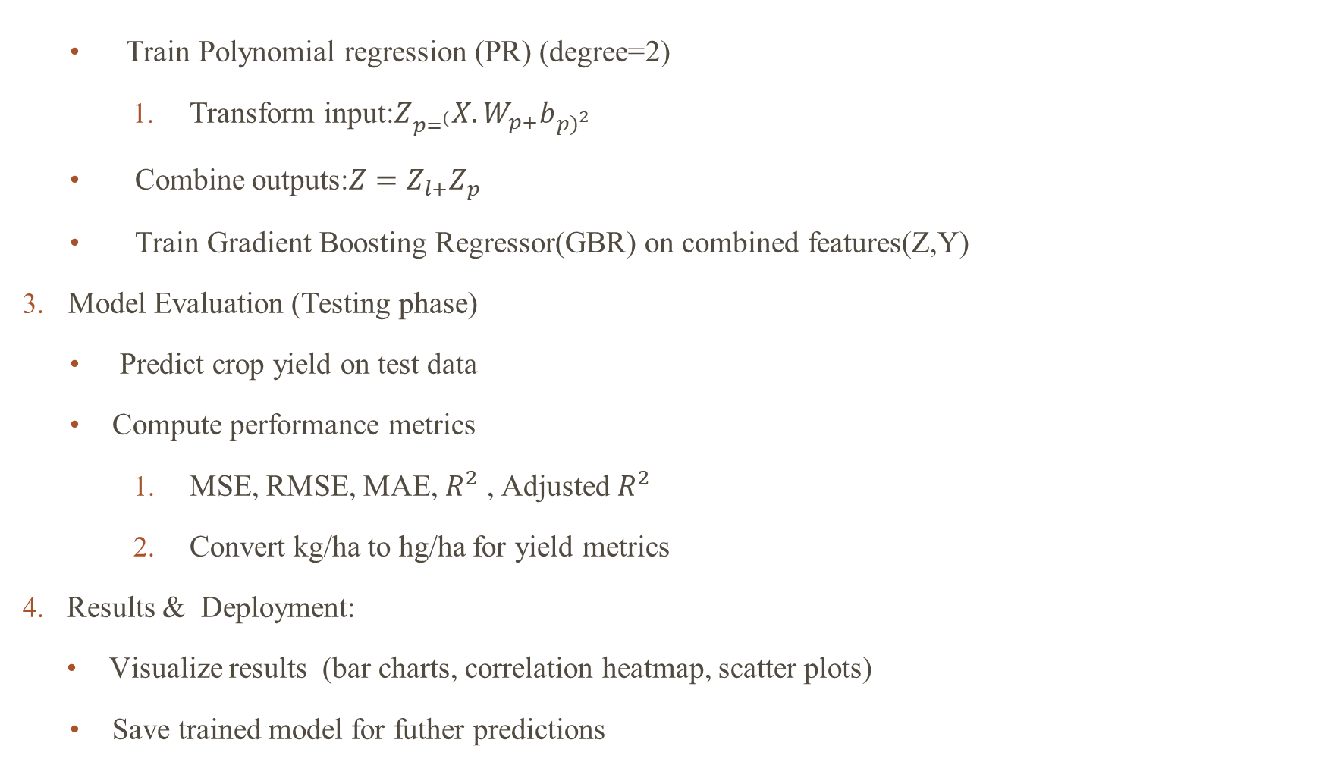
Train Polynomial regression (PR) (degree=2)
Transform input:$Z_{p=^{(}}X.W_{p+}b_{p)^{2}}$
Combine outputs:$Z=Z_{l+}Z_{p}$
Train Gradient Boosting Regressor(GBR) on combined features(Z,Y)
Model Evaluation (Testing phase)
Predict crop yield on test data
Compute performance metrics
MSE, RMSE, MAE, $R^{2}$ , Adjusted $R^{2}$
Convert kg/ha to hg/ha for yield metrics
Results & Deployment:
Visualize results (bar charts, correlation heatmap, scatter plots)
Save trained model for futher predictions
28-03-2025

Slide 13
DATASET
Dataset Name: Yield_Prediction.csv
Source:Available in open datasets (e.g., Kaggle).
Number of Records: 28,242
Number of Attributes (Features): 7
Dataset Link: https://www.kaggle.com/code/kushagranull/crop-yield-prediction/input

Slide 14
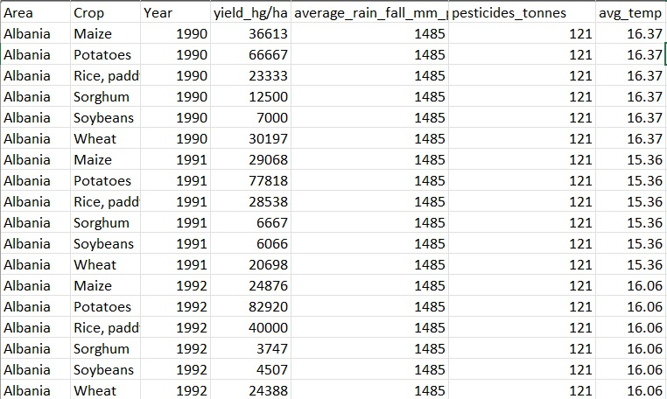
FEATURES

Slide 15
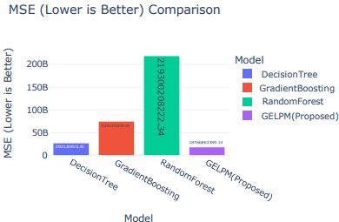
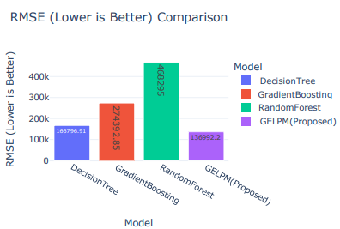
RESULTS AND DISCUSSION
Fig(1) :MSE Fig(2):RMSE
28-03-2025

Slide 16
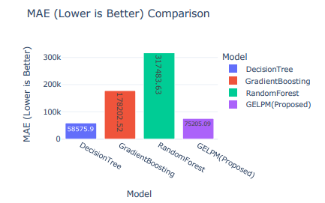
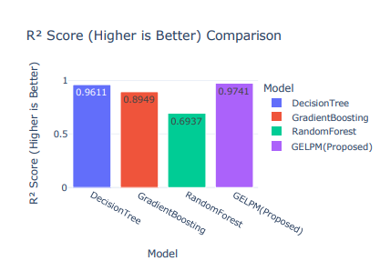
Fig(3) :MAE
Fig(4): $R^{2}$

Slide 17
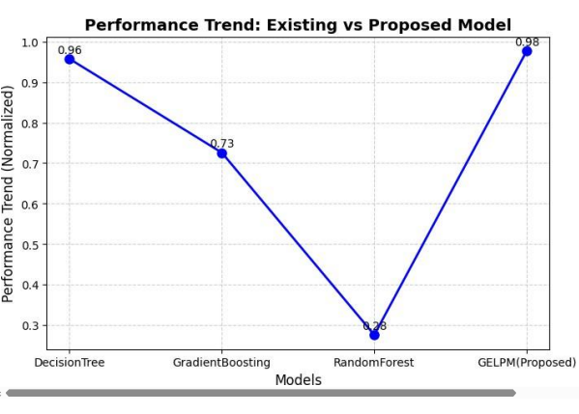
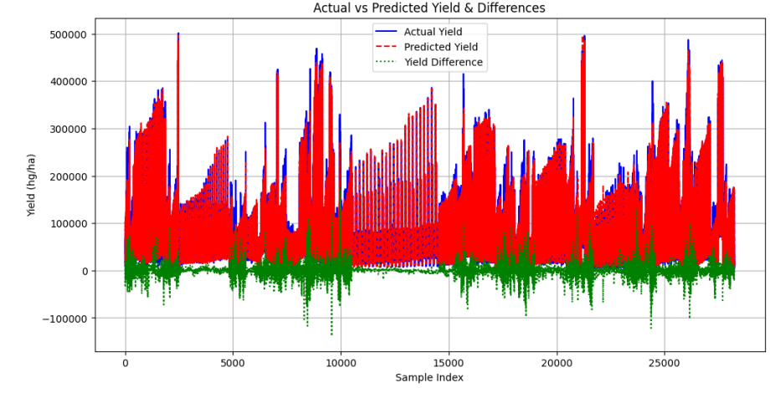
Fig(5): Existing vs Proposed Model
Fig(6): Actual Yield vs Predicted Yield
28-03-2025

Slide 18
CONCLUSION
The GEMLP Model significantly improves crop yield estimation using linear regression, polynomial transformation, and ensemble learning techniques to make better predictions.
The model employs various agronomic parameters for optimal resource utilization and sustainable agricultural development.
GEMLP Model information enables farmers, policymakers, and stakeholders to make better, data-based decisions that can enhance agricultural planning.
The model is scalable and extendable to other crops and geographic locations, making it increasingly applicable across the world.
The future work can extend the model further by including IoT-based real-time monitoring and remote sensing data, further increasing predictive capability for precision agriculture.
28-03-2025

Slide 19
REFERENCES
Kuradusenge, Martin, et al. "Crop yield prediction using machine learning models: Case of Irish potato and maize." Agriculture 13.1 (2023): 225.
Musanase, Christine, et al. "Data-driven analysis and machine learning-based crop and fertilizer recommendation system for revolutionizing farming practices." Agriculture 13.11 (2023): 2141.
Ali, Abdelraouf M., et al. "Crop yield prediction using multi sensors remote sensing." The Egyptian Journal of Remote Sensing and Space Science 25.3 (2022): 711-716.
Abbas, Farhat, et al. "Crop yield prediction through proximal sensing and machine learning algorithms." Agronomy 10.7 (2020): 1046.
Tian, Li, et al. "Yield prediction model of rice and wheat crops based on ecological distance algorithm." Environmental Technology & Innovation 20 (2020): 101132.
28-03-2025

Slide 20
THANK YOU
28-03-2025

