Slide 1

KNN
-- Mounika Voriganti

Slide 2
Introduction
The k-nearest neighbors (KNN) algorithm is a simple, easy-to-implement supervised machine learning algorithm that can be used to solve both classification and regression problems.
It is also called a lazy learner algorithm because it does not learn from the training set immediately instead it stores the dataset and at the time of classification, it performs an action on the dataset.
K-NN algorithm stores all the available data and classifies a new data point based on the similarity. This means when new data appears then it can be easily classified into a well suite category by using K- NN algorithm.

Slide 3
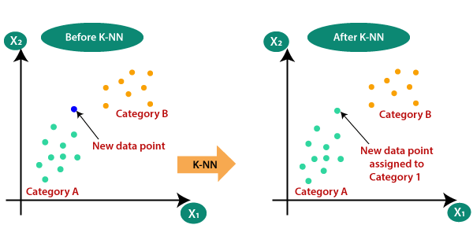
Steps in KNN

Slide 4
Step-1: Select the number K of the neighbors
Step-2: Calculate the Euclidean distance of K number of neighbors
Step-3: Take the K nearest neighbors as per the calculated Euclidean distance.
Step-4: Among these k neighbors, count the number of the data points in each category.
Step-5: Assign the new data points to that category for which the number of the neighbor is maximum.
Step-6: Our model is ready.

Slide 5
For Classification, count the number of data points in each category among the k neighbors. New data point will belong to class that has the most neighbors
For Regression, value for the new data point will be the average of the k neighbors.

Slide 6
Distance Calculations:
Distance can be calculated using
Euclidean distance
Manhattan distance

