Slide 1

UNDERFITTING & OVERFITTING
-- Mounika Voriganti

Slide 2
Bias :
Bias Means error of the training data.
Variance :
Variance means error of the testing data.
What is generalized model :
The goal of a good machine learning model is to generalize well from the training data to any data from the problem domain. This allows us to make predictions in the future on data the model has never seen.
A model that generalizes well is a model that is neither underfit nor overfit.

Slide 3
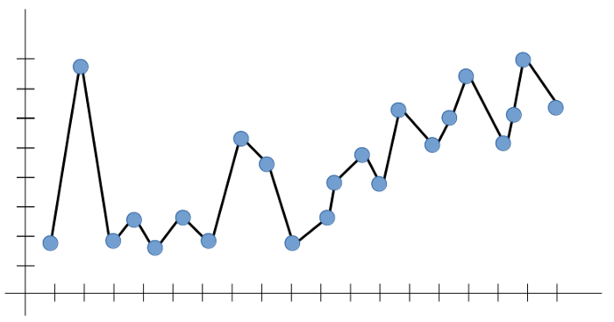
Over Fitting
Overfitting is the case where the overall cost is really small, but the generalization of the model is unreliable. This is due to the model learning “too much” from the training data set.

Slide 4
Accuracy during training is very high but accuracy during testing is very low then this condition is called overfitting.
It is able to perform well on training dataset but it does not perform well on testing dataset.
Low Training error
High Testing Error
Low Bias
High Variance
Training Error - 1% | Testing Error - 25%

Slide 5
How to Avoid Overfitting in a model
Cross-Validation
Training with more data
Removing features
Regularization
Ensembling

Slide 6
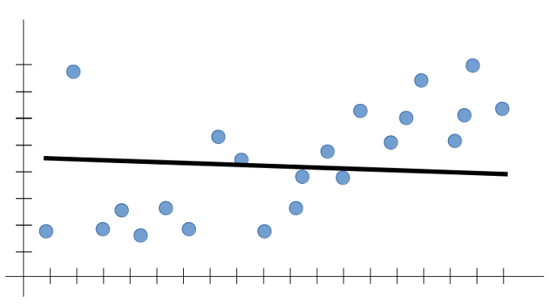
Under fitting
Underfitting is the case where the model has “ not learned enough” from the training data, resulting in low generalization and unreliable predictions.

Slide 7
Accuracy during training is very low but accuracy during testing is very high then this condition is called overfitting.
It does not perform well on training dataset as well as on testing dataset.
High Training error
High Testing error
High Bias
High Varience
Training Error - 20% | Testing Error - 20%

Slide 8
How to avoid under fitting in a model
Increase model complexity
Increase number of features

Slide 9
Bias variance trade off :
We need to have a model that is neither underfitting and nor overfitting. which is called as Bias-Variance trade-off.
If there is no balance between variance and bias then the model will not be able to generalize a failure to perform well on new data.
In short, a simple model with fewer parameters has high bias and low variance. In contrast, a model with many parameters has high variance and low bias. For any supervised model, a search for a right/good balance without overfitting and underfitting the data is required. An optimal balance of bias and variance prevents both overfiting and underfiting of the model.

Slide 10
Thank You

