Slide 1
Support Vector Machine
--Mounika Voriganti

Slide 2
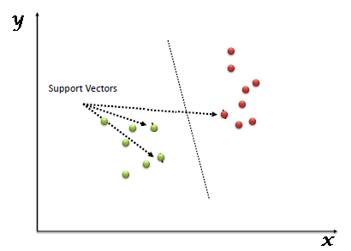
Introduction
SVM is one of the most popular Supervised Learning algorithms which can be used for both classification or regression challenges. However, it is mostly used in classification problems.
The SVM algorithm helps to find the best line or decision boundary, called hyperplane that classify the data points

Slide 3
Types of SVM
Linear SVM(LSVM):
This is used for linearly separable data, which means if a dataset can be classified into two classes by using a single straight line, then such data is termed as linearly separable data, and classifier is used called as Linear SVM classifier.
Non-linear SVM(NLSVM):
This is used for non-linearly separated data, which means if a dataset cannot be classified by using a straight line, then such data is termed as non-linear data and classifier used is called as Non-linear SVM classifier.

Slide 4
Support Vectors: The data points or vectors that are the closest to the hyperplane. SVM algorithm finds the closest point of the lines from both the classes. These points are called support vectors. Hyperplane: The SVM algorithm helps to find the best line or decision boundary, this best boundary or region is called as a hyperplane. We always create a hyperplane that has a maximum margin, which means the maximum distance between the data points. The hyperplane with maximum margin is called the optimal hyperplane. Margin: The distance between the support vectors is called as margin and the goal of SVM is to maximize this margin.

Slide 5
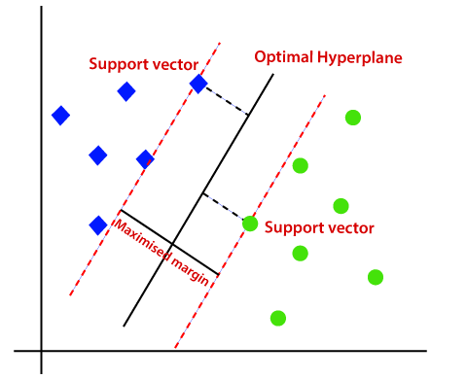

Slide 6
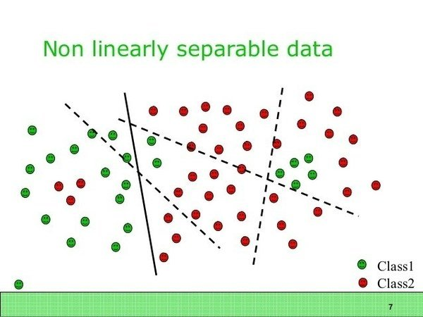
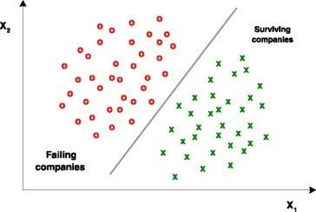
Linearly Separable Dataset
Non Linearly Separable Dataset
A dataset is said to be linearly separable if it is possible to draw a line that can separate the red and green points from each other.

Slide 7
Kernel Trick / Kernel function:
A kernel transforms a low-dimensional input data space into a higher dimensional space.
So, it converts non-linear separable problems to linear separable problems by adding more dimensions to it.
the kernel trick helps us to build a more accurate classifier. Hence, it is useful in non-linear separation problems.

Slide 8
Types of kernel
Linear Kernel
Polynomial Kernel
Radial basis function(RBF)
Sigmoid Kernel

Slide 9
Sigmoid Kernel
Radial basis function(RBF)
This is the most popular support vector machine kernel choice, and the default one used in sklearn. RBF is short for "radial basis function“. It is a general-purpose kernel; used when there is no prior knowledge about the data.
Mostly, it is used in deep learning, to solve ANN based problems.

Slide 10
Thank you

