Slide 1
Detail Visual Analysis
--- Mounika Voriganti

Slide 2
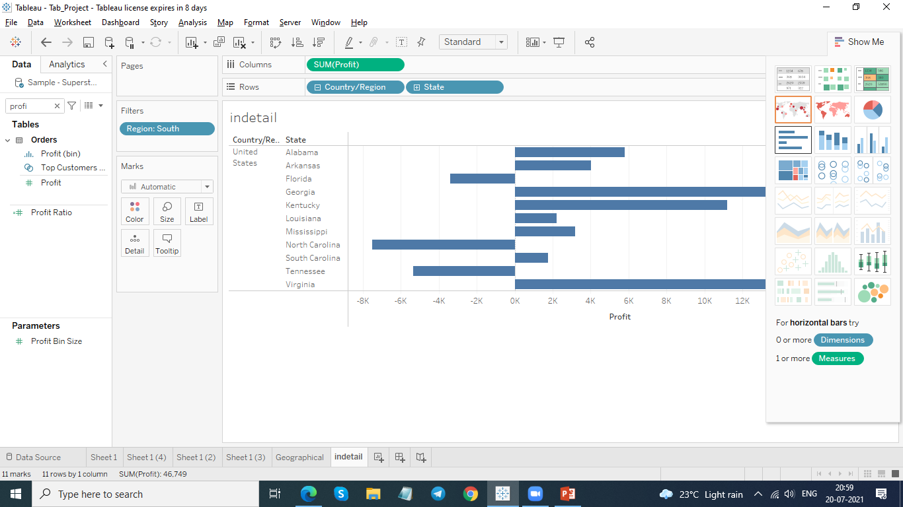
Represent the country and state wise profit in horizontal bar format.

Slide 3
Identify the state having negative profit.
Florida
North Carolina
Tennessee

Slide 4
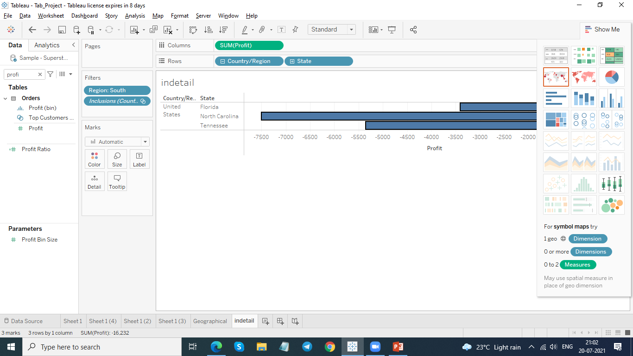
Show the bars for state having negative profit.

Slide 5
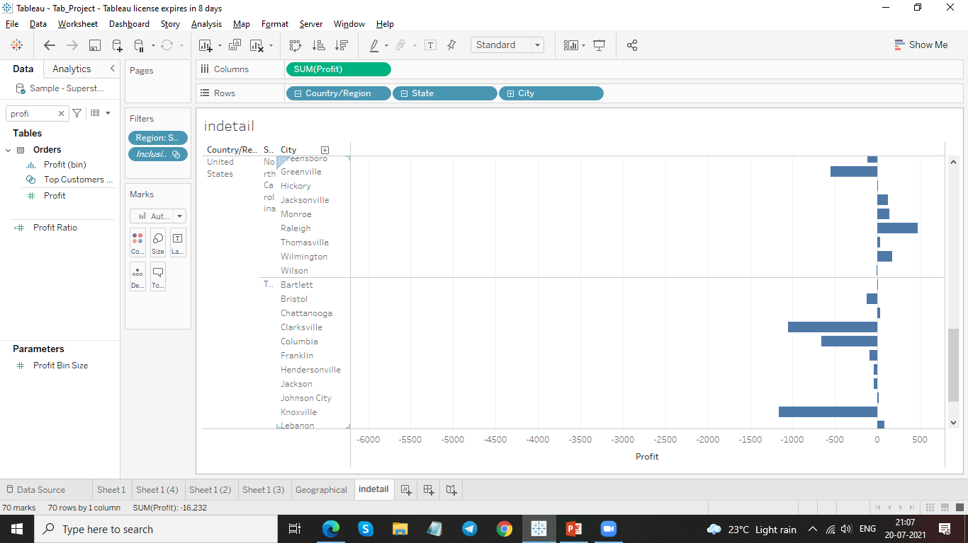
click the plus icon on the State field to drill-down to the City level of detail.

Slide 6
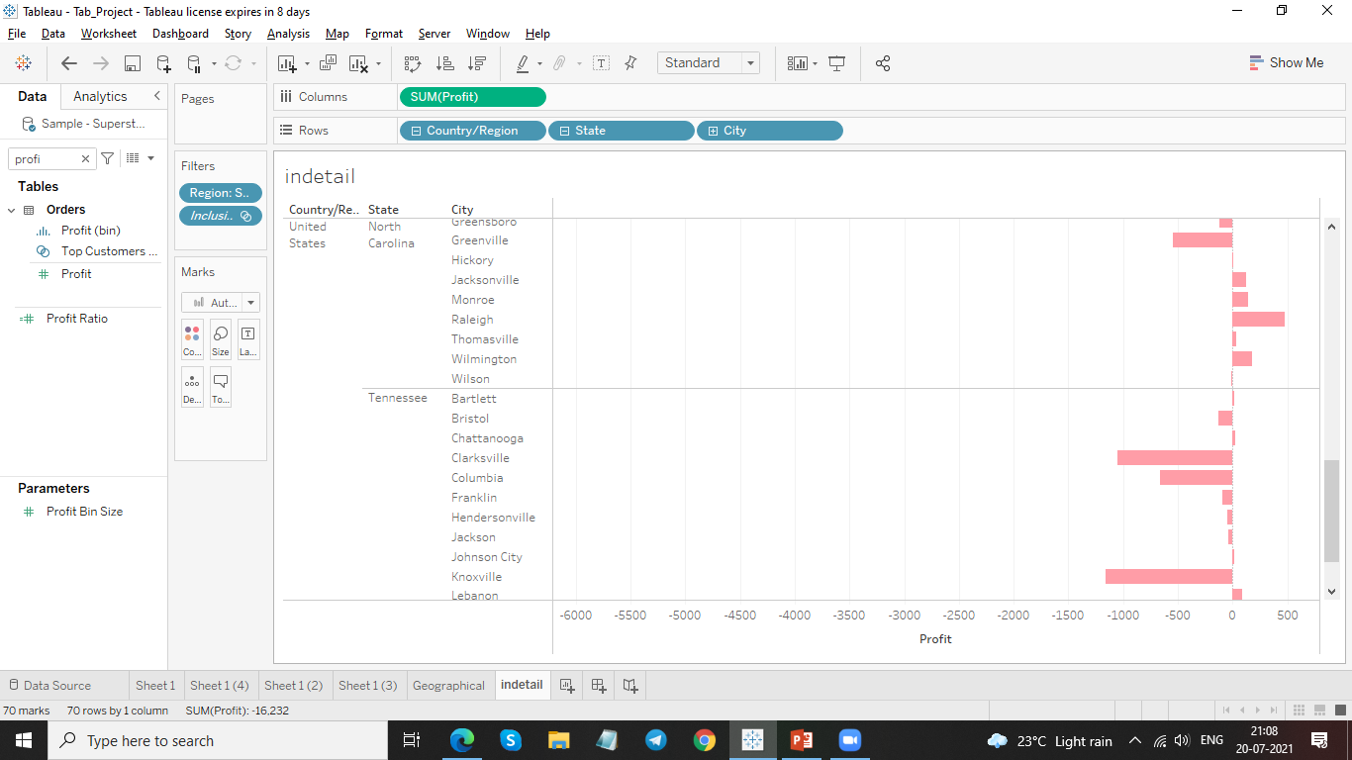
Apply color to your view.

Slide 7
Thank You

