Slide 1

Data Geographically
-- Mounika Voriganti

Slide 2
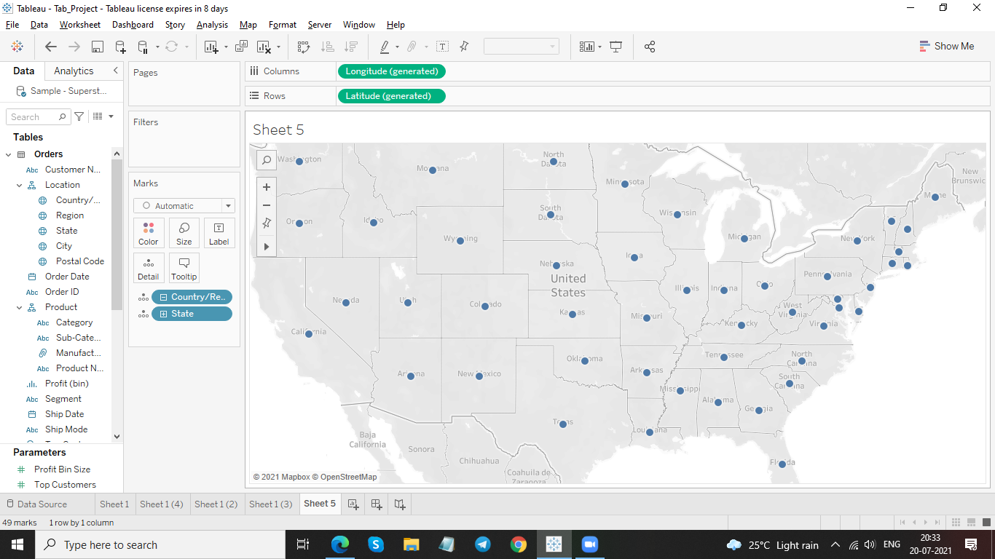
Create a Map view to represent all the states with country

Slide 3
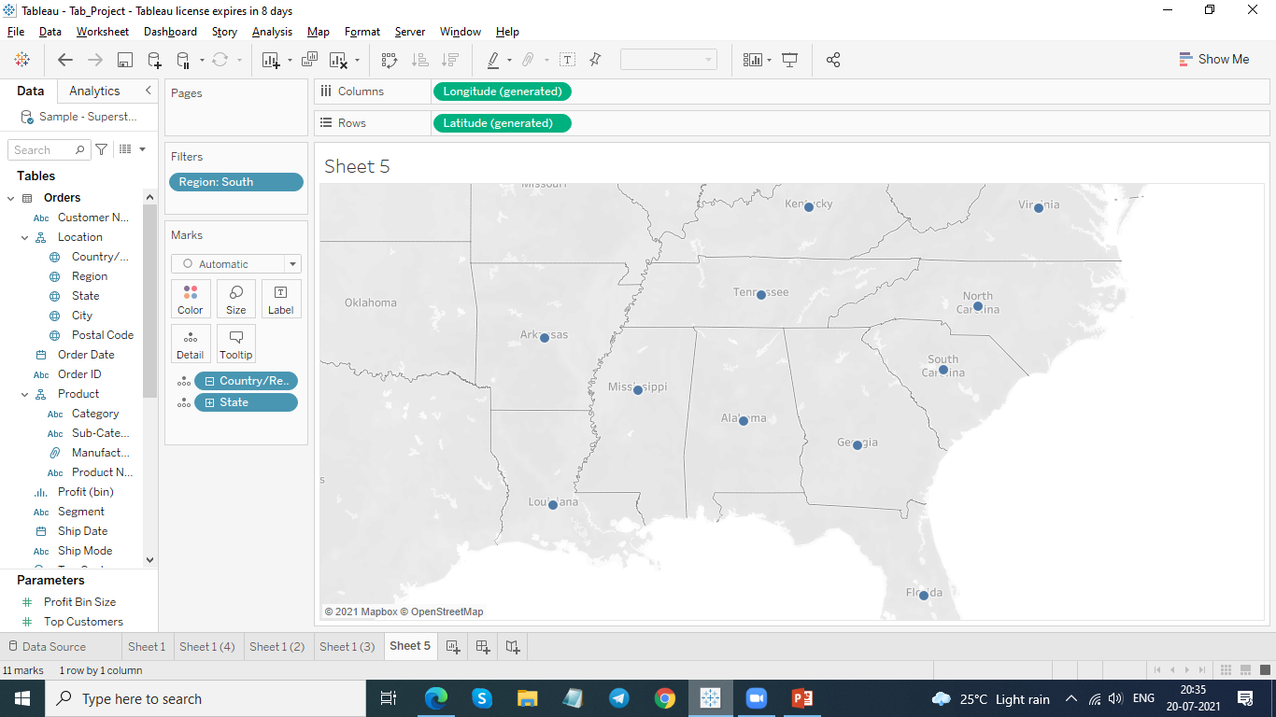
Check your map for south region.

Slide 4
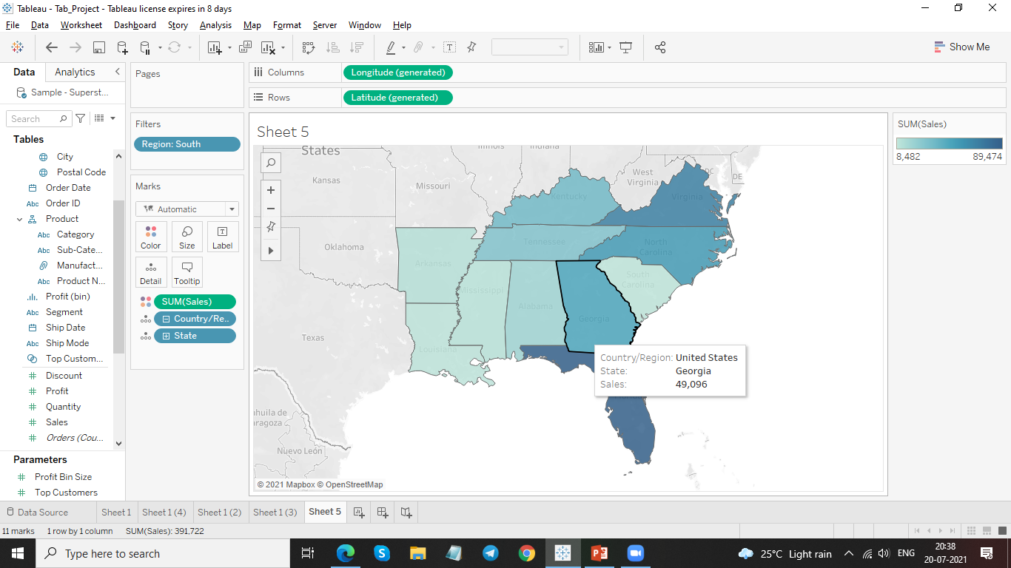
Check the sales for south region.

Slide 5

Represent your sales in USD.

Slide 6
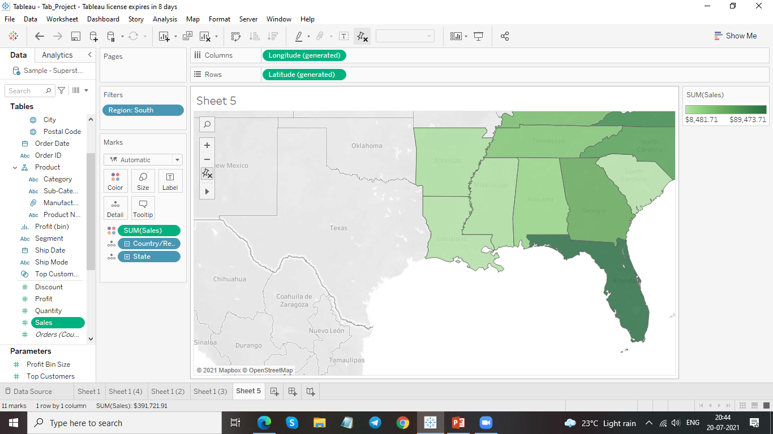
Edit color for you map.

Slide 7
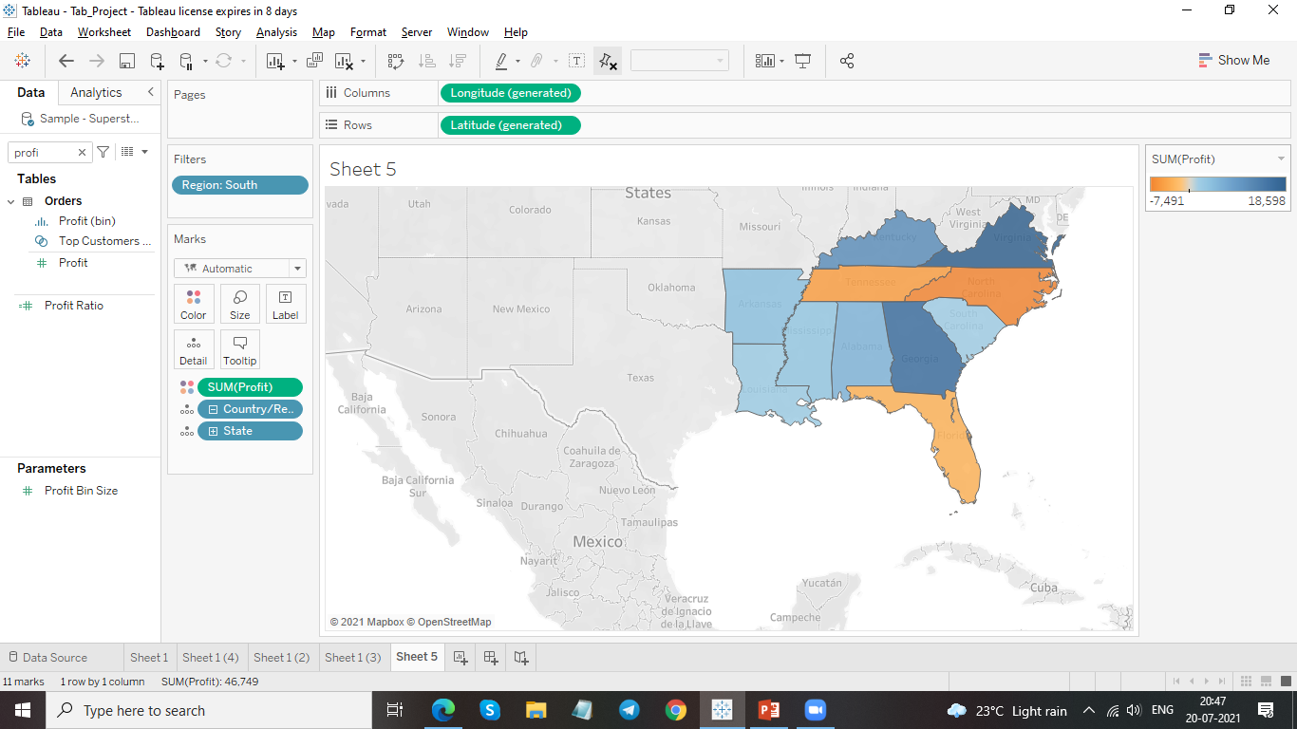
Show profit for all the states in your map in south region

Slide 8
Find out the name of some states having negative profit.
Florida
North Carolina
Tennessee

Slide 9
Note down the name of the states having lowest profit and highest profit.
Highest Profit – Virginia [ 18,598 ]
Lowest Profit – South Carolina [ -7491 ]

Slide 10
Thank you

