Slide 1

Visual Formatting & Analysis
-- Mounika Voriganti

Slide 2
Check your view for the year 2018 and 2021.

Slide 3
Show the profit in the tooltip for sales for each subcategory of every type of product.

Slide 4
3. In scenario 1, change the color of the view from the Marks card.

Slide 5
4. Identify the subcategory & category that are having negative profit.

Slide 6
5. Identify the subcategory & category that have highest profit.

Slide 7
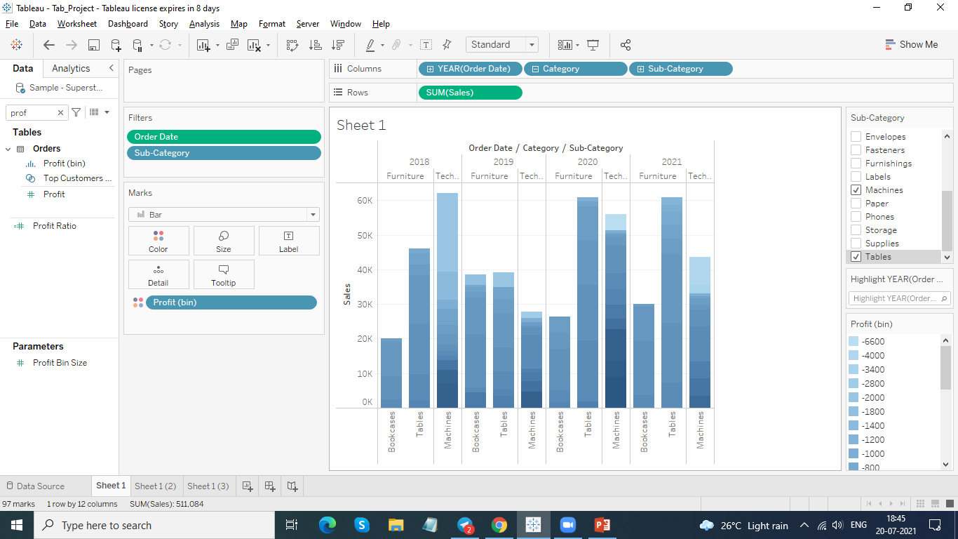
In the Sub-Category filter card, clear all of the check boxes except Bookcases, Machines, and Tables and have closer look on each value

Slide 8
7. Find out some important insights from your view.

Slide 9
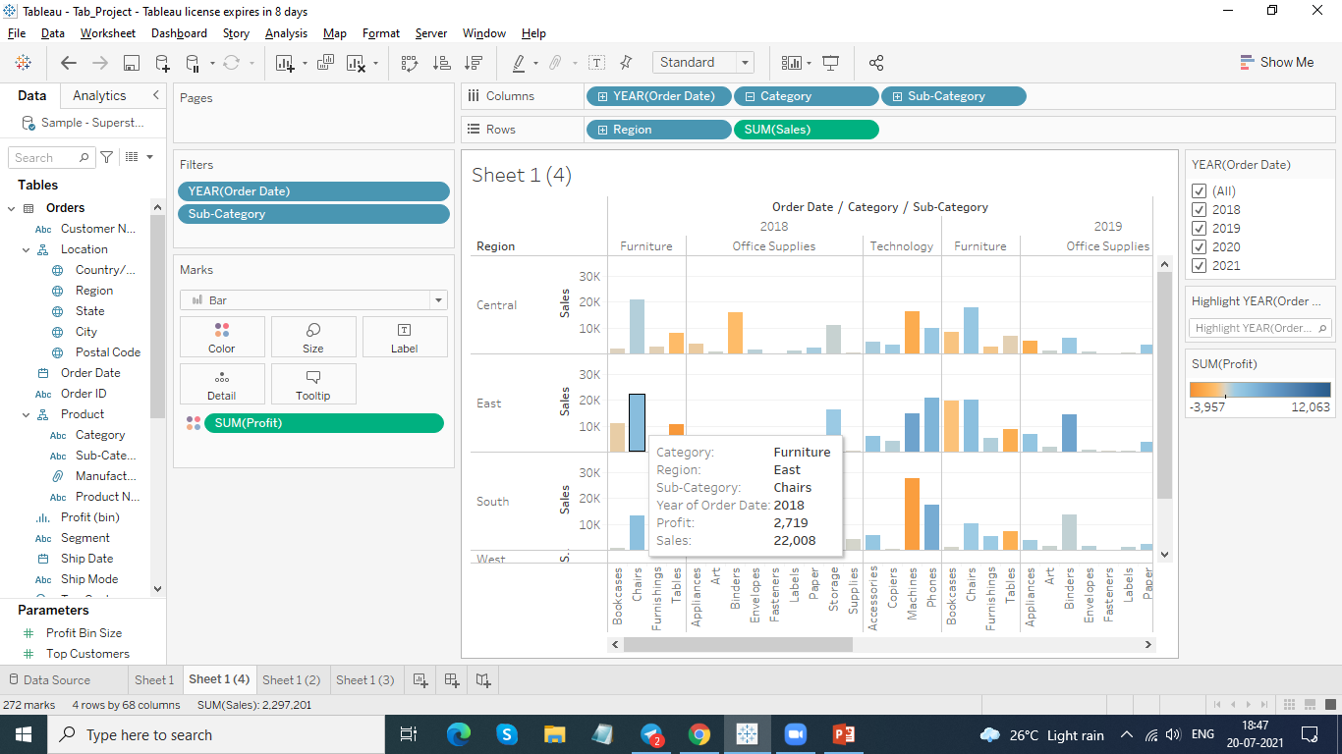
Show the sales region wise for every subcategory and category and every year.

Slide 10
9. Duplicate your worksheet and check sales region wise for Machine type subcategory.

Slide 11
10. In which region machine had highest negative profit.

Slide 12
11. Check your view for south region and find out some meaningful insights and take some wise decision to increase profit in the south region.

Slide 13
Rename your worksheets. Save your workbook.

Slide 14
Thank You

