Slide 1
Digital Portfolio
STUDENT NAME: Mounika K
REGISTER NO AND NMID: 2428C0488 and A176C0DA3DF8F8F9ADC470FE49313361
DEPARTMENT: B.Sc Artificial Intelligence and Machine Learning
COLLEGE: KPR College of Arts Science and Research/ Bharathiar University

Slide 2
PROJECT TITLE
Corporate Employee Career Portfolio

Slide 3


AGENDA
Problem Statement
Project Overview
End Users
Tools and Technologies
Portfolio design and Layout
Features and Functionality
Results and Screenshots
Conclusion
Github Link
3/21/2024 Annual Review

Slide 4

PROBLEM STATEMENT
Many corporate employees do not have a structured platform to showcase their career growth, achievements, and skills in an organized manner.
Traditional resumes often fail to highlight continuous learning, career development, and skill enhancement.
HR teams and managers find it difficult to track and evaluate employee progress effectively without a centralized portfolio system.
Lack of a digital career portfolio reduces visibility of employees’ true potential in corporate environments.

Slide 5

PROJECT OVERVIEW
The Corporate Employee Career Portfolio is a digital platform designed to help employees showcase their career journey, skills, and achievements.
It provides employees with an organized and professional way to present their resumes, technical skills, and career aspirations.
The system enables resume uploads, skill highlighting, and career tracking, making it easier for HR and management to evaluate employee growth.
This portfolio also serves as a tool for employees to demonstrate their corporate readiness and enhance their visibility within organizations.

Slide 6

WHO ARE THE END USERS?
Corporate Employees
~To create and maintain their career portfolio
~To upload resumes, showcase skills, and track career growth
Human Resource (HR) Teams
~To access and review employee portfolios
~To evaluate employee progress, skills, and suitability for roles
Corporate Managers / Employers
~To identify skilled employees for promotions, projects, and opportunities
~To make data-driven career development decisions

Slide 7

TOOLS AND TECHNIQUES
Frontend: HTML5, CSS3, JavaScript
Resume Upload: File input with form handling
Design: Responsive layout using CSS
Version Control: GitHub for code management & hosting
Techniques: User-centered design, modular coding, responsive web design

Slide 8
POTFOLIO DESIGN AND LAYOUT
Header & Navigation Bar → Provides quick access to sections (Home, About, Skills, Resume Upload, Contact)
Home Section → Introduction and career objective
About Section → Brief description about employee background and aspirations
Skills Section → Highlights both soft skills and technical skills
Resume Upload Section → Allows employees to upload their resume for HR review
Contact Section → Provides email and phone details for communication
Footer → Copyright and portfolio identity
8

Slide 9
FEATURES AND FUNCTIONALITY
Employee Profile Showcase → Displays career objectives, skills, and background
Resume Upload → Employees can upload their latest resumes for HR review
Skill Highlighting → Separate section for both soft skills and technical skills
Responsive Design → Works across devices (desktop, tablet, mobile)
Simple Navigation → Easy access to all sections through a clean header menu
Contact Section → Provides direct communication details for employees

Slide 10

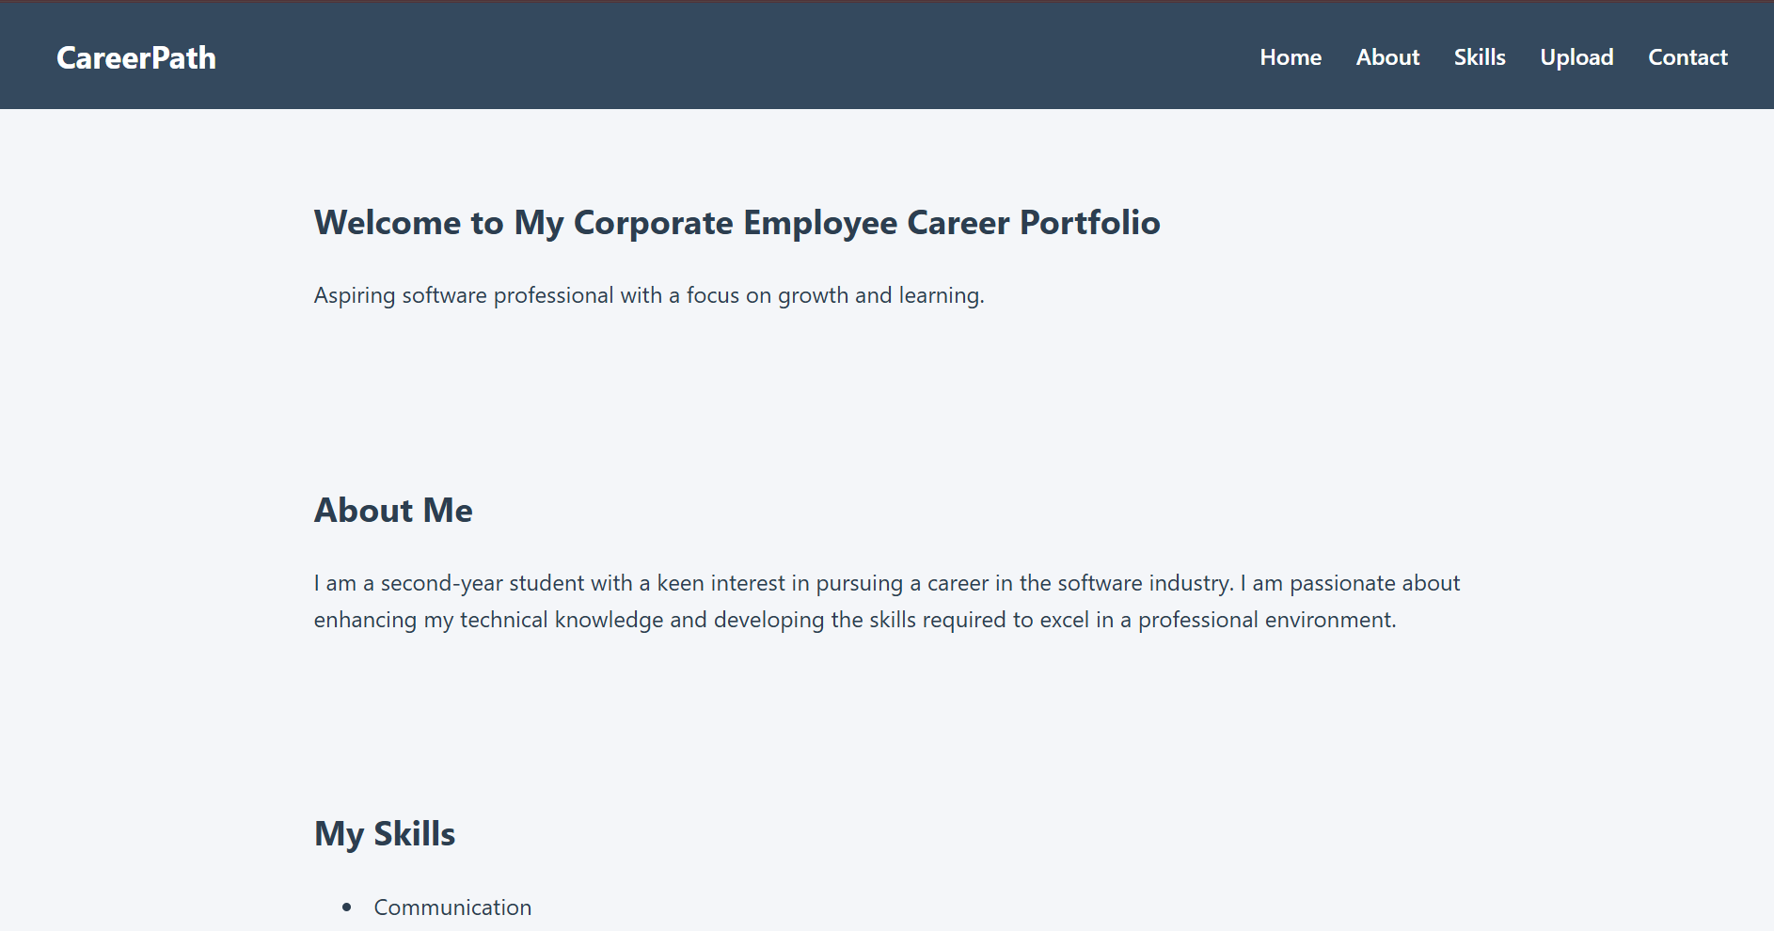
RESULTS AND SCREENSHOTS
3/21/2024 Annual Review
10

Slide 11
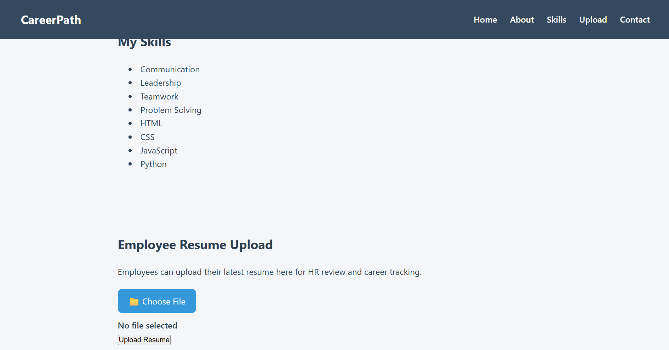
RESULTS AND SCREENSHOTS
3/21/2024 Annual Review
11

Slide 12
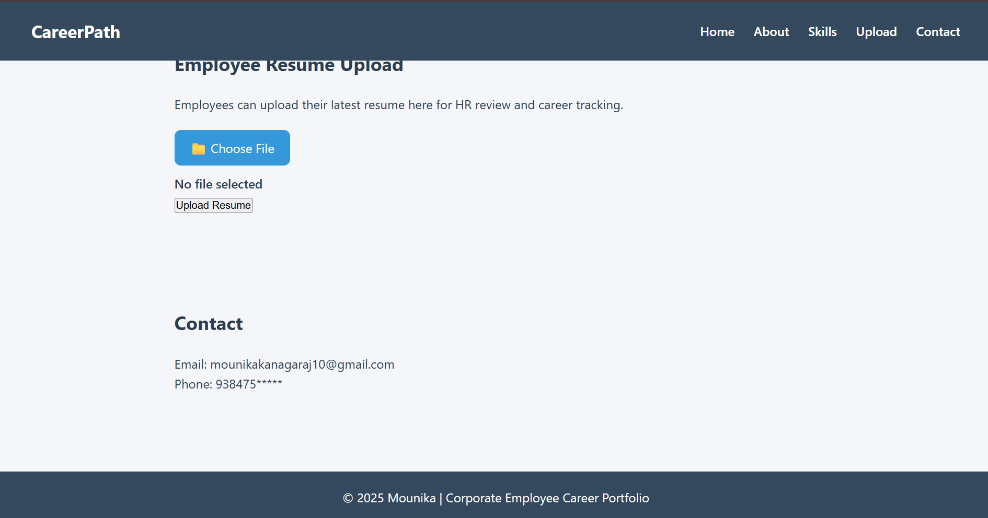
RESULTS AND SCREENSHOTS
3/21/2024 Annual Review
12

Slide 13
CONCLUSION
The Corporate Employee Career Portfolio provides a structured, digital platform for employees to showcase their skills, achievements, and career growth.
It simplifies resume management and enhances visibility for HR and management.
Promotes professional development, skill tracking, and career progression in a corporate environment.
Serves as a centralized, user-friendly tool to support both employees and organizations in achieving career goals efficiently.
13

Slide 14
GITHUB LINK
https://github.com/Mounika10122006
14

