Slide 1

IPL ANALYSIS DASHBOARD
(2008-2025)
PRESENTED BY:
MOUNIKA MARADAPU

Slide 2
PROJECT OBJECTIVE
Analyse IPL performance across 18 seasons
Identify best teams & players
Study match, toss and venue impact
Support decision-making for teams, analysts & fans
The goal is to convert raw IPL data into meaningful cricket insights.

Slide 3
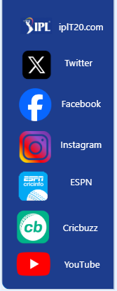
DATA SOURCES
Match data (season, teams, venue, winner)
Player performance (runs, wickets, 4s, 6s)
Ball-by-ball records
Team standings
Data is structured so that we can filter by season, team, player and venue.
SOCIAL MEDIA
IPL Accounts: using Buttons
By clicking “Ctrl+” to navigate IPL pages

Slide 4
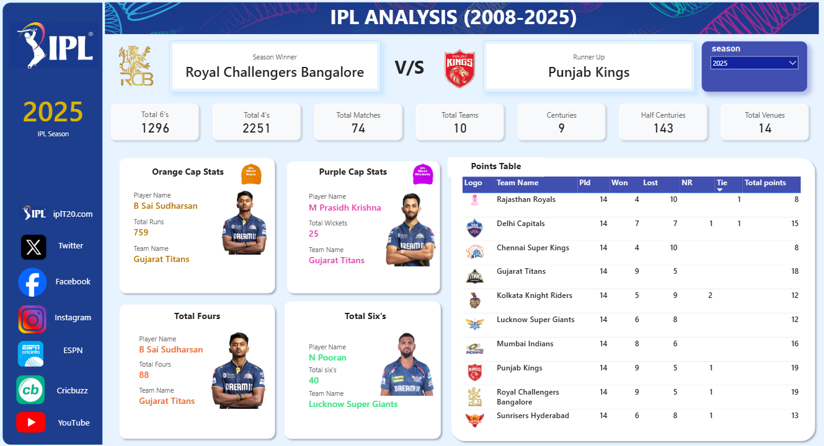
DASHBOARD OVERVIEW
Top = Season summary
Middle = Player awards
Right = Points table
Filters on top right
This is a single-page interactive dashboard showing the complete IPL season

Slide 5
SEASON SUMMARY
KPI | MEANING
Total matches | Matches played in the selected season
Total Teams | Teams participated
Total 4s, 6s | Batting aggressiveness
Centuries, Half-Centuries | Batting dominance
Total Venues | Grounds used
These KPIs give a high-level overview of how competitive and high-scoring the season was

Slide 6
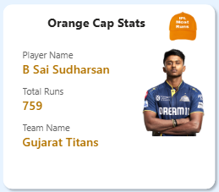
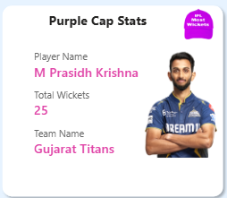
FEATURES
Season Winner vs Runner-up
Winner(logo)
Runner-up(logo)
This section highlights the outcome of the season
Orange Cap (Top Batsman)
From dashboard:
Player name
No.of Runs
Team name
The Orange Cap is awarded to the highest run scorer. This identifies the most impactful batsman of the season
Purple Cap (Top Bowler)
Player name
No.of Wickets
Team name
Purple Cap identifies the best wicket-taking bowler

Slide 7
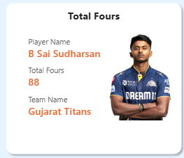
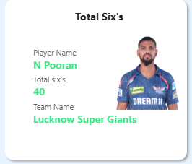
BOUNDARY HITTERS
Total Fours
Player name
No.of fours
Team name
Player picture
Total Sixes
Player name
No.of sixes
Team name
Player picture
These visuals highlight the most aggressive and attacking batsmen

Slide 8
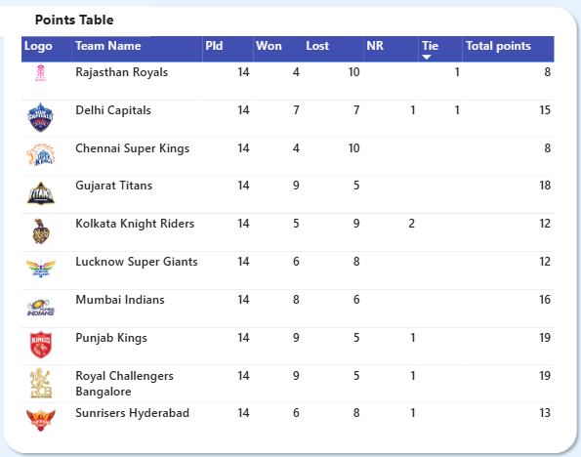
POINTS TABLE
COLUMN | MEANING
Played | Matches played
Won / Lost | Performance
NR | No result
Points | Qualification score
Teams with the highest points qualify for playoffs. Team1 & Team2 lead with some points

Slide 9
BUSINESS INSIGHTS
Which Team dominates individual awards in each season
Team1 & Team2 Strongest/Weakest teams
Know the team is strong in which stream
Balanced competition or not (close points)

Slide 10
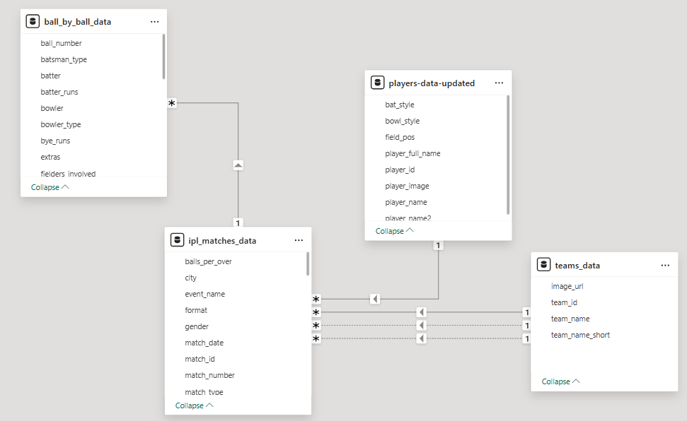
Tools & Technology
Power BI
DAX
Excel / CSV
Data modelling

Slide 11
Conclusion
Dashboard gives season-wise IPL insights
Helps teams, analysts and fans
Enables performance comparison & trends

Slide 12


