Slide 1

Ransomware
CSCE 5550 – Spring 2025
Group – 3
Anila Arram
Durga Shankar Dalayi
Sai Keerthana Thummalapalli
Mounika Yarram

Slide 2

Introduction
Overview of ransomware and its impact
Importance of understanding ransomware behavior
The project is to simulate a ransomware attack. For instance, it has: Research, Action (Encryption & Decryption), Infection, Monitoring, Detection, Mitigation phases.
Key tools and technologies used for the project: Python, OSSEC and Metasploit.
Controlled virtual machine environment for safe experimentation
Bridge theoretical learning with practical application of the techniques learnt through hands on project.

Slide 3

Related Works
The early example of ransomware using RSA encryption is CryptoLocker(2013)
SMB vulnerability (WannaCry) – Spread across the globe (2017)
File Integrity Monitoring (IEEE, 2020) Data is used by means of hashing and change detection (with new and missing records)
ACM (2022) - Machine Learning based detection (classification) of Ransome behavior.
MITRE ATT&CK framework - Provides common TTPs for attackers
Objectives: Ransomware from defense side: Behavioral analysis (Symantec 2019).
There are lots of trends on ransomware, for example, ransomware is going more sophisticated and more targeted.

Slide 4
Project Approach
After all, researching ransomware techniques and encryption strategies is that simple these days.
Development of a custom encryption tool (AES-256) for file encryption
The malicious PDF was created using Metasploit as infection vector.
Monitoring system using OSSEC and python watchdog library.
File integrity checks as well as hash comparisons for real-time detection
This is mitigation by changing file permission, quarantine and restore from backup.
The following phases were Research, Encryption, Infection, Monitoring, Detection, Mitigation.

Slide 5

Encryption Process
The contents of file is encrypted using AES-256 encryption.
Directory setup with 'critical' folder and multiple subfolders
Recursive encryption occurs when sub directory files are encrypted, meaning that all files in the sub directories will be encrypted.
For identifying the encrypted files, the encrypted files with '.enc' extension will be renamed.
Created for verification and recovery decryption component.
This allows to back up original files, so that then it will be possible to recover data.
Script ensures that directory structure is maintained after it is encrypted.

Slide 6
Infection Method
It is used to exploit the PDF vulnerabilities via metasploit framework.
Two malicious PDFs with reverse shell payload created by the attacker.
Payload gets triggered upon opening the PDF (zero-click attack)
Phishing attack meant PDF as legitimate business document for phishing attack.
Gains access via outdated versions of the PDF reader.
The PDF was delivered to the victim system using Secure Copy Protocol (SCP).
The simulated attack vector is a common real world ransomware infection.

Slide 7
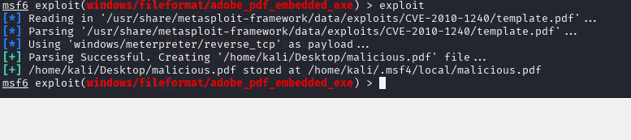
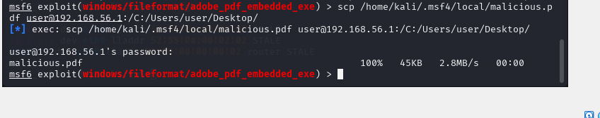

Infection
Generated the Malicious PDF
Sent the Malicious PDF to the Target
The file is sent successfully to the target:

Slide 8
Monitoring System
OSSEC Host IDS for use in foreign integration monitoring and logging events
This is a Python watchdog library to watch file system events.
Real-time monitoring of the 'critical' directory for changes
Detection of file creation, modification, and deletion in target directory
This allows log outputs displayed in terminal for immediate analysis.
A system for alerting the user of suspicious activity.
Extensibility: can be scaled up to monitor any files or directories.

Slide 9
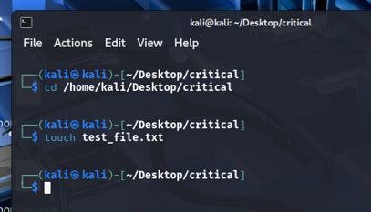
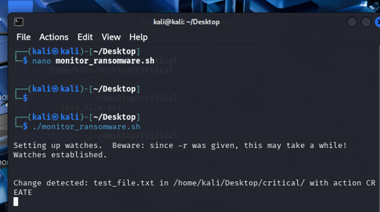
Monitoring
Try to change anything in the malicious pdf
See the results in the main terminal

Slide 10
Detection System
File Integrity checks and hash comparison, for detection.
File monitoring was set to detect .enc file extensions.
Comparison of SHA-256 hash to ensure unauthorized modifications.
By being able to monitor real time, there is very little delay between infection and detection.
Alert gets triggered on file naming which can be a Ransomware operational activity.
Detection logic refined for avoiding false false positives caused due to legitimate file change.
System is scaleable enough to monitor entire directories or many files.

Slide 11
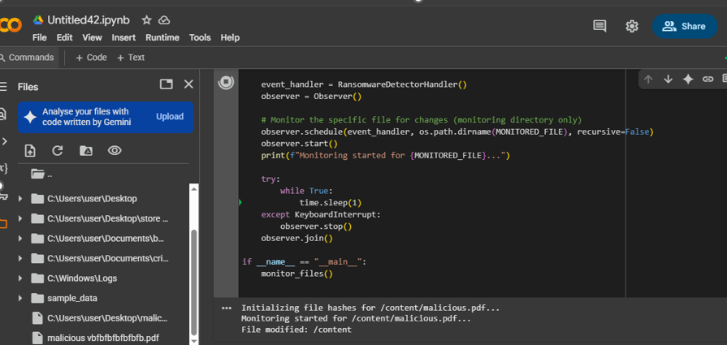
Detection

Slide 12
Mitigation Strategy
It changes permissions on infected files so they cannot be opened.
They have permissions set to 00000, to prevent further modification and encryption.
Quarantined compromised files inside a separate directory for safe handling.
Performing backup restore to do the encrypted file recovery.
The system is intended to be able to detect and send email alert system for system administrators on detection.
The backup systems are named as critical to build the effective mitigation.
There are future planned improvements to expand the mitigation strategies.

Slide 13
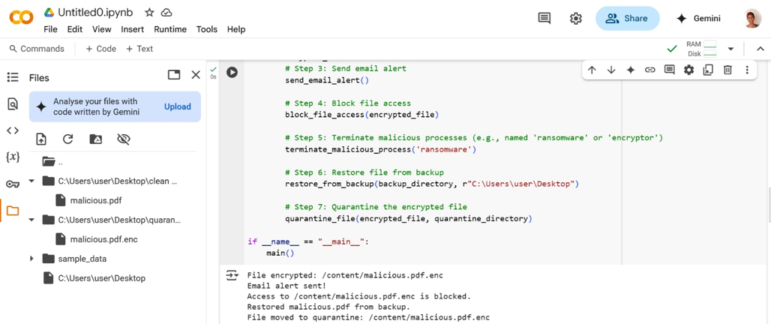
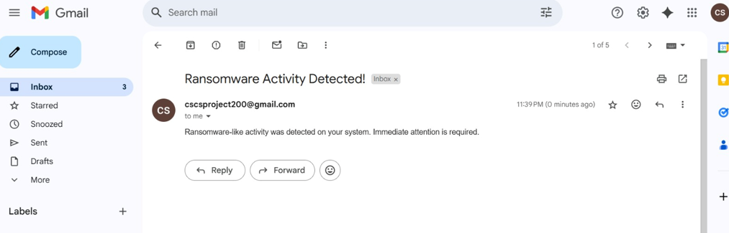
Mitigation

Slide 14

Results and Analysis
All target files were encrypted successfully using the encryption process.
A ransomware activity was flagged in real-time by detection system.
Mitigation strategy successfully blocked modification in the file
Restore of the encrypted files from backup recovery proved effective.
Email alert system was successfully sent to the system administrators.
Real time monitoring proved to be very useful in minimizing damage.
Future work will be devoted to enhance alert system reliability and widen detection scope.

Slide 15

Conclusion
Real world attack scenarios could be successfully simulated by ransomware simulation.
Either a layered defense strategy: Prevention, Detection, Mitigation or an unlayered defense strategy.
They had real time detection, file blocking and backup recovery that minimized damage.
Some identified backup systems and email alert mechanisms as important.
Lessons learned that are critical for their understanding of the system vulnerability and the timeliness of response.
Improvements required in alert systems and detection techniques to be made on a continual basis.
The project helps to better understand the ransomware defense strategies.

Slide 16
Future Work
Machine Learning or Anomaly Detection can be used for expansion of the detection capabilities.
Finally have the possibility to simulate other ransomware attack vectors such as via phishing links.
Improve the backup systems so that it can recover quickly while attacks are live.
One system exploring was automated incident response systems and related countermeasures.
It will help to develop more robust defense framework for enterprise environments.
Researching strategies that will prevent and recovering from decentralized ransomware.

