Slide 1

ENZ BOOK CLUB
ONLINE BOOK REVIEW SYSTEM

Slide 2

PROJECT MEMBERS:
Id
Name
Batch
Group
2563249
AMARA JYOTHI
230 Java SL AK
5
2564068
2562896
MOUNIKA JANAMALA 230 Java SL AK
5
5
DEBARUPA PAUL
230 Java SL AK
230 Java SL AK
230 Java SL AK
2563810
2564567
KUNAL
5
5
CHAKRABORTY
PERUGU SOUJANYA
2563126
2563001
2563486
PRATHIBA K
230 Java SL AK
230 Java SL AK
230 Java SL AK
5
5
5
SRIDHAR A
SYED ARIZ HAIDER

Slide 3

ABSTRACT
The business-to-consumer aspect of electronic commerce (e-commerce) is the most
visible business use of the World Wide Web. The primary goal of an e-commerce site is
to sell used books and services online and the project deals with developing an e-
commerce website for Online Book Sale. It provides the user with a catalog of different
books available for purchase in the store. In order to facilitate online purchase a
shopping cart is provided to the user.

Slide 4
INTRODUCTION
The ENZ BOOK CLUB project is to implement a computer-based online book
review system. This system objective is to the system design Book Review
Management system, and to develop a customer web-based Review
Management system. The user will upload the Reviews on the website. The
reader can give the ratings and feedback to the reviews. Based on the
feedback and the ratings given by the user, the publisher can publish the
books.

Slide 5
PROPOSED SYSTEM
Provides facilities to access the book system from anywhere in the community. The
customer can visit the site and purchase the used book according to their
requirements and all transactions can be done through a common network. Many
features of e-commerce have been implemented here.
ADVANTAGES:
• Online stores are cheap.
• Online shopping is very convenient.
• Online stores are not limited

Slide 6
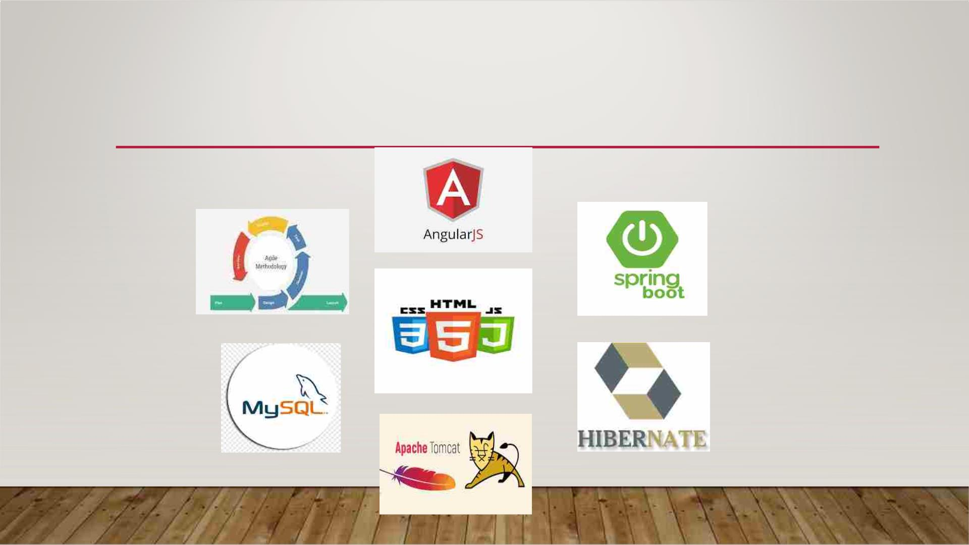
TOOLS & TECHNOLOGIES

Slide 7
MODULES
Admin Module: Used for managing the reviews details and user information.
Users Module: Used for managing the users of the system.

Slide 8
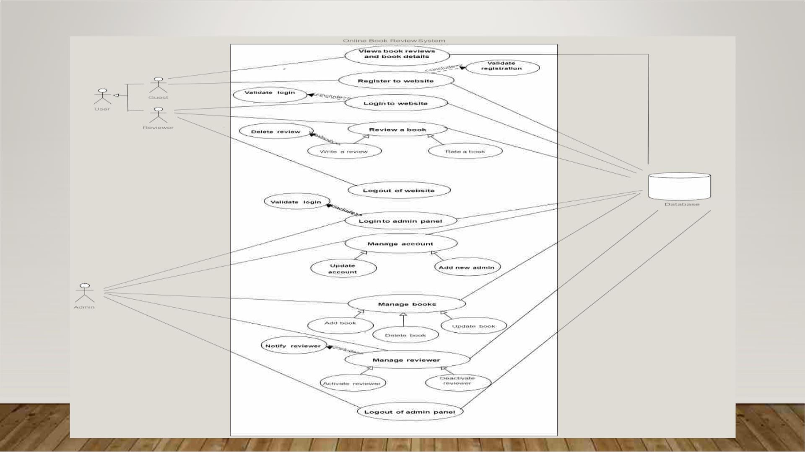
ER DIAGRAM

Slide 9
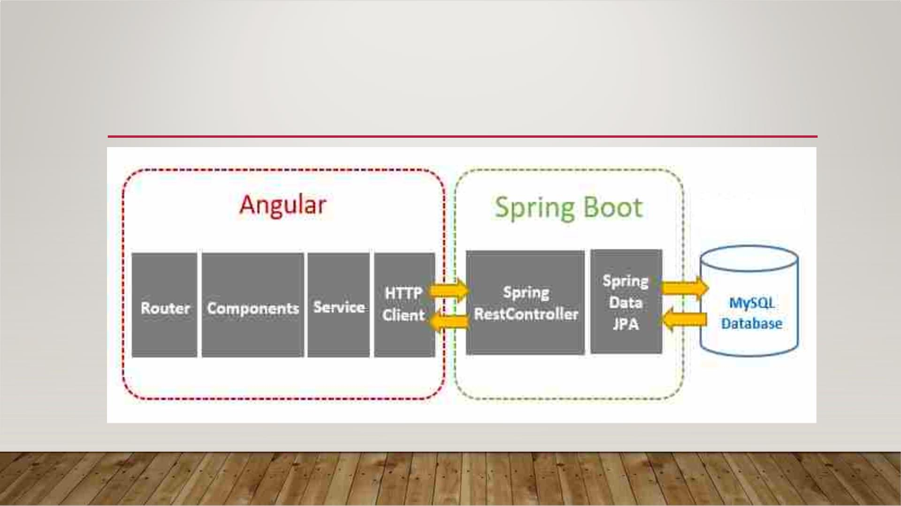
HOW IT WORKS

Slide 10
USER REGISTRATION
If the user is new to the site, he/she can sign up to register by filling an online
registration form. A user id will be generated automatically and provided to
registered user. If the user is already a registered member of the site, he can
open his account by simply signing in. If the user wants to purchase a
particular book, he/she should have an account.

Slide 11
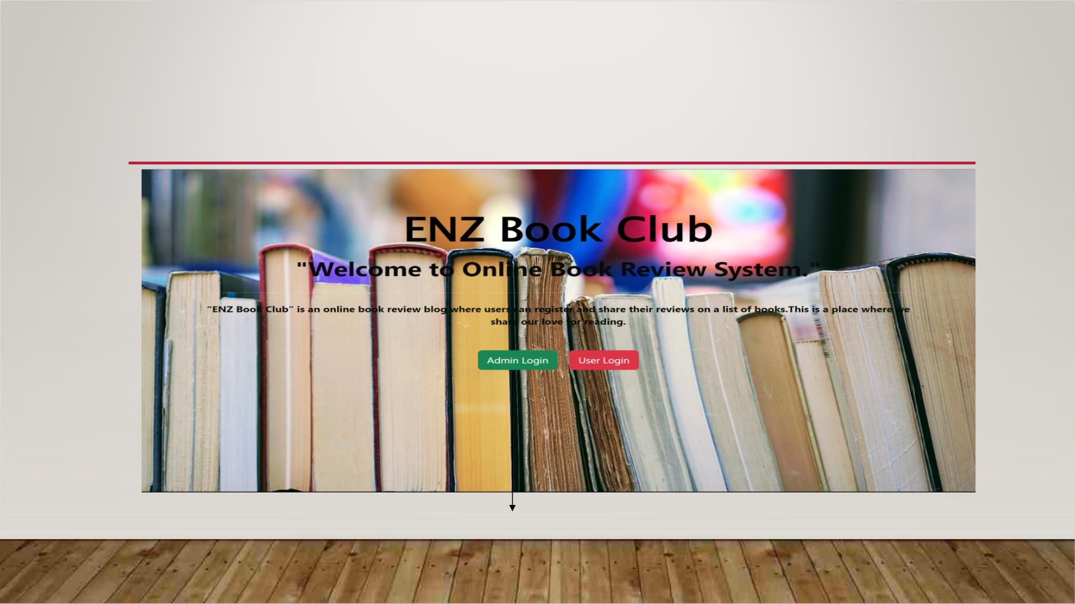
DASHBOARD
Click on “Admin Login” to login to the Admin portal

Slide 12
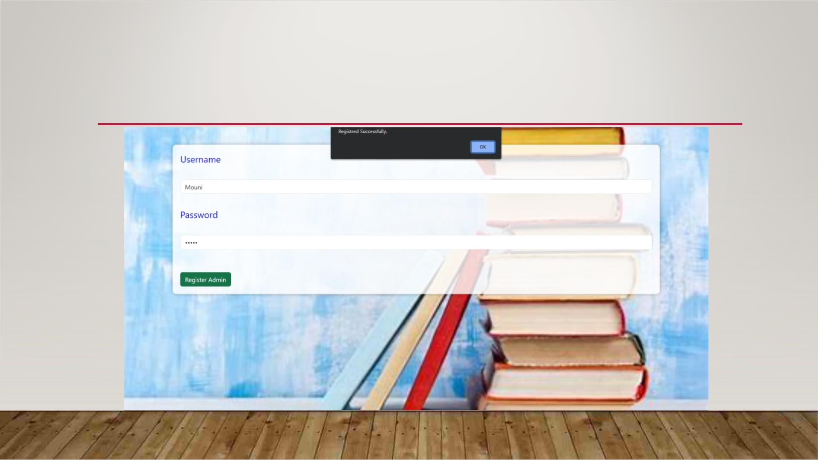
ADMIN REGISTRATION

Slide 13
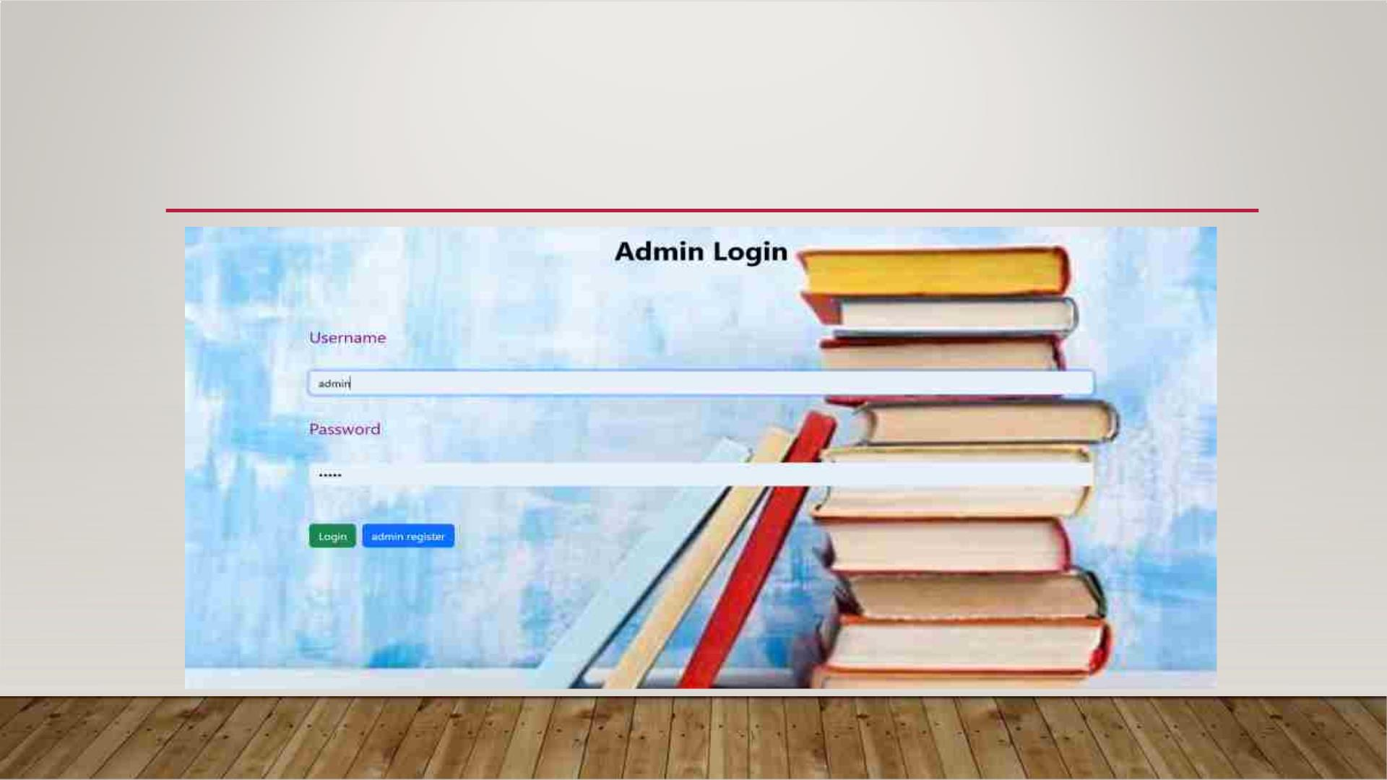
ADMIN LOGIN

Slide 14
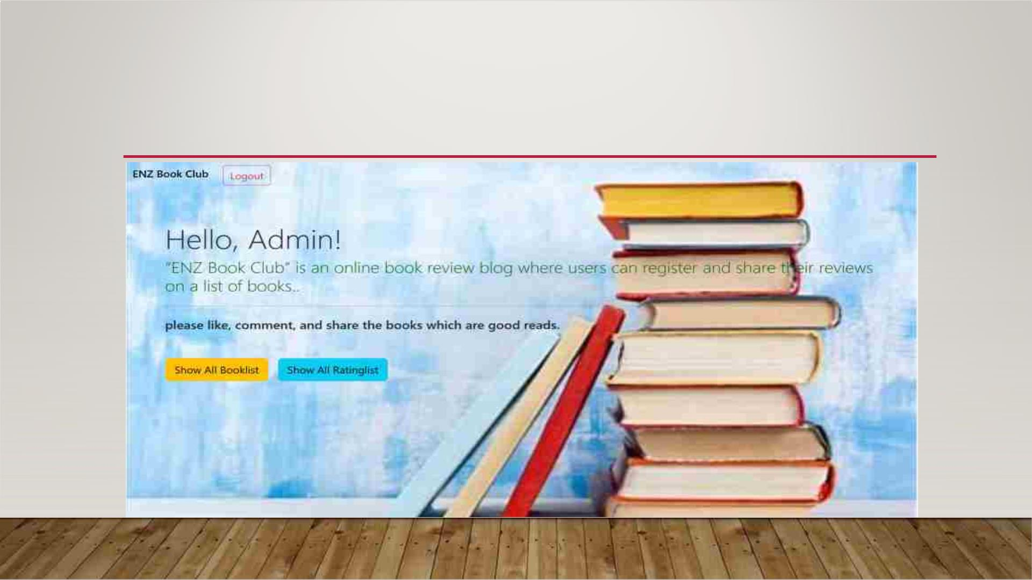
ADMIN HOME PAGE

Slide 15
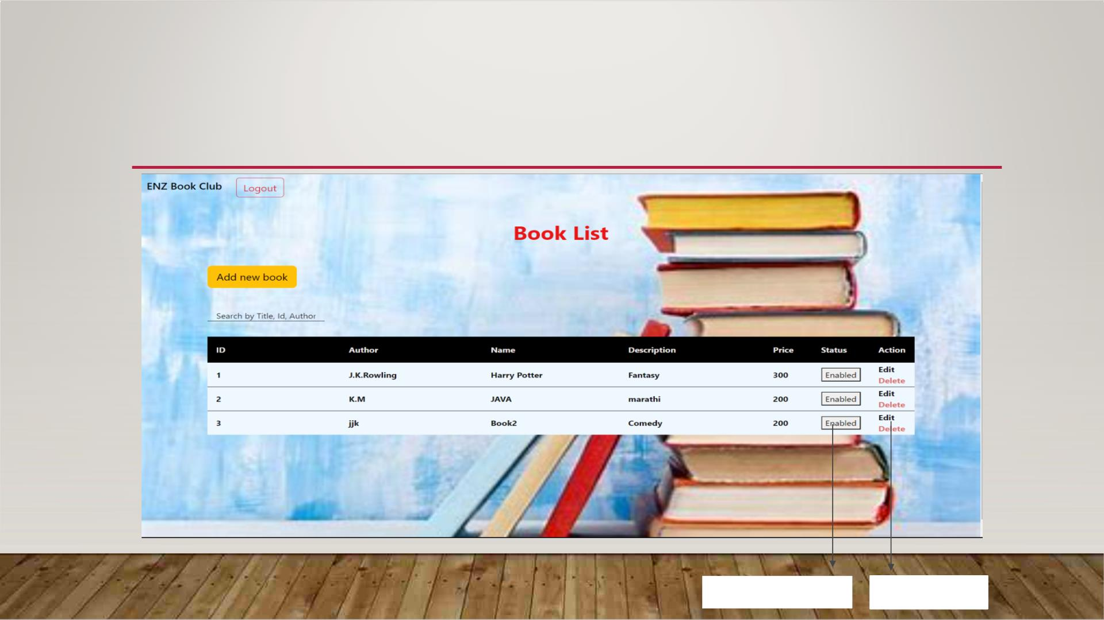
BOOK LIST
Enable/Disable
Edit/Delete

Slide 16
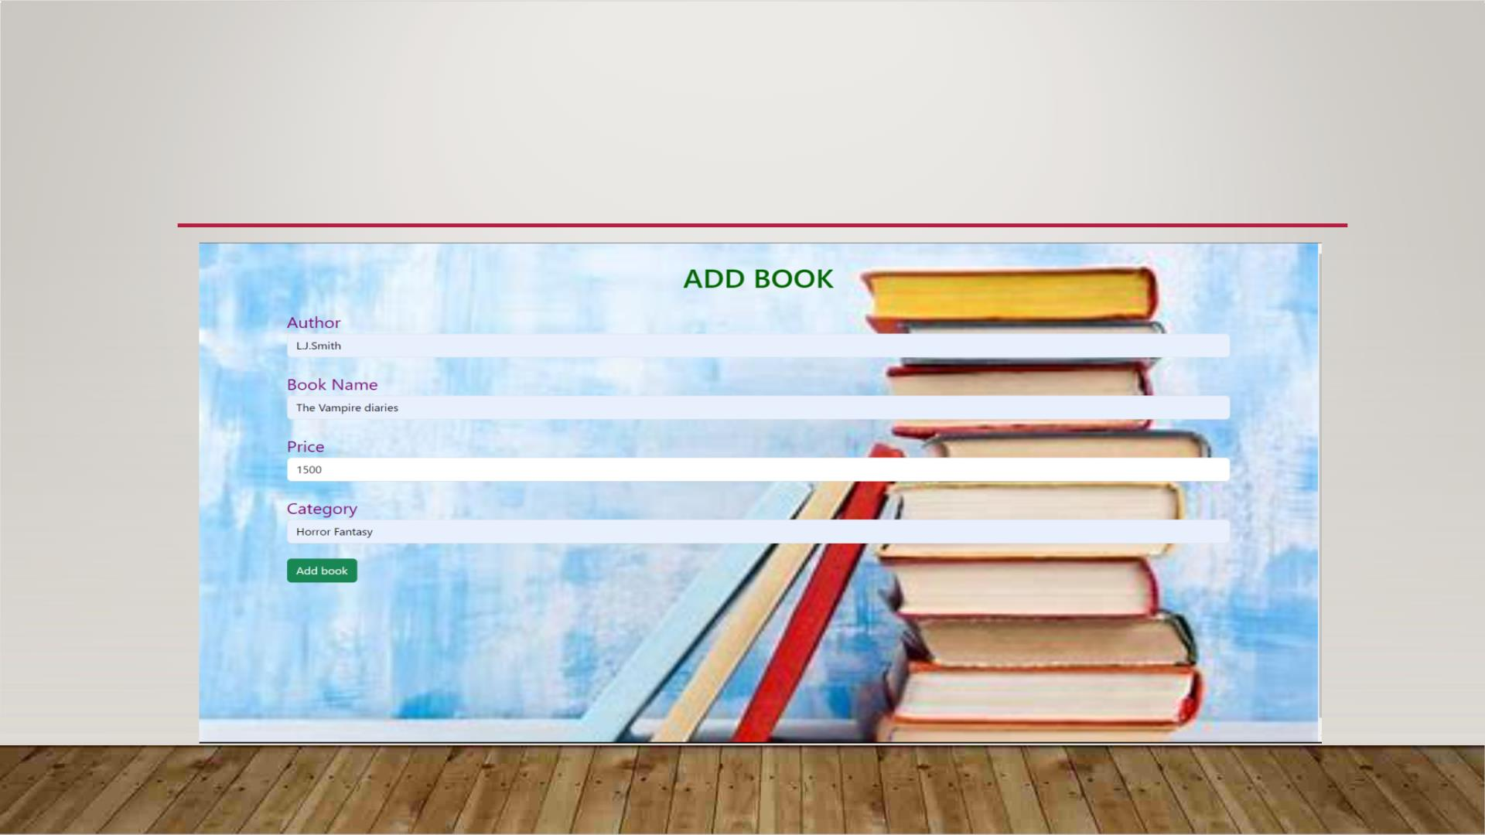
ADD BOOK

Slide 17
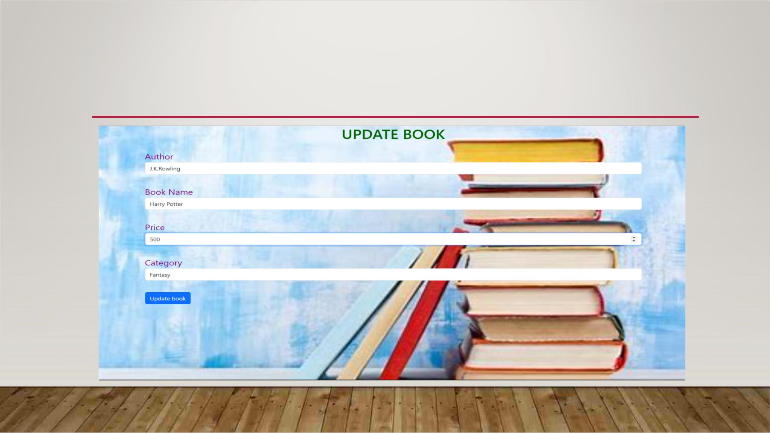
EDIT BOOK

Slide 18
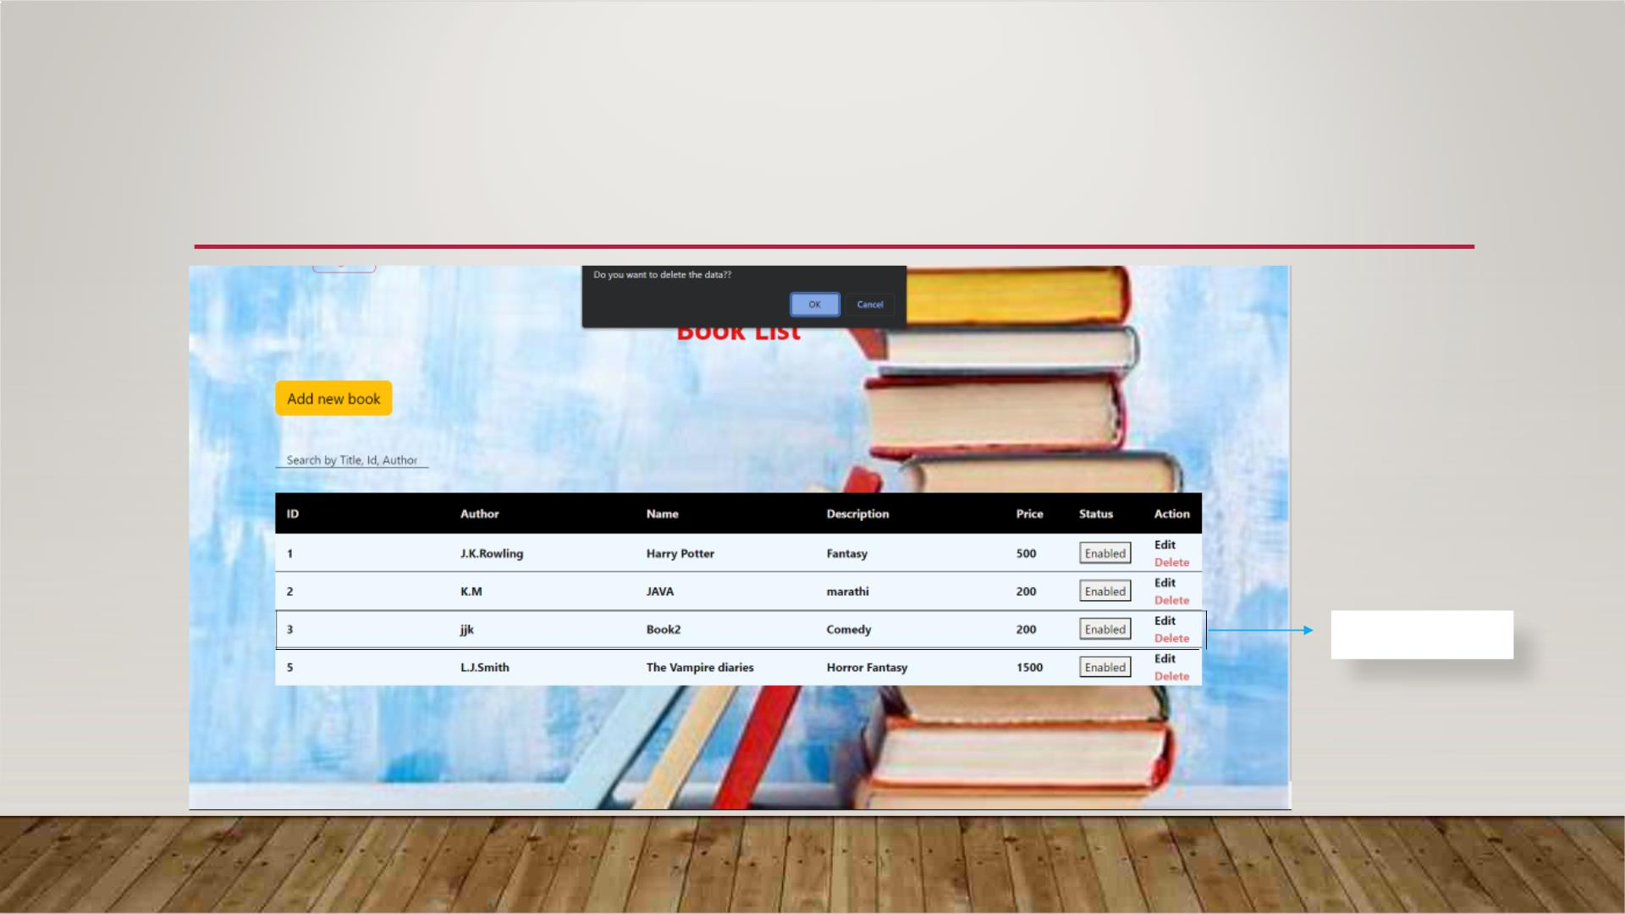
DELETE BOOK
Deleted

Slide 19
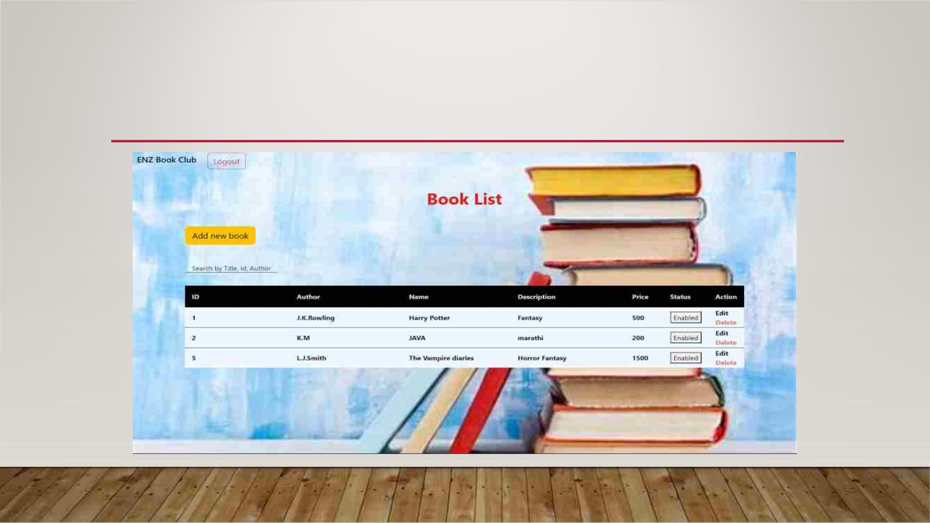
BOOK LIST AFTER DELETE

Slide 20
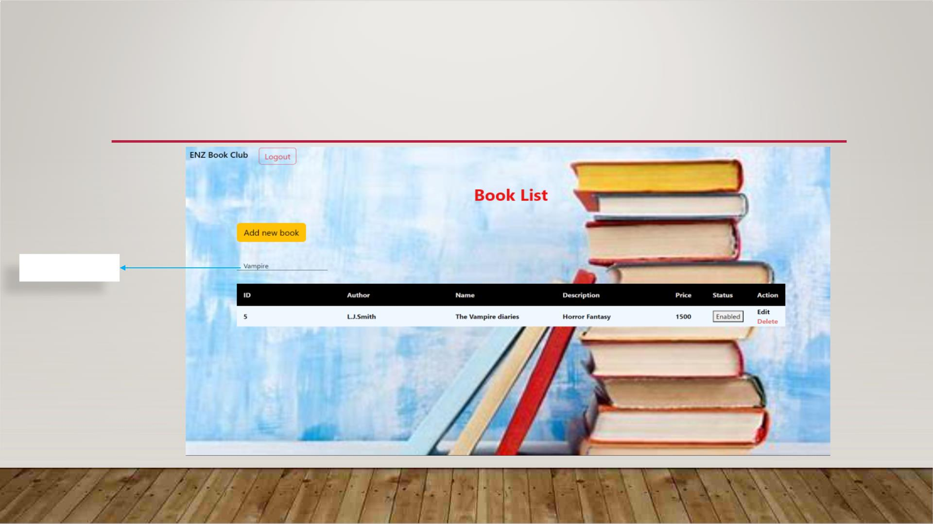
SEARCH BOOK LIST
Search

Slide 21
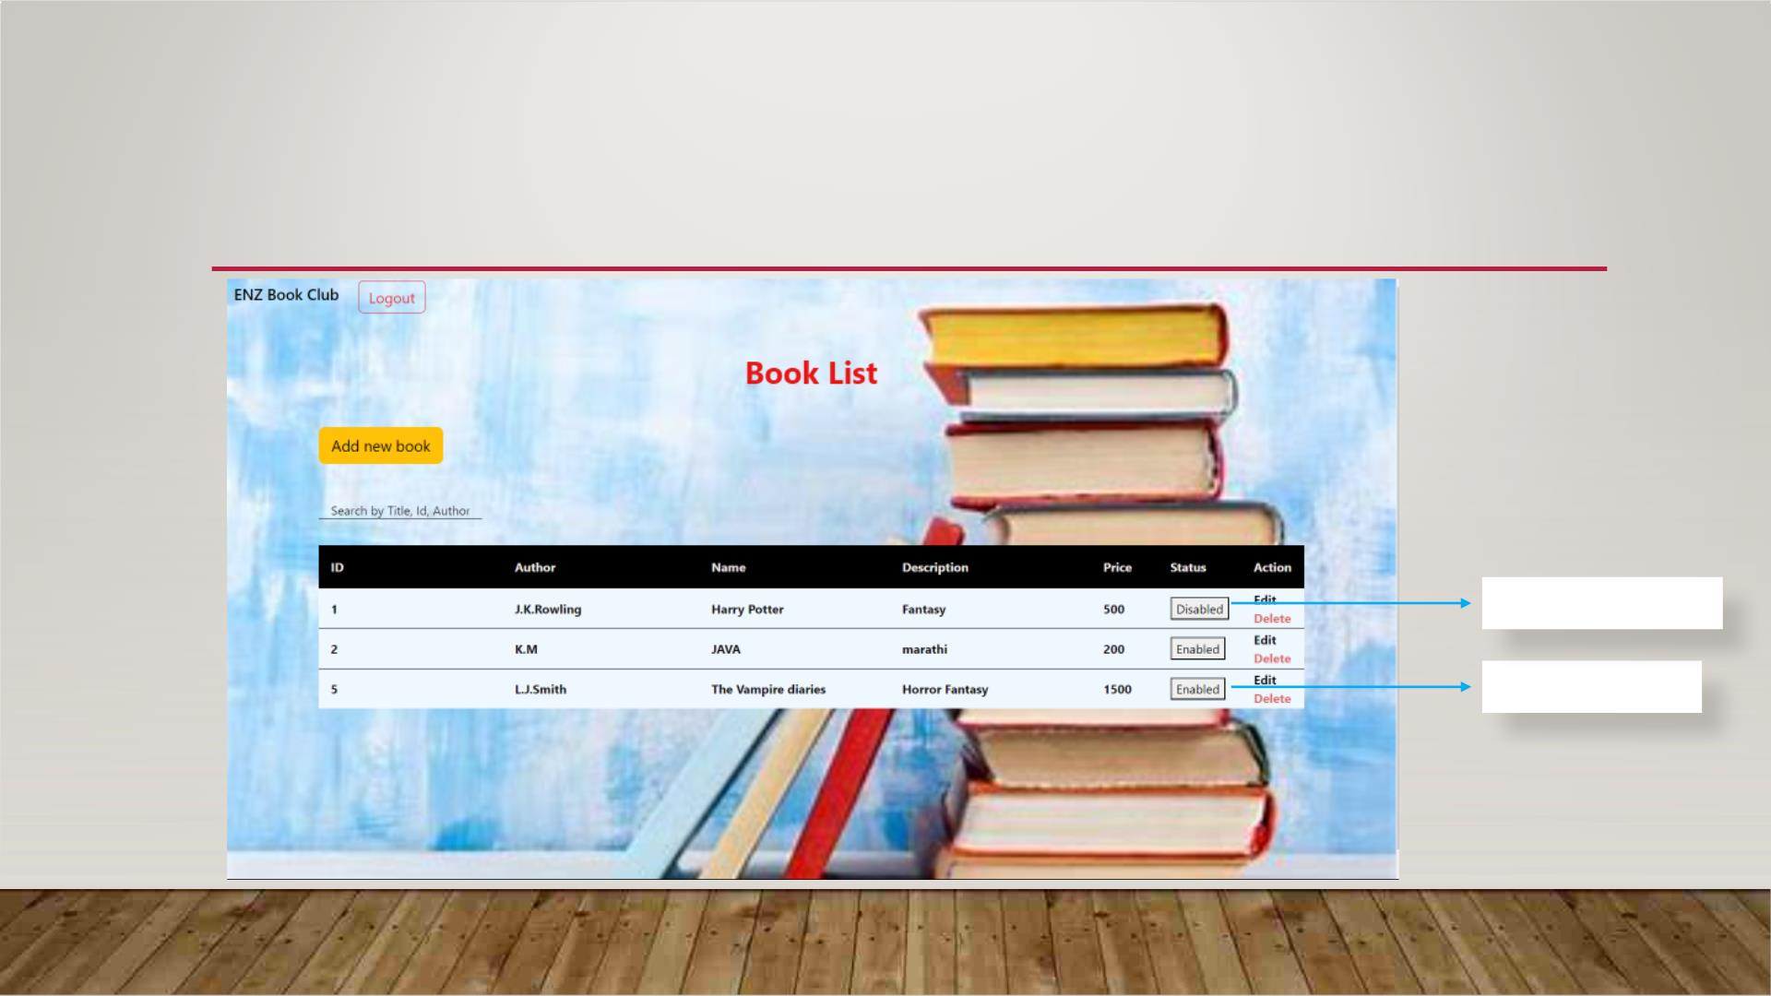
ENABLE/DISABLE BOOK
Book Disabled
Book Enabled

Slide 22
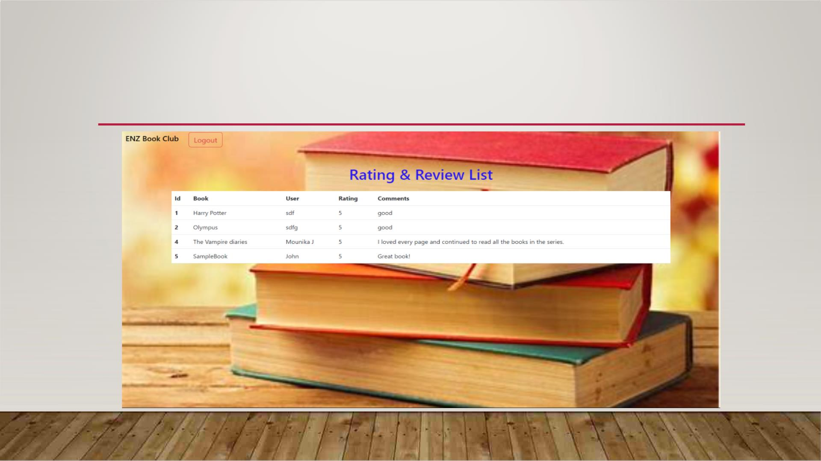
VIEW RATINGS

Slide 23
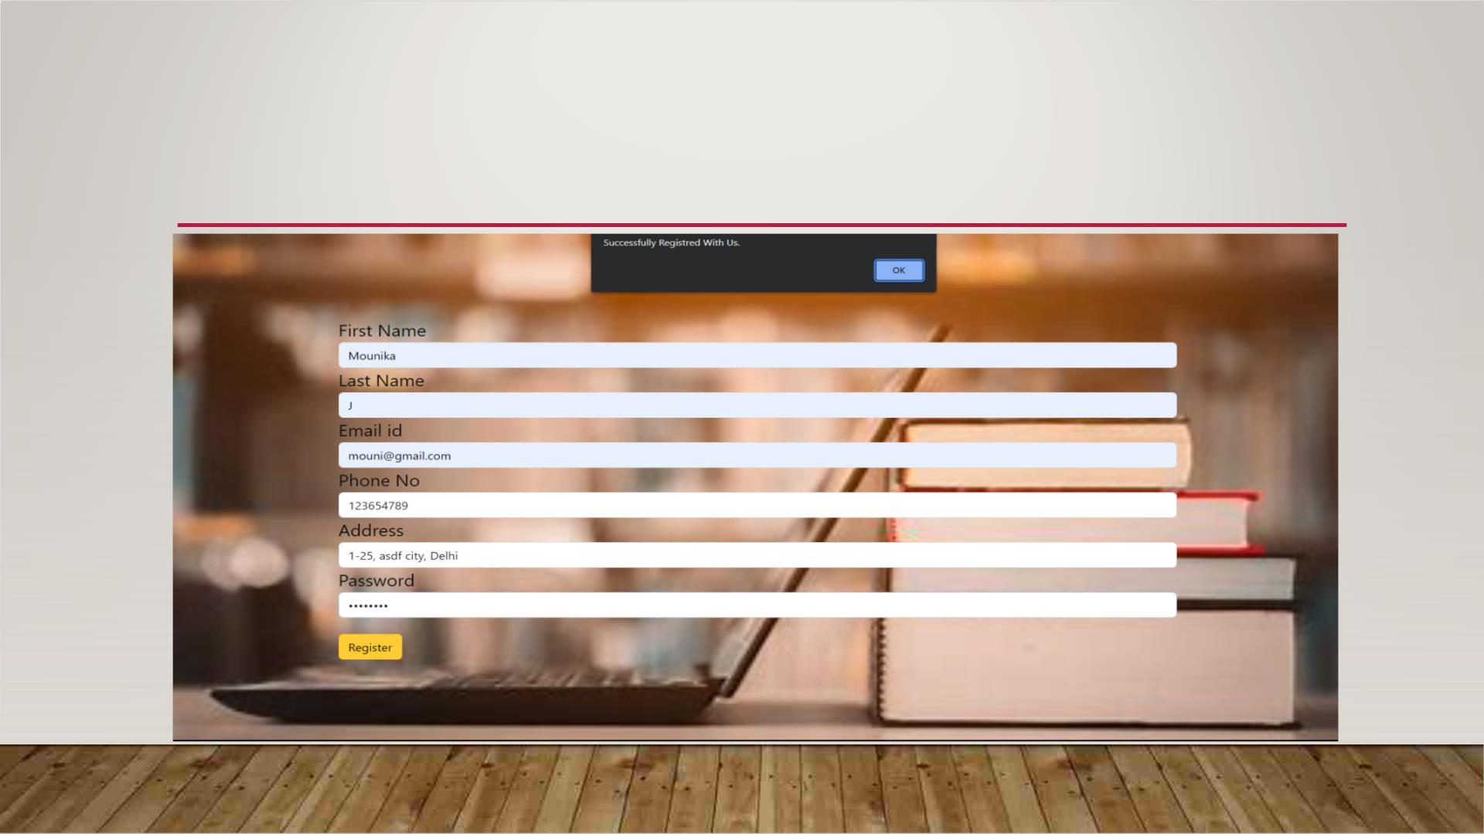
USER REGISTRATION

Slide 24
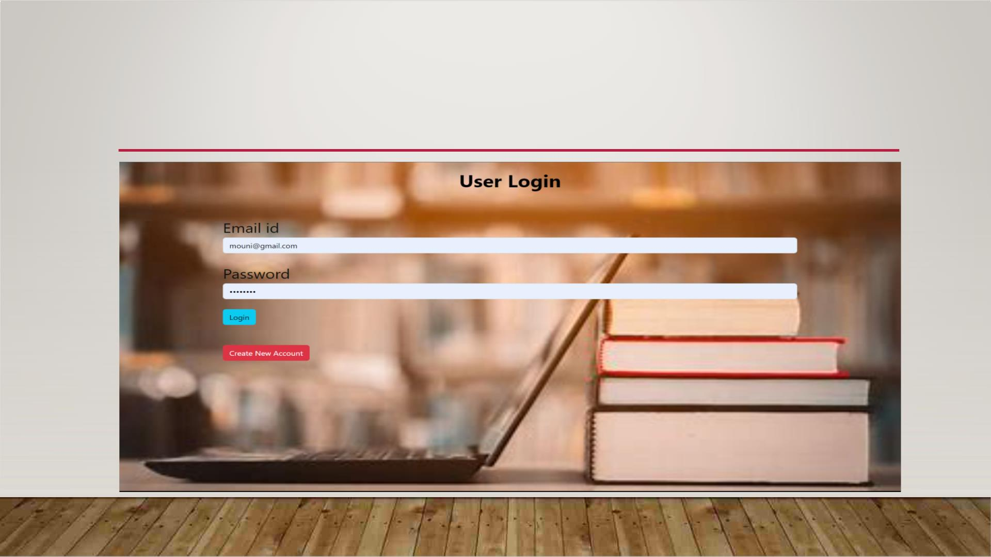
USER LOGIN

Slide 25
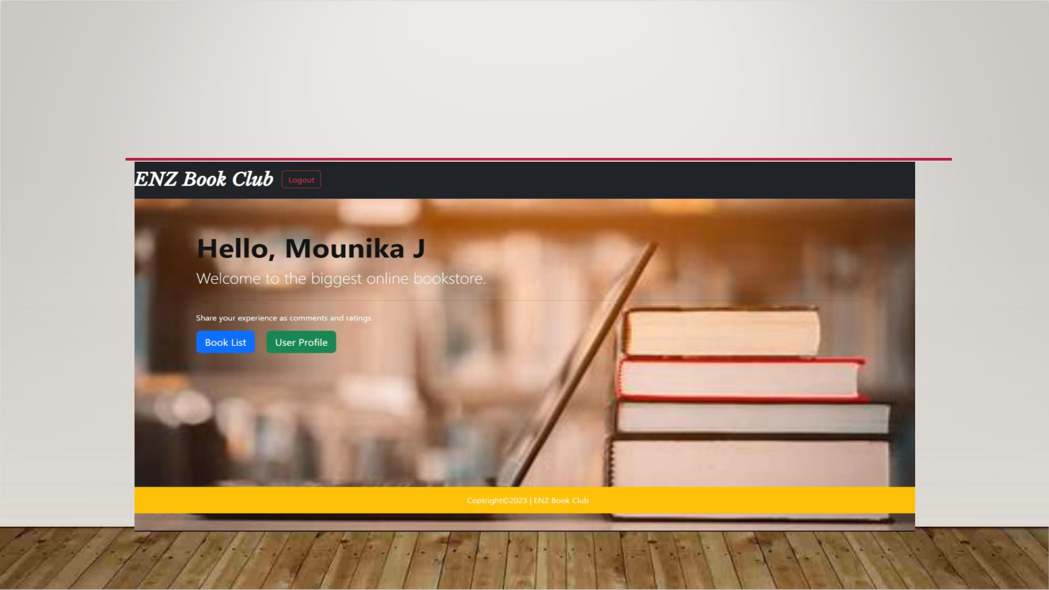
USER HOME PAGE

Slide 26
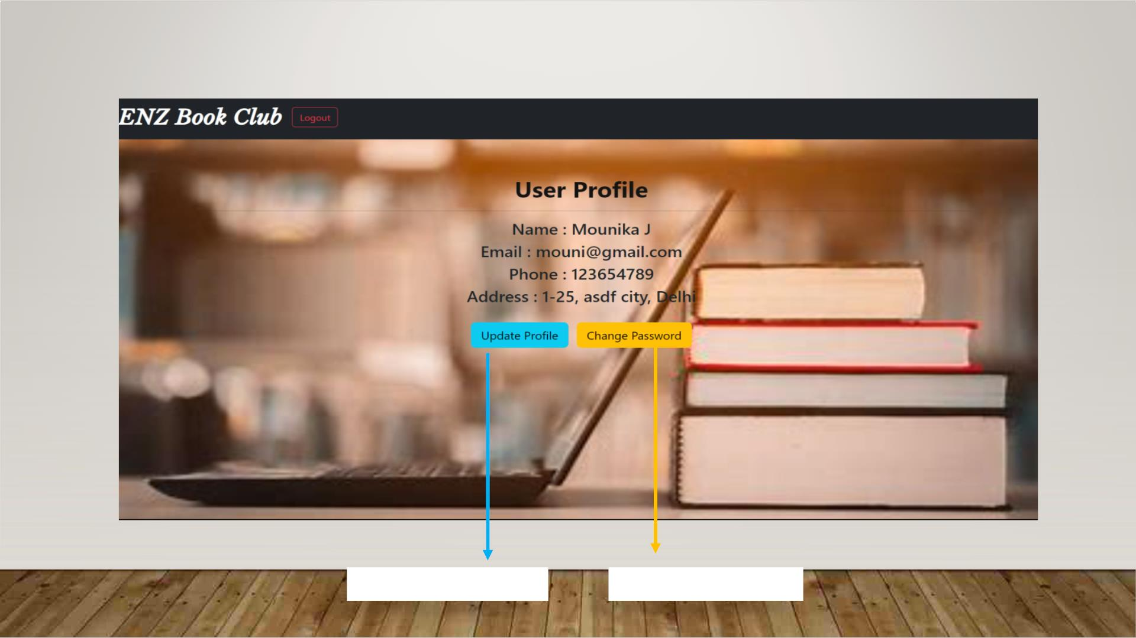
USER PROFILE
Update User Profile
Change Password

Slide 27
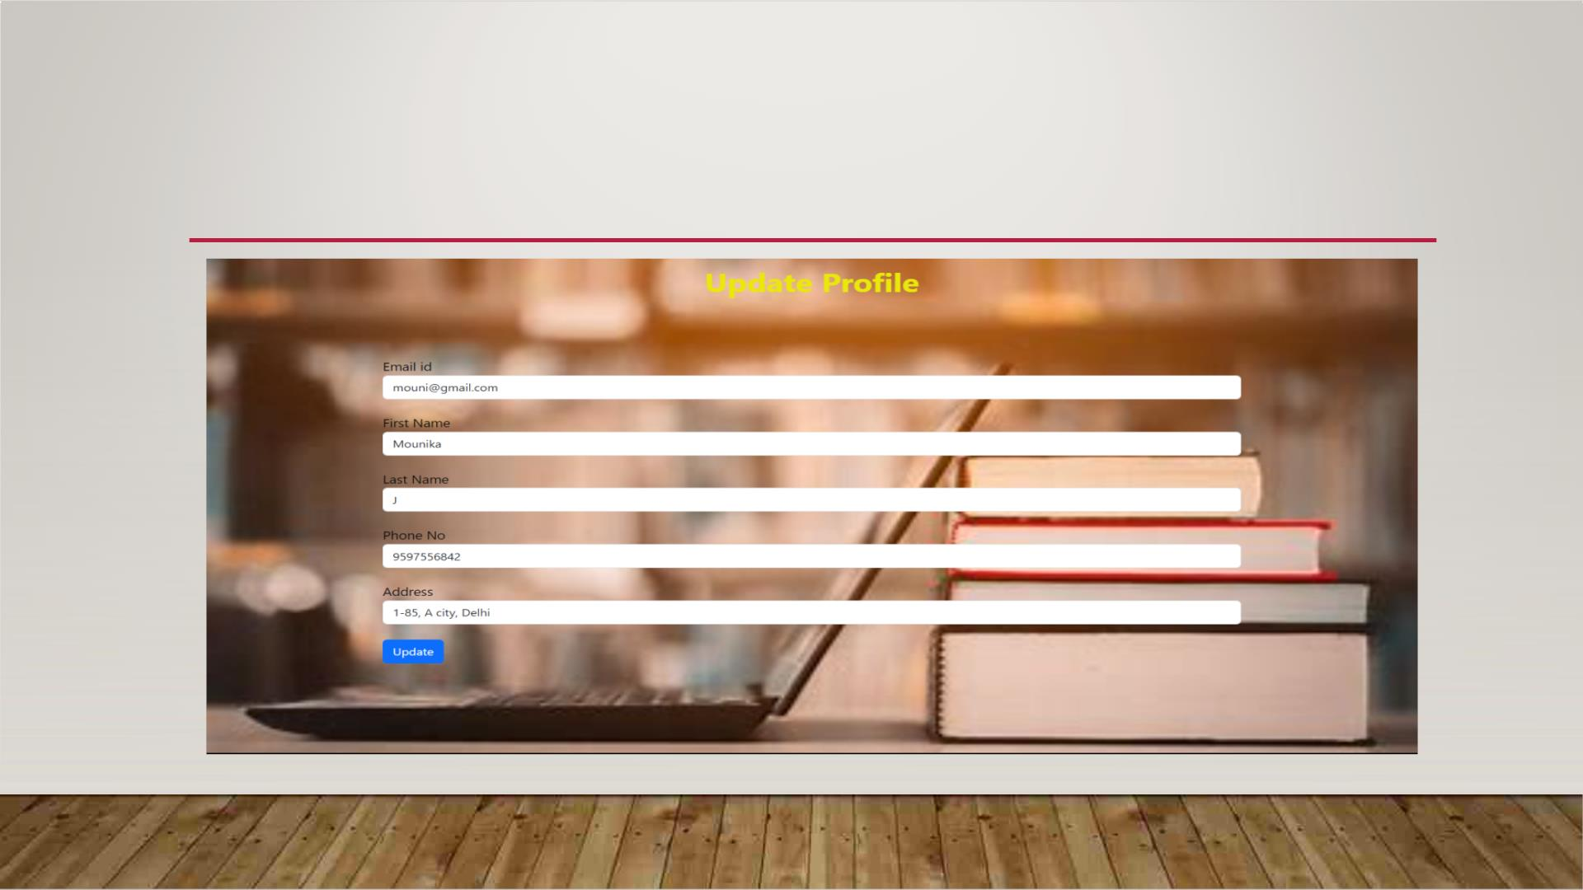
UPDATE USER PROFILE

Slide 28
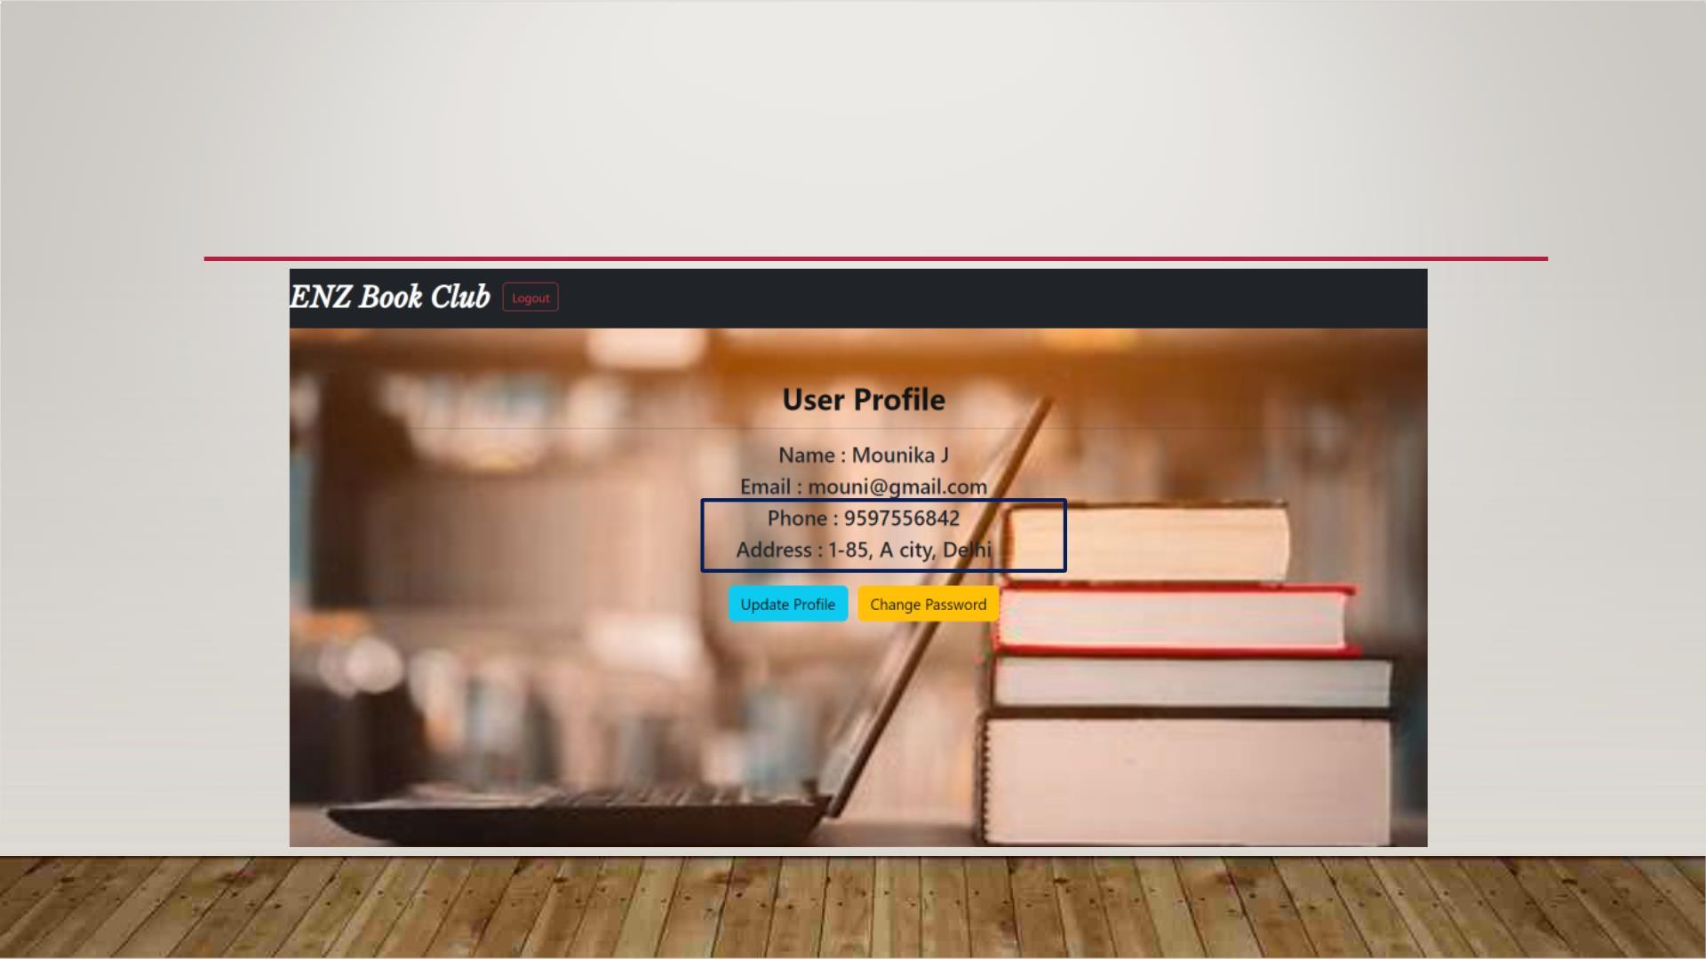
UPDATED PROFILE

Slide 29
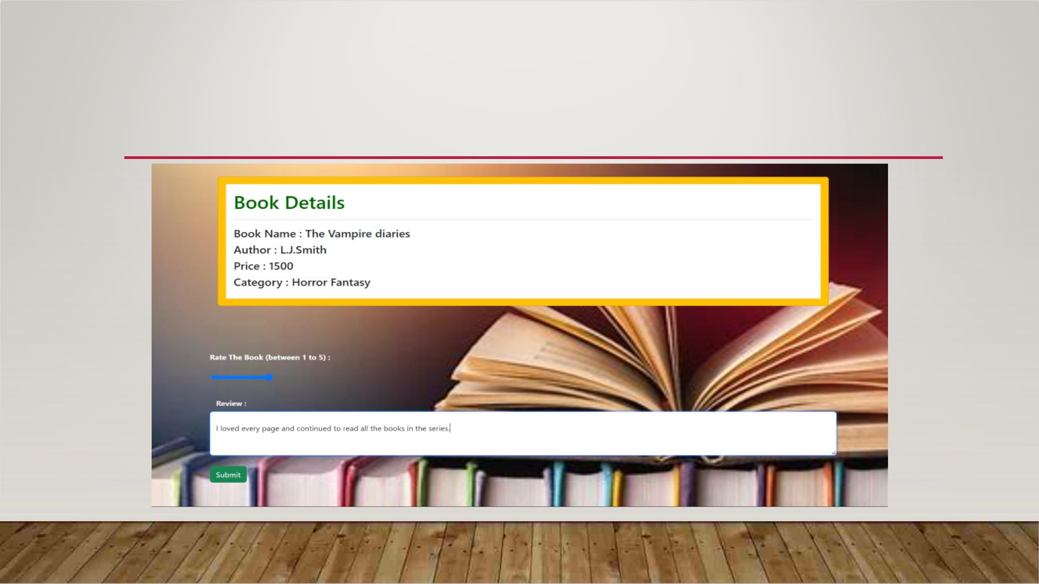
BOOK REVIEW

Slide 30
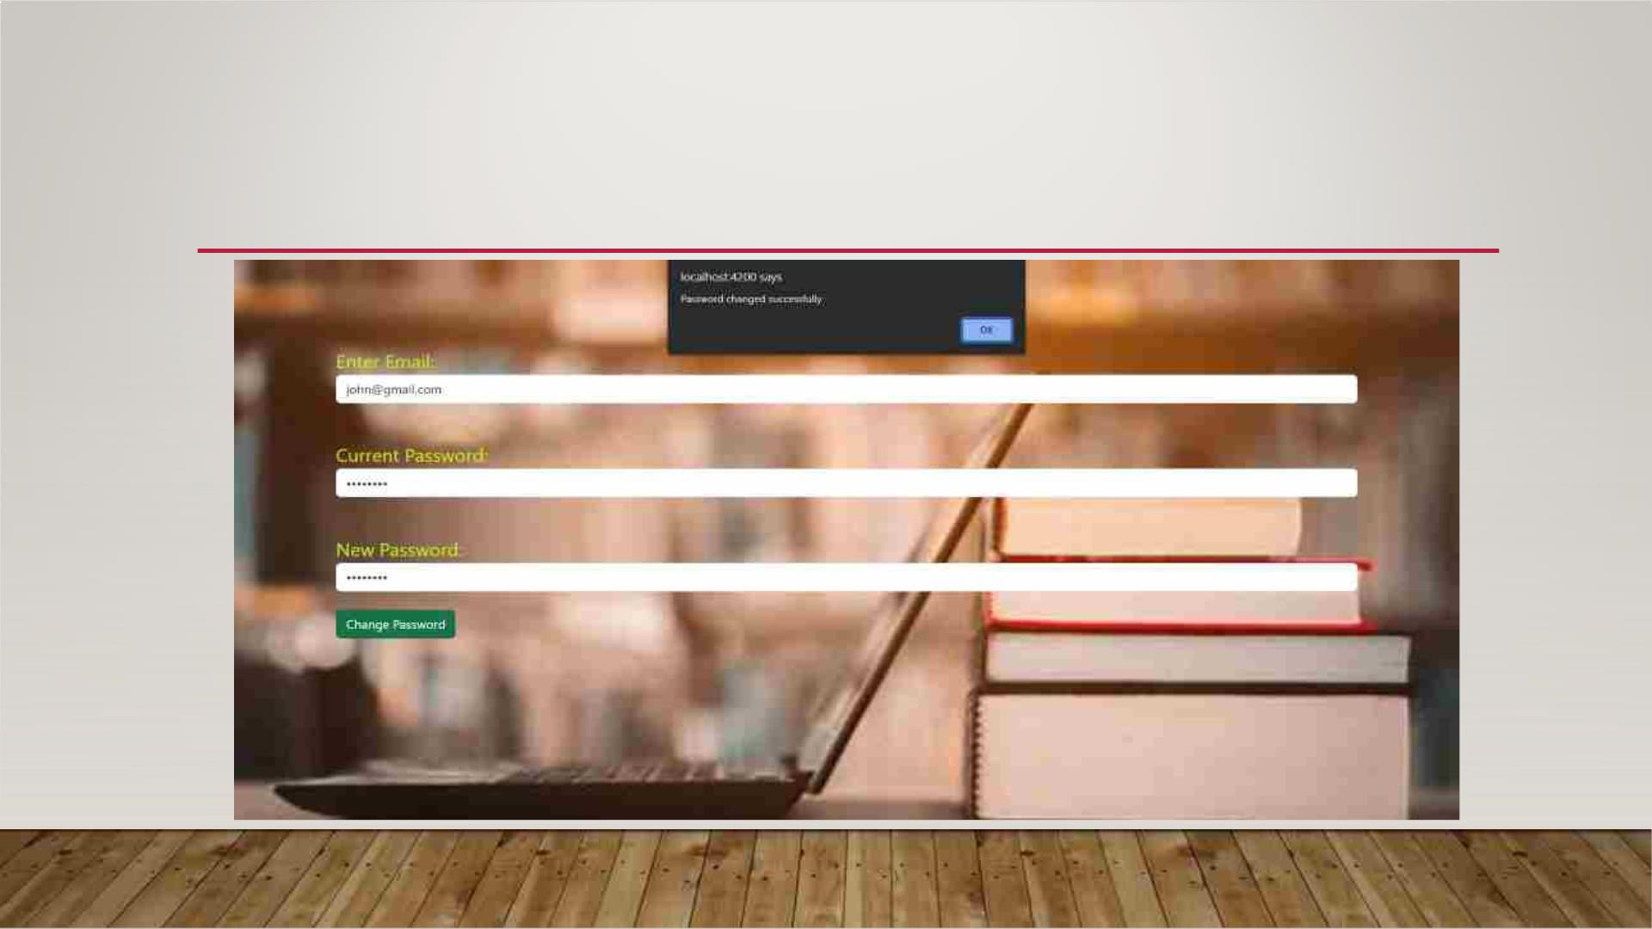
CHANGE USER PASSWORD

Slide 31
CONCLUSION
ØOur project is only a humble venture to satisfy the needs to manage their project work.
Several user-friendly coding has also adopted.
ØThe objective of software planning is to provide a frame work that enables the manger to
make reasonable estimates made within a limited time frame at the beginning of the
software project and should be updated regularly as the project progresses.
Ø At the end it is concluded that we have made effort on following points.

Slide 32


