Slide 1
Analyze Engine Configurations Based on AutoMobile Engine Dataset
Mounika Kanakanti
Batch - 33 (1528)

Slide 2
Agenda:
Problem Understanding
Data Understanding
Data Preparation
Model Building
Test Data Preparation
Predicting on Test Data

Slide 3
Problem Understanding:
Physical analysing of engine configurations involves an expensive, noisy and time-consuming process.
Building analytics model using previous data on various configurations tested would help the manufacturers narrow down only few configurations for further testing on physical bench test.
type
posts

Slide 4
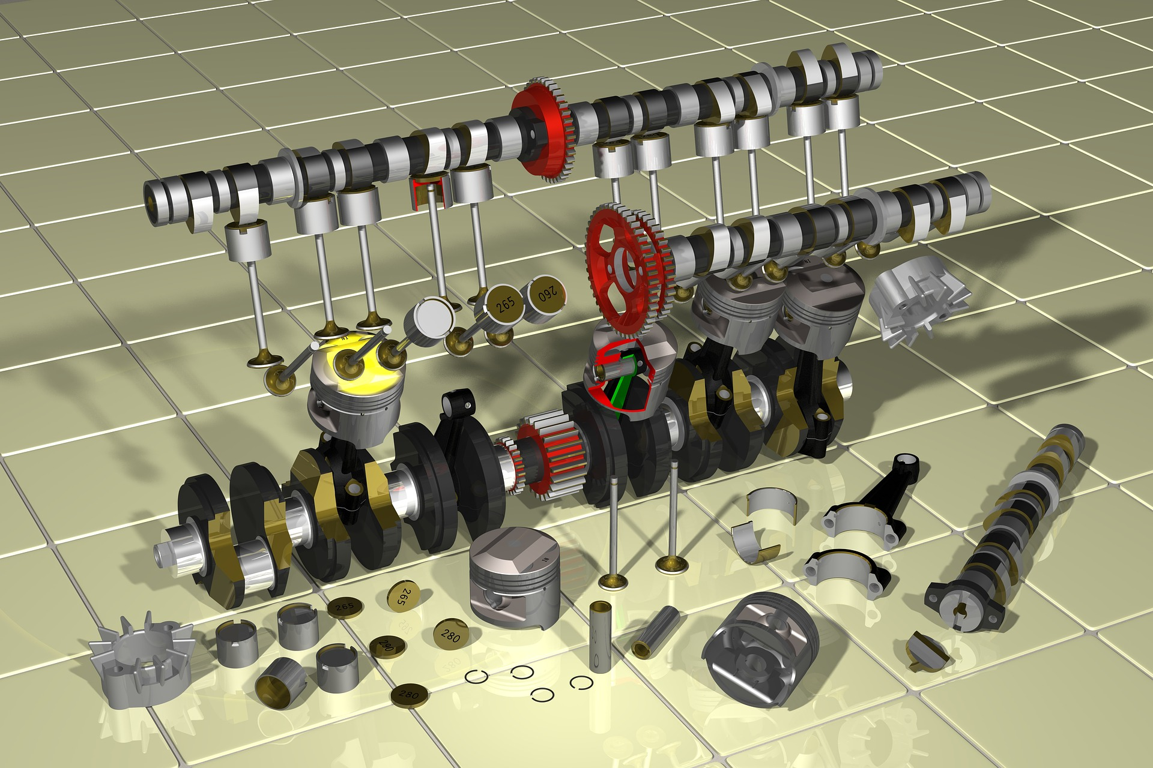

Slide 5
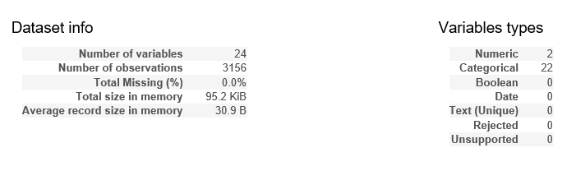
Raw Data Characteristics:
The given automobile dataset contains the various engine configurations as features and the target variable represents the outcome of the bench test.
Fig : Raw Data Characteristics

Slide 6
Data Preparation:
Renaming columns
Label Encoding
Replacing NaNs
Attaching additional data
Handling missing values
Cross Validation

Slide 7
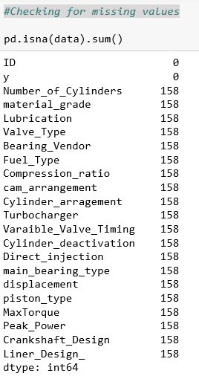
Handling Missing Values:
Fig: Sum of Missing Values in each of the columns

Slide 8
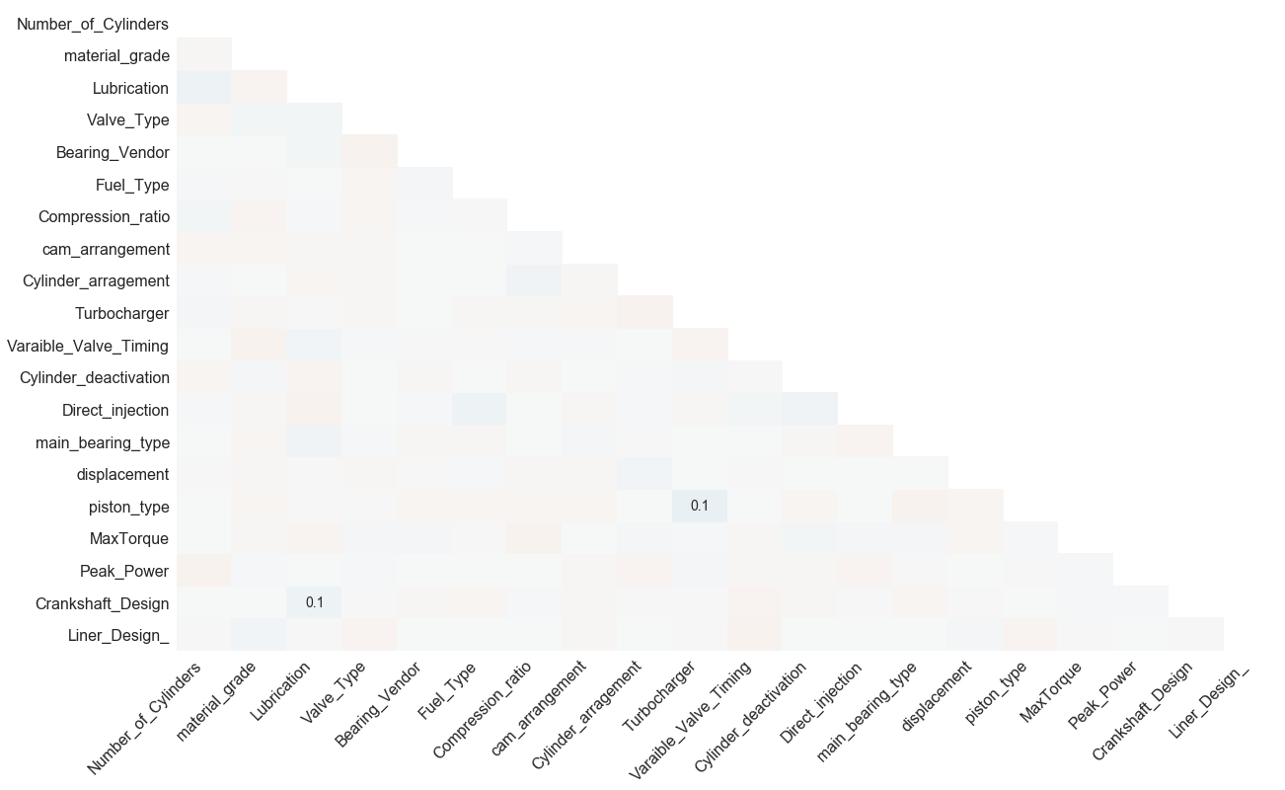
Finding Missing Value Patterns:
Fig: HeatMaps for finding missing value patterns

Slide 9
Imputation Methods Used:
fillna(method=‘ffill’):
Propagates the previous value forward.
KNN with k=3:
Considers the k nearest(in terms of characteristics) records for filling up missing values.

Slide 10
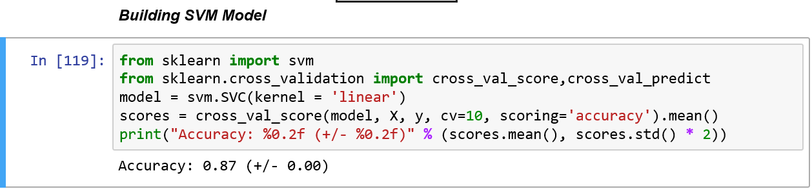
Model Building
Fig : SVM Model in Python
The predictions were 87% accurate.

Slide 11
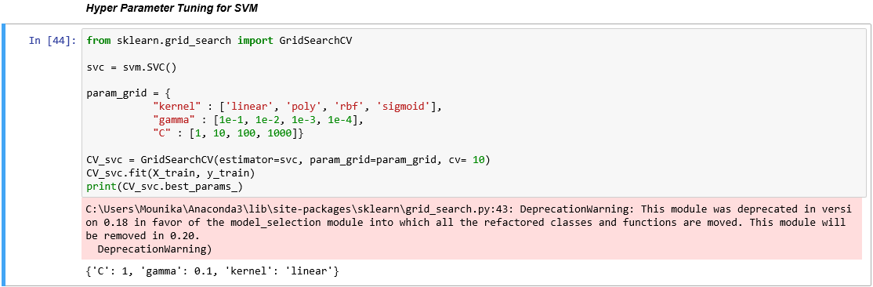
Hyper Parameter Tuning for SVM:
The grid search method tries all the possible comibations of given parameters and returns the parameters of best model.

Slide 12
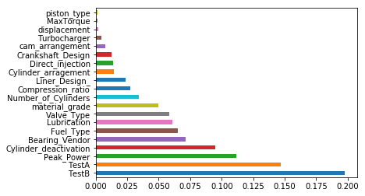
Random Forest Model:
Fig: Importance of features returned by random forest model

Slide 13
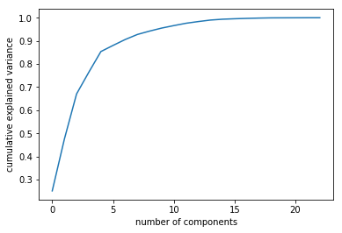
Other used models:
SVM with important features returned by Random forest model
SVM with PCA components.
Fig : Number of components vs Cumulative explained variance obtained by PCA

Slide 14
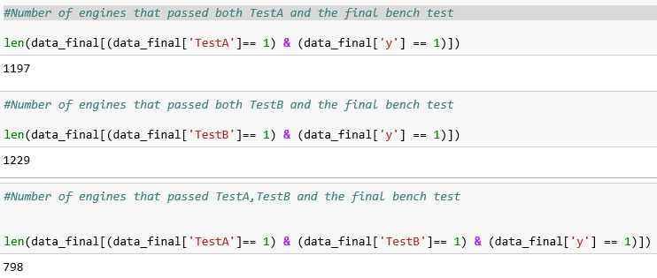
Data Insights
Analyzing the affect of TestA and TestB on the final bench test results:
We observe that the TestA and TestB has significant affect on the final bench test results.

Slide 15
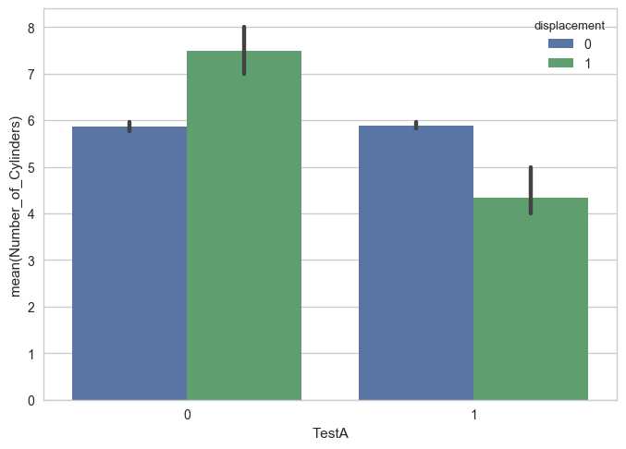
How does Number of Cylinders affect TestA results ?
Fig: TestA vs Number of Cylinders

Slide 16
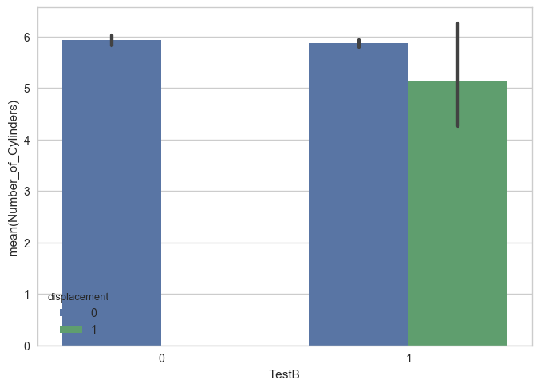
How does Number of Cylinders affect TestB results ?
Fig: TestB vs Number of Cylinders

Slide 17
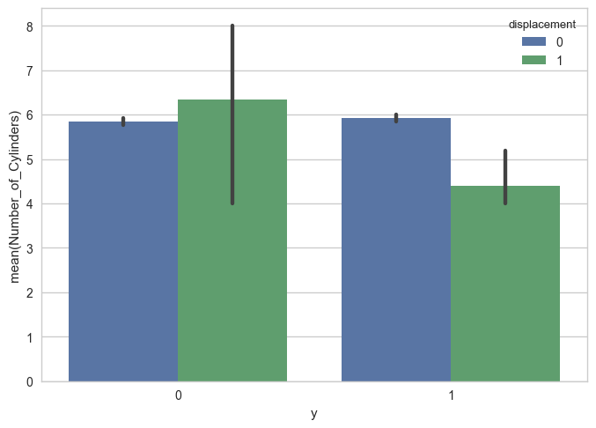
How does Number of Cylinders affect Bench Test results ?
Fig: y vs Number of Cylinders

Slide 18
Conclusion:
The overhead of performing expensive and noisy physical bench test for engines has been overcome by predicting the bench test results from the given dataset containing various engine configurations.
In this way, we can not only predict just the bench test results but also find patterns in engine configurations that are more likely to pass the bench test which helps while building a new engine.

Slide 19
THANK YOU

