Slide 1

Personality Type Indicator
Mounika Kanakanti
Batch – 33 (1528)
Notes:
To use this title animation slide with a new image simply 1) move the top semi-transparent shape to the side, 2) delete placeholder image, 3) click on the picture icon to add a new picture, 4) Move semi-transparent shape back to original position, 5) Update text on slide.

Slide 2
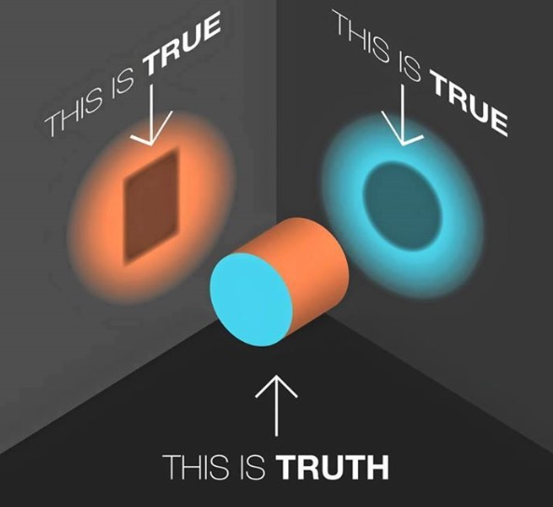
“"It is up to each person to recognize his or her true preferences."
- Isabel Briggs Myers

Slide 3
Introduction
MBTI (Myerrs Briggs Personality Indicator) – a tool to assess personality types.
What is its purpose?
To make the theory of psychological types understandable and useful in people’s lives.
What does it do?
Divides people into 16 types, based on the combination of traits they fall into.
Extroversion(E) vs Introversion (I)
Sensing(S) vs Intuition (N)
Thinking (T) vs Feeling (F)
Judging (J) vs Perceiving (P)
Where is it used?
Day to day lives or business world for career counselling, developing management styles, team building and conflict management.

Slide 4
How much can we trust these given personality types?
The Problem
!

Slide 5
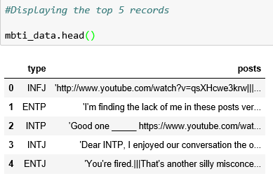
MBTI Dataset:
MBTI Dataset
This dataset contains over 8600 rows of data, on each row is a person’s:
Type (This persons 4 letter MBTI code/type)
A section of each of the last 50 things they have posted (Each entry separated by "|||" (3 pipe characters))

Slide 6
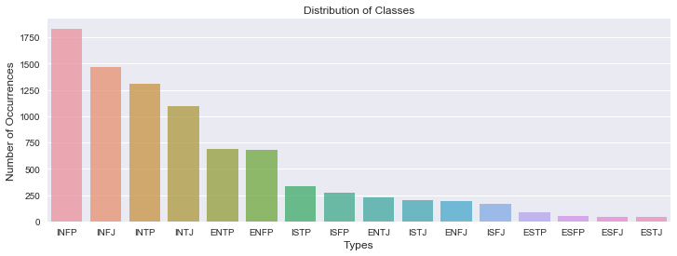
Distribution of Classes:
The classes are really imbalanced.

Slide 7
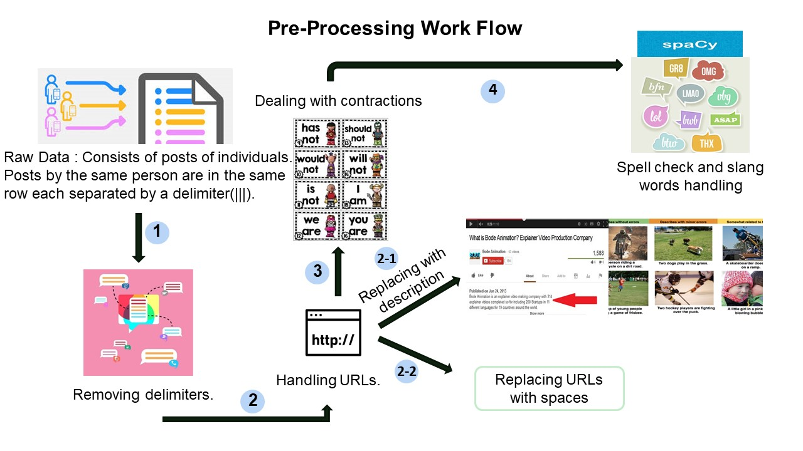

Slide 8
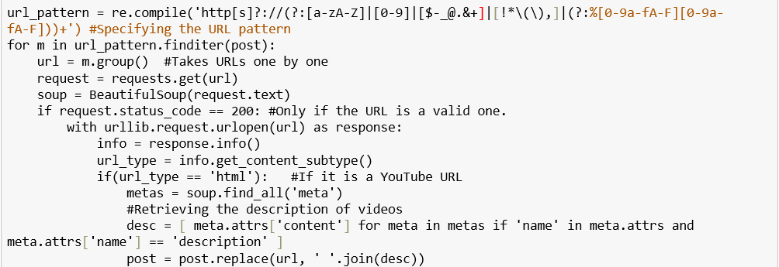
Handling URLs :

Slide 9
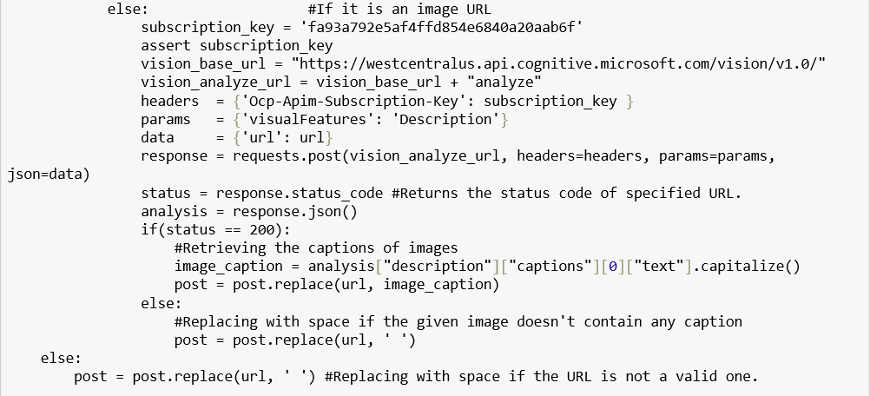
Contd.. :

Slide 10
Flowchart for Slang and Spell Check :

Slide 11

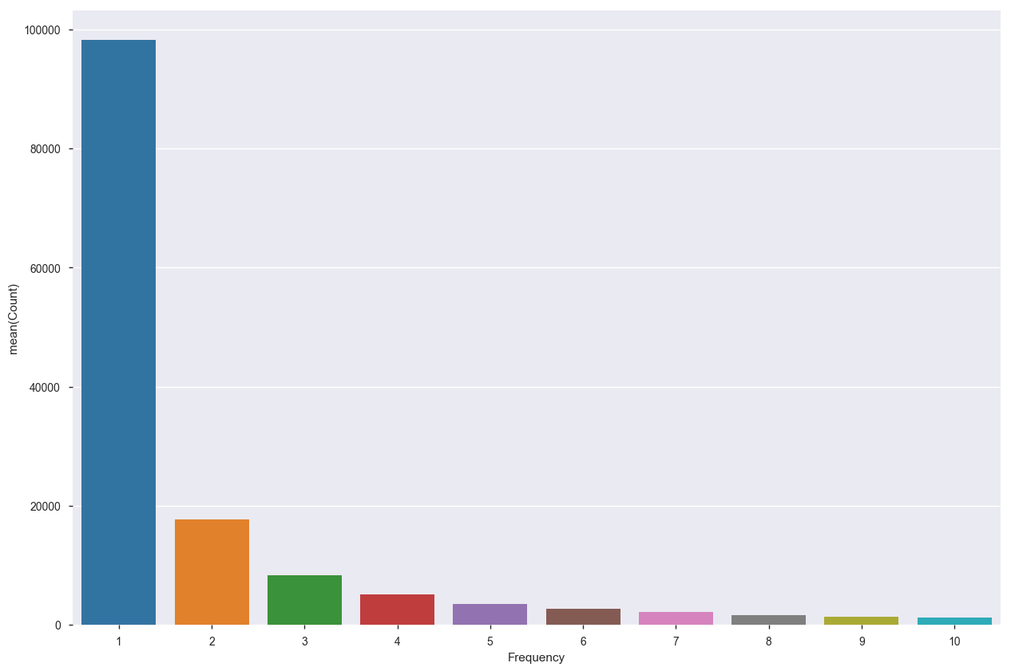
Analysing Word Counts:
The size of the corpus made the function to work really long.
Solution:
Deep Spelling

Slide 12
Methods Used:
Feature Extraction
Why convert text to features?
Many Machine Learning algorithms and almost all Deep Learning Architectures are incapable of processing strings or plain text in their raw form.
TF – IDF Vectorizer
Word2Vec
CNN
LSTM

Slide 13
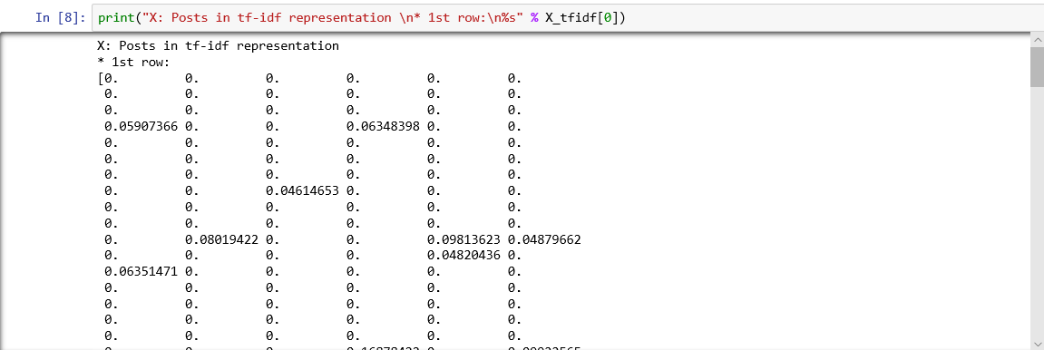
TF – IDF Vectorizer :
Converts text to numeric vectors by considering the term frequencies and inverse document frequency.

Slide 14
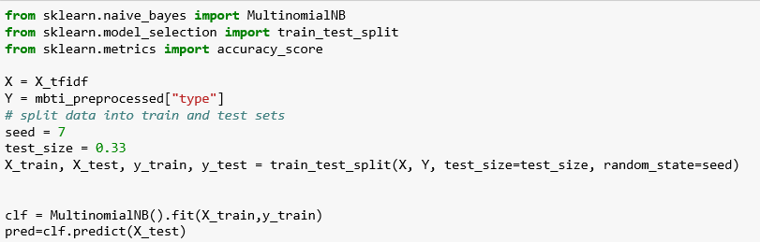
Model Building Using TF - IDF :
Fig: Naive Bayes Classifier in Python

Slide 15
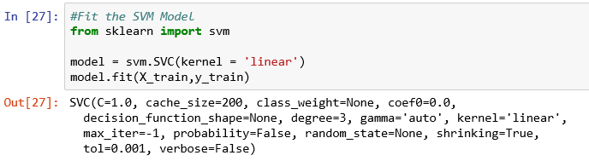
Contd..
Fig : SVM using TF – IDF Features in Python
SVM performed better when compared to Naïve Bayes Classifier with an accuracy of 65%.

Slide 16
“You Shall Know a Word By The Company it Keeps”
— JR FIRTH

Slide 17
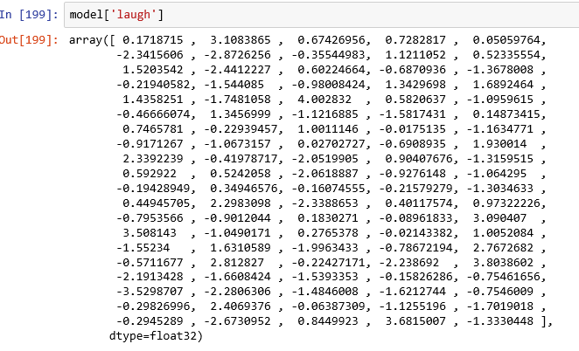
Word2Vec:
Fig: Creating Word2Vec Embeddings
Fig : Sample Word Embedding

Slide 18
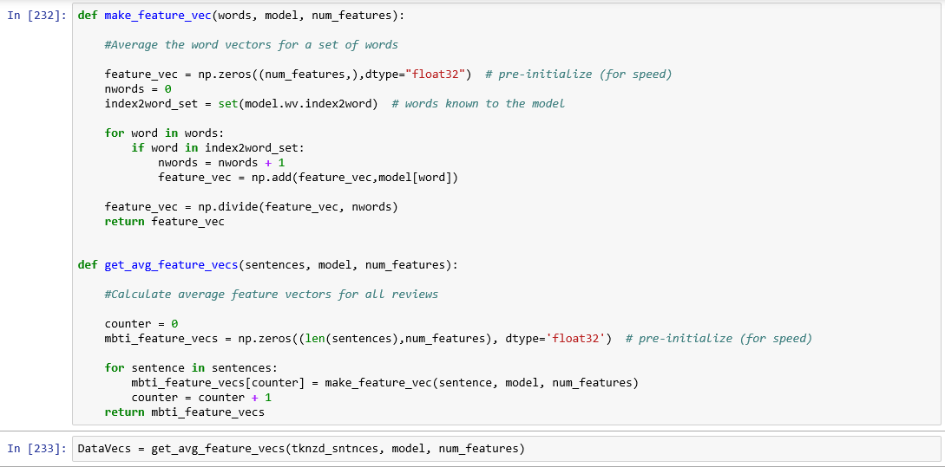
Averaging Word Embeddings for each Document:
Fig: Naive Bayes Classifier in Python

Slide 19
Future Scope :
Implementing Deep Learning for Cleaning text.
Improving Word2Vec Embeddings
Dimensionality Reduction
Working on Hypotheis Testing of Problem Statement.
Finding patterns between different personality types.

Slide 20
THANK YOU

