Slide 1
IBM University Engagement Project Submission
“Exploring the Power of Agentic AI with IBM Granite and LangFlow”

Slide 2

Project Tile – Interview Mate AI
Domain of Project – Education
Student Name | Recent Passport Photo | Email ID | Mobile number [WhatsApp]
K.Mounika |  | mounikakarri50@gmail.com | 8978904659
Recommended font style and size:
Font Style: Arial
Font Size (Heading): 28
Font Size (Content): 20

Slide 3
Problem Statement -22
Interview Trainer Agent
The Challenge – An Interview Trainer Agent, powered by RAG (Retrieval-Augmented Generation), prepares users for job interviews by generating tailored question sets and preparation strategies based on their profile name, experience level, and job role.
The Objective
Build an AI-powered Interview Trainer Agent that delivers personalized interview preparation and guidance for students and job seekers. The solution should:
• Performance Assessment – Evaluate technical knowledge, communication, relevance, completeness, and confidence.
• Resume Analysis – Analyze the user's resume and identify skills, projects, education, experience, and certifications.
• Multi-Agent System –
• Resume Analyzer Agent (analyzes candidate resume)
• Question Generator Agent (generates personalized interview questions)
• Mock Interviewer Agent (conducts interactive mock interviews)
• Evaluation Agent (evaluates answers and provides feedback)
• Interview Orchestrator Agent (coordinates all agents and manages the interview process)
• Progress Dashboard

Slide 4
Proposed Solution -
Proposed Solution: AI-Powered Interview Trainer Agent
The proposed solution is a multi-agent AI-powered Interview Trainer Agent built using IBM watsonx Orchestrate, watsonx.ai, IBM Granite Models, and RAG to provide personalized interview preparation and real-time interview guidance.
At its core, the system uses a Retrieval-Augmented Generation (RAG) pipeline to retrieve relevant interview questions, role expectations, technical concepts, HR questions, and behavioral scenarios from a structured knowledge base.
The system consists of five key agents:
Resume Analyzer Agent
Question Generator Agent
Mock Interviewer Agent
Evaluation Agent
Interview Orchestrator Agent
IBM watsonx Orchestrate is used to coordinate the multi-agent workflow, while watsonx.ai and IBM Granite models provide AI capabilities.
Overall, the solution delivers an end-to-end intelligent interview preparation platform that helps students and job seekers practice interviews, identify skill gaps, improve communication, and prepare effectively for their target roles.

Slide 5
Technology Used
• IBM watsonx Orchestrate
• IBM Granite Model
Html
Css
Javascript
• IBM Cloud
• RAG
• IBM watsonx.ai
• Knowledge Base
• A2A (Agent-to-Agent)
• React.js
• FastAPI
• Supabase & PostgreSQL

Slide 6
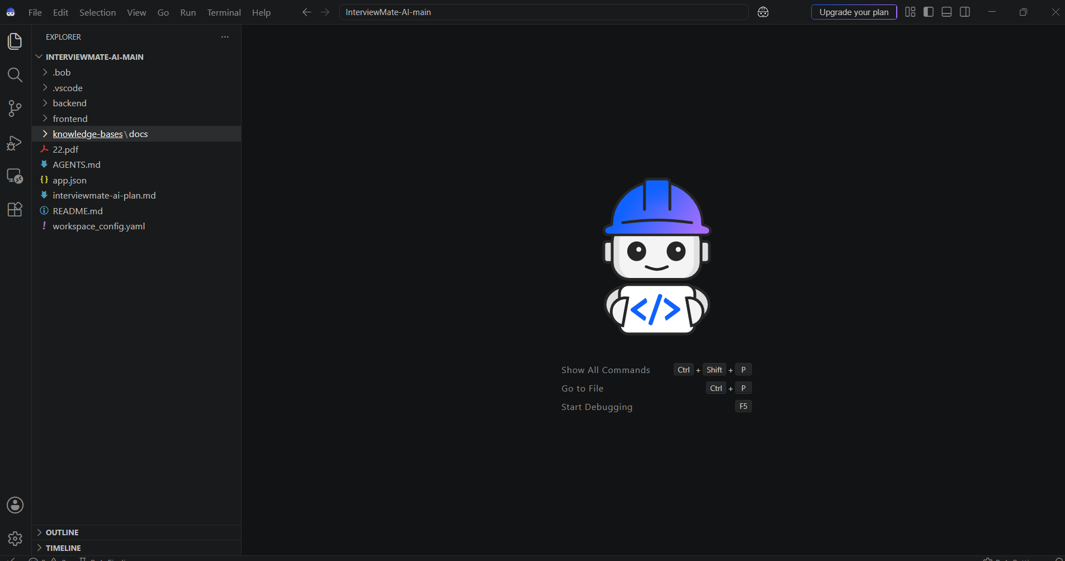
Required Files created using IBM bob :

Slide 7
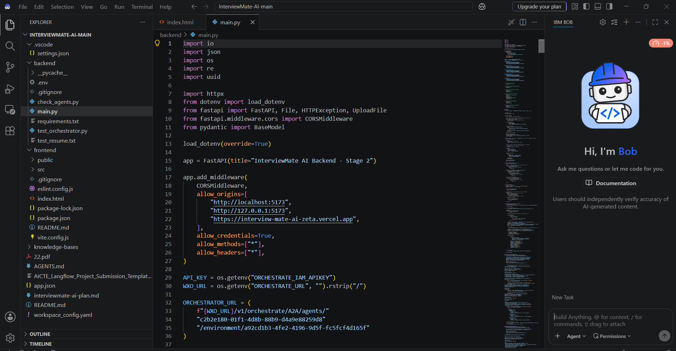
Required Files created using IBM bob :

Slide 8
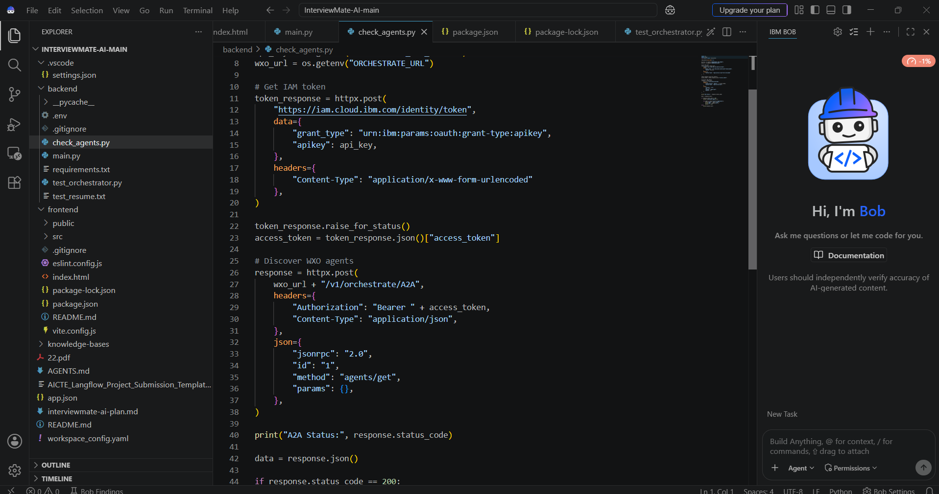

Slide 9
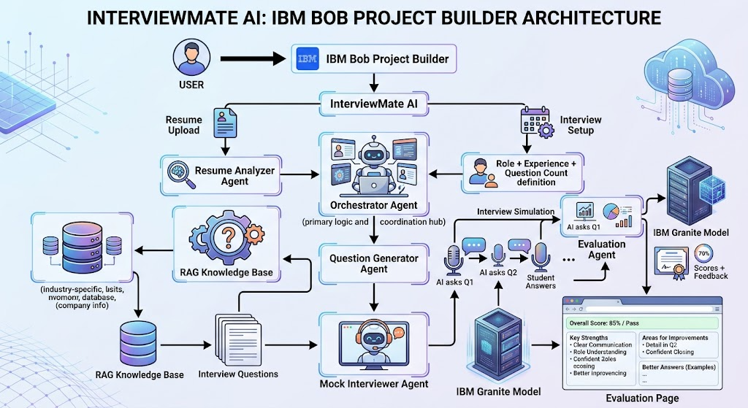
Architecture blueprint

Slide 10
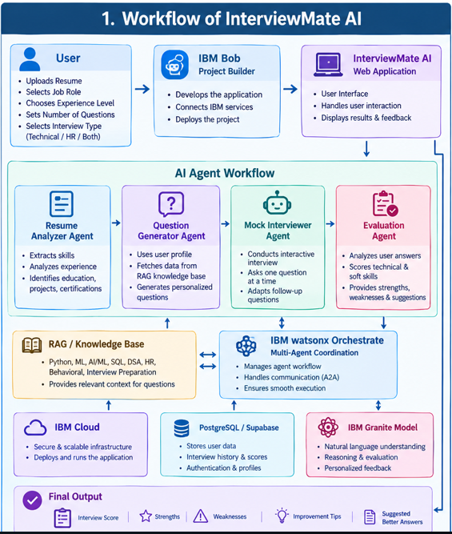
Langflow workflow -

Slide 11

Role of Agentic AI in the solution
Agentic AI enables InterviewMate AI to function as an intelligent, autonomous interview-training system rather than a simple chatbot. Each agent performs a specific role—such as analyzing resumes, generating interview questions, conducting mock interviews, and evaluating candidate answers
Agentic AI also provides context awareness, understanding user details such as skills, education, projects, experience, selected job role, and interview preferences to generate relevant questions and feedback.
It supports real-time adaptation during mock interviews. The Mock Interviewer Agent asks questions one at a time and can generate follow-up questions based on the candidate's responses, making the interview more interactive and realistic.
Overall, Agentic AI makes InterviewMate AI proactive, personalized, adaptive, and goal-driven, acting like a smart virtual interview coach that helps candidates improve their technical knowledge, communication skills, and interview performance.

Slide 12
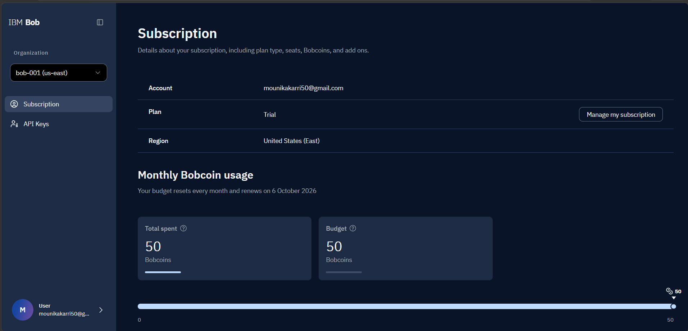
Token Usage
50 bob coins are used
After all Prompts
·
·
·

Slide 13
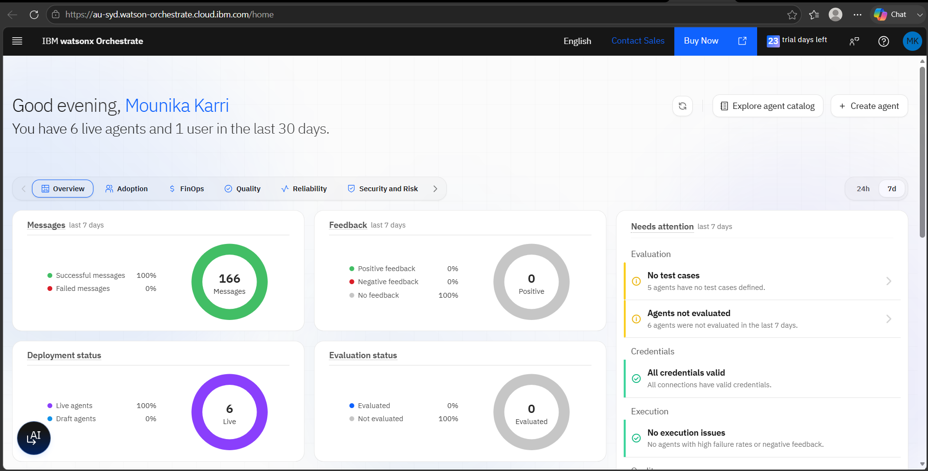
ScreenShots:

Slide 14
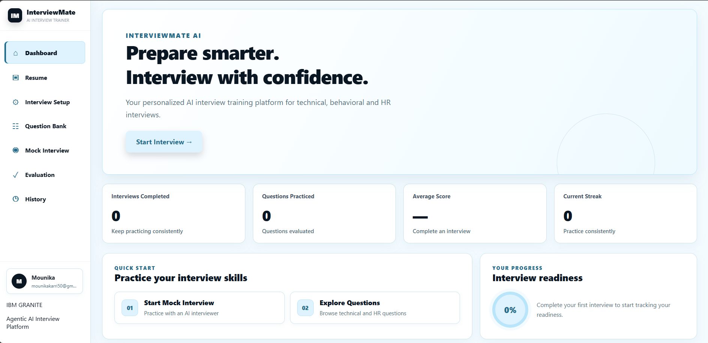
Website Screenshots:

Slide 15
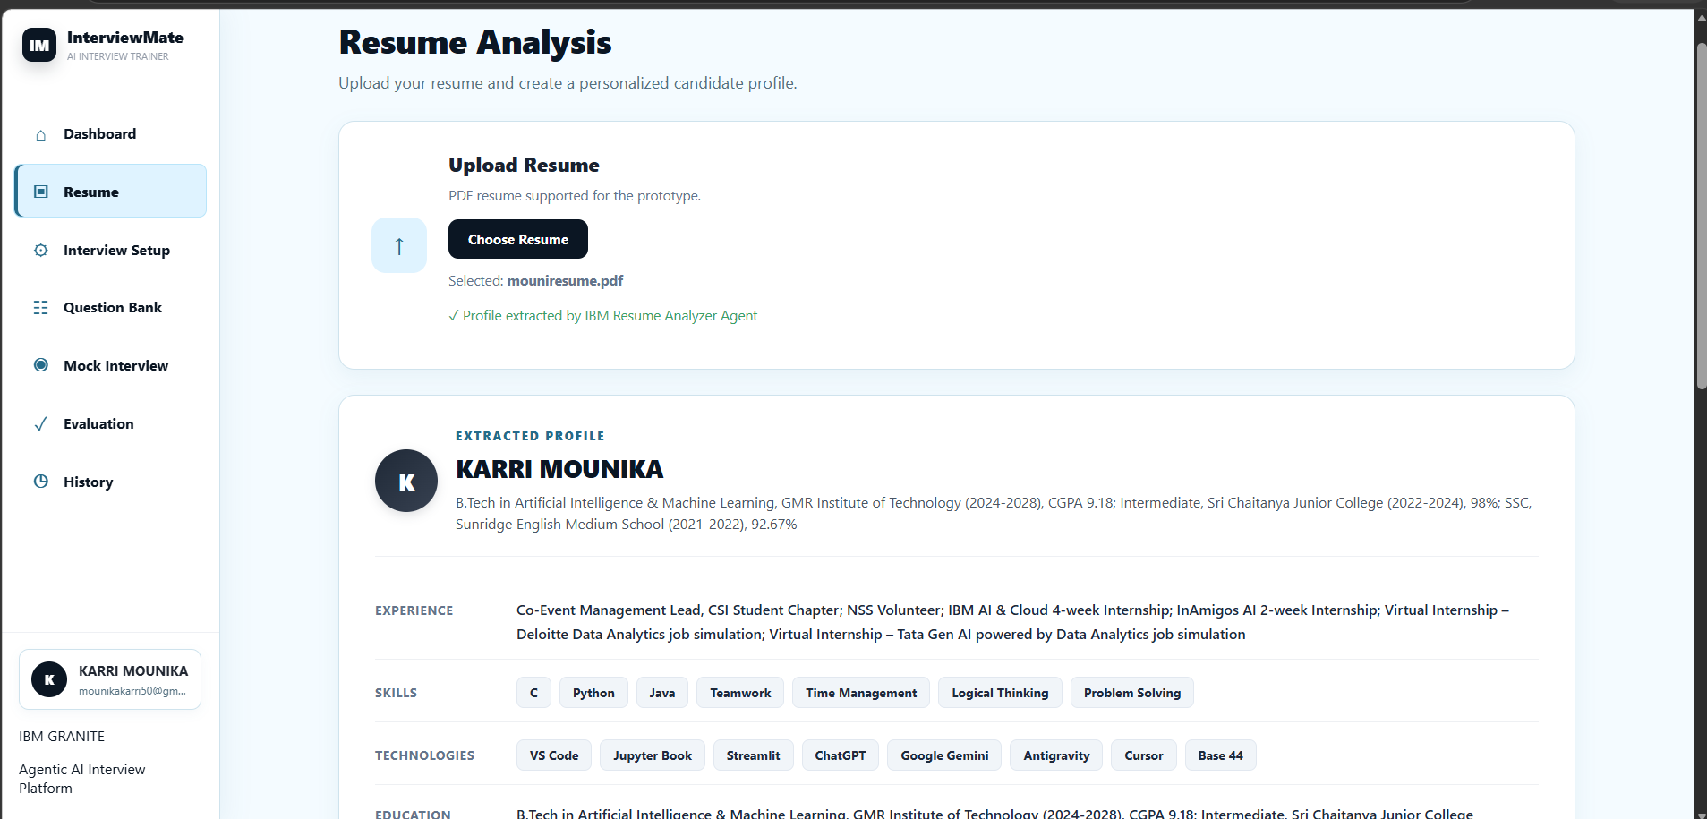

Slide 16
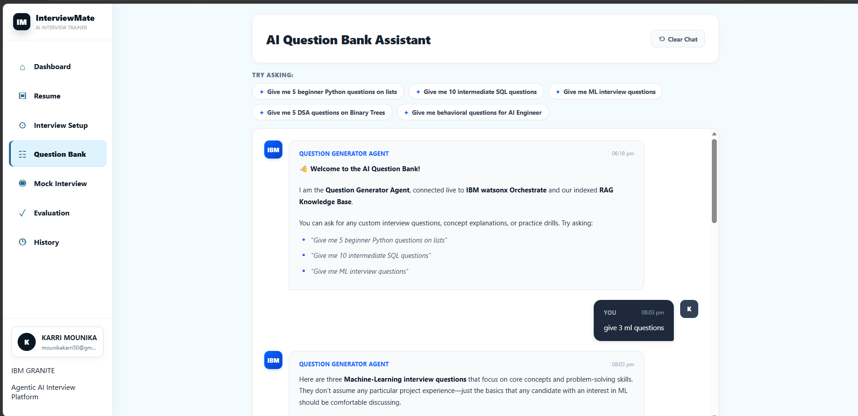

Slide 17
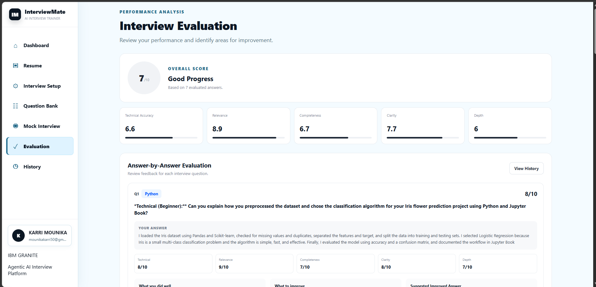

Slide 18
Novelty and Uniqueness
The proposed InterviewMate AI stands out by combining Agentic AI, RAG, personalization, and adaptive mock interviews into a single intelligent interview-training system.
Multi-Agent Intelligence –The Resume Analyzer, Question Generator, Mock Interviewer, and Evaluation Agent work together through the Orchestrator to provide an end-to-end interview experience.
RAG-Based Question Generation – Integrates a dedicated interview knowledge base containing Python, ML/AI, SQL, DSA, HR, behavioral, and role-expectation content to generate relevant and context-aware questions.
Resume-Based Personalization – Questions are tailored to the candidate's skills, education, projects, certifications, experience, and selected job role, rather than providing the same questions to every user.
Adaptive Mock Interview – The Mock Interviewer conducts the interview one question at a time and can adapt follow-up questions based on the candidate's responses, making the experience closer to a real interview.
Multi-Modal Interview Support – The platform can support text and voice-based interaction, allowing candidates to practice interviews in a more natural way.
Overall, the uniqueness of InterviewMate AI lies in transforming interview preparation from a static question-answer chatbot into a personalized, adaptive, and goal-driven AI interview coach.

Slide 19
Git Hub Link
Github URL –Mounika2515/InterviewMate-AI
·
·
·

Slide 20
Future Scope
1. Integration with Job Portals & Professional Platforms –
The system can be integrated with job portals and professional networking platforms to collect job descriptions, required skills, experience requirements, and role-specific expectations. This will enable InterviewMate AI to generate more relevant and personalized interview questions based on current industry requirements and specific job opportunities.
2. AI-Powered Voice Interview & Multilingual Support –
Enhancing the system with a voice-enabled mock interview assistant and multilingual support will improve accessibility and provide a more realistic interview experience. Users can interact with the AI interviewer using their voice and practice interviews in their preferred language, making the platform more interactive, inclusive, and suitable for candidates from diverse backgrounds.
·
·
·

Slide 21
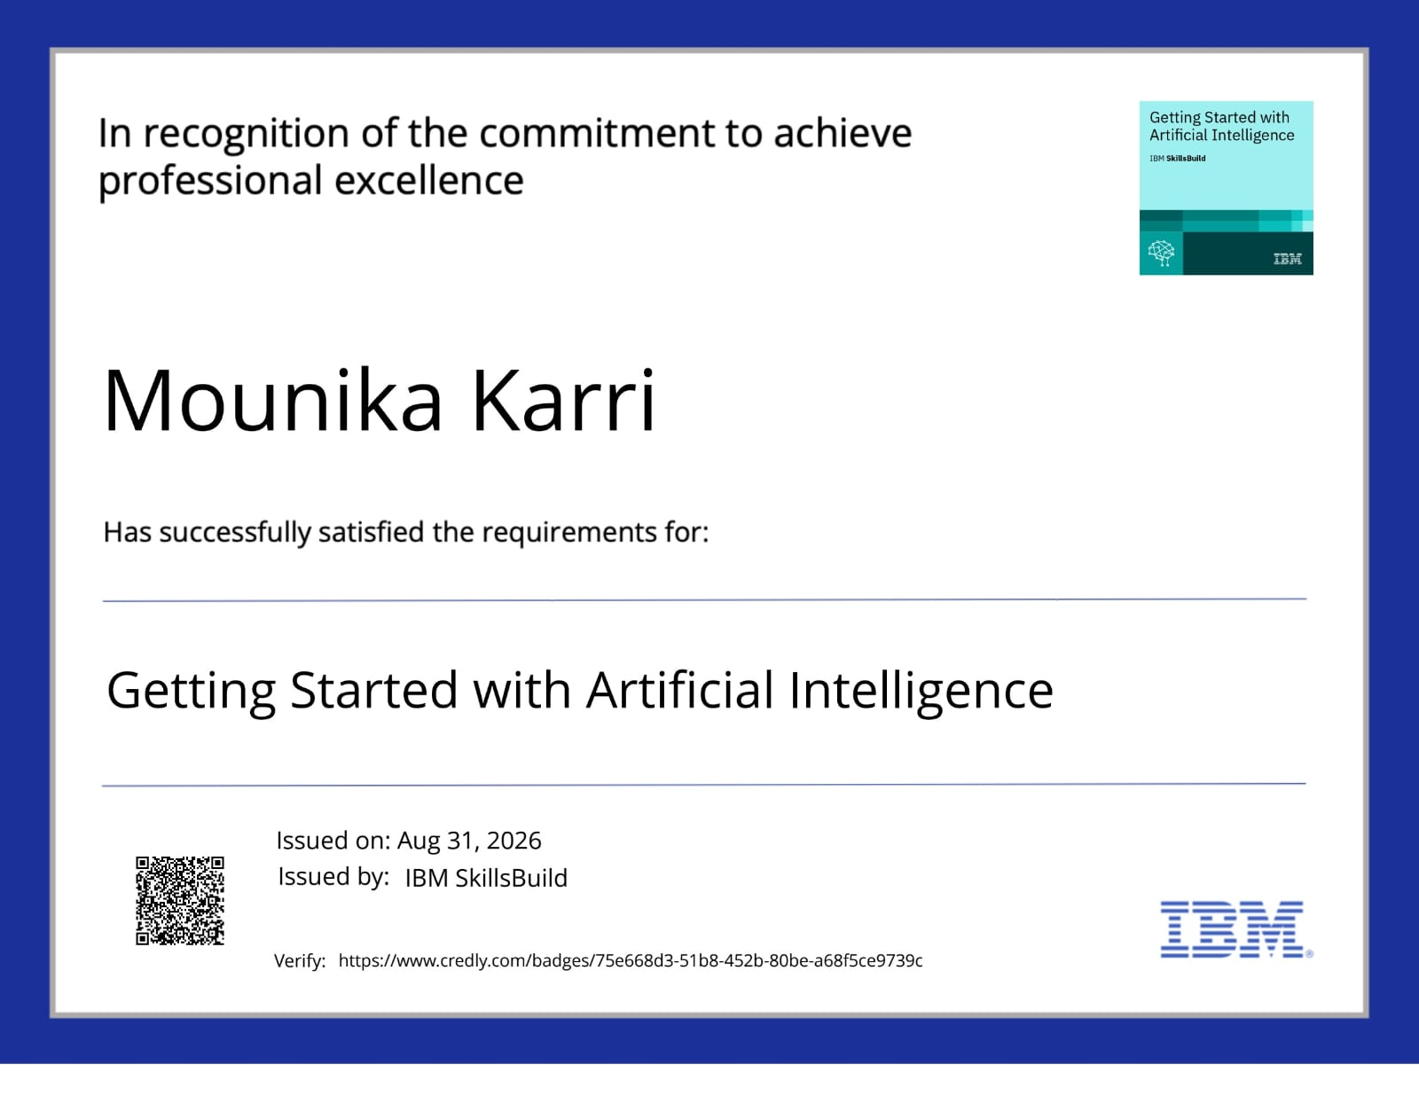
Certificates Earned:
Please add your credly certificate

Slide 22
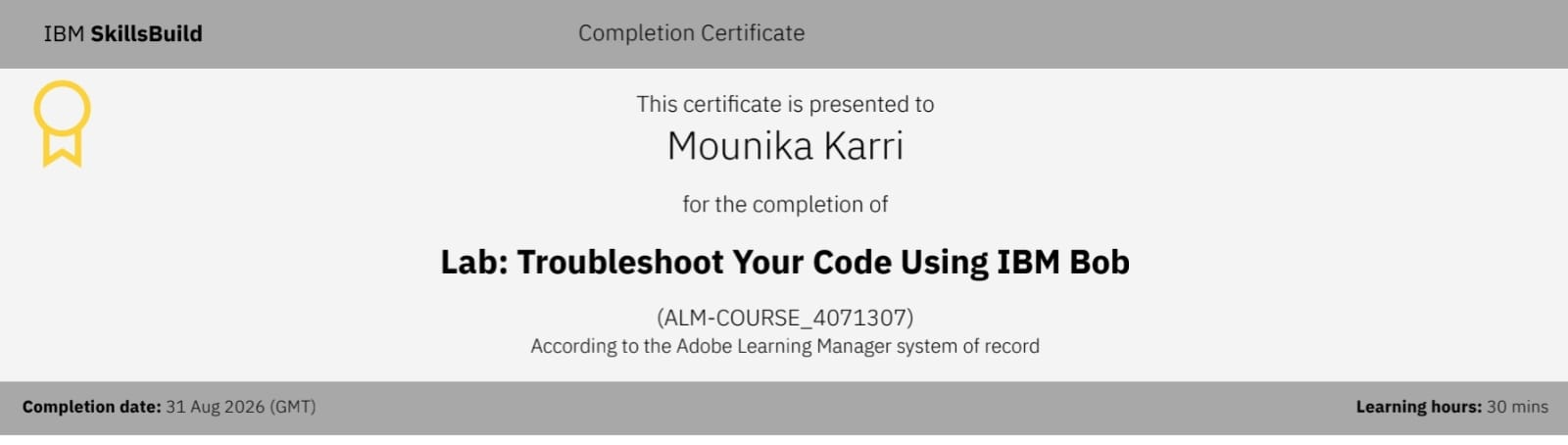
Certificates Earned:​
Add your IBM BOB Certificate

Slide 23


