Slide 1



Sustainable Supply Chain Performance Dashboard using Power BI
Sanaka.Mounika

Slide 2

Learning Objectives
• Visualize & Analyze: Master Power BI to create interactive dashboards showcasing key performance indicators (KPIs) like sales, profit, and customer trends.
•Gain Business Insights: Identify growth opportunities, optimize pricing, and improve customer satisfaction through data-driven analysis.
•Develop Power BI Skills: Become proficient in data cleaning, transformation, DAX, and data modeling within Power BI.
•Drive Strategic Decisions: Provide actionable recommendations based on data insights to boost profitability and market share.
GOAL
Source :
www.freepik.com/

Slide 3
Tools and Technology used
Power BI is a Microsoft business analytics service that provides interactive visualizations and business intelligence capabilities for data analysis and reporting.
Power BI Desktop: The primary tool for report development.
Power Query Editor: Used for data cleaning, transformation, and shaping.
DAX (Data Analysis Expressions): The formula language for calculations and metrics.
Data Connectors: Enable importing data from diverse sources (Excel, CSV, databases, etc.).
Visualizations (Charts & Graphs): Present insights in a clear and compelling way.
Power BI Service: For publishing, sharing, and collaborating on reports and dashboards.

Slide 4
Methodology
Bar Chart: A bar chart in Power BI is a visualization tool used to display categorical data with rectangular bars, allowing users to compare and analyze data across different categories.
Stacked Column Chart: Stacked column charts in Power BI effectively visualize how a total amount is divided into different parts, showing both individual contributions and the overall sum for each category.
Pie Chart: A pie chart in Power BI is a circular visualization that displays how different categories contribute to a whole, with each category represented by a slice of the pie proportional to its value.
Line Chart: A line chart in Power BI is a visualization that displays trends and patterns over time or across categories, using a series of connected data points to represent continuous data.
Donut Chart: A donut chart in Power BI is a variation of a pie chart, displaying how different categories contribute to a whole, with a hollow center allowing for additional information or visualizations to be displayed.
Card: A card in Power BI is a visualization that displays a single metric or key performance indicator (KPI) in a concise and easy-to-read format, often used to highlight important information or trends.
Scatter Chart: A scatter chart in Power BI is a visualization that displays the relationship between two continuous variables, using dots to represent individual data points, helping to identify patterns, correlations, and outliers.
Tree Map: A tree map in Power BI is a hierarchical visualization that displays data as a set of nested rectangles, with size and color representing values and categories, helping to analyze and compare large datasets.
Map: A map in Power BI is a geographical visualization that displays data on a interactive map, allowing users to visualize and analyze data by location, region, or country, and gain insights into spatial relationships and trends.

Slide 5
Problem Statement:
• Analyzing Total Sales by each State.
• Comparing Total sales by each city.
• Investigating the correlation between regional sales and economic indicators to develop targeted strategies.
• Evaluating Avg profit by each region.
• Assesing Total Shipping cost by each ship mode.
Examining Avg unit price of each product category.
Examining Month Wise Profit.
Comparing Total sales , Total profit , total quantity ordered.
Analyzing Average Discount and Average Unit Price by each Product Category.

Slide 6
Problem Statement:
Comparing Max profit by day and region
Examining Order Priority by Product Category
Understanding Maximum Profit by State or Province and Region
Analyzing Count of Customer name by Customer segment
Understanding Max sales and Profit by Product Category and Sub-Category
Comparing Average of shipping cost, Average of sales and Max of quantity ordered by new region

Slide 7
Solution:
To Analyze the Super Store Performance we use the following visualizations:
1. Bar Chart
2. Pie Chart
3. Line Chart
4. Scatter Chart
5. Donut Chart
6. Stacked Column Chart
7. Card
8. Tree Map

Slide 8
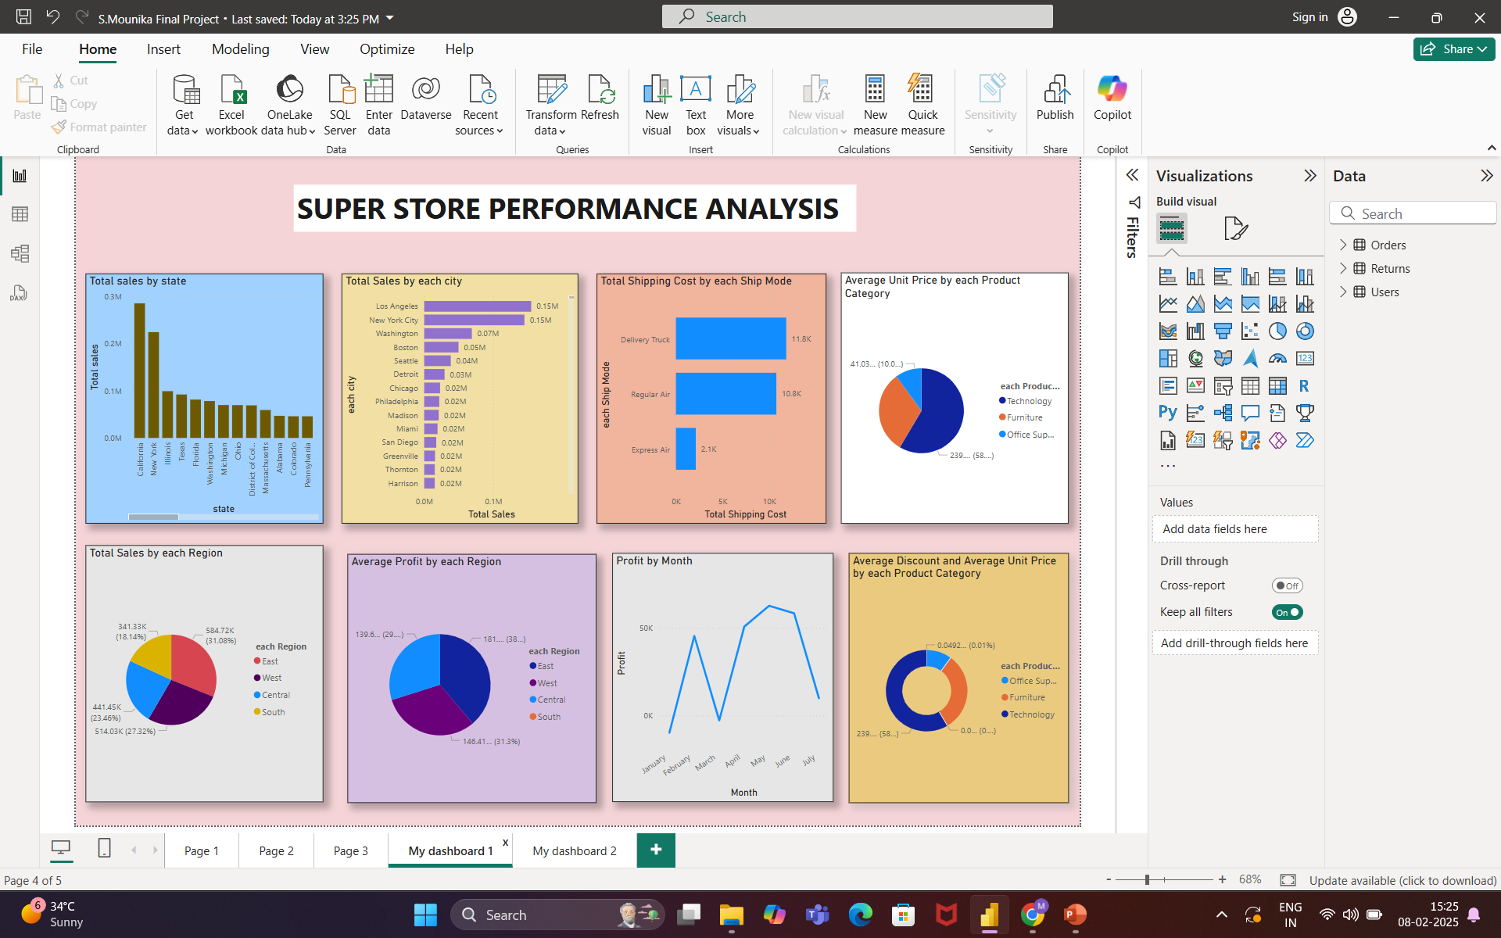
Screenshot of Output:

Slide 9
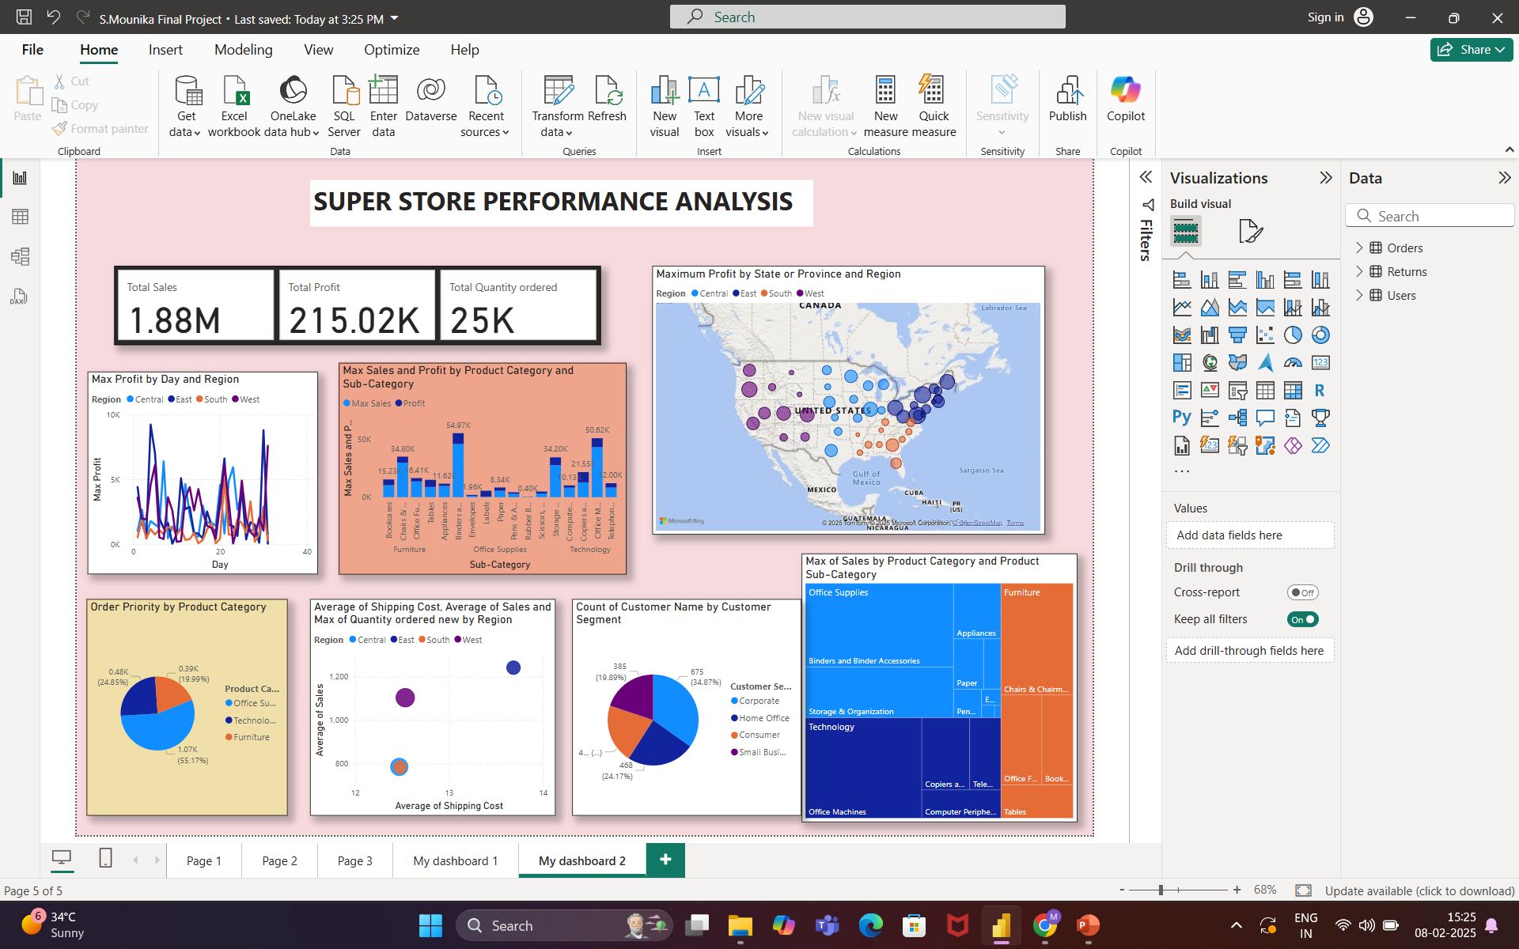
Screenshot of Output:

Slide 10
Conclusion:
• The Super Store excels in the East and California, driven by Technology and Office Supplies (especially phones, copiers, storage).
• Consumers are the largest customer segment.
• While sales are strong, further analysis is needed to understand regional differences (e.g., lower South sales) and optimize shipping costs.
The company should leverage its strengths in key products and regions while addressing areas for improvement.
Recommendations:
Focus marketing on top states/cities.
Optimize shipping costs.
Adjust pricing strategies.
Leverage seasonal trends.
"Power BI empowers businesses with interactive and dynamic visualizations, unlocking data-driven insights and informed decision-making. Its effective usage enables organizations to transform complex data into actionable intelligence, driving growth and success."

