Slide 1



Department of Computer Science Engineering-Data Science
A Major-Project Phase-2 Presentation
on
“AI Powered Deepfake Detection: Liveliness Detection”
Presented by
Chetana H K | 3BR22CD007
K Shashikala | 3BR22CD023
Mounika M | 3BR22CD039
Pushpitha J R | 3BR22CD046
Under the Guidance of
Dr. Jagadish R.M
Project Guide
Dept. of CSE-DS
Dr. Jagadish R.M
Project Coordinator
Dept. of CSE-DS
Dr. D. Aradhana
Head of the Department
Dept. of CSE-DS

Slide 2
CONTENTS
ABSTRACT
OBJECTIVES PROBLEM STATEMENT SCOPE OF THE PROJECT SOFTWARE/HARDWARE REQUIREMENTS DESCRIPTION OF MODULES IMPLEMENTATION TESTING RESULT(SNAP SHOTS) CONCLUSION REFERENCES

Slide 3
ABSTRACT
Every person in this new generation has access to all of humanity's wisdom. Many technological possibilities are available. Nonetheless, we misuse this benefit by using deepfake for face swap. The deep fake method of machine learning, which is popular on social media, superimposes one person's face over another person's face. Deep learning, which has allowed researchers to produce deepfake images and videos considerably more rapidly and affordably, is the main ingredient in deepfakes.
This project focuses on detecting deepfake media using AI techniques. With the rise of manipulated videos and images, particularly those generated using deep learning, this system aims to analyze visual cues and artifacts to identify fake content with high accuracy.

Slide 4
OBJECTIVES
To detect deepfakes using deep learning models.
To implement liveness detection to prevent spoofing using images, videos, or masks.
To distinguish between live humans and deepfakes or replayed content.
To create a user-friendly web platform to easily upload the images and video.
To provide visual feedback or a report of detection results.

Slide 5
PROBLEM STATEMENT
To develop an AI-powered system capable of detecting deepfake content and verifying real- time human presence through liveness detection, to enhance digital security, ensure media authenticity, and prevent identity spoofing attacks.

Slide 6
SCOPE OF PROJECT
The project focuses on detecting visual deepfakes and basic spoofing attempts using deep learning. It includes simple liveness checks such as blinking, head movement, and texture cues. The system works only with video and image inputs and supports real-time analysis. Its accuracy depends on input quality and may not detect highly sophisticated deepfakes. It is not intended for high-security applications.

Slide 7
SOFTWARE REQUIREMENTS
OPERATING SYSYTEM | WINDOWS 11
FRONTEND | HTML, CSS
BACKEND | FLASK,PYTHON
LIBRARIES | TENSORFLOW, NumPy
IDE | VISUAL STUDIO
WEB BROWSER | CHROME

Slide 8
HARDWARE REQUIREMENTS
PROCESSOR(CPU) | INTEL i5
RAM | 8GB
GRAPHICS CARD | Integrated GPU
STORAGE | 512 GB SSD
DISPLAY | 720p-1080p
INTERNET | real-time detection

Slide 9
DESCRIPTION OF MODULES
Data collection and Preprocessing Module: Collects real and fake videos, extracts frames, detects faces, and applies resizing and normalization to prepare data for training.
Deepfake and Liveness detection module: Uses AI to detect visual artifacts and fake patterns. Liveness check ensures the input is from a real person, not synthetic media.

Slide 10
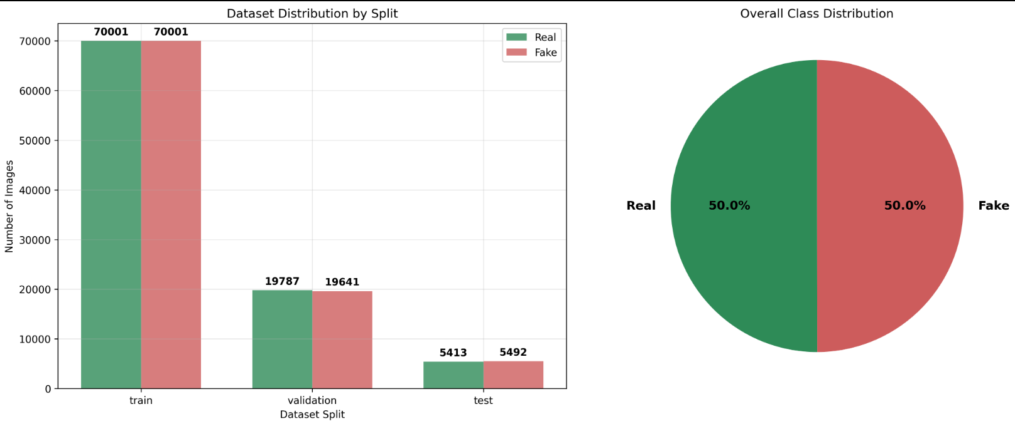
DATASET DISTRIBUTION:

Slide 11
IMPLEMENTATION
Technical Architecture
DeepGuard AI integrates deepfake detection and liveness analysis using a MobileNet-based deep learning model, deployed with a Flask web application for real-time image and video analysis.
Development Tools
Python (TensorFlow/Keras, OpenCV, NumPy)
MTCNN for face detection
Flask backend + Bootstrap 5 UI
Google Colab for model training
Workflow Process
Data preprocessing & augmentation
Transfer learning using MobileNet
Model fine-tuning & evaluation
Real-time inference (image/video)
Confidence scoring and visual feedback
Algorithm | Dataset | Metrics
MobileNet + Liveness Detection | Real vs Fake + Spoof samples | Accuracy (97%), Confidence Score, FPS

Slide 12
TESTING
UI Testing
Test Case No | Test Case Description | Input | Expected Output | Status
UI_01 | Verify homepage loads properly | Launch app | Homepage should display without errors | Pass
UI_02 | Check navigation to Image Detection page | Click Image Detection button | Image detection page should open | Pass
UI_03 | Check navigation to Video Detection page | Click Video Detection button | Video detection page should open | Pass
UI_04 | Responsive layout check | Open app in mobile view | Layout should adjust and remain readable | Pass
UI_05 | Drag-and-drop file upload UI | Drag image/video onto upload area | File should be previewed or accepted | Pass

Slide 13
Image Test Cases
Test Case No | Test Case Description | Input | Expected Output | Status
IMG_01 | Upload valid image file | .jpg / .png | System should detect and show Real or Deepfake with confidence score | Pass
IMG_02 | Upload invalid format | .exe / .txt / .zip | System should show message: “Invalid image format” | Pass
IMG_03 | Submit without selecting an image | Click detect button | System should show “No file selected” | Pass
IMG_04 | Upload corrupted image | Broken or unreadable file | System should show “Unable to process image” | Pass
IMG_05 | Large resolution image check | 4K image | System should resize and detect without crashing | Pass

Slide 14
Video Test Cases
Case No | Test Case Description | Input | Expected Output | Status
VID_01 | Upload valid video file | .mp4 / .avi | System should analyze frames and show final result with statistics | Pass
VID_02 | Upload unsupported format | .gif / .webm | System should display “Unsupported video format” | Pass
VID_03 | Submit without uploading video | Click detect button | System should show “No file selected” | Pass
VID_04 | Test processing of long video | Video longer than 2 min | System should process without crashing (processing may take time) | Pass
VID_05 | Video with no face detected | Random scenery video | System should show “No face detected” message | Pass

Slide 15
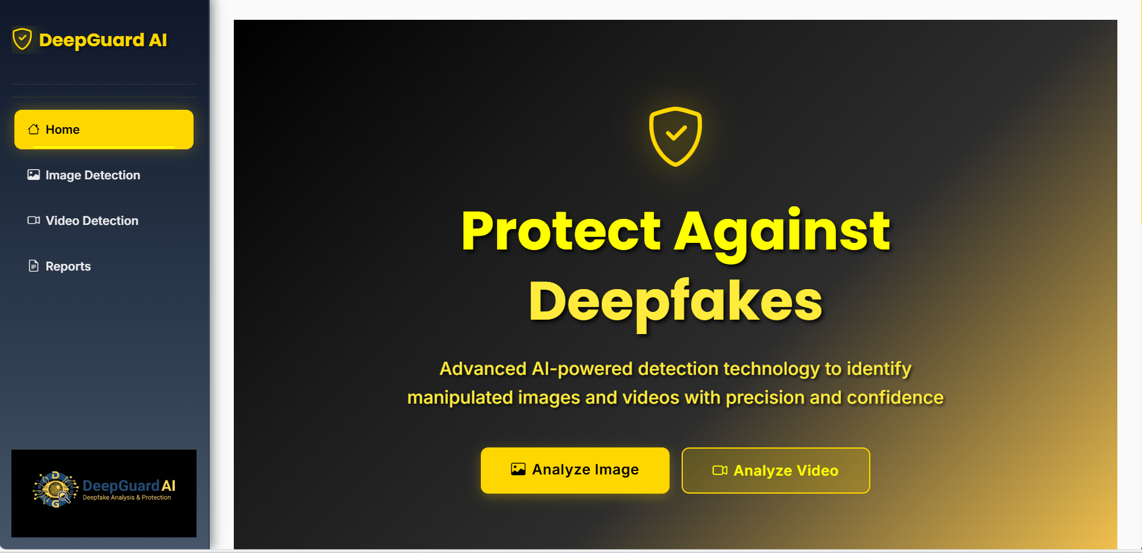
RESULT (SNAP SHOTS)

Slide 16
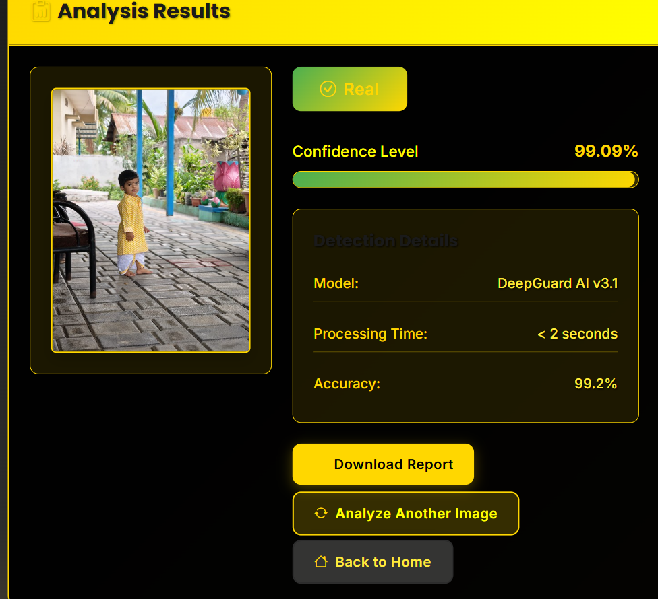
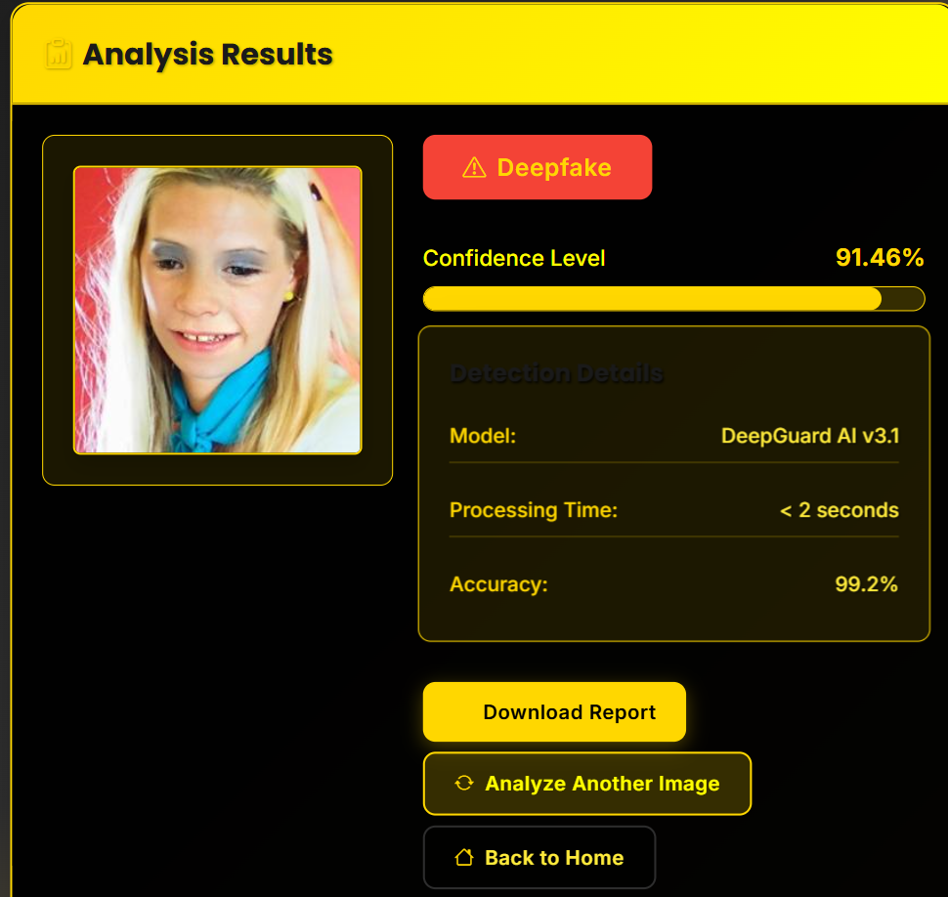
IMAGE DETECTION

Slide 17
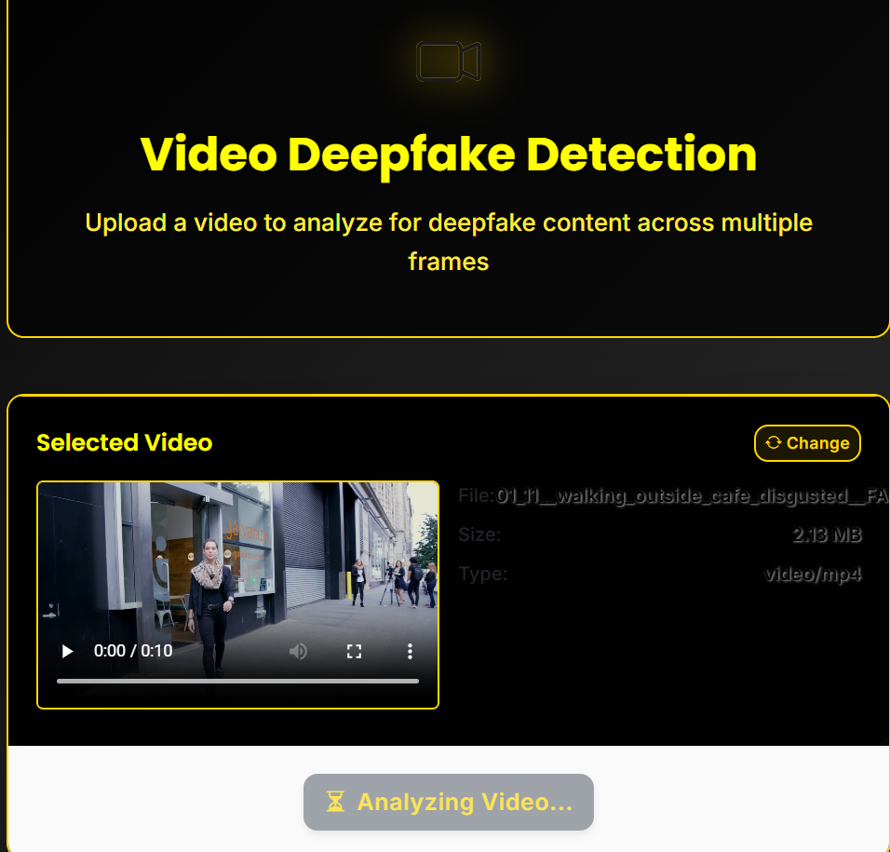
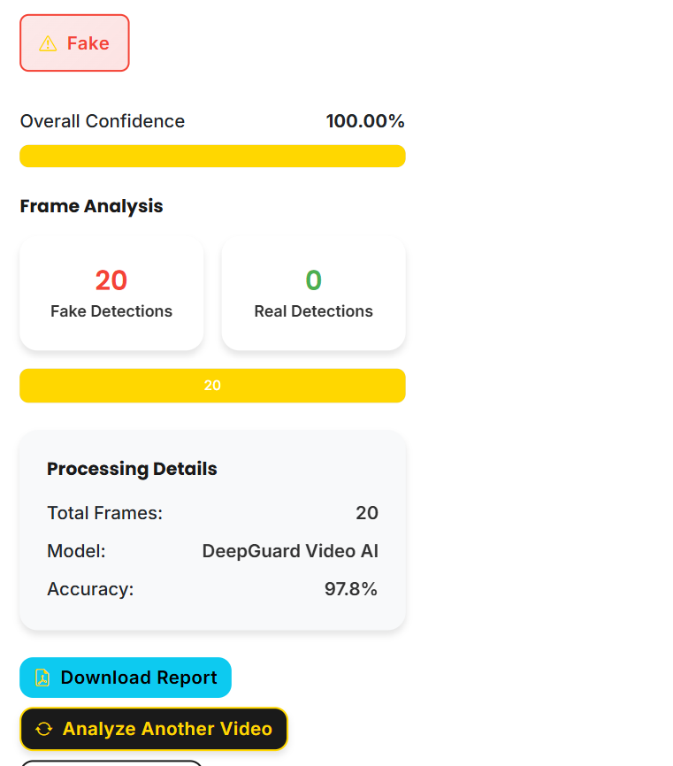
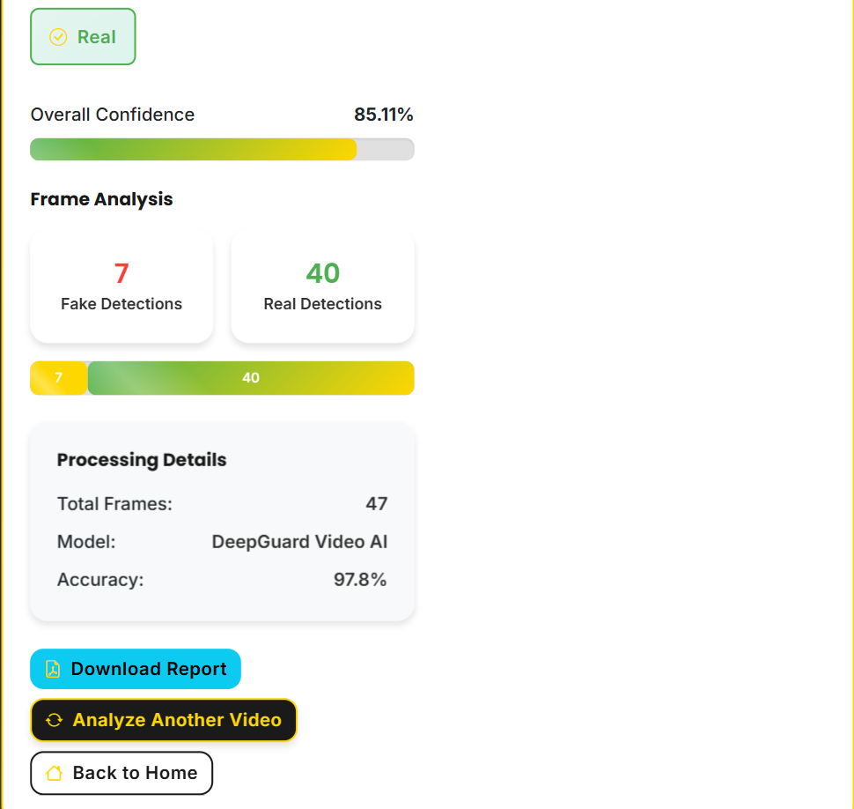
VIDEO DETECTION

Slide 18
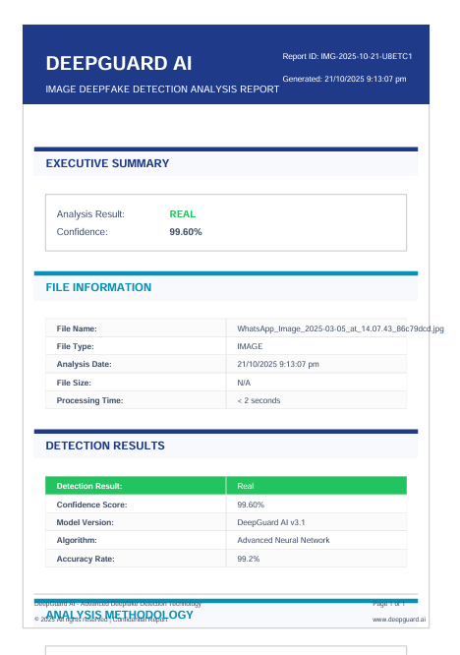
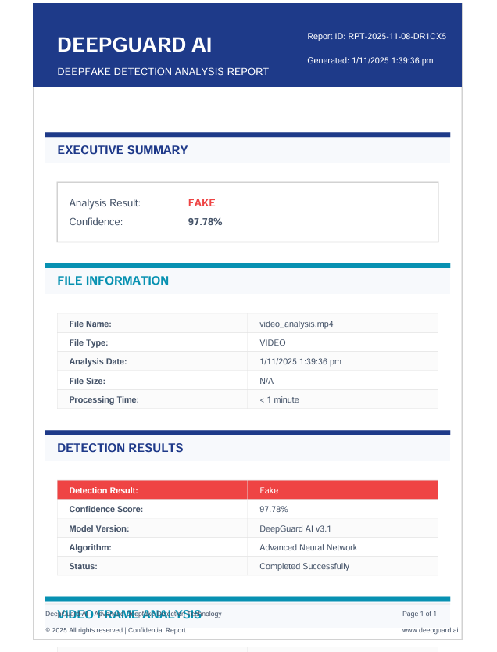
ANALYSED REPORT

Slide 19
CONCLUSION
The AI-Powered Deepfake and Liveness Detection project demonstrates an effective method for detecting deepfake images and videos using deep learning. With the help of a lightweight MobileNet model and transfer learning, the system can reliably classify real and fake media. The web interface enables users to easily upload files and obtain results with confidence scores. This project proves that AI can play an important role in stopping the spread of deepfakes and ensuring digital media security. In the future, the system can be improved for better accuracy and to handle new deepfake techniques.

Slide 20
REFERENCES
https://www.researchgate.net/publication/386304850_Artificial_intelligence_for_deepfake_detection_systematic_review_and_impact_analysis/link/674cb404790d154bf9bb78eb/download?_tp=eyJjb250ZXh0Ijp7ImZpcnN0UGFnZSI6InB1YmxpY2F0aW9uIiwicGFnZSI6InB1YmxpY2F0aW9uIn19
https://www.kaggle.com/c/deepfake-detection-challenge/data
https://www.ijnrd.org/papers/IJNRD2310407.pdf
https://www.researchgate.net/publication/390141504_Deepfake_and_Biometric_Spoofing_AIDriven_Identity_Fraud_and_Countermeasures/link/67e2104972f7f37c3e8ae823/download?_tp=eyJjb250ZXh0Ijp7ImZpcnN0UGFnZSI6InB1YmxpY2F0aW9uIiwicGFnZSI6InB1YmxpY2F0aW9uIn19
https://ceur-ws.org/Vol-3900/Paper9.pdf
https://scholar.google.co.in/scholar?q=ai+powered+deepfake+detection+liveness+detection+research+paper&hl=en&as_sdt=0&as_vis=1&oi=scholart#d=gs_qabs&t=1747980296465&u=%23p%3DKlVoxZwaWaoJ

