Slide 1
NOMAD USECASE
By
Bhulakshmi Makkena
Naga Mounika Dandamudi
Bhargav Krishna Velgapudi
Regendra Prasad palagarla

Slide 2
Nomad
Best route from source to destination
Provides weather information at particular times on the way to destination
Stores the history of journeys suggested to the user
After reaching destination, should suggest the near by places to visit

Slide 3
Architecture
We choose Web mash-up style architecture to design our application
Why Mash-up?
Reuse of existing applications
Rapidly develop applications
Does not require the user to have extensive IT or programming skills
Cost of application development is reduced greatly.

Slide 4
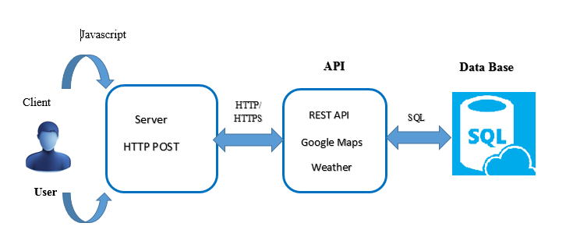
Server-Side Mashup

Slide 5
Design Considerations in Server-Side Mashups
There are various things to consider when you do a server-side mashup:
Security
Caching of results
The need to modify the response
Ways to handle exceptions and errors

Slide 6
Design pattern
Proxy:
An object representing another object.
Provide a surrogate or placeholder for another object to control access to it.
Observer:
It define a one-to-many dependency between objects so that when one object changes state, all its dependents are notified and updated automatically.

Slide 7
Use Case Diagram

Slide 8
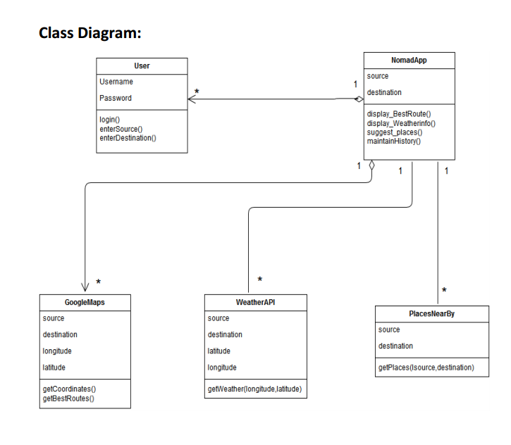
Class Diagram

Slide 9
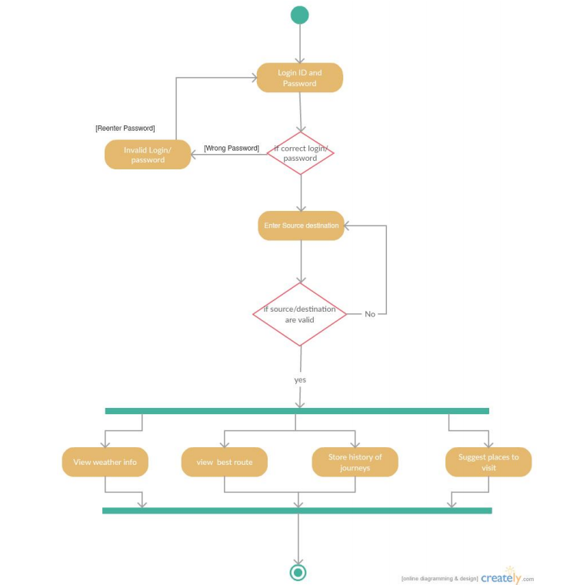
Activity Diagram

Slide 10
Sequence Diagram- Best Route

Slide 13
Thank you
Any Questions?

