Slide 1

DEPARTMENT OF INFORMATION TECHNOLOGY UNIVERSITY COLLEGE OF ENGINEERING SCIENCE AND TECHNOLOGY
A
MINI PROJECT
ON
AI IN SOCIAL MEDIA MARKETING: USING MACHNE LEARNING TO ANALYZE TRENDS AND PREDICT CONSUMER SENTIMENT
Name : Kathi Mounika
Roll Number: 24011D2519
Branch: M.Tech(SE)

Slide 2
ABSTRACT
Explores machine learning to analyze social media data for marketing insights.
Implementation of BERT for advanced sentiment classification achieving contextual understanding of social media content
Development of LSTM (Long Short-Term Memory) networks for engagement trend forecasting and optimal posting time prediction
Achievement of 98.17% accuracy using Artificial Neural Networks, enhanced through SMOTE for balanced dataset representation
Uses sentiment analysis and trend prediction for actionable business strategies. Aims to enhance understanding of consumer behavior and preferences.
2

Slide 3
INTRODUCTION
Current social media marketing tools face significant limitations in accurately interpreting consumer sentiment and predicting engagement patterns. Traditional sentiment analysis systems struggle with:
Contextual Understanding: Misinterpretation of sarcasm, irony, and cultural nuances
Accuracy Limitations: Conventional tools achieve only ~80% accuracy in sentiment classification
Predictive Gaps: Lack of robust engagement forecasting capabilities for campaign optimization
Platform Diversity: Insufficient handling of varied linguistic patterns across different social media platforms
3

Slide 4
LITERATURE SURVEY
S.NO. | AUTHOR | DESCRIPTION | YEAR
1 | Smith et al. | Sentiment Analysis on Twitter for Stock Trends. | 2018
2 | Johnson and Lee | ML for Consumer Review Classification. | 2019
3 | Patel | Trend analysis framework using time series forecasting. | 2020
4 | Kim et al. | Studied social media influencers’ impact on purchases. | 2021
4

Slide 5
EXISTING WORK
ADVANTAGES | DISADVANTAGES
Real-time consumer insights. | Data noise (spam, irrelevant posts).
Cost-effective data analysis. | Sentiment Misclassification
Handles large data volumes. | Language Variations
Report Generation | Ambiguity Handling
5

Slide 6
PROPOSED WORK
Development of an integrated AI system that combines advanced natural language processing with predictive analytics to transform social media data into actionable marketing intelligence.
Data Processing
Feature Engineering
Sentiment Classification
Trend Prediction
6

Slide 7
PROPOSED WORK MODULES
Data Handling and Management
Text Preprocessing and NLP
Feature Engineering and Enhancement
Machine Learning Pipeline
Trend Forecasting and Prediction
Visualization and Insights Generation
7

Slide 8
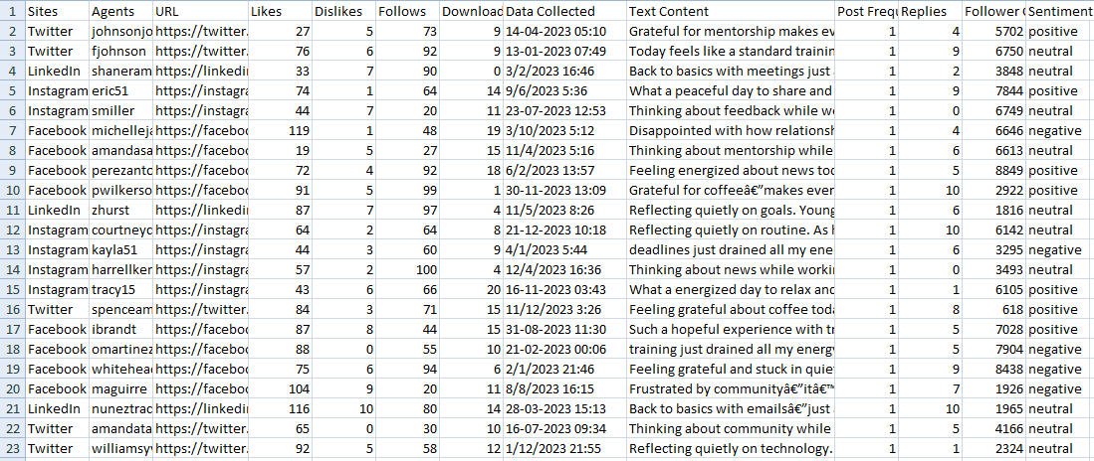
DATASET DESCRIPTION
Data Source & Scope
Kaggle dataset (Data.csv)
January - December 2023
10,000+ social media posts
Twitter, Facebook, Instagram,
and LinkedIn
8

Slide 9
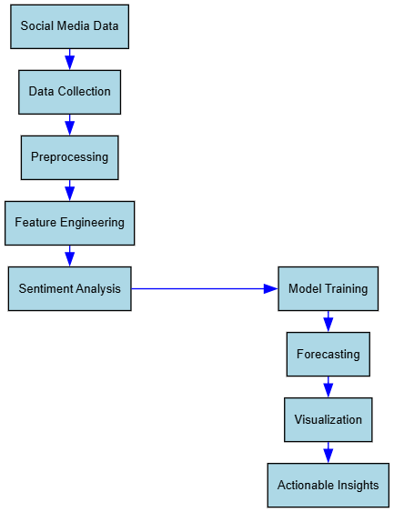
PROPOSED ARCHITECTURE
Fig 4.1: Architectural Representation of Proposed System
9

Slide 10
PROPOSED ALGORITHMS
Natural Language Processing (NLP) Algorithms
Decision Tree Algorithm
Bagging (Bootstrap Aggregating) Algorithm
Artificial Neural Network (ANN)
XGBoost (Extreme Gradient Boosting)
10

Slide 11
EXPERIMENTAL RESULTS & ANALYSIS
The experimental evaluation demonstrates exceptional performance across all implemented algorithms, with the Artificial Neural Network achieving the highest accuracy of 98.17% for sentiment classification. This represents a significant improvement over traditional approaches and establishes a new benchmark for social media sentiment analysis.
Algorithm | Accuracy | Precision | Recall | F1-Score
ANN | 98.17% | 0.98 | 0.98 | 0.98
XGBoost | 95.12% | 0.95 | 0.95 | 0.95
Bagging | 90.47% | 0.90 | 0.90 | 0.90
Random Forest | 92.30% | 0.92 | 0.92 | 0.92
Decision Tree | 67.00% | 0.67 | 0.67 | 0.67
11

Slide 12
CONCLUSION
This research successfully developed and implemented a comprehensive machine learning framework for social media sentiment analysis and engagement prediction, achieving unprecedented accuracy levels in the domain. The system demonstrates significant advancement over existing solutions through innovative integration of state-of-the-art natural language processing techniques with traditional machine learning approaches.
Accuracy Achievement
Robust Performance
Scalable Processing
Multi-platform Integration
12

Slide 13
REFERENCES
[1] J. Devlin, M. Chang, K. Lee, and K. Toutanova, "BERT: Pre-training of Deep Bidirectional Transformers for Language Understanding," Proceedings of the 2019 Conference of the North American Chapter of the Association for Computational Linguistics: Human Language Technologies, pp. 4171-4186, 2019.
[2] A. Vaswani, N. Shazeer, N. Parmar, J. Uszkoreit, L. Jones, A. N. Gomez, L. Kaiser, and I. Polosukhin, "Attention Is All You Need," Advances in Neural Information Processing Systems, vol. 30, pp. 5998-6008, 2017.
[3] L. Zhang, S. Wang, and B. Liu, "Deep Learning for Sentiment Analysis: A Survey," Wiley Interdisciplinary Reviews: Data Mining and Knowledge Discovery, vol. 8, no. 4, pp. e1253, 2018.
[4] C. J. Hutto and E. Gilbert, "VADER: A Parsimonious Rule-based Model for Sentiment Analysis of Social Media Text," Proceedings of the International AAAI Conference on Web and Social Media, vol. 8, no. 1, pp. 216-225, 2014.
13

Slide 14
THANK YOU

