Slide 1
SOFTWARE PROJECT MANAGEMENT

Slide 2
ENGINEERING AND PRODUCTION STAGES
By
K. Mounika
24011D2519

Slide 3
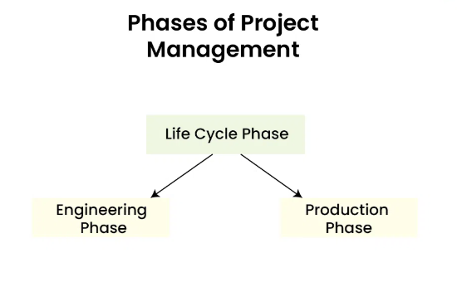
Life Cycle Phases:
Lifecycle phases consist of various separated modules with defined functionalities.
Lifecycle phases are mainly divided into two broad categories:
Engineering Phase
Production Phase

Slide 4
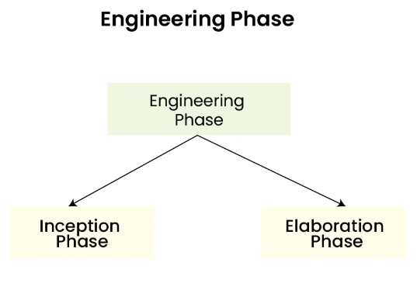
Engineering Phase:
The engineering phase involves establishing the goal and defining the overall scope of the project. The engineering phase involves a small team size and it is usually less predicted. The engineering phase is further divided into 2 Phases:
Inception Phase
Elaboration Phase

Slide 5
Inception Phase:
The inception Phase involves establishing goals and gathering the requirements needed for the software development. It involves cost estimation and identifying the risk factors. In the inception phase, we mainly work on the scope of the project and architecture. Feasibility analysis is also an important part of the inception phase.

Slide 6
Elaboration Phase:
The elaboration phase involves in-depth evaluation and study as well as establishing a strong architecture and infrastructure. In the elaboration phase, we work on the efficiency of our architecture. In this phase, we also analyze use cases and other software diagrams. We reduce the risk to a certain extent and a preliminary user module is prepared in this phase.

Slide 7
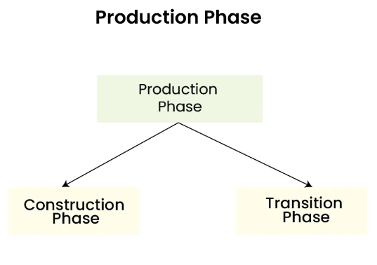
Production Phase:
In the Production phase, we mainly focus on the Implementation of the Project and optimization including the reduced cost and risk factors of our project. It also involves various testing for efficient deployment of the project. It involves a large team size and most of the time it is predictable. It is broadly divided into 2 Phases:
Construction Phase
Transition Phase

Slide 8
Construction Phase:
In the construction phase, we perform the implementation of our software. In this phase, we minimize the risk and eliminate it. All the features and components are integrated into an application. In this phase, we perform strict testing, and process optimization is done. We minimize the development cost and work to improve its efficiency. The construction phase mainly focuses on the implementation and testing of our software.

Slide 9
Transition Phase:
In the Transition phase, we perform strict testing mainly beta testing and deployment of software or project. After receiving the feedback from the user, we performed some changes in our software to make it more efficient. In this phase, the developer works on a project with a user’s view to make the software more supportable and user-friendly.

Slide 10

Questions

Slide 11
Thank You

