Slide 1
DEPARTMENT OF INFORMATION TECHNOLOGY UNIVERSITY COLLEGE OF ENGINEERING SCIENCE AND TECHNOLOGY
YOGA ASANAS & PRANAYAMA
BY
K. Mounika
24011D2519

Slide 2
Yoga
Definition: Systematic methodology for physical, mental, and respiratory enhancement
Relevance to Engineering: Stress management, focus enhancement, cognitive optimization
Modern Context: Integration with high-performance professional environments
Core Components: Asanas (physical postures) + Pranayama (breath control)

Slide 3
ASANAS
Structured Physical Practices for Maximum Output
Classification Framework:
Standing Asanas - Foundation & Stability
Sitting Asanas - Flexibility & Concentration
Supine Asanas - Relaxation & Recovery
Prone Asanas - Strength & Alignment
Balancing Asanas - Coordination & Focus

Slide 4
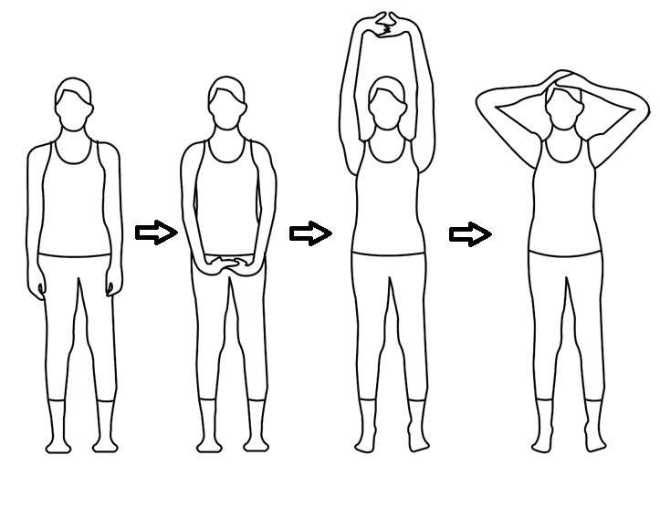
Essential Asanas - Standing Foundation
1. Tadasana (Mountain Pose)
Function: Postural alignment, core stability
Duration: 30-60 seconds
Benefits: Spinal decompression, improved posture

Slide 5
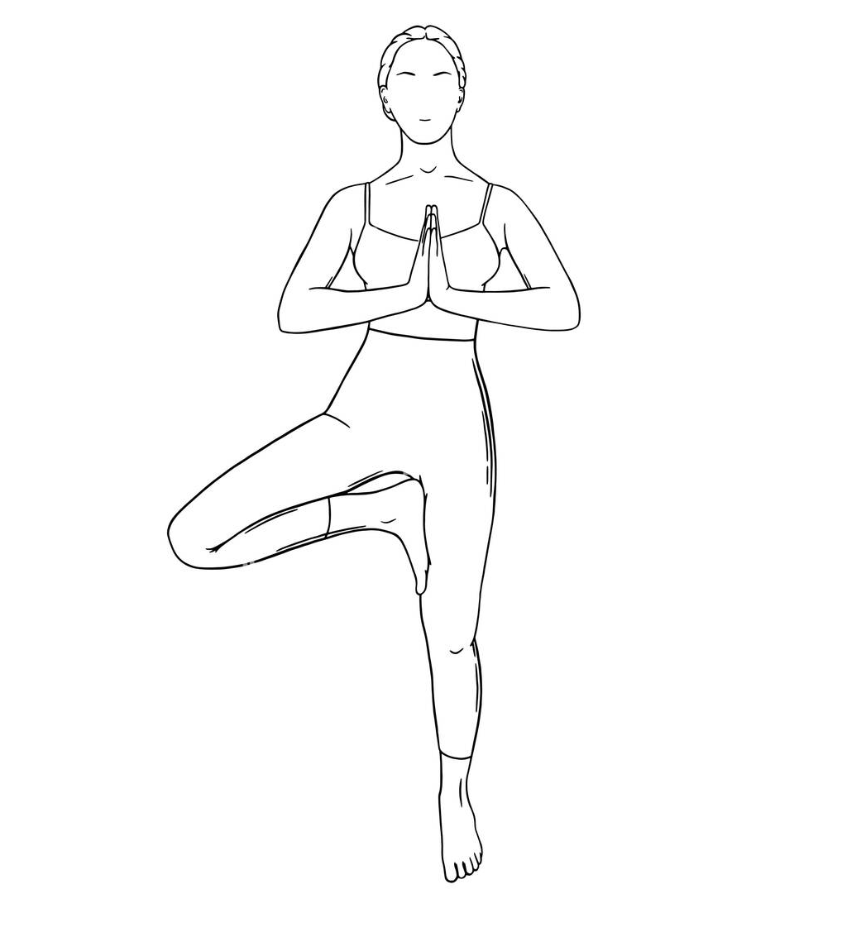
2. Vrikshasana (Tree Pose)
Function: Balance optimization, concentration
Duration: 30 seconds each leg
Benefits: Enhanced focus, ankle stability

Slide 6
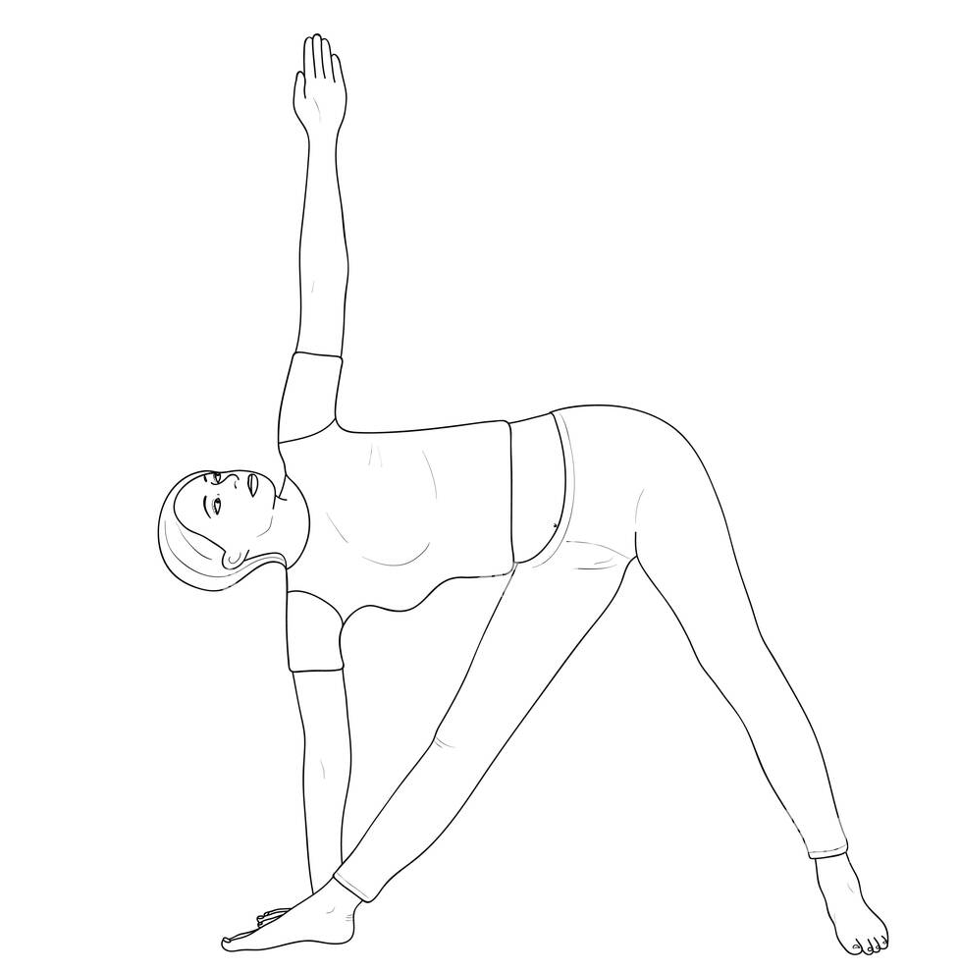
3. Trikonasana (Triangle Pose)
Function: Lateral flexibility, core engagement
Duration: 30-45 seconds each side
Benefits: Improved digestion, stress relief

Slide 7
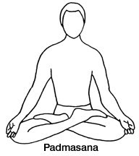
Essential Asanas - Sitting & Flexibility
Seated Asanas for Cognitive Enhancement
1. Padmasana (Lotus Pose)
Function: Meditation readiness, hip flexibility
Duration: 2-5 minutes
Benefits: Improved concentration, reduced anxiety

Slide 8
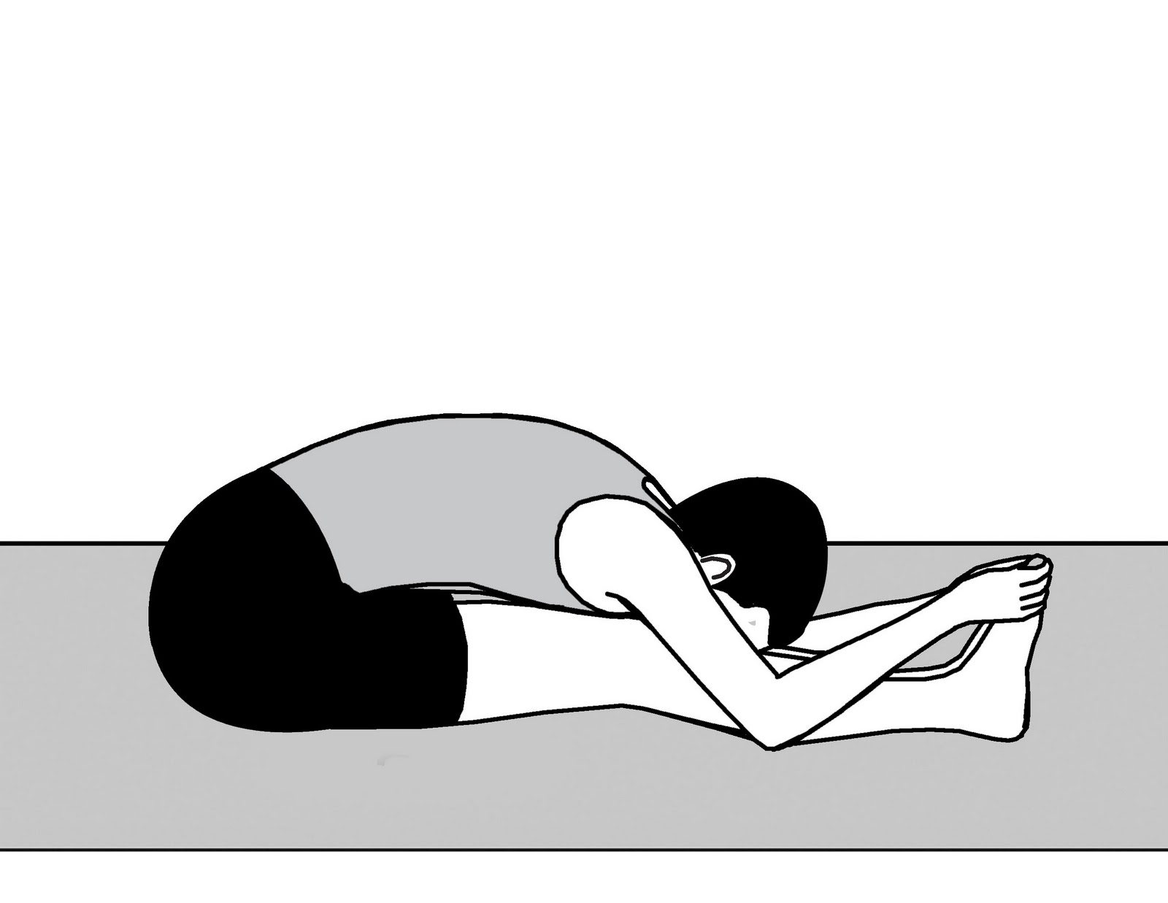
2. Paschimottanasana (Forward Fold)
Function: Hamstring flexibility, spinal mobility
Duration: 1-2 minutes
Benefits: Mental calmness, improved digestion

Slide 9
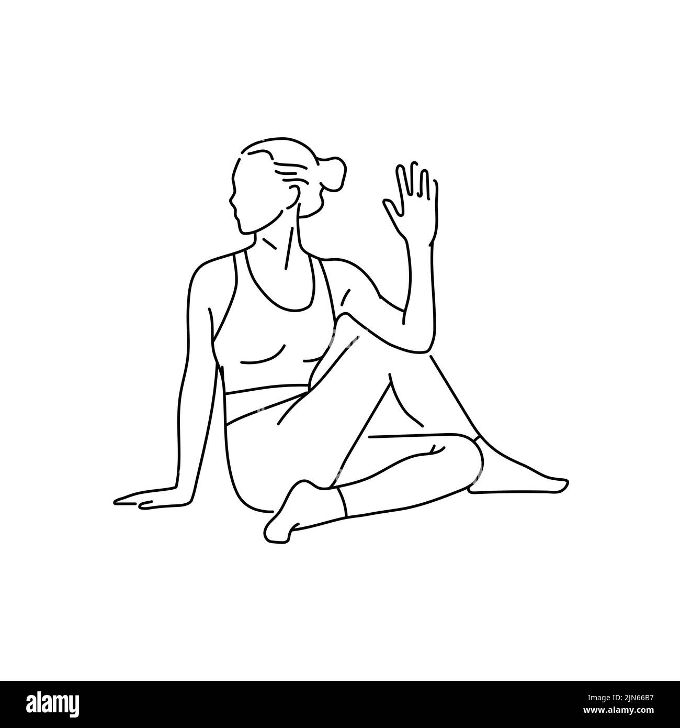
3. Ardha Matsyendrasana (Spinal Twist)
Function: Spinal mobility, organ stimulation
Duration: 30 seconds each side
Benefits: Detoxification, improved spine health

Slide 10
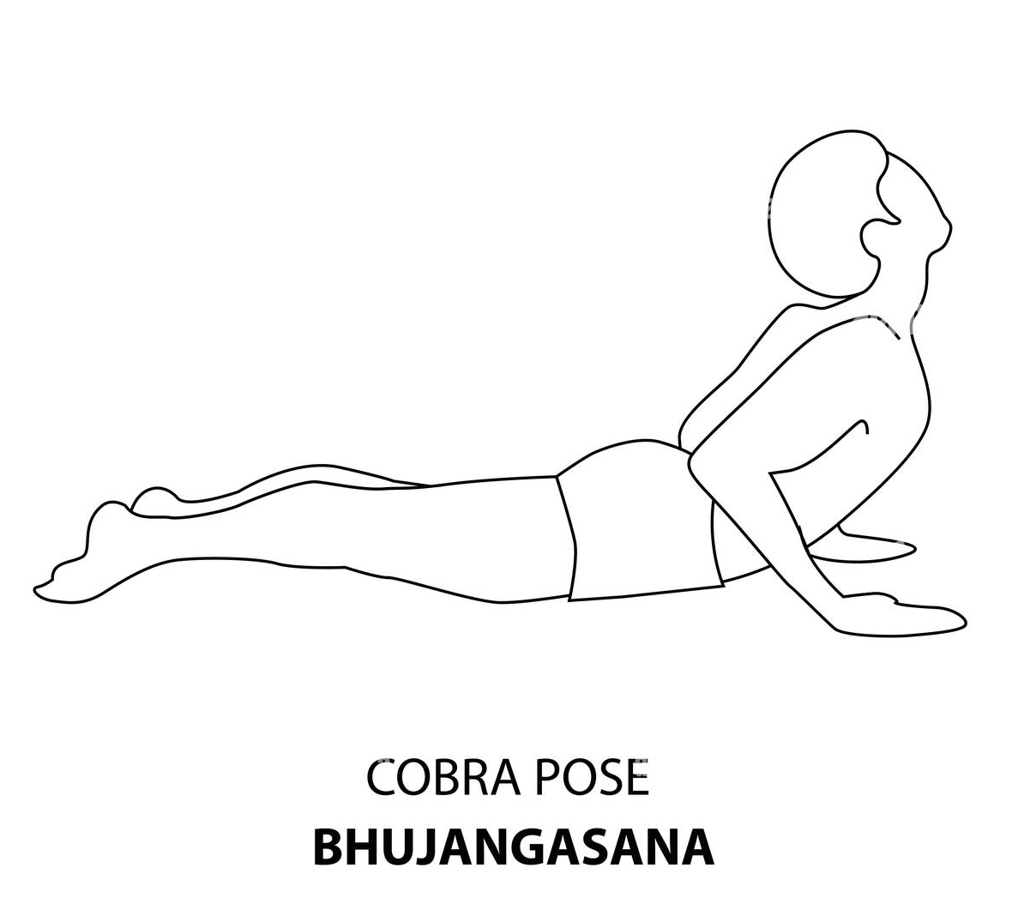
Essential Asanas - Strength & Recovery
1. Bhujangasana (Cobra Pose)
Function: Back strengthening, chest opening
Duration: 15-30 seconds
Benefits: Improved posture, respiratory capacity

Slide 11
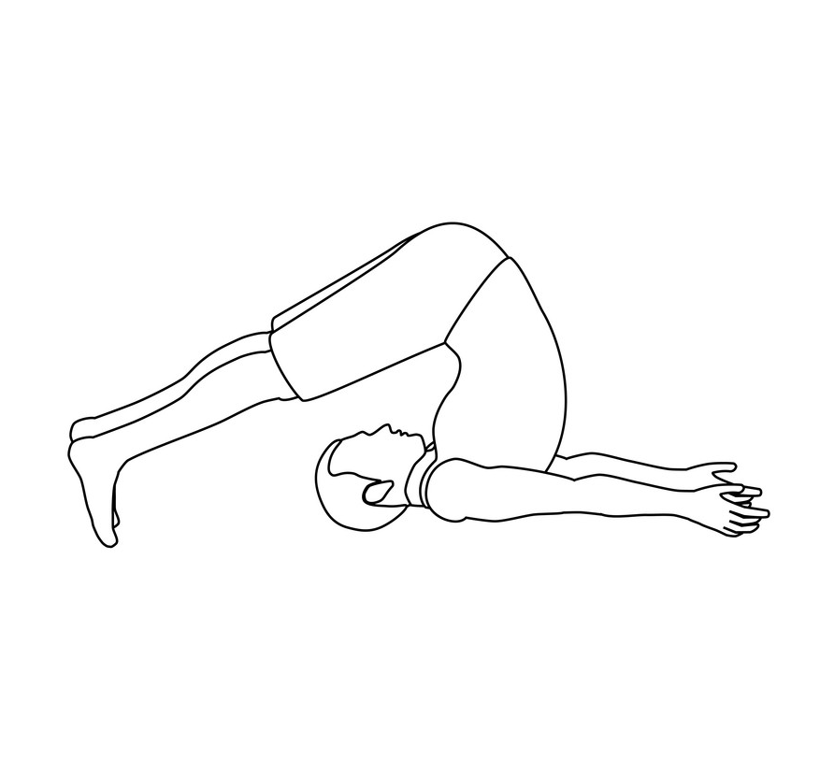
2. Halasana (Plow Pose)
Function: Spinal flexibility, circulation
Duration: 30-60 seconds
Benefits: Stress relief, improved sleep

Slide 12
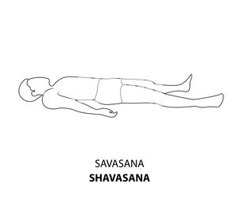
3. Savasana (Corpse Pose)
Function: Complete relaxation, recovery
Duration: 5-10 minutes
Benefits: Stress reduction, improved sleep quality

Slide 13
PRANAYAMA - Respiratory Control Systems
Breath as a Performance Optimization Tool
Definition: Controlled breathing techniques for physiological and mental regulation
Core Principles:
Puraka: Controlled inhalation
Kumbhaka: Retention phase
Rechaka: Controlled exhalation
Ratio Management: Systematic timing protocols
13

Slide 14
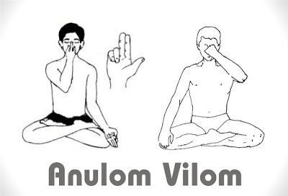
Primary Pranayama Techniques
1. Anulom Vilom (Alternate Nostril)
Protocol: 4-4-4 count (inhale-hold-exhale)
Duration: 5-10 minutes
Benefits: Nervous system balance, improved focus

Slide 15
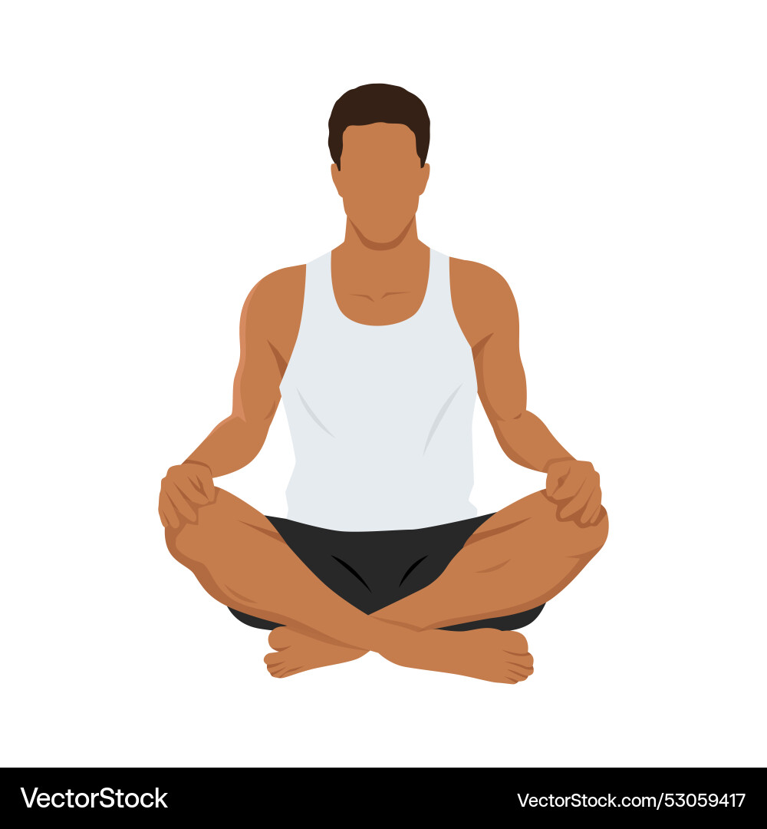
2. Bhastrika (Bellows Breath)
Protocol: Rapid, forceful breathing cycles
Duration: 3 rounds of 10 breaths
Benefits: Increased energy, improved circulation

Slide 16
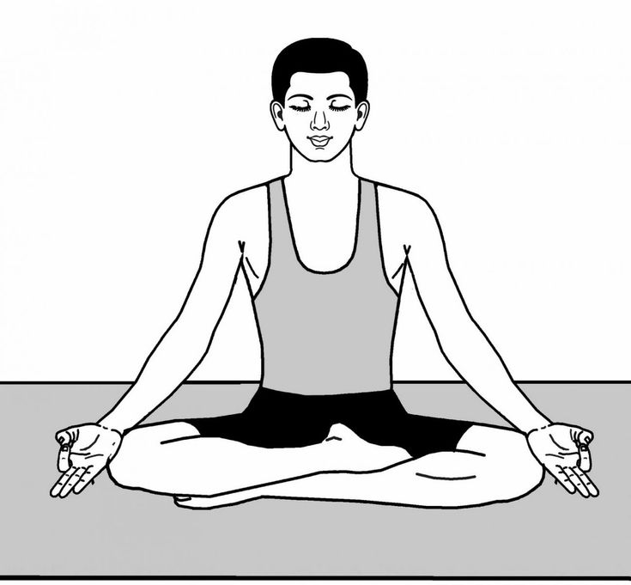
3. Ujjayi (Victory Breath)
Protocol: Controlled throat breathing
Duration: Throughout asana practice
Benefits: Heat generation, concentration enhancement

Slide 17
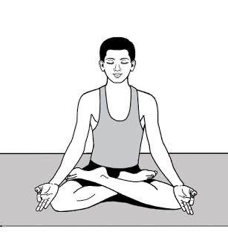
Advanced Pranayama Techniques
Enhanced Respiratory Protocols
1. Kapalbhati (Skull Shining)
Protocol: Forceful exhalation, passive inhalation
Duration: 3 rounds of 20-30 breaths
Benefits: Core strengthening, mental clarity

Slide 18
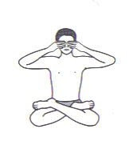
2. Bhramari (Bee Breath)
Protocol: Humming during exhalation
Duration: 5-10 rounds
Benefits: Stress reduction, improved concentration

Slide 19
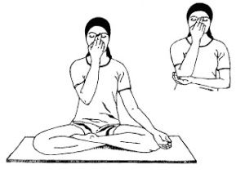
3. Nadi Shodhana (Channel Purification)
Protocol: Systematic nostril breathing
Duration: 10-15 minutes
Benefits: Nervous system optimization,
mental balance

Slide 20
Key Takeaways for Technical Professionals
Implementation Strategy:
Start with basic asanas and pranayama
Maintain consistent daily practice
Track progress with measurable metrics
Integrate with existing routines
Seek qualified guidance when needed

Slide 21
THANK YOU

