Slide 1
INTERNSHIP PROJECT SUBMISSION
Enterprise Data Reconciliation &
Business Intelligence Dashboard
An end-to-end ETL pipeline built with Python, SQL, Regex & Pandas
Student Name: Mudavath Mounika
Internship: Data Analytics Internship
Submission Date: 30-07-2026
Tech Stack: Python • SQLite • Pandas • Regex • Matplotlib • Seaborn

Slide 2
PROBLEM STATEMENT
Three Messy, Disconnected Data Sources
01
02
03
HR Database
Server Logs
Exchange Rates
SQLite table of user accounts contains historical status logs — the same user can appear 2-3 times as Pending → Active → Suspended, with no easy way to tell who is currently active.
100,000+ raw text log lines. Transaction data (date, user, product, amount) is buried inside unstructured strings, mixed in with failed "ERROR" transactions.
Daily EUR→USD rates are provided, but markets are closed on weekends — so Saturday/Sunday transactions have no matching rate and risk being silently dropped.
The Ask: Build a pipeline that extracts, cleans, merges and reconciles all three sources into a single trustworthy dataset — in under 2 minutes, with no data silently lost — and produce a CFO-ready revenue dashboard.
2

Slide 3
PROJECT SOLUTION
A 4-Phase ETL Pipeline
1
2
3
4
Extract (SQL)
Transform (Regex)
Reconcile (Merge)
Load (Dashboard)
Window function (ROW_NUMBER) collapses the historical user log down to each user's latest status; filter to Active only.
One vectorized .str.extract() call pulls Date, User ID, Product ID and EUR value out of 100k raw log lines. ERROR rows dropped first.
Exchange rates sorted and forward-filled so weekend gaps don't break the join; merged to transactions, then to Active users.
USD revenue computed, aggregated by month and by customer, and visualized as a two-panel CFO dashboard.
→
→
→
In [1]
In [2]
In [3]
In [4]
Result: 94,902 clean transactions → 53,899 tied to Active users → $148,274,622.91 reconciled USD revenue
3

Slide 4
TOOLS & METHODS
Technologies Used
Python
SQLite + SQL
Pandas
Core scripting language for the entire pipeline
Window functions (ROW_NUMBER) for historical user data
Vectorized data cleaning, merging & aggregation
Regex
Matplotlib / Seaborn
Jupyter / Colab
Parsing unstructured transaction data from log strings
CFO dashboard: revenue trend & top-customer charts
Development & documentation environment
4

Slide 5
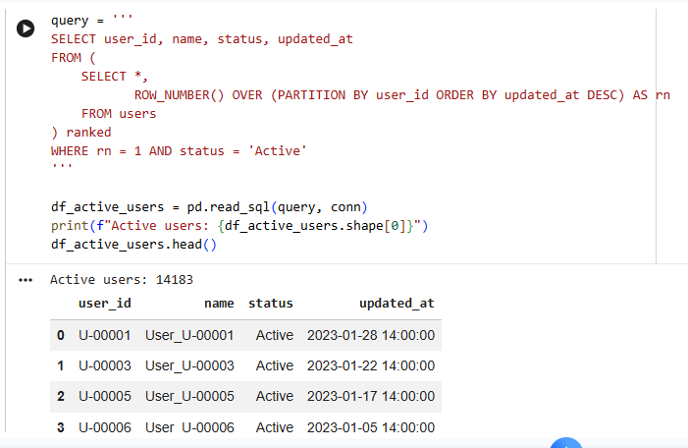
PROJECT SCREENSHOTS · PHASE 1
SQL Extraction — Active Users
Objective
Extract the latest active users from the historical users table.
Approach
Connected to the SQLite database.
Used the ROW_NUMBER() window function to rank records by updated_at.
Selected the most recent record (rn = 1) for each user.
Filtered only users whose latest status is Active.
Output
Retrieved 14,183 active users.
Displayed the first few records using df_active_users.head().
5

Slide 6
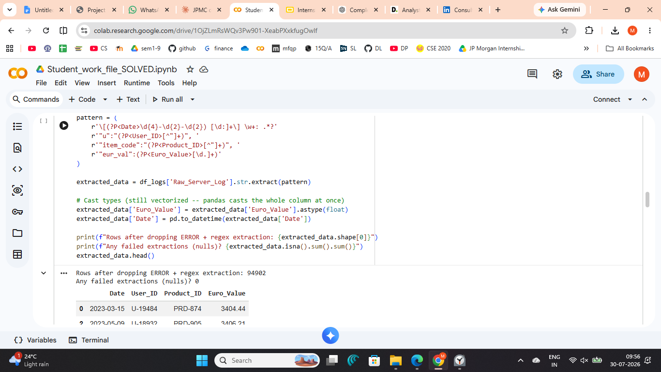
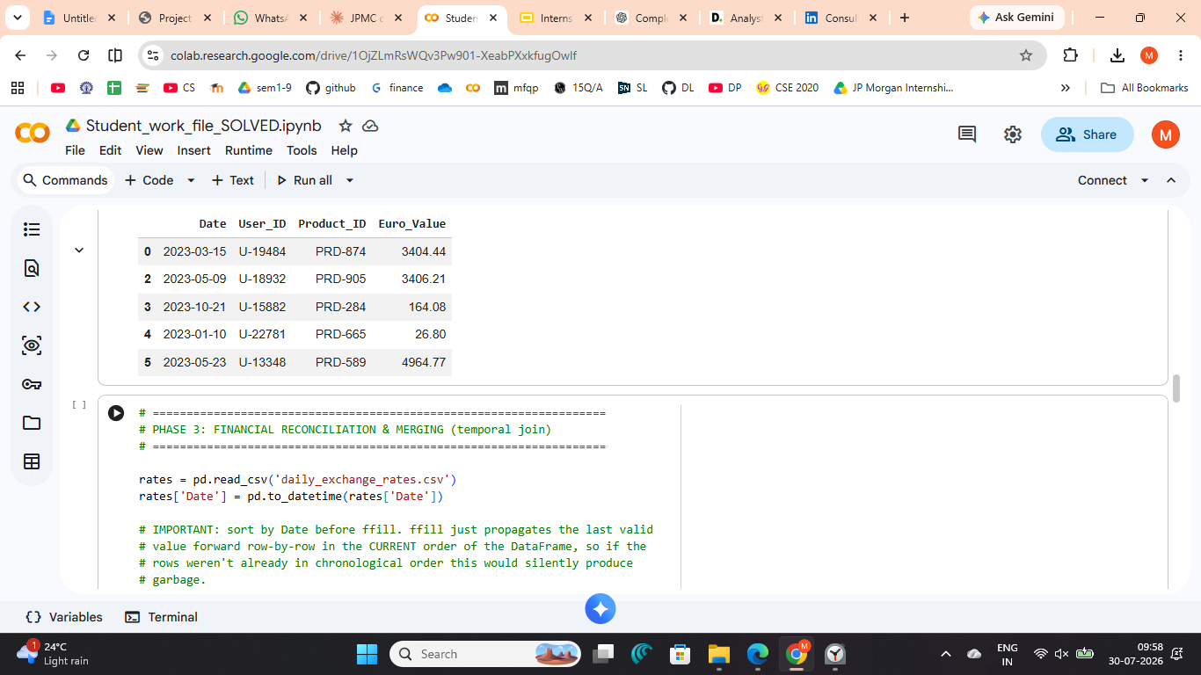
PROJECT SCREENSHOTS · PHASE 2
Regex — Parsing the Server Logs
Objective
Extract structured transaction data from raw server logs using Regex.
Approach
Loaded server logs into Pandas.
Removed ERROR records.
Used str.extract() with Regex to extract:
Date
User ID
Product ID
EUR Value
Converted extracted fields to appropriate data types.
Output
94,902 valid transactions extracted.
0 failed extractions.
Key Insight
Converted unstructured logs into a clean dataset for financial analysis.
6

Slide 7
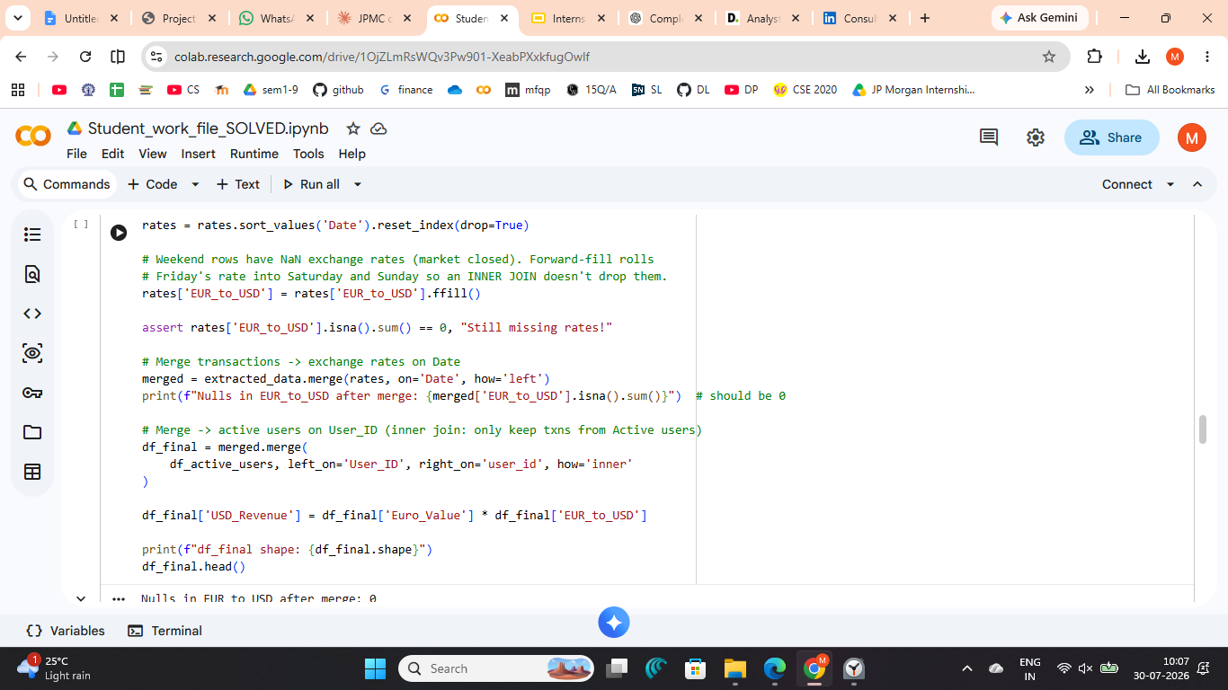
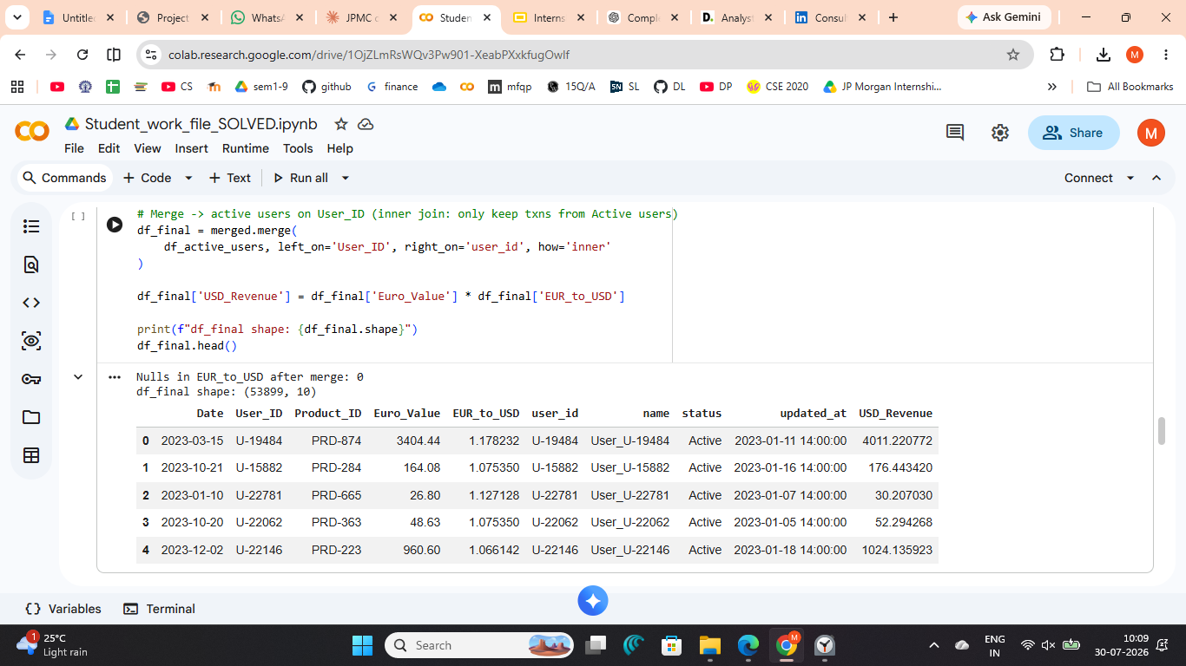
PROJECT SCREENSHOTS · PHASE 3
Financial Reconciliation — EUR → USD
Objective
Merge transaction data with exchange rates and convert EUR transactions to USD.
Approach
Filled missing exchange rates using ffill().
Merged transactions with daily exchange rates.
Filtered only Active users.
Calculated USD Revenue for each transaction.
Output
0 missing exchange rates after merge.
Final dataset: 53,899 records with USD Revenue.
Key Insight
Created a reconciled financial dataset ready for business analysis and reporting.
7

Slide 8
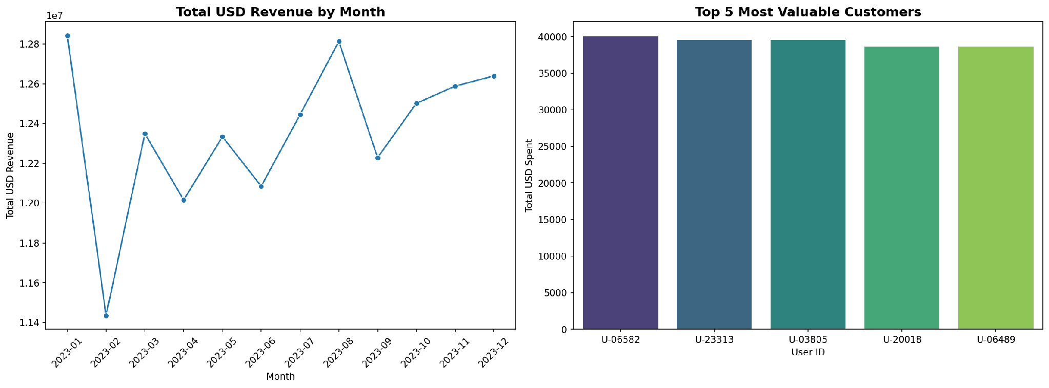
PROJECT SCREENSHOTS · PHASE 4
Dashboard — Final Output
8

Slide 9
PROJECT REPORT
Key Results at a Glance
94,902
53,899
$148.27M
< 41s
Log entries parsed
(0 failed extractions)
Reconciled transactions
(Active users only)
Total reconciled
USD revenue
End-to-end pipeline
runtime (limit: 2 min)
Summary
The pipeline correctly resolves each of the three data-quality traps in the brief: it collapses duplicate user history to current status via a SQL window function, extracts structured fields from unstructured logs with a single vectorized regex, and forward-fills weekend exchange rates so no transaction is silently dropped from the reconciliation. The result is a single trustworthy dataset ready for monthly revenue and top-customer reporting.
9

Slide 10
CONCLUSION
What This Project Demonstrates
Advanced SQL — window functions to resolve slowly-changing dimension (SCD) data
Regex & string parsing — extracting structured data from unstructured log text
Data reconciliation — correctly handling missing weekend exchange-rate data
Performance-aware Pandas — fully vectorized, no row-by-row loops, sub-1-minute runtime
Business communication — translating a technical pipeline into a CFO-ready dashboard
Thank you
10

