Slide 1
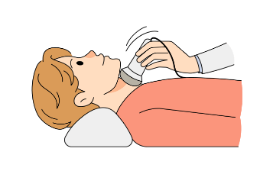
THYROID DISEASE DETECTION
Mentor :Dr.Manasa
Team members : Somi Manaswini Mounika Akhila Nandini
Susanna

Slide 2
PROBLEM STATEMENT
Develop a web-based platform for thyroid disease detection, making it accessible to users for self-assessment and early diagnosis. The platform will provide a user-friendly interface that allows individuals to input relevant health data, and it will use a machine learning model to assess the likelihood of thyroid disease. Users will receive instant feedback on their health status, and if necessary, they will be directed to seek professional medical guidance.

Slide 3
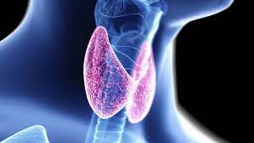
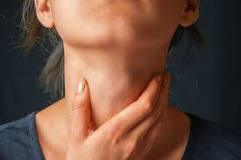
INTRODUCTION
Thyroid disorders are among the most common endocrine disorders, affecting millions of people worldwide. Proper diagnosis often requires a combination of patient history, clinical examination, and specialized blood tests. However, access to healthcare and timely diagnosis can be challenging for many.
This project aims to bridge that gap by providing a web-based platform that uses a machine learning algorithm to predict the type of thyroid condition a person might have, based on a questionnaire and specific blood test values. By leveraging technology and data science, this solution offers a preliminary assessment tool to help users gain insights into their thyroid health.

Slide 4

EXISTING SYSTEM AND DISADVANTAGES
1. Accuracy and Reliability Concerns
2. Data Privacy and Security
3. Ethical and Accountability Risks
4. Compliance with Regulations
5. Continuous Maintenance and Improvement

Slide 5


OVERCOMING EXISTING REAL WORLD PROBLEMS
ML models can analyze large amount of data leading to more accuracy
Eliminating the need for frequent visits to healthcare centers
Personalized recommendations based on individual patient data using ML models
Keeping track of the user’s history
They can serve as clinical decision support for health care providers.

Slide 6

PROPOSED SYSTEM WITH ADVANTAGES
Taking user input 21 questions including blood test values.
Random forest - ensemble model known for delivering high accuracy in both classification and regression tasks.
random forests helps mitigate errors by combining multiple models, leading to more consistent and reliable results.
use a subset of features for each split, reducing the number of computations during the prediction process.
Random forests can perform predictions in parallel by utilizing multi-core processors

Slide 7







TECHNOLOGY STACK
Python
Html
JavaScript
Css (Cascading style sheets)
MongoDB
Express
Node JS

Slide 8
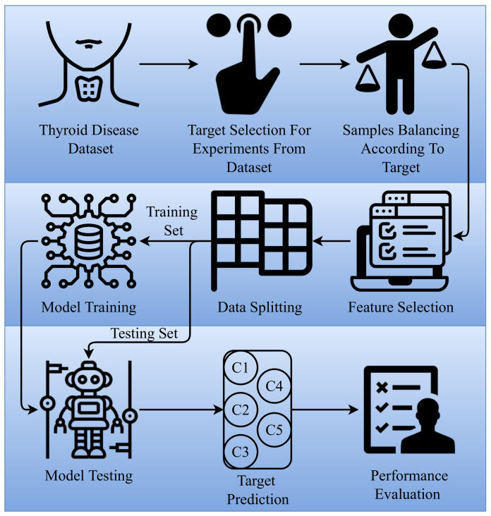
The targets for prediction in ML algorithm were:
Healthy without thyroid
hyperthyroid
Compensated hypothyroid
Primary hypothyroid
Secondary hypothyroid

Slide 9
CODING / IMPLEMENTATION
classification model - 100 decision trees in random forest
Express framework to define app routes and run the website on local server.
The route for handling predictions - API running on local server 5000.
Embedded javascript view engine (ejs)
Mongodb.js to define with database
User authentication using session variables
Server is set to listen on port 3000.

Slide 10
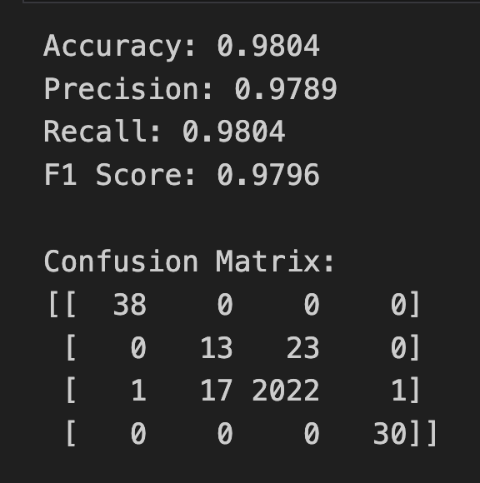
TESTING AND FINAL IMPLEMENTATION
Dataset contains 10721 rows of data and 21 columns.
Model training 80% , testing 20%.
Random Forest classifier
98.4% accuracy and 97.8% precision.
Nodemon app.js
MongoDB local database collection - ThyroidDB

Slide 11
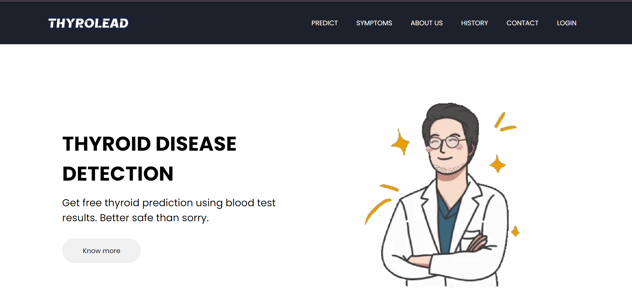
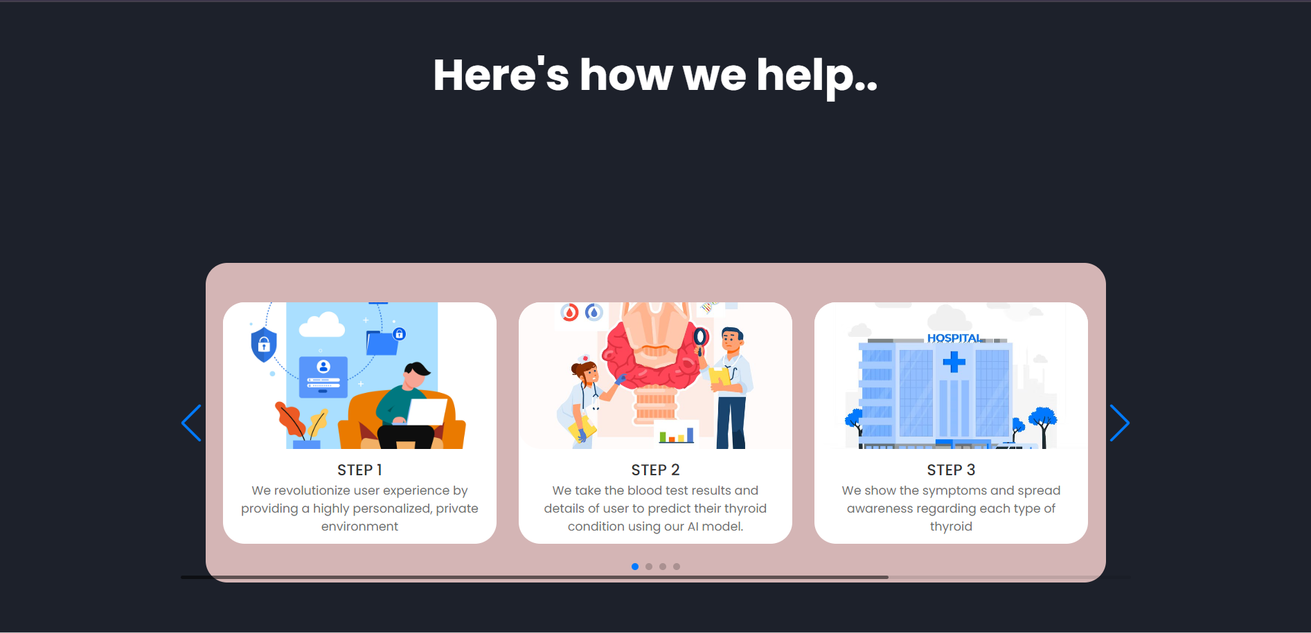
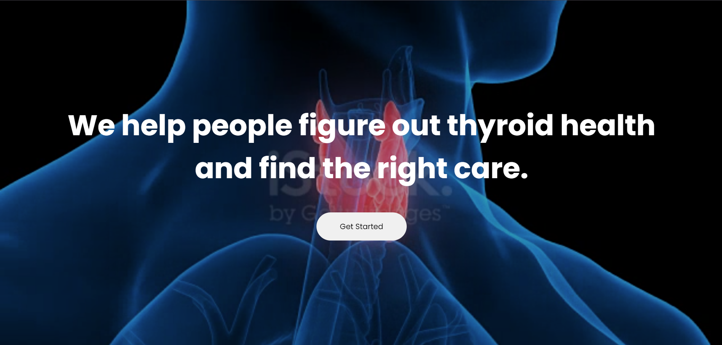
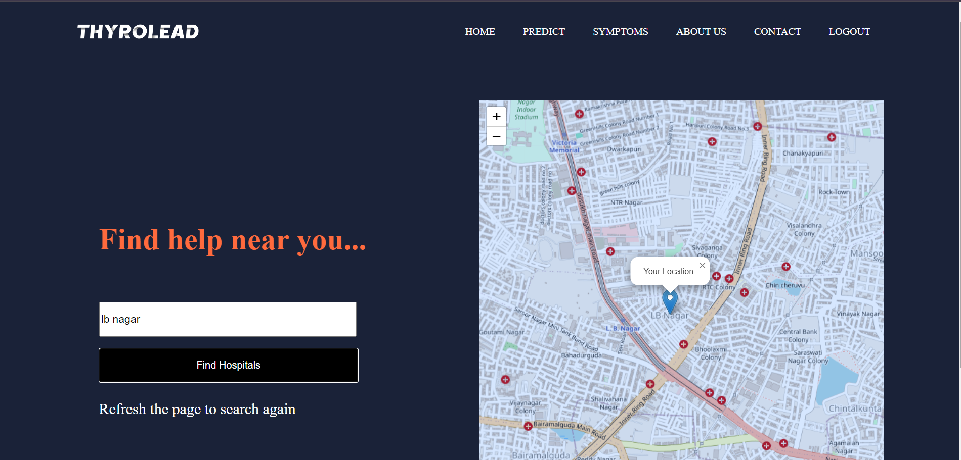

Slide 12
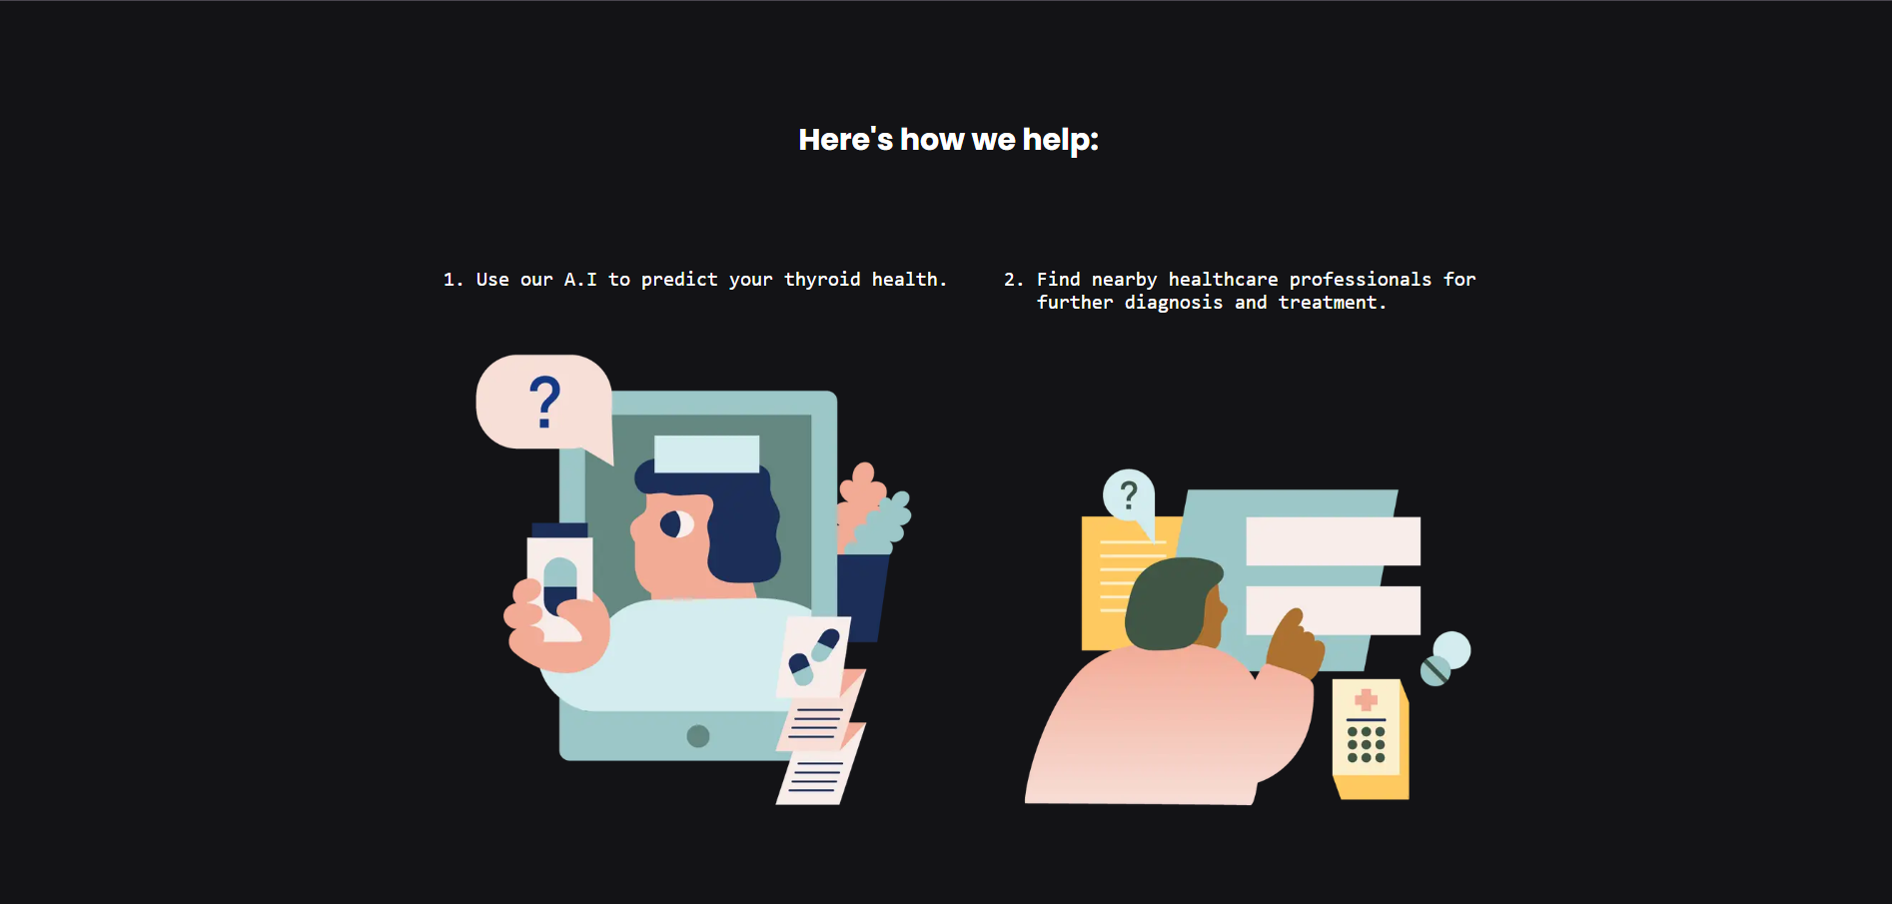
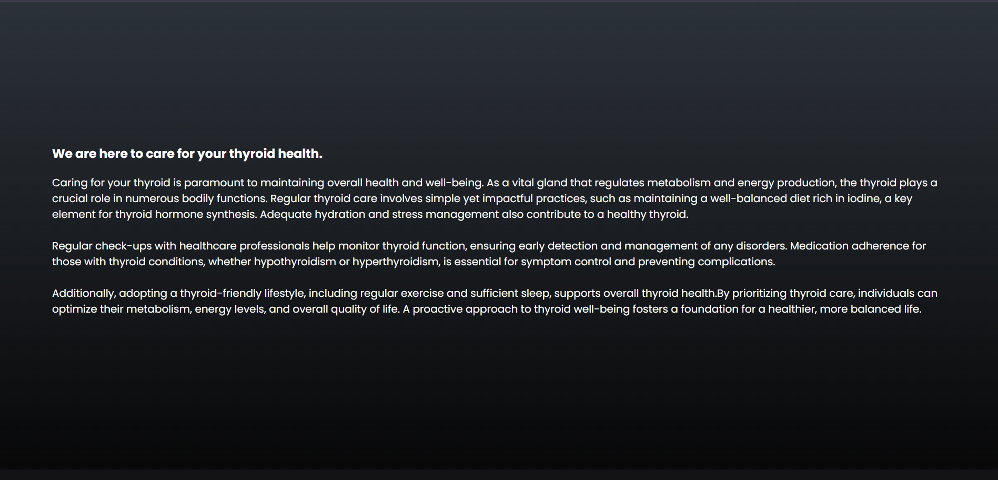
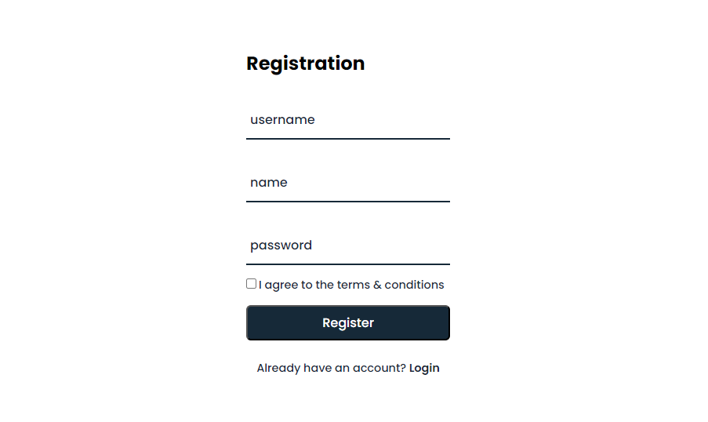
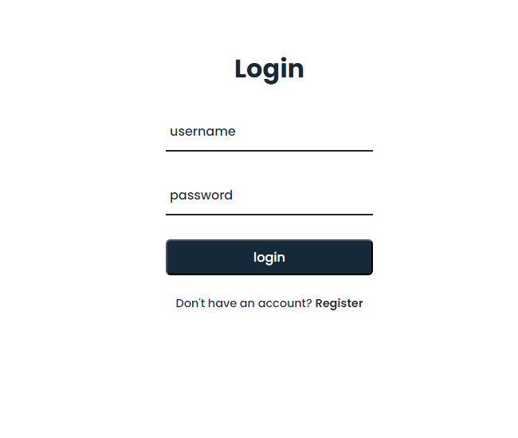

Slide 13
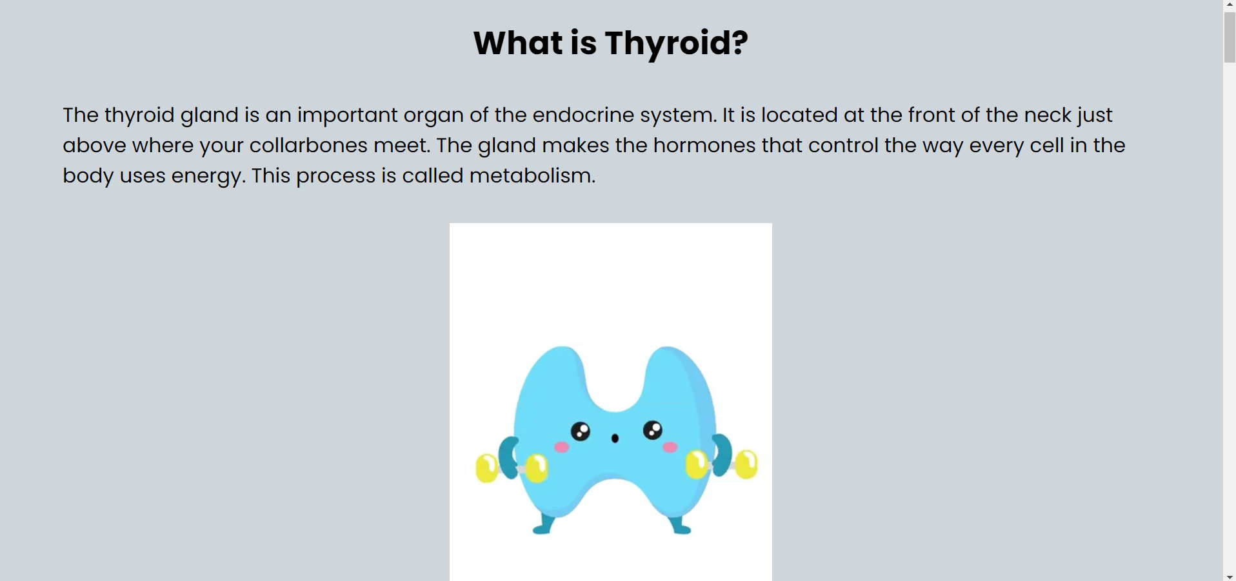
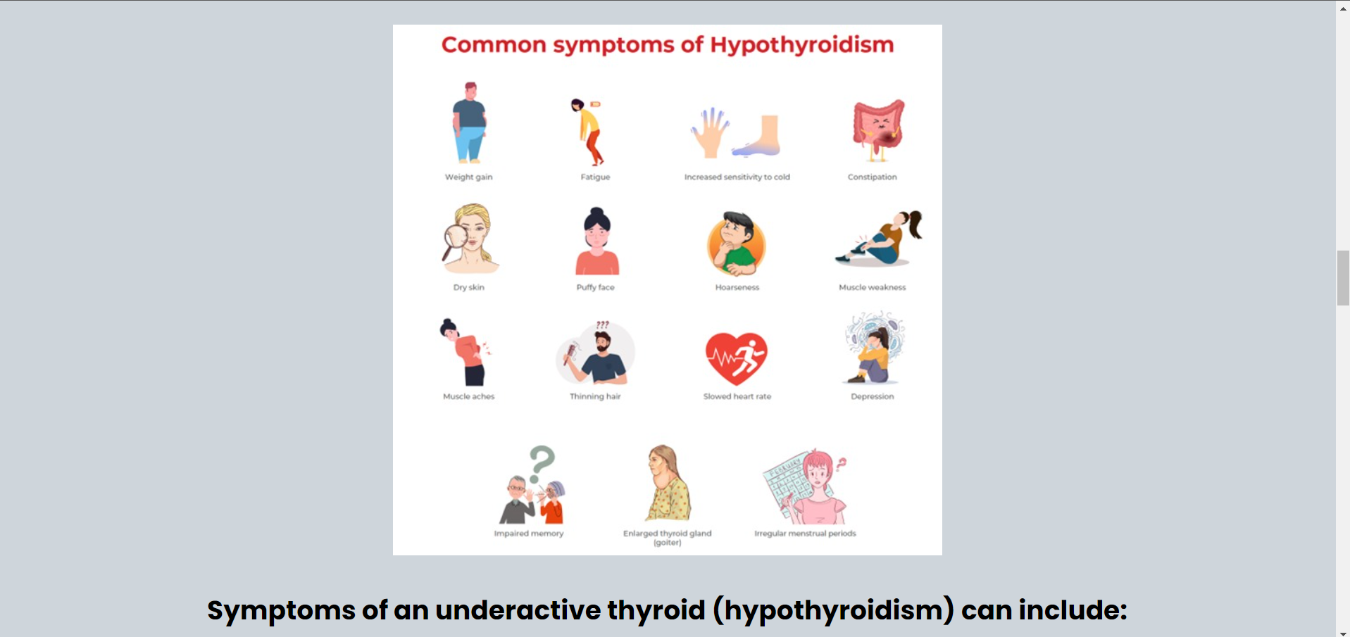
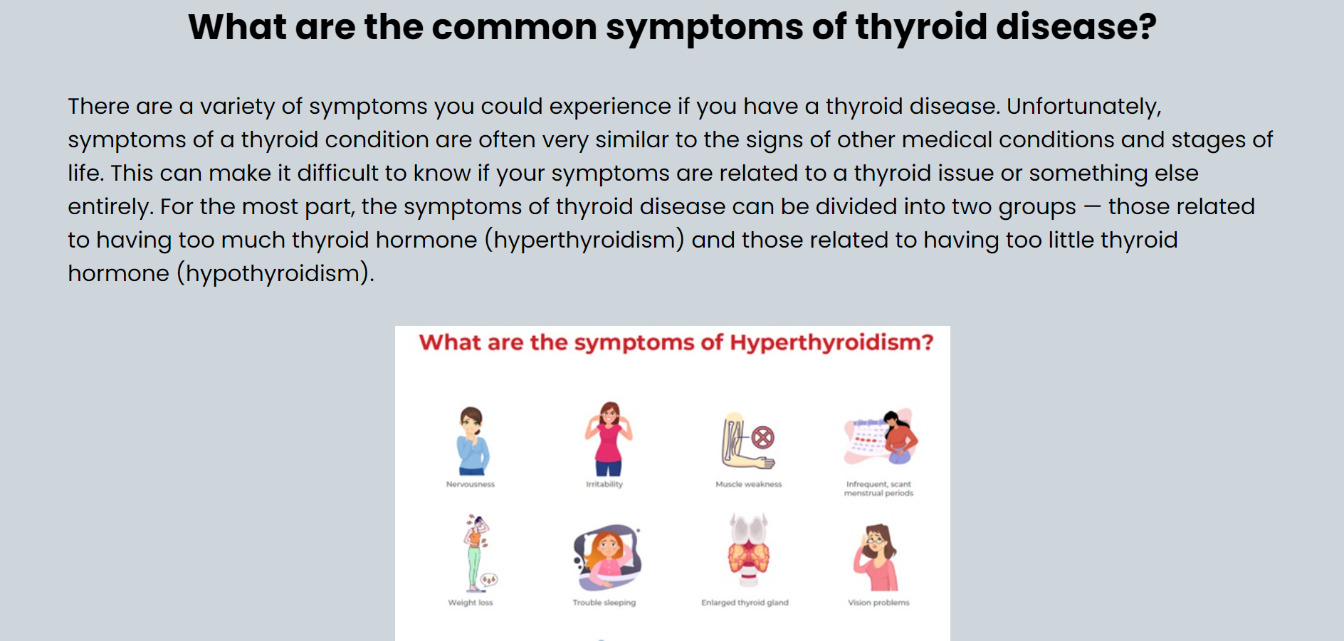
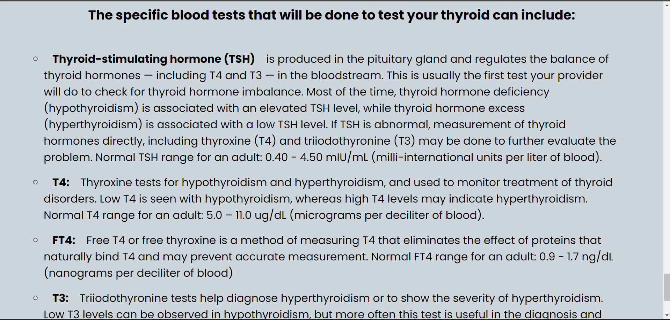

Slide 14
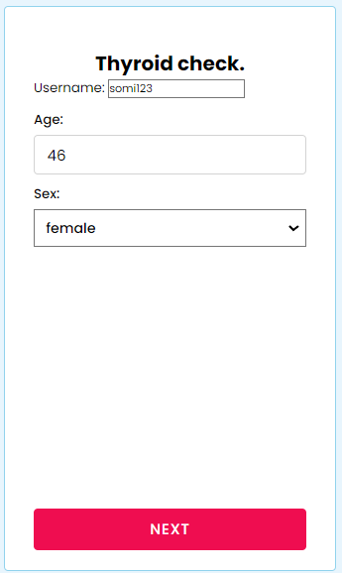
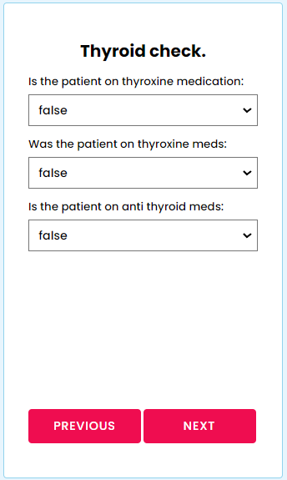
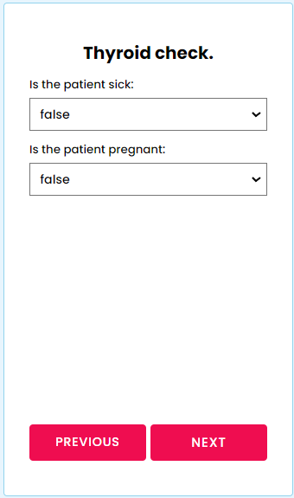

Slide 15
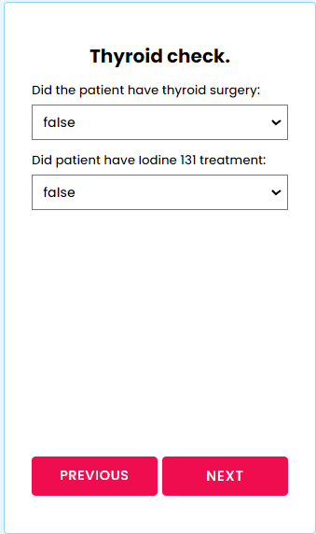
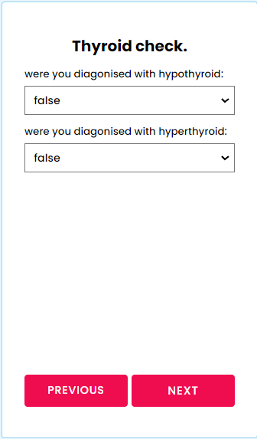
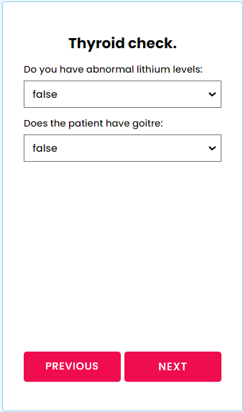

Slide 16
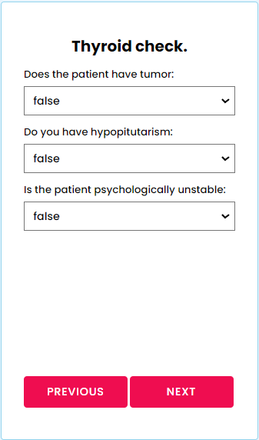
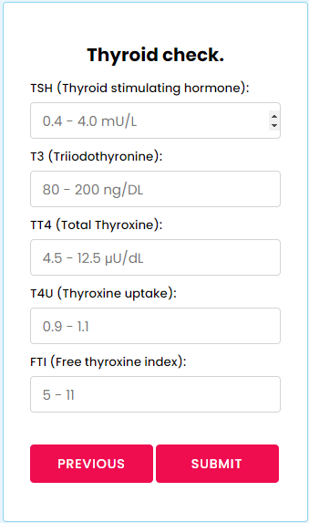

Slide 17
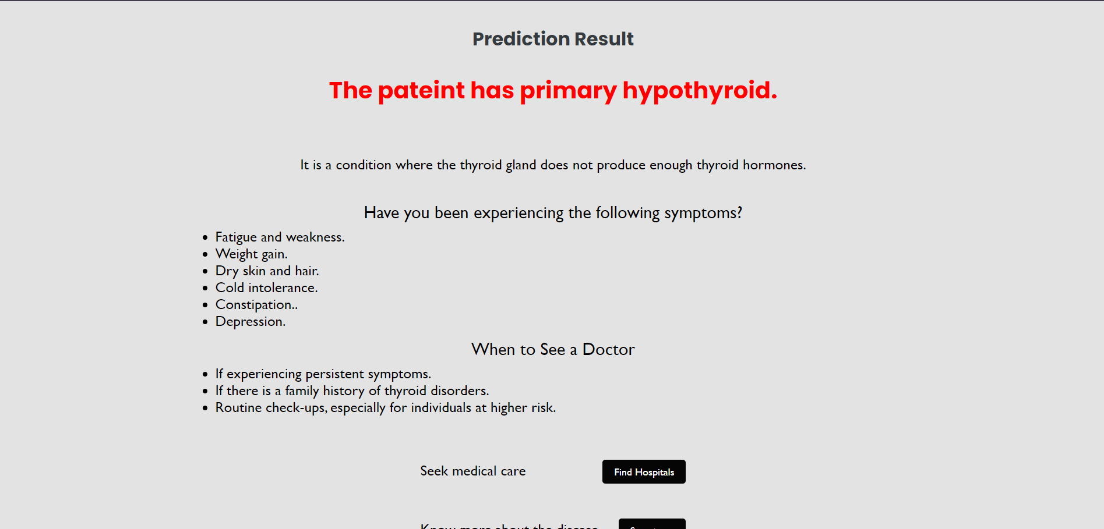
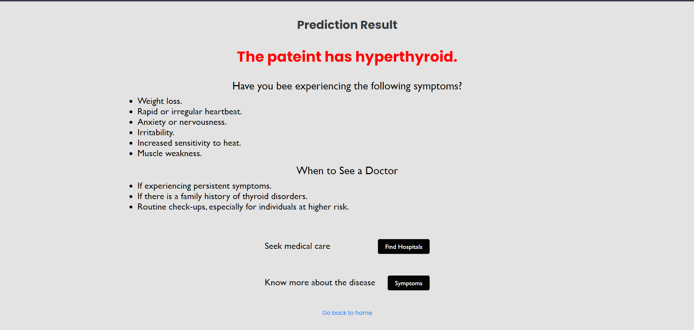
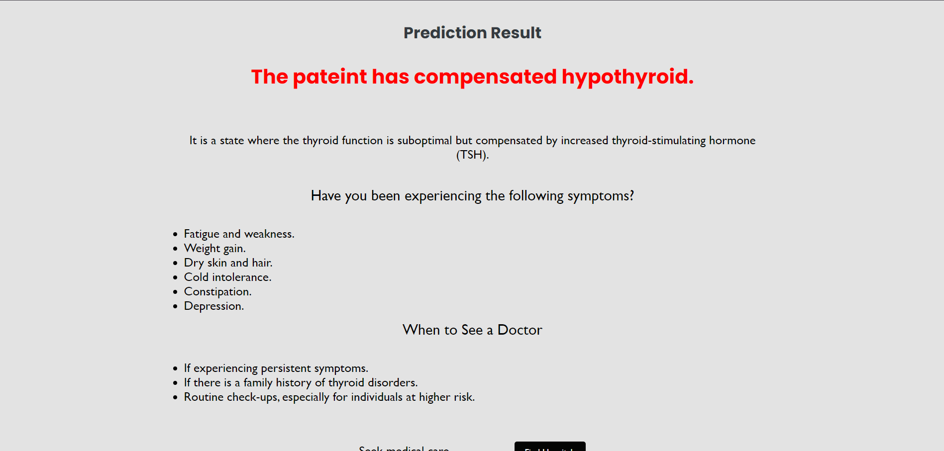
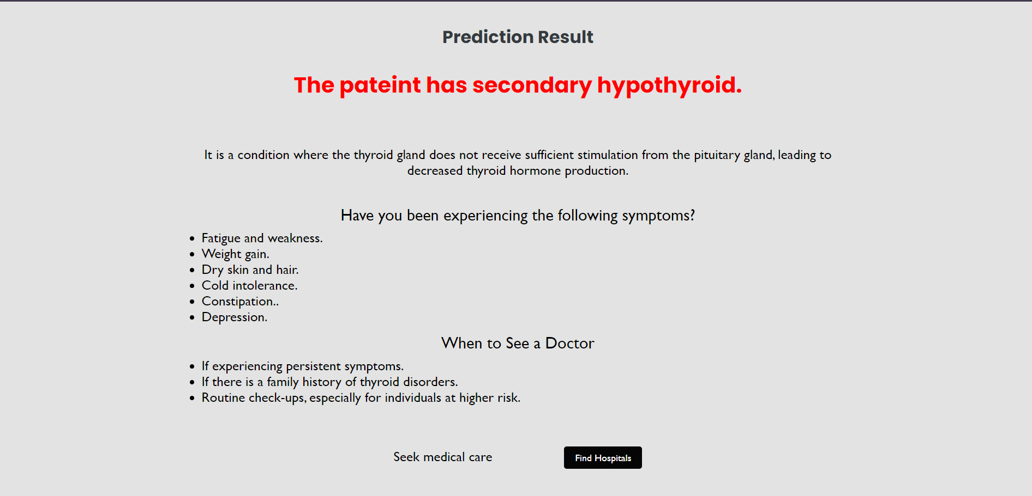

Slide 18
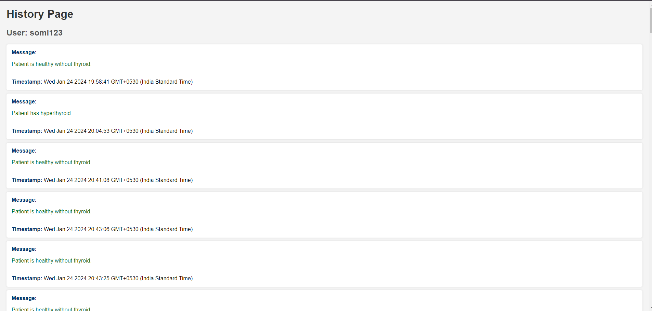

Slide 19

CONCLUSION AND FUTURE SCOPE
Provides preliminary indication of health status.
Help bridge the gap for accessible healthcare resources.
Ensuring robust data privacy, and resolving ethical concerns.
Helps reduce the workload for healthcare professionals, allowing them to focus on cases requiring more detailed attention.
Can explore integrating with medical systems, expanding diagnostic capabilities, and creating a mobile app to increase accessibility and user engagement.

Slide 20
THANK YOU

