Slide 1
AI-Powered Candidate Ranking System
Intelligent Resume Screening and Candidate Recommendation using Artificial Intelligence
Submitted By: Goli Mounika B.Tech 4yr – CSE (AI & ML) Malla Reddy Engineering College for Women (MRECW) Data & AI Challenge 2026 India Runs x Redrob AI

Slide 2
AI-Powered Candidate Ranking System
Recruitment is a critical process for organizations, but traditional hiring methods often rely on manual resume screening and keyword-based filtering. These approaches can be time-consuming, inefficient, and may overlook qualified candidates whose skills and experience do not exactly match predefined keywords.
The AI-Powered Candidate Ranking System is designed to make recruitment smarter and more efficient by leveraging Artificial Intelligence and Natural Language Processing techniques. The system analyzes job descriptions and candidate resumes, extracts relevant skills and experience, evaluates semantic similarity between job requirements and candidate profiles, and generates a ranked list of applicants based on their suitability for the role.
By combining resume parsing, skill matching, experience analysis, and AI-based ranking, the proposed solution helps recruiters quickly identify the most suitable candidates while reducing screening time and improving hiring accuracy.

Slide 3
Problem Statement
Traditional recruitment processes often rely on manual resume screening and keyword-based filtering systems. These methods are time-consuming, prone to human bias, and may fail to identify qualified candidates whose skills and experience are relevant but not explicitly mentioned in the job description. Organizations need an intelligent solution that can understand candidate profiles, evaluate their suitability for a role, and provide accurate rankings to support faster and smarter hiring decisions.

Slide 4
Challenges in Traditional Hiring
Manual screening of resumes is time-consuming.
Keyword-based systems may miss qualified candidates.
Large volumes of applications are difficult to process efficiently.
Human bias can affect candidate evaluation.
Lack of explainability in candidate selection.
Difficulty in identifying candidates with transferable skills.
Increased recruitment costs and longer hiring cycles.

Slide 5
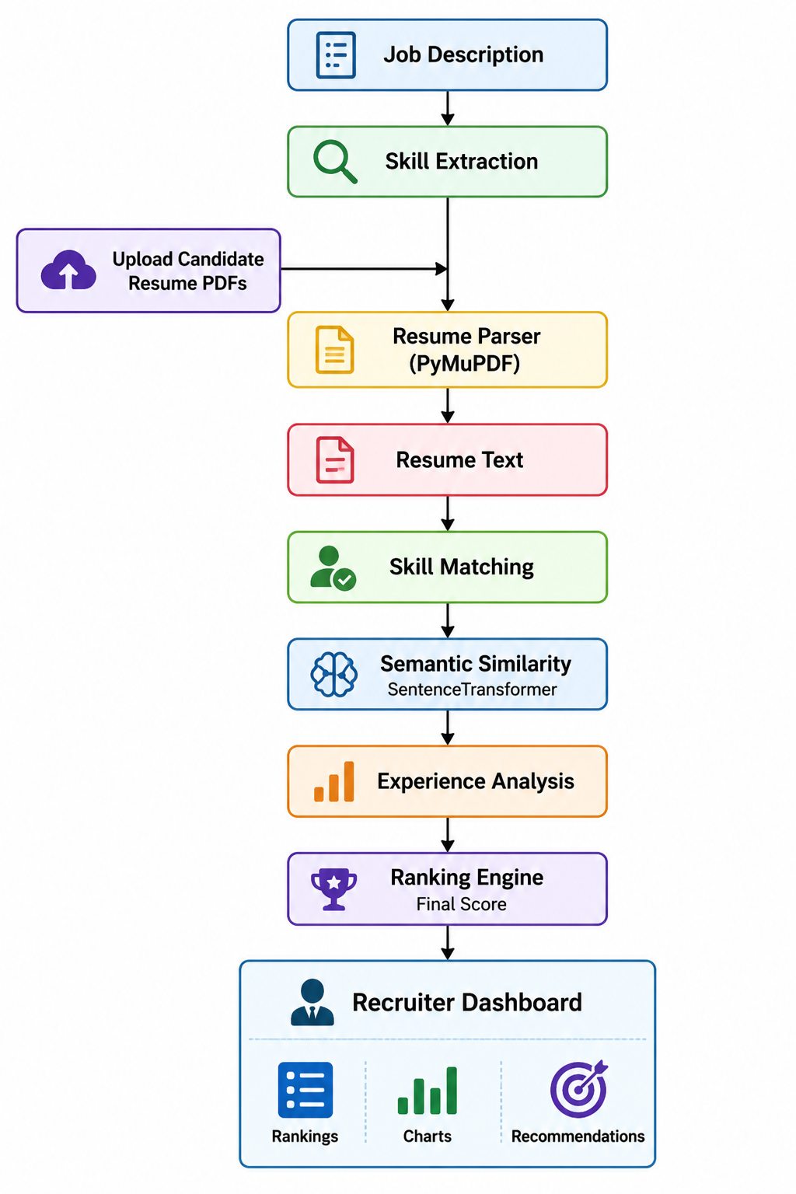
System Architecture

Slide 6
Technologies Used
Python – Core programming language for development.
Streamlit – Interactive web application and recruiter dashboard.
Sentence Transformers – Semantic similarity and candidate matching.
Scikit-Learn – Similarity calculations and ranking logic.
PyMuPDF – PDF resume parsing and text extraction.
Plotly – Interactive data visualization and charts.
Pandas – Data processing and result management.
Regular Expressions (Regex) – Experience extraction from resumes.

Slide 7
Resume Parsing Module
The Resume Parsing Module automatically extracts textual information from uploaded PDF resumes using PyMuPDF. The extracted content is processed to identify important details such as technical skills, experience, projects, and qualifications. This structured information is then used by the ranking engine to evaluate candidate suitability for a given job role.
Key Functions:
PDF Text Extraction
Skill Identification
Experience Detection
Candidate Profile Generation

Slide 8
Candidate Ranking Logic
The system evaluates each candidate using a hybrid scoring approach:
Semantic Similarity Analysis
Compares the resume content with the job description using Sentence Transformers.
Skill Matching
Identifies matching skills between job requirements and candidate profiles.
Experience Analysis
Extracts and evaluates years of experience from resumes.

Slide 9
Candidate Ranking Logic
Final Score = 40% Semantic Similarity + 40% Skill Match + 20% Experience Score
Based on the final score, candidates are categorized as:
• Strong Hire
• Consider
• Not Recommended

Slide 10
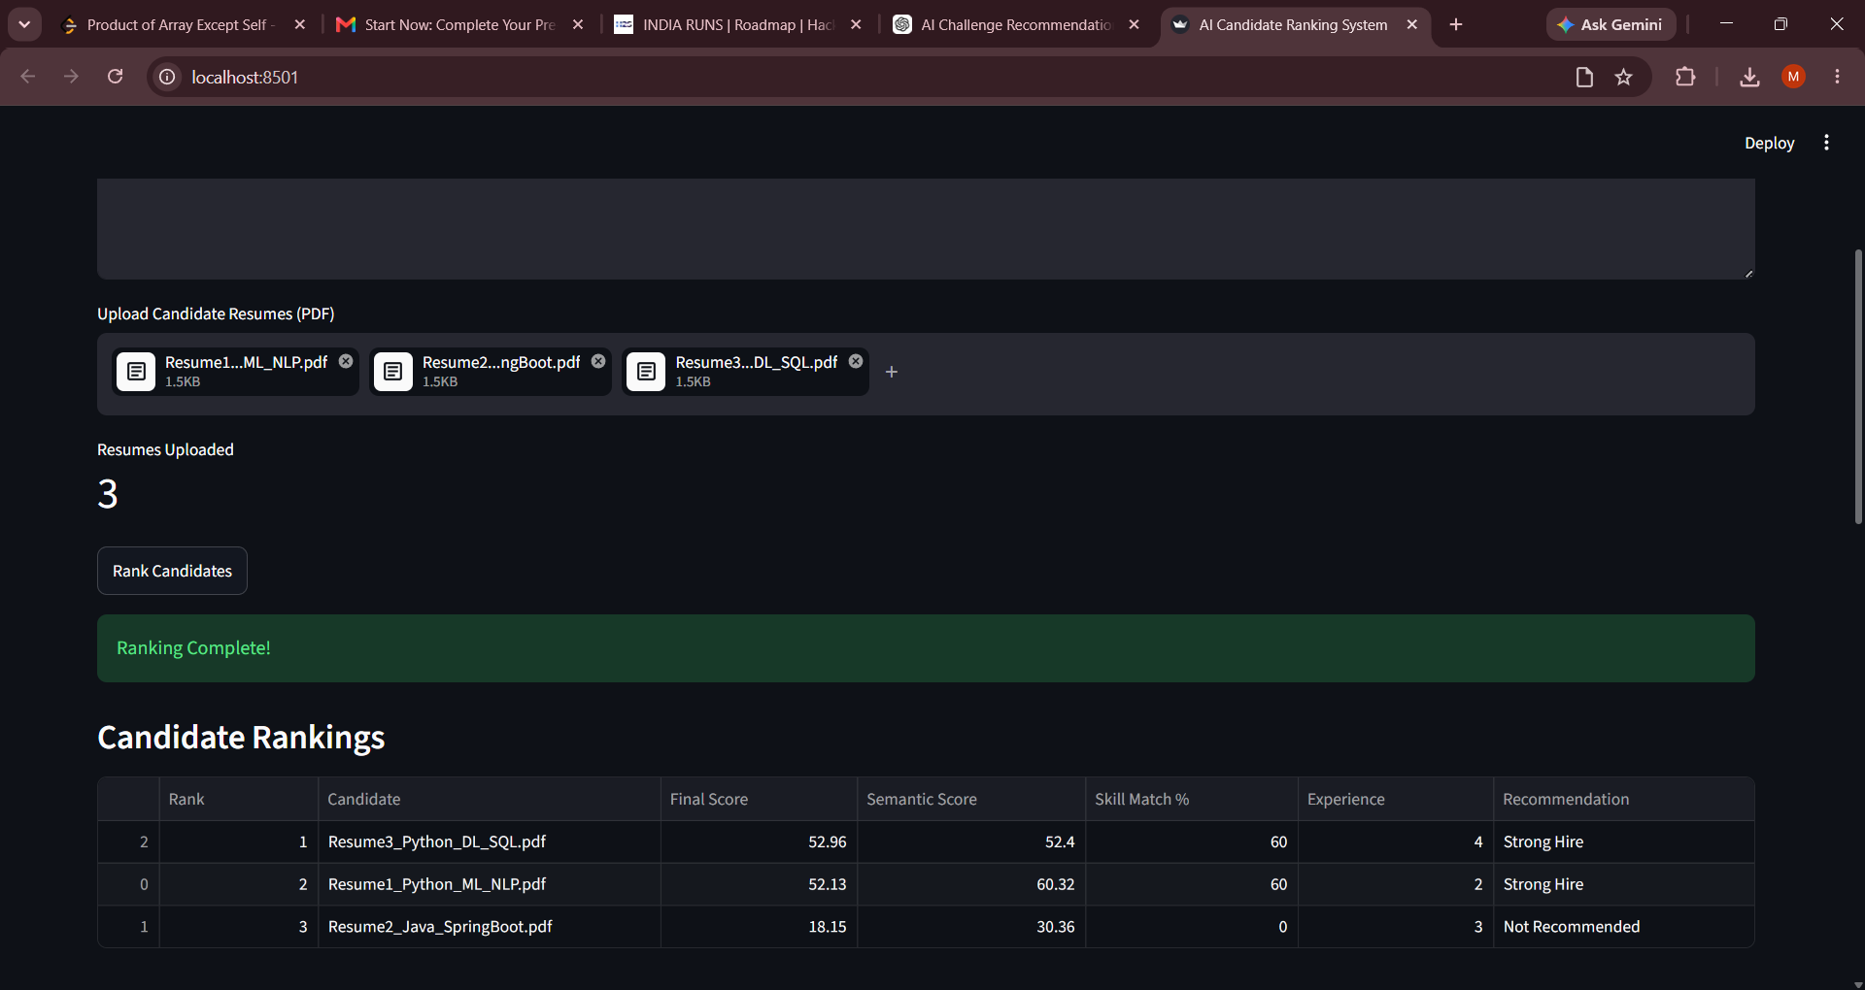
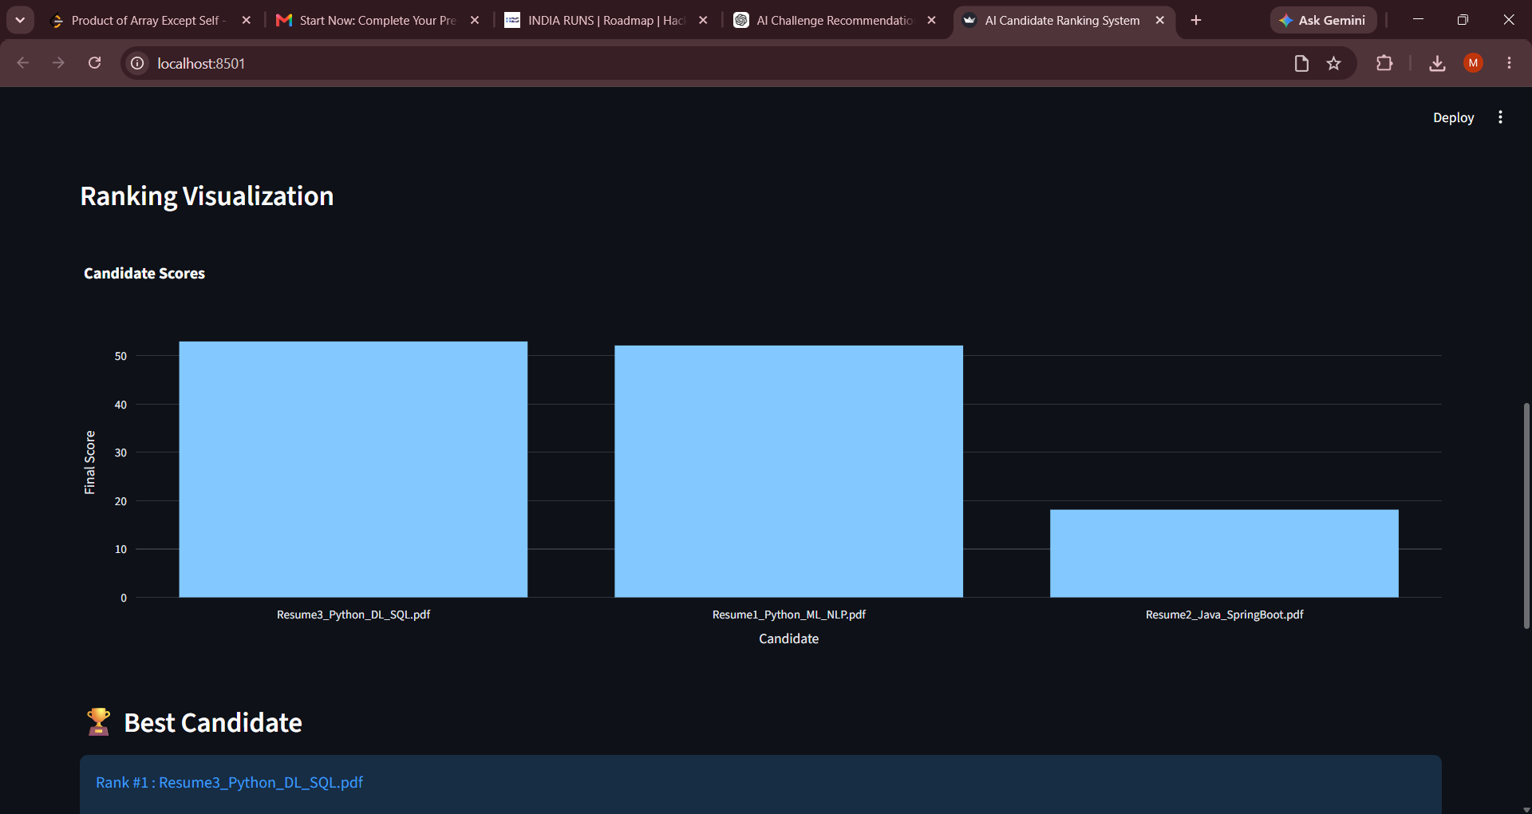
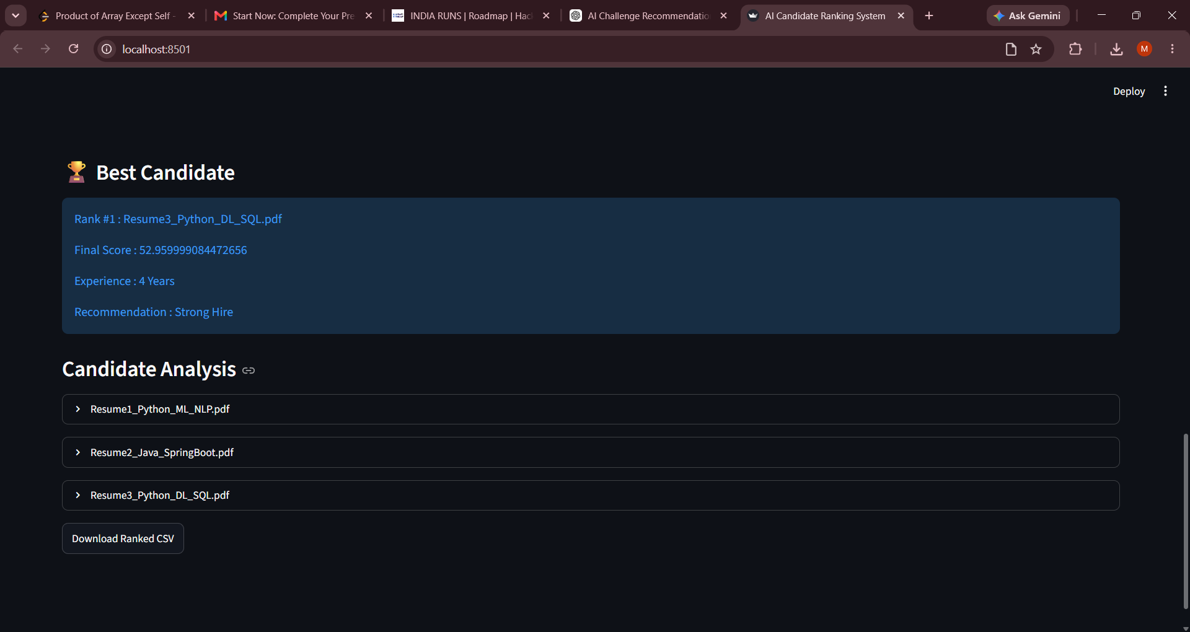
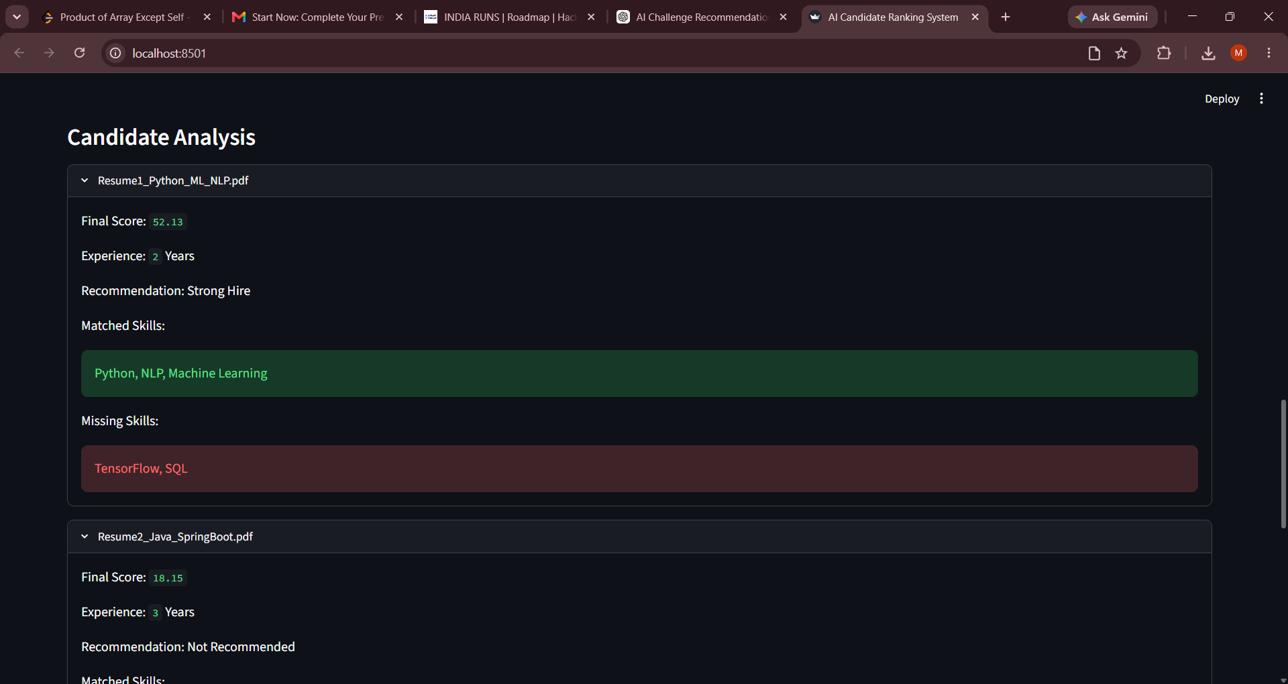
Dashboard Screenshots

Slide 11
Results
The proposed AI-Powered Candidate Ranking System successfully ranks candidates according to their relevance to the job description.
Achievements:
Automated resume screening process.
Improved candidate matching accuracy.
Generated recruiter-friendly recommendations.
Identified matched and missing skills.
Reduced manual evaluation effort.
Exported ranked candidate reports in CSV format.
The system provides a transparent and explainable ranking mechanism that helps recruiters make informed hiring decisions.

Slide 12
Future Enhancements
Integration with Large Language Models (LLMs) for advanced candidate evaluation.
ATS (Applicant Tracking System) integration.
Interview performance prediction.
Real-time job recommendation engine.
Behavioral and personality analysis.
Multi-language resume support.
Cloud deployment for enterprise-scale recruitment.
AI-generated recruiter feedback and hiring insights.

